Slide 1
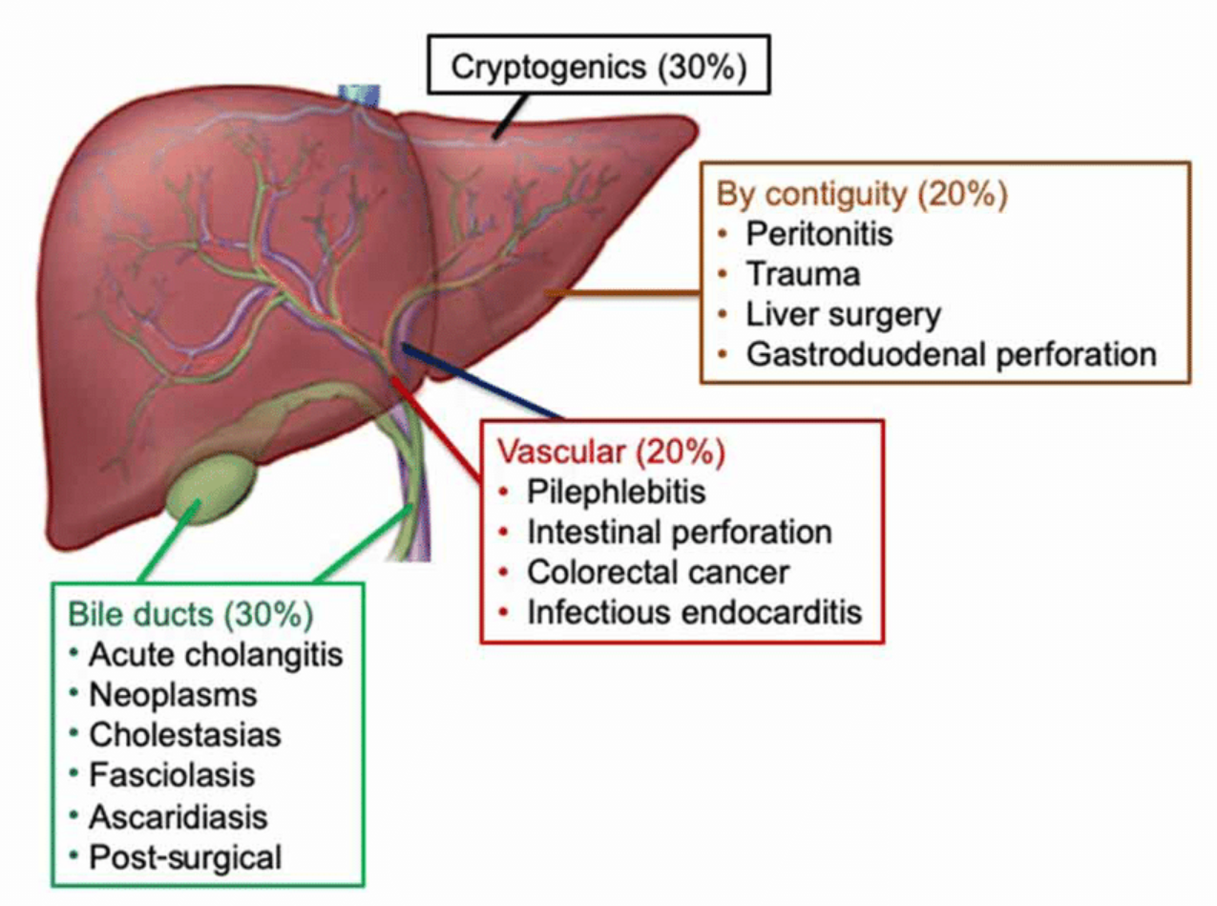
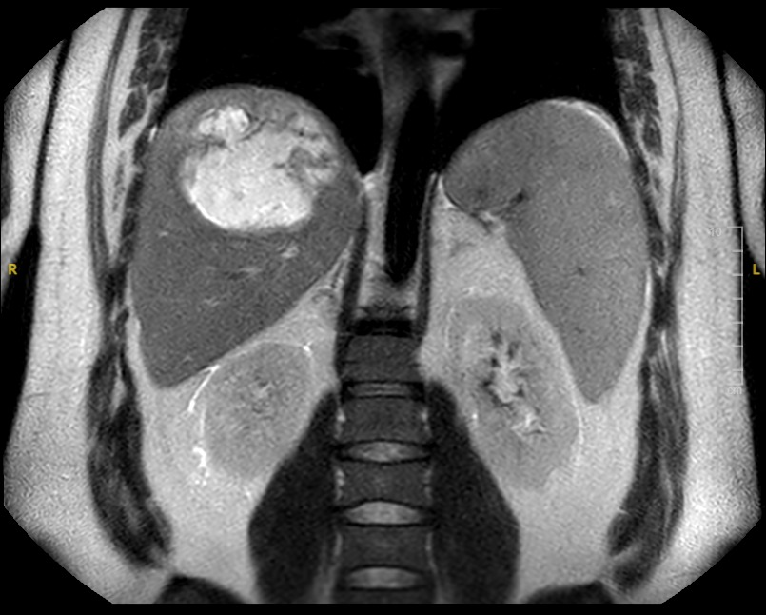
Cryptogenic Pyogenic Liver Abscess due to Parvimonas micra and Fusobacterium nucleatum
Allen Byl DO¹, Hope Oddo MD¹, Danielle Gilbert DO¹, Nataliya Khimitch MD¹, Paul Videau MD¹, Victoria Burke MD¹ ¹Louisiana State University Health Sciences Center Department of Medicine, New Orleans, LA
Background
Hospital Workup
Discussion
Pyogenic liver abscess (PLA) is a serious and potentially fatal condition that involves accumulation of pus in the liver parenchyma. PLAs are the most common abscesses affecting intra-abdominal organs.
PLA is usually caused by enteric gram-negative bacteria such as Escherichia coli, Klebsiella pneumoniae, and other anaerobic organisms. The infection is often polymicrobial.
PLA can result from portal vein pyemia, invasion from primary biliary infection, or hematogenous seeding.
Vitals:
Labs:
Imaging:
Management of PLA centers on appropriate antibiotics to cover enteric gram-negative bacilli and anaerobes pending culture data and sensitivities, and prompt aspiration/drainage of the abscess
Certain bacteria have been identified as potential heralds of colorectal cancer.
One study specifically identified Parvimonas micra, Peptostreptococcus stomatis, Fusobacterium nucleatum and Akkermansia muciniphila as overrepresented in the gut microbiomes in a Malaysian cohort of colorectal patients.
In our case the patient’s history was pertinent for a family history of colorectal cancer, and he lacked any other predisposing risk factors for developing a PLA. This case is notable due to the organisms isolated from abscess culture, Parvimonas micra and Fusobacterium nucleatum, both of which have been associated with colorectal cancer.
While both organisms are colonizers of the oropharynx and gastrointestinal tract and are associated with odontogenic infections, there are only a few case reports of Parvimonas and Fusobacterium hepatic abscesses, particularly in young, healthy, and immunocompetent patients. Furthermore, it is exceedingly rare to have co-infection of these pathogens, with only one other case report seen at time of this writing.
Temperature: 98.6 °F
Blood pressure: 140/68
Heart rate: 122 beats per minute
Oxygen saturation: 94% on room air
WBC: 11.2
AST/ALT: 32/59
Total bilirubin: 2.8 mg/dL
CRP: >30 mg.dL
ESR: 58 mm/hour
Negative Hepatitis panel
Triple phase Liver CT:
8-9cm mass in right hepatic dome, indeterminate etiology, not consistent with hemangioma
Hospital Course:
Contrasted MRI
Mature hepatic abscess measuring 9.8 x 9.6 x 8 cm in the right lobe of the liver, and splenomegaly. No evidence of biliary or pancreatic pathology.
On admission:
Blood cultures were collected, and patient was started on empiric piperacillin-tazobactam
Ultrasound-guided aspiration of abscess Cultures were collected, and a drain was left in place
Figure 1: Etiologies of Pyogenic Liver Abscess
Patient Data
Risk factors include Diabetes Mellitus, underlying hepatobiliary or pancreatic disease, immunosuppression, liver transplants, and use of proton-pump inhibitors.
Cryptogenic PLA is also associated with increased risk of colorectal cancer.
The following case presentation highlights an unusual bacterial cause of cryptogenic PLA due to organisms associated with colorectal cancer.
Conclusion
Every case of PLA should prompt a search for a source of infection and assessment for pre-disposing risk factors.
In cases of cryptogenic PLA, it is reasonable to consider CRC as potential source of bowel perforation and portal vein pyemia, especially when bacteria typically associated with CRC are isolated from abscess cultures.
Anaerobic culture from abscess:
Heavy growth
Parvimonas Micra
Moderate growth
Fusobacterium nucleatum
Blood cultures remained negative at 5 days
Case Presentation
References
The patient is a 30- year-old male with past medical history of obesity, alcohol use, and humeral bone cyst in childhood who presented with fevers, chills, body aches, and abdominal pain for 7 days.
The patient described the abdominal pain as colicky, associated with nausea, non-bloody non-bilious vomiting, and right shoulder pain.
Altemeier WA, Culbertson WR, Fullen WD, Shook CD. Intra-abdominal abscesses. Am J Surg. 1973 Jan;125(1):70-9. doi: 10.1016/0002-9610(73)90010-x. PMID: 4566907.
Huang CJ, Pitt HA, Lipsett PA, Osterman FA Jr, Lillemoe KD, Cameron JL, Zuidema GD. Pyogenic hepatic abscess. Changing trends over 42 years. Ann Surg. 1996 May;223(5):600-7; discussion 607-9. doi: 10.1097/00000658-199605000-00016. PMID: 8651751; PMCID: PMC1235191.
Chan KS, Chen CM, Cheng KC, Hou CC, Lin HJ, Yu WL. Pyogenic liver abscess: a retrospective analysis of 107 patients during a 3-year period. Jpn J Infect Dis. 2005 Dec;58(6):366-8. PMID: 16377869.
Lin HF, Liao KF, Chang CM, Lin CL, Lai SW. Correlation between proton pump inhibitors and risk of pyogenic liver abscess. Eur J Clin Pharmacol. 2017 Aug;73(8):1019-1025. doi: 10.1007/s00228-017-2256-9. Epub 2017 Apr 22. PMID: 28434021.
Jeong SW, Jang JY, Lee TH, Kim HG, Hong SW, Park SH, Kim SG, Cheon YK, Kim YS, Cho YD, Kim JO, Kim BS, Lee EJ, Kim TH. Cryptogenic pyogenic liver abscess as the herald of colon cancer. J Gastroenterol Hepatol. 2012 Feb;27(2):248-55. doi: 10.1111/j.1440-1746.2011.06851.x. PMID: 21777280.
Strobel S, Whitaker D, Choi E, Lindow J, Lago K. P. micra and F. necrophorum: Hepatic Abscesses in a Healthy Soldier. Case Rep Infect Dis. 2022 Mar 26;2022:5500365. doi: 10.1155/2022/5500365. PMID: 35345475; PMCID: PMC8957035.
Osman, M. A., Neoh, H. M., Ab Mutalib, N. S., Chin, S. F., Mazlan, L., Raja Ali, R. A., ... & Jamal, R. (2021). Parvimonas micra, Peptostreptococcus stomatis, Fusobacterium nucleatum and Akkermansia muciniphila as a four-bacteria biomarker panel of colorectal cancer. Scientific reports, 11(1), 2925.
Bergsten, E., Mestivier, D., Donnadieu, F., Pedron, T., Barau, C., Meda, L. T., ... & Nigro, G. (2023). Parvimonas micra, an oral pathobiont associated with colorectal cancer, epigenetically reprograms human colonocytes. Gut microbes, 15(2), 2265138.
Figure 2: Contrasted MRI showing mature hepatic abscess in the right lobe of the liver measuring 9.8 x 9.6 x 8 cm

