Slide 1
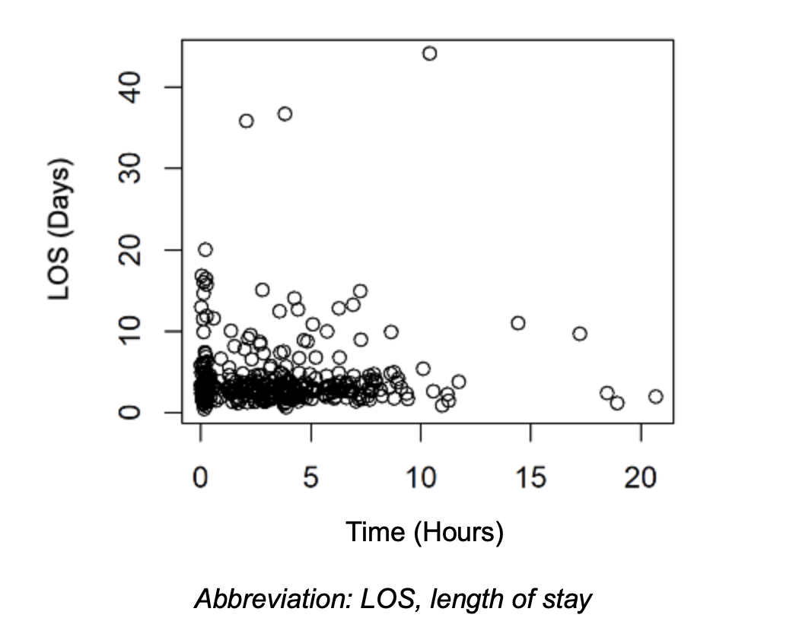
Does Preoperative Antibiotic Timing Prior to Incision and Drainage Procedures for Severe Odontogenic Infections Affect Length of Stay or Reoperation? D. Mire, DDS¹, E. Park, DMD, MD¹, A. Chapple, PhD¹, A. Adamec, DDS, MD¹, M. Koury, MS¹, B. Christensen, DDS, MD² ¹LSU Health New Orleans, ²Geisinger Health System
Introduction
Results
Results Continued
Odontogenic infections are serious, potentially life-threatening conditions that can develop insidiously and progress rapidly. These infections are not uncommon, oftentimes presenting in emergency departments, with a study by Abramowicz and colleagues finding 74,480 hospitalizations in 2012 and 2013 due to facial cellulitis, which was presumed mostly of odontogenic origin.² Outpatient treatment options for mild odontogenic infections consist of a beta-lactamase antibiotic regimen, which is usually amoxicillin with clavulanic acid or clindamycin alone in penicillin-allergic patients. Inpatient treatment for more advanced infections, however, typically includes surgical incision and drainage (I&D) with a preoperative and postoperative antibiotic regimen of ampicillin-sulbactam and culture of purulent material for susceptibility-guided antibiotic therapy.³
A standard in healthcare settings to decrease the risk of perioperative surgical site infections (SSI) is surgical antibiotic prophylaxis (SAP). The World Health Organization (WHO) recommends SAP within 120 minutes prior to surgical start time, with administration closer to incision time for antibiotics with a shorter half-life such as penicillins.⁴ While there has been an abundance of research on SAP, none have focused on the relevance prior to surgeries specifically treating odontogenic infections. These surgeries are unique in the sense that there is already active infection upon presentation. Therefore, the aim of SAP is not to prevent the formation of an SSI but to prevent complications such as re-infection or persistence of infection after an I&D procedure. The main objective of this study is to determine if the timing of SAP has an effect on the patient's total hospital length of stay and need to return to the operating room (OR) for repeat I&D procedure(s).
The authors of this paper conducted a retrospective cohort study that analyzed the effect of preoperative antibiotic timing on length of stay and need for reoperation for I&D surgeries treating severe odontogenic infections. All patients treated for an odontogenic infection via I&D in the OR at University Medical Center of New Orleans by the LSUHSC Department of Oral and Maxillofacial Surgery (OMS) between 1/1/2015 and 7/30/2021 were included for review. Inclusion criteria consisted of odontogenic infection diagnosed based on history, physical exam, and imaging and infection severity requiring treatment in the OR under general anesthesia.
The independent variable of this study was preoperative antibiotic timing, defined as the time in hours between antibiotic administration and surgery start time, noted as “incision time” in the patient’s surgery log. The primary dependent variable of this study was length of stay (measured in days), and the secondary dependent variable of this study was the need for reoperation (yes/no). Other variables investigated included age (measured in years), gender (male/female), number of involved head and neck spaces (yes/no for each space), infection location (yes/no for each space) and antibiotic regimen (ampicillin-sulbactam only/other regimen).
Table 1 reports the relationship between each study variable and the independent variable, preoperative antibiotic timing, defined as the time between antibiotic administration and “incision start time.”
Table 2 reports the independent variable, preoperative antibiotic timing, versus the primary and secondary dependent variables, length of stay and reoperation, respectively.
The p-value testing a polynomial functional relationship between preoperative antibiotic timing and length of stay after adjustment is shown below (Figure 1) for degree 1 (line), 2 (quadratic), 3 (cubic) and 4 (quartic) polynomial functions.
All p-values were > 0.10, indicating that the addition of preoperative antibiotic timing to the models did not improve prediction of length of stay. Said differently, there was no statistical evidence of a relationship between preoperative antibiotic timing and length of stay after adjustment.
Figure 1. P-value for a Polynomial Functional Relationship between Preoperative Antibiotic Timing and Length of Stay (Adjusted)
Table 1. STUDY VARIABLE VERSUS PREOPERATIVE ANTIBIOTIC TIMING
Variable | Preoperative Antibiotic Timing (Hours) | P Value
History
Age (years) | 0.001 | 0.982
Gender
Male | 3.5 ± 3.52 | 0.246
Female | 2.94 ± 2.8
Diagnosis
Number of Spaces | -0.006 | 0.899
Submental | 3.33 ± 3.55 | ​​0.872
Sublingual | 3.36 ± 3.3 | 0.559
Submandibular | 3.26 ± 3.19 | 0.783
Submasseteric | 3.28 ± 3.64 | 0.563
Pterygomandibular | 3.17 ± 3.34 | 0.534
Pharyngeal | 3.13 ± 3.36 | 0.446
Buccal | 2.5 ± 2.52 | 0.166
Vestibular | 4.63 ± 4.91 | 0.268
Canine | 4.68 ± 3.68 | 0.415
Temporal | 1.81 ± 3.08 | 0.208
Treatment
Antibiotic Regimen
Ampicillin-sulbactam Only | 3.33 ± 3.18 | 0.101
Not Ampicillin-sulbactam Only | 2.77 ± 3.27
Discussion
Odontogenic infections are potentially life-threatening complications of advanced dental disease which affect thousands of people in the United States each year. Many of these advanced infections require I&D procedures for definitive treatment. These procedures are often preceded by administration of SAP. This study sought to investigate whether the timing of SAP prior to surgery had an effect on the length of stay or need for reoperation for patients with an odontogenic infection who underwent an I&D procedure. The authors in this study hypothesized that there would be a positive relationship between increased preoperative antibiotic timing and length of stay as well as the need for reoperation. We found that there is no correlation between preoperative antibiotic timing and length of stay or need for reoperation in the adjusted analysis (Table 2). Additionally, there was no statistically significant relationship between preoperative antibiotic timing and any of the covariates in this paper (Table 1).
Limitations:
Variability in antibiotic regimens
Lack of consideration of intraoperative or postoperative antibiotic regimens
Different surgical operators with variable skill levels
Variable post-operative care
Several factors unaccounted for, e.g., each patient’s medical condition(s)
Table 2. PREOPERATIVE ANTIBIOTIC TIMING VERSUS LENGTH OF STAY AND REOPERATION
Variable | Length of Stay (Days) | P Value | Reoperation (n = 37) | No Reoperation (n = 359) | P Value
Preoperative Antibiotic Timing (Hours) | 0.039 | 0.436 | 2.86 (3.96) | 3.26 (3.11) | 0.106

