Slide 1
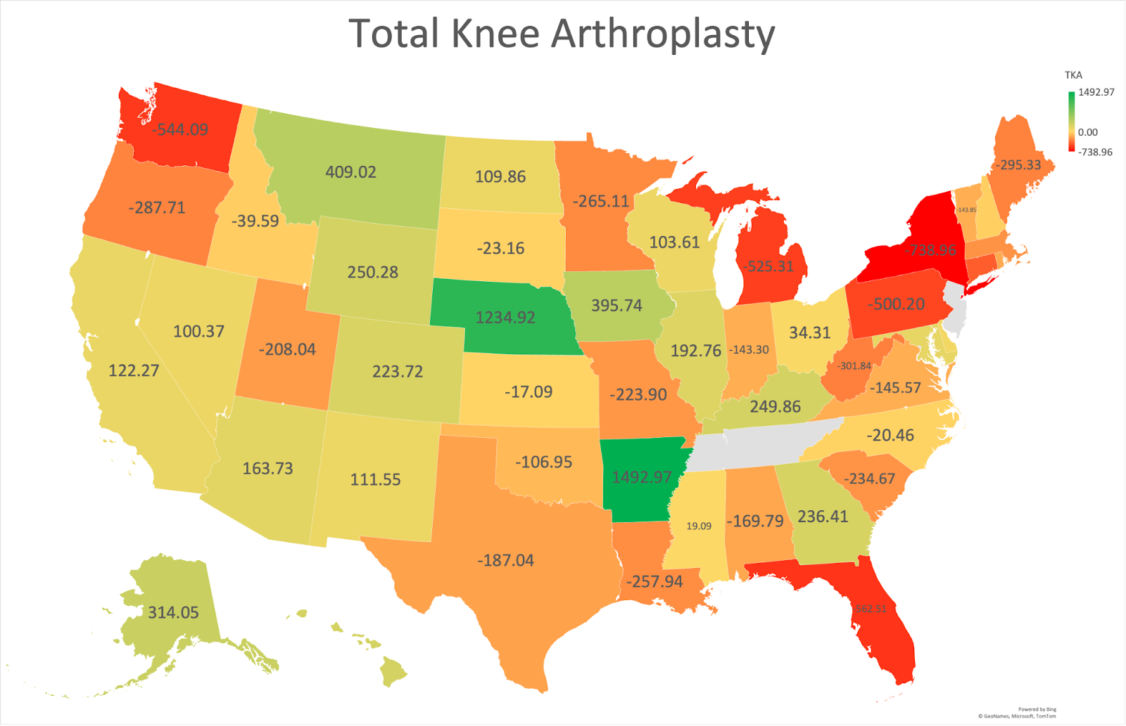
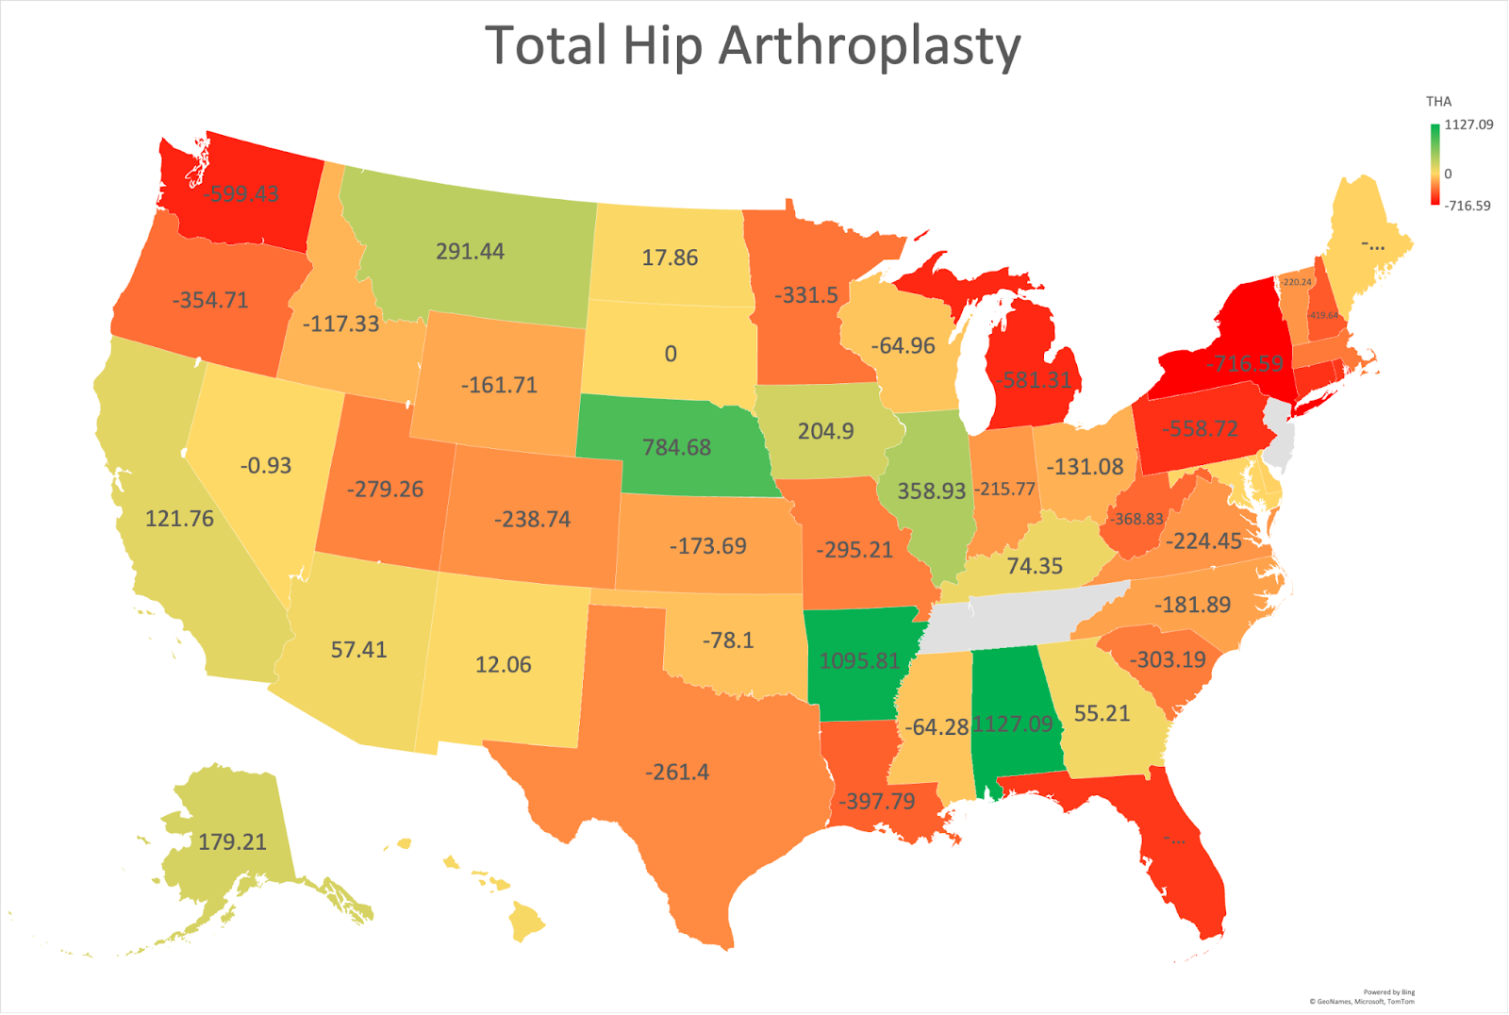
Medicaid Reimbursement for Total Joint Arthroplasty in the United States: Implications For Patient Access to High-Quality Arthroplasty Care
LaMiah Hall BS, MPH¹, Mary K. Richardson BS², Brandon S. Gettleman BS², Morgan McCoy MS¹, Matan Ozery MD, P¹. Maxwell Courtney MD³, Nathanael D. Heckmann MD², Anna Cohen-Rosenblum MD MSc¹ ¹Department of Orthopaedic Surgery, Louisiana State University Health Sciences Center, New Orleans, LA ²Department of Orthopaedic Surgery, Keck School of Medicine of University of Southern California, Los Angeles, CA ³Rothman Orthopaedic Institute, Philadelphia, PA
Introduction
Results
Conclusion
Patients with Medicaid insurance have decreased access to care and worse outcomes after TKA/THA compared with other insurance payers (1,2)
Medicare is a large focus of advocacy, but few studies have evaluated Medicaid reimbursement which varies by state (3-5).
The purpose of this study was to evaluate differences in reimbursement between Medicaid and Medicare for THA and TKA
In 2022, 48 states reported Medicaid physician fee schedules, and 50 states reported for Medicare.
Historical Medicaid data through 2012 was available from 19 states, with additional states reporting over time.
TKA 2012-2022
Medicaid: declined 26%
Medicare: declined 37%
THA 2012-2022
Medicaid: declined 22%
Medicare: declined 33%
2022 comparison:
54% (26/48) of states reimbursed less for Medicaid TKA
64% (31/48) of states reimbursed less for Medicaid THA
Most states reimburse surgeons less for Medicaid than Medicare, with wide variability.
Although cuts to Medicaid reimbursement have been substantial, they are less steep than recent Medicare cuts.
Future directions
Study involving Medicaid claims data and geographic distribution of arthroplasty surgeons
Survey to Louisiana Orthopaedic Association and other state orthopaedic societies regarding Medicaid volume and surgeon-perceived barriers to care.
Objective and Significance
The purpose of this study was to evaluate differences in physician reimbursements by state between patients undergoing TKA or THA with Medicaid insurance compared to Medicare insurance.
Methods
Individual states were queried for publicly-available Medicaid physician fees and the Centers for Medicaid and Medicare Services physician fee schedule tool was accessed to report Medicare fees from 2012 to 2022 for primary TKA/THA.
All values were reported in 2023 inflation-adjusted dollars.
Differences in reimbursement rates were reported
Figure 1: Differences between Medicaid and Medicare reimbursement for total knee arthroplasty by state. States in which Medicaid reimbursed less than Medicare are shown in red, states with similar reimbursement are shown in yellow, and states in which Medicaid reimbursed more than Medicare are shown in green.
Figure 2: Differences between Medicaid and Medicare reimbursement for total hip arthroplasty by state. States in which Medicaid reimbursed less than Medicare are shown in red, states with similar reimbursement are shown in yellow, and states in which Medicaid reimbursed more than Medicare are shown in green.
Acknowledgements
LSUHSC Department of Orthopedic Surgery
Keck School Medicine of USC
Rothman Orthopaedic Institute
Discussion and Limitations
Incomplete availability of Medicaid data
Difficulty in accessing and interpreting state websites, only 48 of 50 states with 2022 data
Historical data even harder to access
Unable to directly correlate with access to care given lack of claims data
Reimbursement data does not answer whether decreased patient access is related to decreased reimbursement rates, worse postoperative outcomes, or some combination thereof.
References
Browne J, Novicoff W, D’Apuzzo M. Medicaid payer status is associated with in-hospital morbidity and resource utilization following primary total joint arthroplasty. J Bone Joint Surg 2014;96:e180(1-6).
Cohen-Rosenblum A, Richardson M, Liu K, et al. Medicaid patients undergo total joint arthroplasty at lower-volume hospitals by lower-volume surgeons and have poorer outcomes. J Bone Joint Surg 2023;105:979-989.
Dy C, Barker A, Brown D, et al. Unmet need for total joint arthroplasty in Medicaid beneficiaries after Affordable Care Act expansion. J Bone Joint Surg 2020;102:1495-14500.
Dy C, Brown D, Maryam H, et al. Two-state comparison of total joint arthroplasty utilization following Medicaid expansion. J Arthroplasty 2019;34:619-625.
Haglin J, Arthur J, Deckey D, et al. Temporal analysis of Medicare physician reimbursement and procedural volume for all hip and knee arthroplasty procedures billed to Medicare Part B from 2000 to 2019. J Arthroplasty 36;2021:S121-S127

