Slide 1
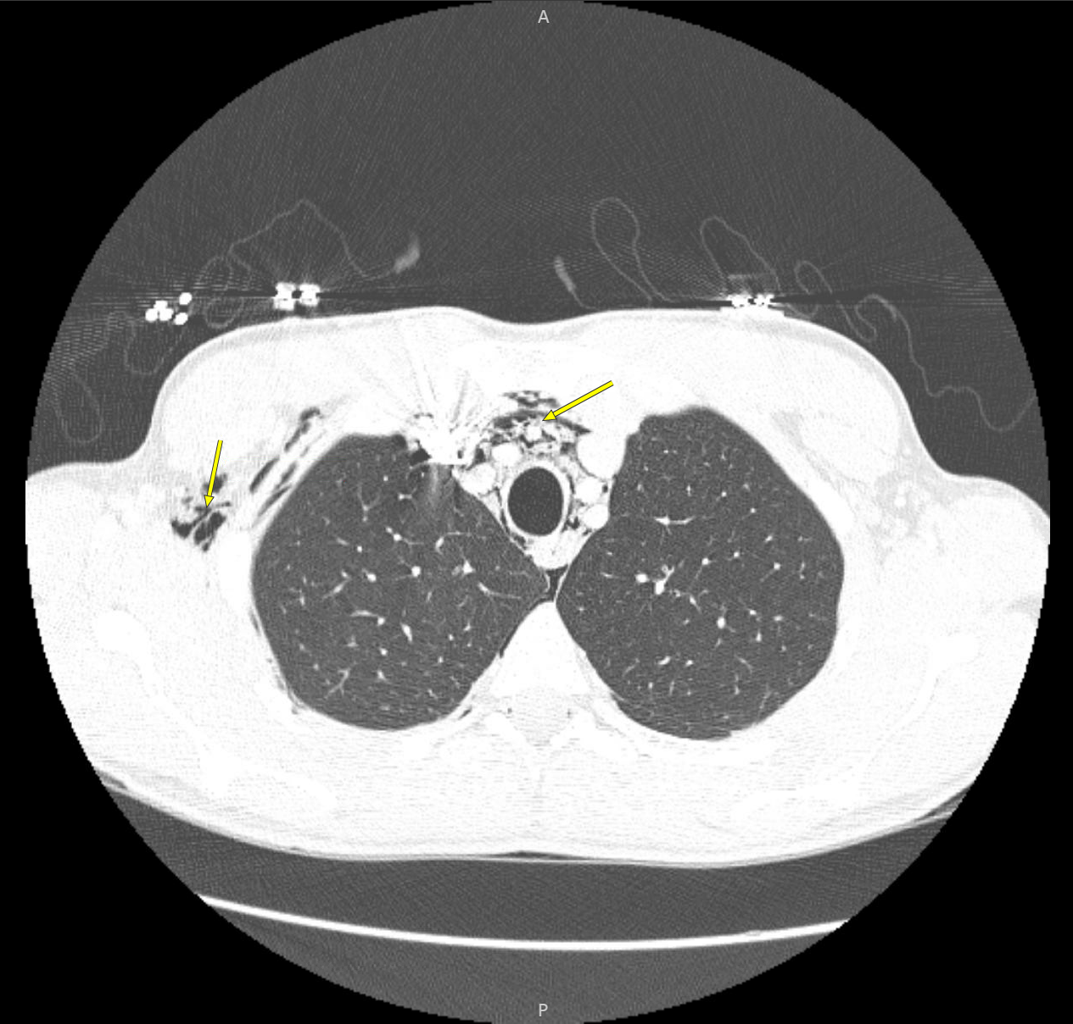
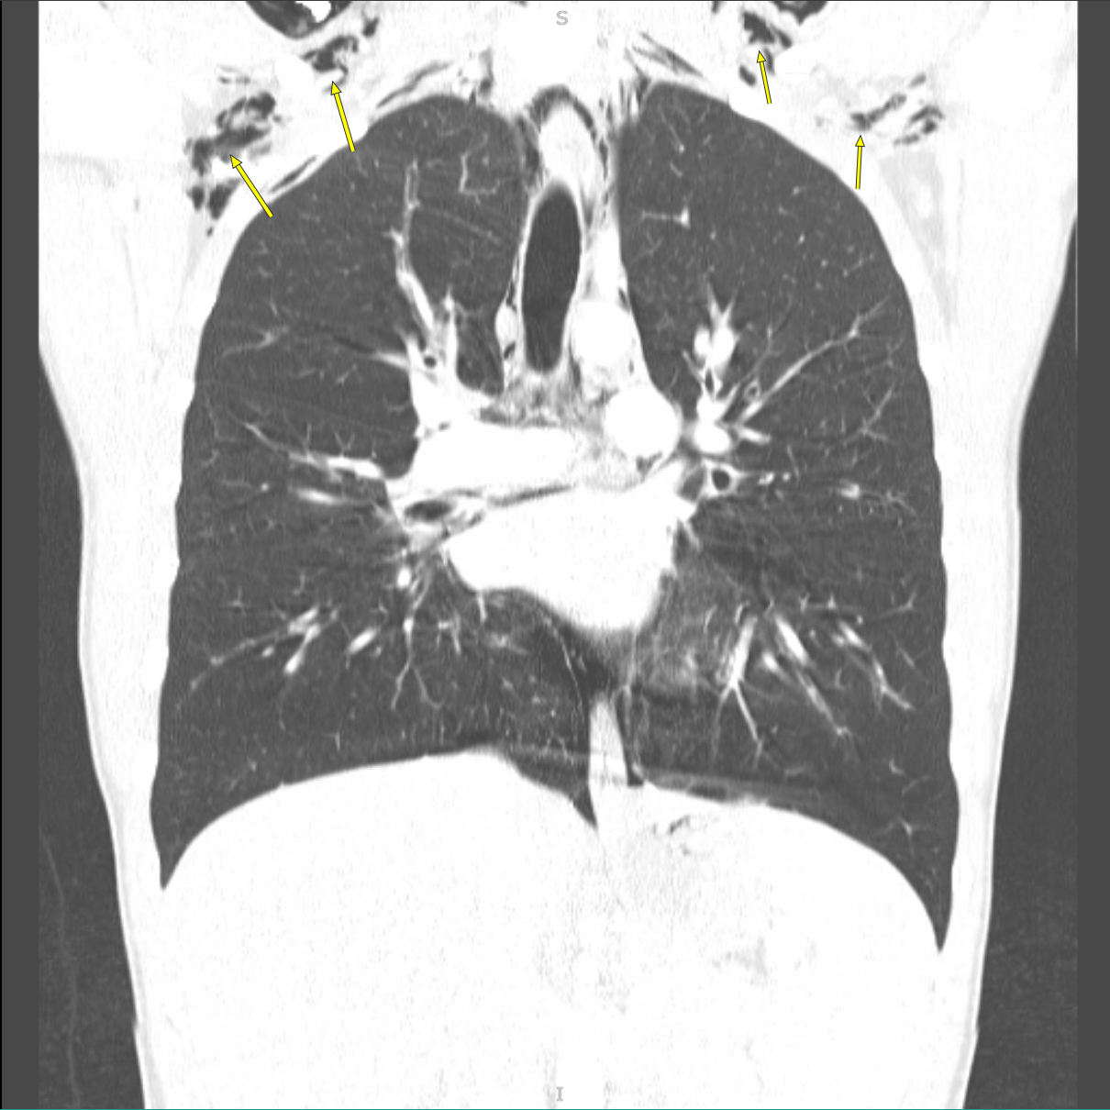
Vaping-related Pneumomediastinum in the Younger Patient Population
Andrew Hoang BS, Atash Ataei MD, Paul Videau MD, Michael Olejniczak MD, Victoria Lulich MD, Hunner Luke MD, Briggs Welch MD, Taylor Sanders MD, Najy Masri MD Louisiana State University School of Medicine in New Orleans
Background
Discussion
Conclusion
Pneumomediastinum (PM) is due to air leaking within the mediastinal tissues that can travel to associated structures.
Can be classified as spontaneous, iatrogenic, or secondary to trauma or a non-traumatic condition
PM is an uncommon complication of asthma and often presents with acute, severe central chest pain and/or shortness of breath.
While relatively rare, it is more common in infancy or adolescence and can present with subcutaneous emphysema.
Of the most common risk factors is asthma exacerbations, and a relatively new risk factor is infection with Covid-19.
As the air leak progresses, it can cause complications such as pneumothorax, pneumopericardium, or pneumorhachis
Can mimic cardiac tamponade due to increased intrapulmonary pressure on venous flow to the heart
This case demonstrates that what was once a relatively rare diagnosis of PM is slowly becoming more prevalent in the light of new risk factors. One 2022 survey demonstrated that in the United States, e-cigarettes are used by up to 14% of high school students and more than 3% of middle school students. One explanation of why vaping may increase the risk of PM is that one must inhale more forcefully than with a traditional cigarette, thus causing greater changes in intrathoracic pressures. The ingredients in the vaping fluid themselves can also be harmful and are currently unregulated by the FDA. As vaping and e-cigarette use is becoming more common in younger patients, providers need to have a high index of suspicion for PM when a patient presents to the hospital with cardiopulmonary symptoms.
Implications for Clinical Practice:
Vaping may contribute to more frequent presentations of uncommon complications to common medical conditions such as pneumomediastinum during asthma exacerbation.
Clinicians may consider adding a question regarding e-cigarette usage to the social history portion of the patient interview separate from tobacco use for younger patients.
Implications for Future Research:
The effects of e-cigarette use should continue to be explored, including short-term effects, long-term effects, and complications/exacerbations of chronic medical conditions. Research regarding the implications of e-cigarette usage is increasing but still sparse. Data suggesting significant health risk could be justification for public health intervention and resource allocation for education and cessation.
Management & Complications
For uncomplicated cases, treatment is often supportive. Patients are observed in the hospital for 24 hours with bed rest and limited physical activity. Other treatments are symptom-based, such as analgesics for pain and antitussives for cough. However, if complicated by another condition, then treatment of said condition is required. PM can occur with pneumothorax, esophageal perforation, and pericarditis, among others. Treatment of pneumothorax ranges from conservative measures utilizing observation with repeat imaging and supplemental oxygen, to air evacuation via pigtail catheters or thoracostomy tubes, to surgical intervention or pleurodesis. Esophageal rupture is associated with a high mortality rate; thus, its management includes avoidance of oral intake, parenteral nutritional support, intravenous broad-spectrum antibiotics, intravenous proton pump inhibitor, and drainage of fluid. Surgical intervention is available for those who fail conservative management. Pericarditis cases in developed countries are often viral or idiopathic and are extremely responsive to treatment with anti-inflammatory drugs. After treatment of PM, some physicians recommend against activities which cause dramatic changes in pressure such as flying on an airplane and scuba diving due to risk of reinjury, though this is controversial.
Purpose
Contact Information
The purpose of this case report is to increase clinician awareness of pulmonary complications of vaping in younger patient populations with underlying conditions affecting the lung.
Address all correspondence to Andrew Hoang at ahoan1@lsuhsc.edu
Case Description
References
18-year-old man presented with abrupt onset shortness of breath (SOB) preceded by three days of upper respiratory symptoms
Past medical history significant for asthma and ADHD
Asthma was poorly controlled as he was not on an inhaled corticosteroid or long-acting beta agonist, using only rescue therapies
The acute SOB awoke him from sleep and was associated with pleuritic chest wall and back pain
He began hourly albuterol nebulizers at home without improvement in his symptoms, at which point he presented to the emergency department
He had no recent allergen exposures, ill-contacts, recent travel, or new pets
Initial exam revealed diffuse expiratory wheezing consistent with an asthma exacerbation in addition to supraclavicular crepitus
Oxygen saturation ranged from low 90s to mid 80s
Chest x-ray and CT chest confirmed the presence of a PM with subcutaneous emphysema extending up to his neck base
He was monitored for 48 hours while undergoing treatment for asthma exacerbation with steroids and regular nebulizer treatments
A repeat x-ray on day of discharge showed near-resolution of the PM and he was discharged with PCP and pulmonology follow-up
1. Yellin A, Gapany-Gapanavicius M, Lieberman Y. Spontaneous pneumomediastinum: is it a rare cause of chest pain? Thorax. 1983;38(5):383-385.
2. Stack AM, Caputo GL. Pneumomediastinum in childhood asthma. Pediatr Emerg Care. 1996;12(2):98-101.
3. Wong KS, Wu HM, Lai SH, Chiu CY. Spontaneous pneumomediastinum: analysis of 87 pediatric patients. Pediatr Emerg Care. 2013;29(9):988-991.
4. Chowdhary A, Nirwan L, Abi-Ghanem AS, et al. Spontaneous Pneumomediastinum in Patients Diagnosed with COVID-19: A Case Series with Review of Literature. Acad Radiol. 2021;28(11):1586-1598.
5. Belotti EA, Rizzi M, Rodoni-Cassis P, Ragazzi M, Zanolari-Caledrerari M, Bianchetti MG. Air within the spinal canal in spontaneous pneumomediastinum. Chest. 2010;137(5):1197-1200.
6. Adhikari R, Manduva D, Malayala SV, et al. A Rare Case of Vaping-Induced Spontaneous Pneumomediastinum. Cureus. 2021;13(8):e17166.
7. Burgwardt S, Huskic A, Schwartz G, Mason DP, Tapias L, Podgaetz E. Spontaneous pneumomediastinum secondary to electronic cigarette use. Proc (Bayl Univ Med Cent). 2020;33(2):229-230.
8. Park-Lee E, Ren C, Cooper M, Cornelius M, Jamal A, Cullen KA. Tobacco Product Use Among Middle and High School Students - United States, 2022. MMWR Morb Mortal Wkly Rep. 2022;71(45):1429-1435.
9. Kouritas VK, Papagiannopoulos K, Lazaridis G, Baka S, Mpoukovinas I, Karavasilis V, Lampaki S, Kioumis I, Pitsiou G, Papaiwannou A, Karavergou A, Kipourou M, Lada M, Organtzis J, Katsikogiannis N, Tsakiridis K, Zarogoulidis K, Zarogoulidis P. Pneumomediastinum. J Thorac Dis. 2015 Feb;7(Suppl 1):S44-9. doi: 10.3978/j.issn.2072-1439.2015.01.11. PMID: 25774307; PMCID: PMC4332083.
10. MacDuff A, Arnold A, Harvey J; BTS Pleural Disease Guideline Group. Management of spontaneous pneumothorax: British Thoracic Society Pleural Disease Guideline 2010. Thorax. 2010 Aug;65 Suppl 2:ii18-31. doi: 10.1136/thx.2010.136986. PMID: 20696690.
11. Lindenmann J, Matzi V, Neuboeck N, Anegg U, Maier A, Smolle J, Smolle-Juettner FM. Management of esophageal perforation in 120 consecutive patients: clinical impact of a structured treatment algorithm. J Gastrointest Surg. 2013 Jun;17(6):1036-43. doi: 10.1007/s11605-012-2070-8. Epub 2013 Apr 5. PMID: 23558714.
12. Imazio M, Demichelis B, Parrini I, Giuggia M, Cecchi E, Gaschino G, Demarie D, Ghisio A, Trinchero R. Day-hospital treatment of acute pericarditis: a management program for outpatient therapy. J Am Coll Cardiol. 2004 Mar 17;43(6):1042-6. doi: 10.1016/j.jacc.2003.09.055. PMID: 15028364.
Figure 1: Axial view of pneumomediastinum (center yellow arrow) and subcutaneous emphysema (left yellow arrow).
Figure 2: Coronal view showing subcutaneous emphysema near the clavicles (yellow arrows).
Notes:
write Figure 1,2,3 etc and: Type out image description
While this patient is an outlier because of advanced age, this case serves to exemplify the potential utility of this treatment modality versus the current standard of care (biliary stenting with adjuvant chemoradiation).
(2019). Cholangiocarcinoma. Genetics Home Reference. https://ghr.nlm.nih.gov/condition/cholangiocarcinoma
Rea DJ, Munoz-Juarez M, Farnell MB, et al. (2004). Major hepatic resection for hilar cholangiocarcinoma: analysis of 46 patients. Jama Surgery 139(5), 514-23. https://www.ncbi.nlm.nih.gov/pubmed?term=15136352
Klempnauer J, Ridder GJ, von Wasielewski R, et al. (1997). Resectional surgery of hilary cholangiocarcinoma: a multivariate analysis of prognostic factors. Journal of Clinical Oncology 15(3), 947-54. https://www.ncbi.nlm.nih.gov/pubmed?term=9060532
Tamandl D, Kaczirek K, Gruenberger B, et al. (2009). Lymph node ratio after curative surgery for intrahepatic cholangiocarcinoma. British Journal of Surgery 96(8), 919-25. https://www.ncbi.nlm.nih.gov/pubmed?term=19591163
Takada T, Amano H, Yasuda H, et al. (2002). Is postoperative adjuvant chemotherapy useful for gallbladder carcinoma? A phase III multicenter prospective randomized controlled trial in patients with resected pancreaticobilary carcinoma. 95(8), 1685-95. https://www.ncbi.nlm.nih.gov/pubmed?term=12365016
Junichi Shindoh. (2017). Ablative therapies for intrahepative cholangiocarcinoma. Hepatobiliary Surgery and Nutrition, 6(1), 2-6. https://www.ncbi.nlm.nih.gov/pmc/articles/PMC5332215/
Auriemma F, et al. (2019). Radiofrequency and malignant biliary strictures: an update. World Journal of Gastrointestinal Endoscopy 11(2):95-102. https://www.ncbi.nlm.nih.gov/pmc/articles/PMC6379741/
(2006). FDA clears RF Ablation System for Use in Nonresectable Liver Tumors. Oncology Journal 20(7). https://www.cancernetwork.com/oncology-journal/fda-clears-rf-ablation-system-use-nonresectable-liver-tumors
McCarty T, et al. (2018). New Indications for Endoscopic Radiofrequency Ablation. Clinical Gastroenterology and Hepatology 16:1007-1017. https://www.cghjournal.org/article/S1542-3565(17)31248-X/pdf

