Slide 1
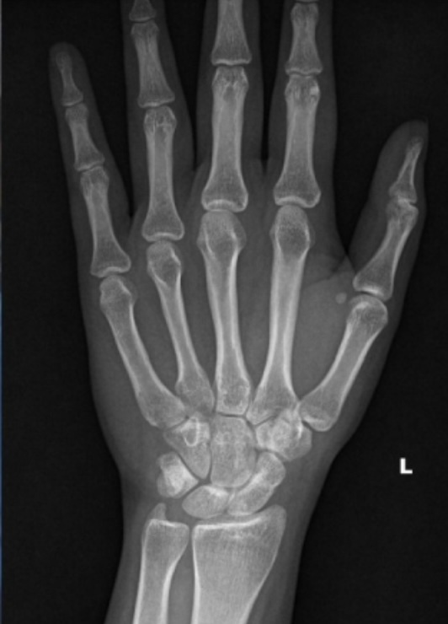
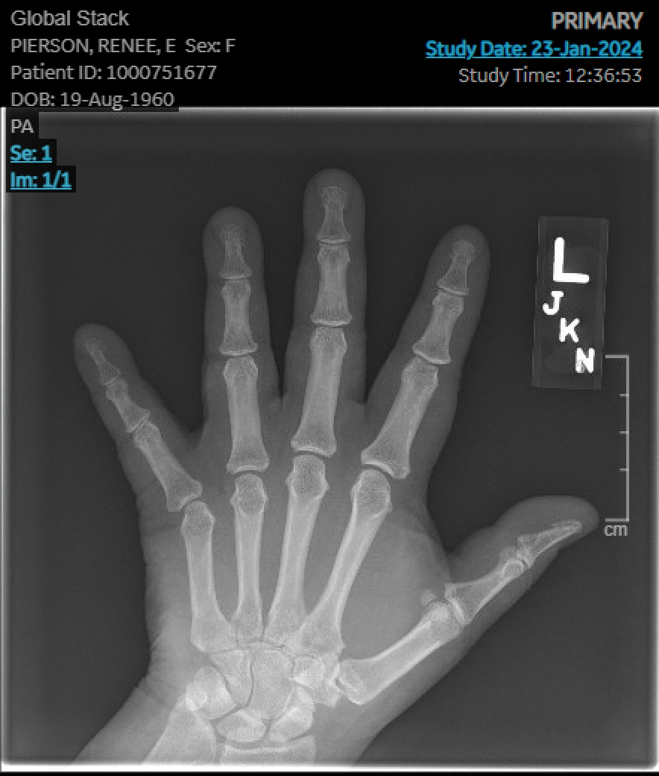
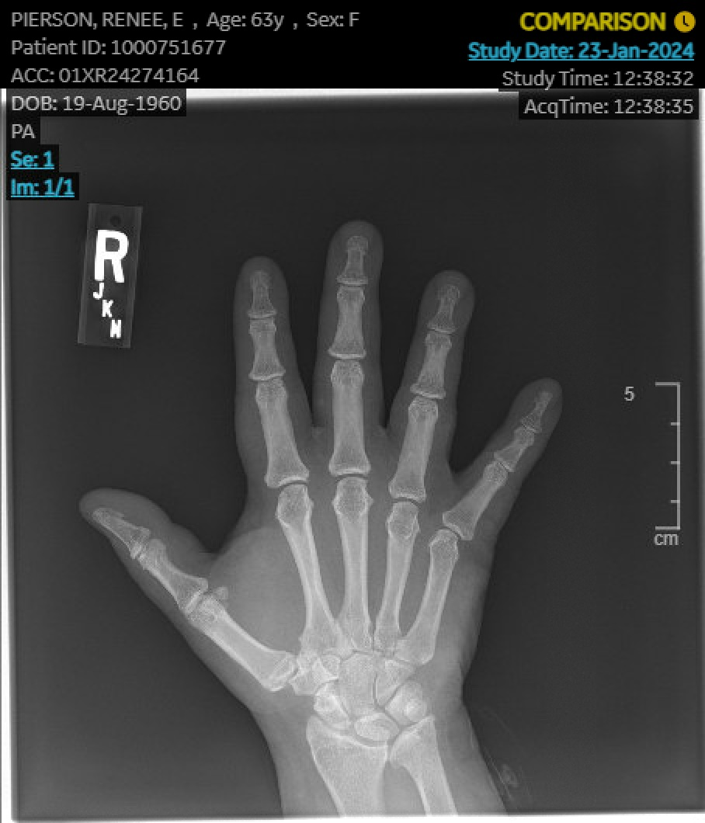
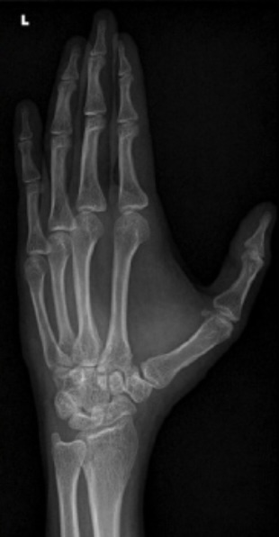
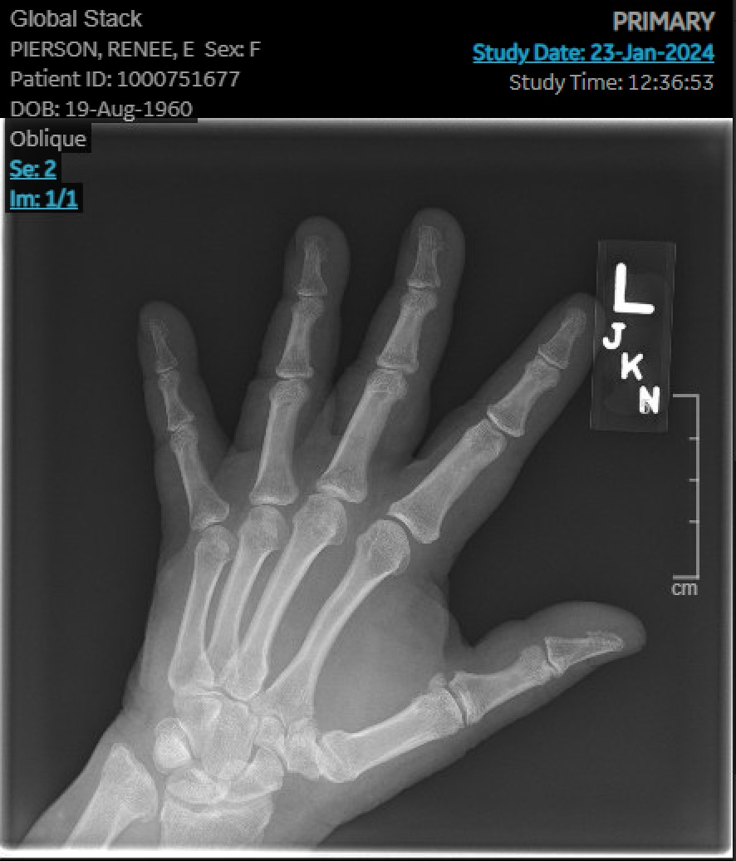
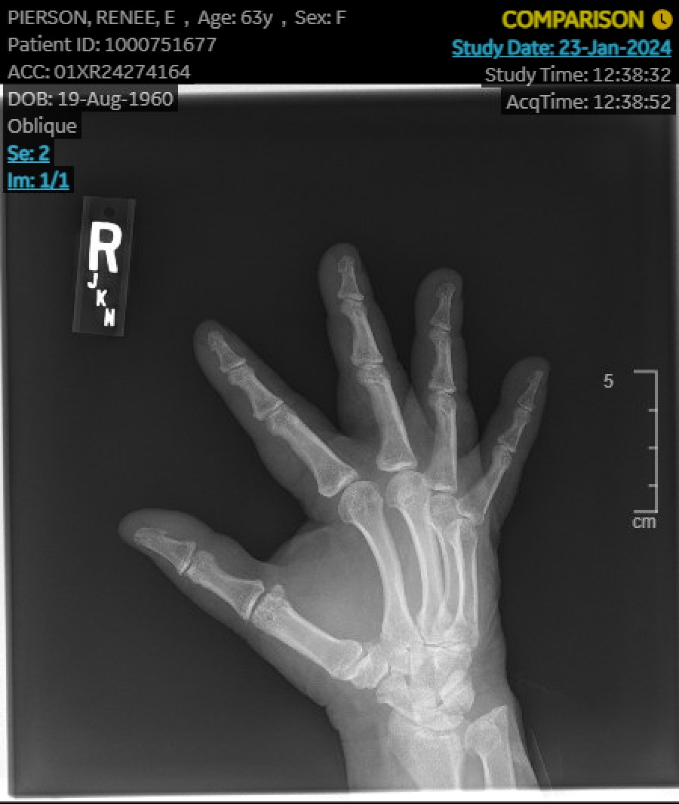
Wrist pain plus positive rheumatoid factor: When rheumatoid arthritis is not rheumatoid arthritis Elizabeth Long¹, Michael J. Reep, D.O.², Stephen M. Lindsey, M.D.² ¹LSUHSC School of Medicine, New Orleans, LA ² Department of Medicine, Rheumatology, LSU Health Sciences Center, New Orleans, LA
Introduction
Case Presentation
Rheumatoid factor (RF) is an autoantibody characterized in autoimmune diseases primarily rheumatoid arthritis (RA). It is considered a mainstay for the diagnosis and prognosis of that disease. However, RF can be elevated in the sera of individuals with other diseases. Chronic infections frequently can cause positive RF, especially subacute bacterial endocarditis, tuberculosis, and hepatitis C.¹ RF is detected in 10-20% of patients with cancer, as high as 26% in patients with non-small cell lung carcinoma.² This elevation of RF may in part be due to the older age of cancer patients and the correlation of RF production with increased age. Up to 10% of healthy individuals may have an elevated RF.²
RA is characterized by synovitis, joint tenderness, and synovial joint destruction. The diagnosis of RA is defined by a scoring system developed by the American College of Rheumatology and includes RF positivity.³ RA should be suspected in patients with morning stiffness lasting longer than one hour, and joint manifestations such as pain and synovitis, especially in the small joints of the feet and hands.⁴ Joint pain can also be caused by other abnormalities such as trauma, overuse, or congenital deformities, and should be considered in evaluating any patient. Madelung deformity is a condition of the distal radius thought to be due to formation of the Vickers ligament which produces growth restriction of the distal radius in the volar ulnar area. Cosmetic deformity and wrist pain are common features. The exact cause of the congenital form is unknown.⁵ When the etiology of symptoms such as wrist pain is unclear, a thorough history, physical exam, and laboratory testing are indicated to differentiate between causes.
A 63-year-old female presented to rheumatology clinic with chief complaint of chronic diffuse muscle stiffness and pain. She endorsed wrist and hand pain since childhood and noted to have Madelung deformity on x-ray ten years earlier. Seen by a hand specialist in the past and declined the recommended surgery. Approximately seven years ago, she continued with wrist pain and was found to have a positive RF of 39 IU/mL and started on hydroxychloroquine for RA. Shortly after, the patient began experiencing shortness of breath and presented to the emergency department. She was diagnosed with stage I lung adenocarcinoma and underwent a left lung thoracotomy and lobectomy with no chemotherapy or radiation.
On recent evaluation, the patient reported stiffness of the neck, shoulder, and knees as well as pain in both hands and feet relieved by naproxen. She endorsed morning stiffness for at least two hours that was relieved with movement. Her past medical history included hypertension, diabetes mellitus, lung cancer, prior 20 pack-year smoking history, and intraductal papilloma s/p lumpectomy. She denied a family history of autoimmune diseases. On physical exam, the patient was unable to fully extend her wrists and had reduced range of motion bilaterally. Dorsal subluxation of each ulna, diffuse knuckle swelling of both hands, and tenderness of the 3rd metacarpophalangeal joint of the right hand, with no heat, redness, or inflammatory swelling, was found. The rest of her physical exam was non-contributory. RF and CCP antibodies were repeated. RF resulted as 21 IU/mL and CCP antibody panel was negative, CRP normal x2. A bilateral wrist x-ray showed a large amount of inclination of the distal radial head bilaterally with positive ulnar variance and mild dorsal subluxation of the distal ulna compatible with Madelung deformity.
The overall clinical impression did not suggest active RA. She was referred to physical and occupational therapies and started on a trial of topical diclofenac in light of a likely degenerative process secondary to her Madelung deformity.
 | Prior value | Repeat test
Rheumatoid Factor | 39 IU/mL | 21 IU/mL
CCP Abs | 5 units/mL | 1.4 units/mL
Table 1. Laboratory results before and after presentation and exam in clinic.
Figure 1. Posteroanterior x-ray of normal hand.⁸
Discussion
The etiology of this patient’s chronic wrist pain and hand deformities was initially unclear. Her history included RA, positive RF, chronic wrist pain and deformity, and lung cancer. The differential included wrist pain secondary to congenital Madelung deformity versus RA. Her repeat RF was low positive and CCP was negative. Her prior RF positivity may have been secondary to malignancy.² Physical exam did not reveal any signs of synovitis. X-rays did not exhibit erosive changes but did confirm deformity. This case demonstrates the need to rule out confounding factors in patients with a history of elevated RF.
Figures 2 and 3. Posteroanterior views of patient’s right and left hands.
Figure 4. Oblique x-ray of normal hand.⁸
Conclusion
RF can be elevated in the sera of individuals with diseases other than RA. It should be noted that RF can be positive in up to 10% of normal patients, particularly as they age.¹ Many chronic infections and malignancy are known to produce RF. While RF has been reported to have a sensitivity ranging from 60-90% depending on the stage of disease, the specificity is just 85%.¹ Therefore, it is imperative to test suspected RA patients for CCP antibody positivity which has a specificity of 96%.⁶ Physical exam is crucial to evaluate for synovitis and joint damage. Xray and US can confirm physical exam findings or show other pathology. This combination of specific testing with clinical signs and symptoms of disease is important to establishing RA diagnosis, determining choice of therapy, and estimating prognosis. To illustrate these conclusions, in a recent study of 138 patients with positive RF >30 IU/mL and negative citric citrullinated peptide (CCP) antibodies, 20 were referred to rheumatology, where only 4 were diagnosed with RA, 3%.⁷
Figures 5 and 6. Oblique views of patient’s right and left hands.
References:
1. Tiwari V, Jandu JS, Bergman MJ. Rheumatoid Factor. PubMed. Published 2020. https://www.ncbi.nlm.nih.gov/books/NBK532898/.
2. Ugolini A, Nuti M. Rheumatoid Factor: A Novel Determiner in Cancer History. Cancers (Basel). 2021;13(4):591. Published 2021 Feb 3. doi:10.3390/cancers13040591.
3. Aletaha D, Neogi T, Silman AJ, et al. 2010 Rheumatoid arthritis classification criteria: An American College of Rheumatology/European League Against Rheumatism collaborative initiative. Arthritis & Rheumatism. 2010;62(9):2569-2581. doi:https://doi.org/10.1002/art.27584.
4. Baker J. UpToDate. www.uptodate.com. Published July 28, 2023. Accessed February 25, 2024. https://www.uptodate.com/contents/diagnosis-and-differential-diagnosis-of-rheumatoid-arthritis#H1410118085.
5. Saxena TA, Mckie J. Madelung Deformity. PubMed. Published 2023. Accessed January 5, 2024. https://www.ncbi.nlm.nih.gov/books/NBK580535/.
6. Braschi E, Shojania K, Allan GM. Anti-CCP: a truly helpful rheumatoid arthritis test?. Can Fam Physician. 2016;62(3):234.
7. Salinas M, Blasco Á, Flores E, Minguez M, Leiva-Salinas C. Double positivity for rheumatoid factor and anti-CCP autoantibodies: improving referral from primary care of patients suspected of having rheumatoid arthritis. Primary Health Care Research & Development. 2024;25. doi:https://doi.org/10.1017/s1463423623000695.
8. Bhat AK, Kumar B, Acharya A. Radiographic imaging of the wrist. Indian J Plast Surg. 2011;44(2):186-196. doi:10.4103/0970-0358.85339

