Slide 1
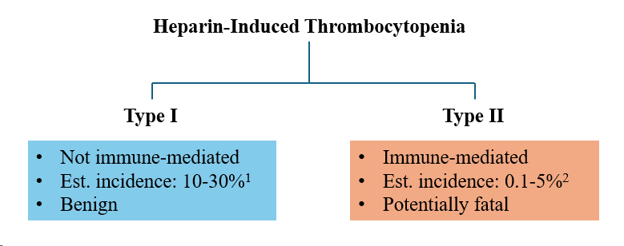
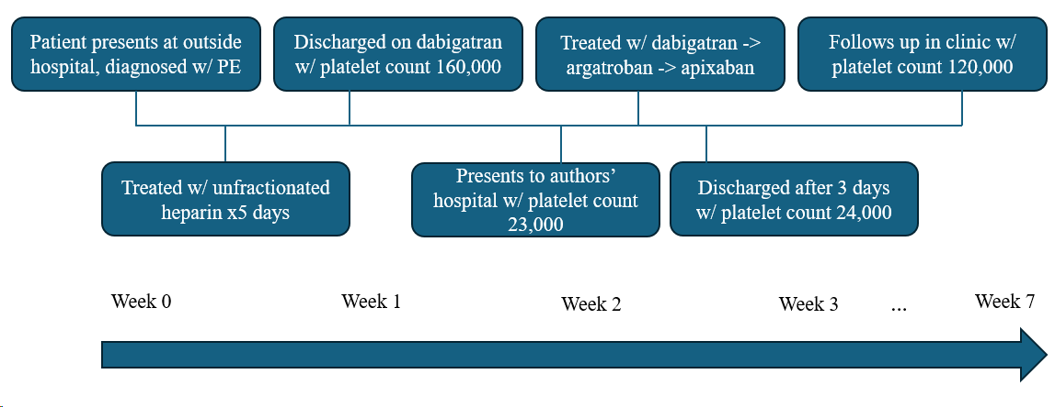
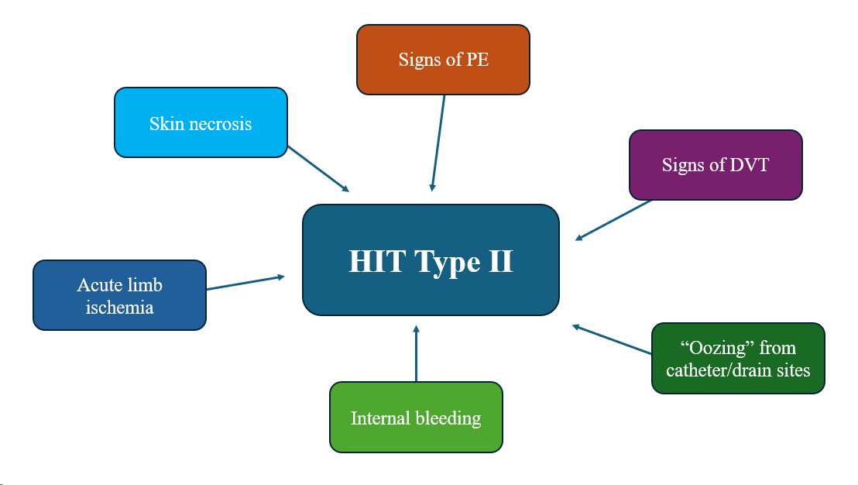
A Case of Type II Heparin Induced Thrombocytopenia Alison Schafer, MS3¹, Heath Scott, DO², Erica Jones, MD², Ashwin Narayana, MD² 1. LSU School of Medicine-New Orleans 2. LSU Internal Medicine-Lafayette
Introduction
Case Presentation
Discussion
Heparin induced thrombocytopenia (HIT) is divided into two subcategories. HIT Type I is a benign thrombocytopenia caused by platelet aggregation; it is not immune mediated¹. HIT Type II is a rarer disorder involving antibodies that form against heparin-platelet factor 4 (PF4) complexes, leading to hypercoagulability and thrombocytopenia¹. The incidence of HIT Type II ranges from approximately 0.1-5%². Prior research suggests the incidence of HIT may be higher with unfractionated heparin than with low molecular weight heparin³.
HIT may present with skin necrosis in addition to thrombosis. A decreased platelet count is typically seen within ten days of starting heparin¹. Multiple laboratory tests are available for HIT, including enzyme-linked-immunoassay and serotonin release assay. Because heparin-PF4 antibodies may be elevated without clinical manifestations of HIT, diagnosis of HIT involves both laboratory testing and clinical correlation⁴. Because HIT is a pro-thrombotic disorder, treatment involves anticoagulation. Alternatives to heparin include direct thrombin inhibitors (argatroban, bivalirudin), and Factor Xa inhibitors (fondaparinux)¹.
A 47-year-old male with past medical history of non-insulin dependent Type 2 diabetes mellitus, hyperlipidemia, Class 3 severe obesity, and obstructive sleep apnea, presented with thrombocytopenia (platelet count of 23,000) that was discovered on outpatient blood work. The patient had been admitted to a different hospital two weeks previously for bilateral pulmonary emboli (he had traveled internationally two weeks before experiencing symptoms). During this previous admission, he had been administered thrombolytic therapy, treated with unfractionated heparin for five days, and discharged on dabigatran with a platelet count of 160,000. On presentation at the authors’ hospital, the patient received a V/Q scan that showed a high probability of pulmonary embolism. Venous ultrasound/doppler of the lower extremities revealed acute occlusive deep vein thrombosis of bilateral popliteal veins, as well as duplicate femoral and popliteal veins bilaterally.
The patient was initially treated with unfractionated heparin for less than two hours before switching to dabigatran twice a day for three doses. He was subsequently treated with intravenous argatroban for one day and then transitioned to apixaban 10 mg twice daily. The patient’s thrombocytopenia persisted throughout the admission, with platelet count ranging from 19,000 to 24,000. After three days, he was discharged with instructions to follow up at the hospital’s outpatient internal medicine clinic. Enzyme-linked immunoassay for heparin-platelet factor 4 (PF4) antibody was positive, supporting a diagnosis of Type II heparin-induced thrombocytopenia (HIT). Carbohydrate antigen (CA) 19-9 was also elevated, suggesting malignancy as a possible cause of hypercoagulability. At a one-month follow-up visit, the patient’s platelet count had increased to 122,000. Platelet count remained stable at two-month follow-up, and CA 19-9 had normalized.
The patient in this case was treated with unfractionated heparin for five days during is initial hospital stay for PE. This is consistent with prior research that indicates the risk of HIT may be higher with unfractionated heparin than with low molecular weight heparin³. The timing of his decrease in platelets also aligns with prior research that suggests platelets in HIT typically decline within ten days of heparin administration¹. Ultrasound revealed the patient had duplicated femoral and popliteal veins. One study found the incidence of duplications along the femoral-popliteal segment to be 15.7%⁵. In the same study, the authors calculated a greater mean decrease in flow velocity in limbs with duplicated femoral-popliteal veins, indicating there may be a greater risk of DVT in patients with this anomaly due to stasis.⁵
Conclusions
This case underscores the importance of close monitoring and follow-up for patients treated with heparin. Furthermore, the findings highlight that patients who present with deep vein thrombosis/pulmonary embolism need to be evaluated thoroughly for sources of hypercoagulability, even in the presence of other risk factors such as recent travel. Finally, duplicated lower extremity veins present a risk of masking deep vein thrombosis and need to be documented for future patient encounters.
Fig. 1: Subcategories of Heparin Induced Thrombocytopenia
Fig. 3: Case Timeline
References
Arachchillage, D., Thachil, J., Anderson, J., Baker, P., Poles, A., Kitchen, S., Laffan, M. (2023). Diagnosis and management of heparin-induced thrombocytopenia: Third edition. British Journal of Haematology, 204, 459-475.
Hogan, M., Berger J.S. (2020). Heparin-induced thrombocytopenia (HIT): Review of incidence, diagnosis, and management. Vascular Medicine. 25(2):160-173. doi:10.1177/1358863X19898253
Arepally, G. (2017). Heparin-induced thrombocytopenia. Blood, 129(21), 2864-2872. https://doi.org/10.1182/blood-2016-11-709873.
Ahmed, I., Majeed, A., & Powell, R. (2007). Heparin induced thrombocytopenia: diagnosis and management update. Postgraduate medical journal, 83(983), 575–582. https://doi.org/10.1136/pgmj.2007.059188
Dona, E., Fletcher, J. P., Hughes, T. M. D., Saker, K., Baptiste, P., Ramanathan, I. (2001). Duplicated popliteal and superficial femoral veins: incidence and potential significance. Australian and New Zealand Journal of Surgery, 70(6), 438-440.
Fig. 2: HIT Type II Clinical Presentation

