Slide 1
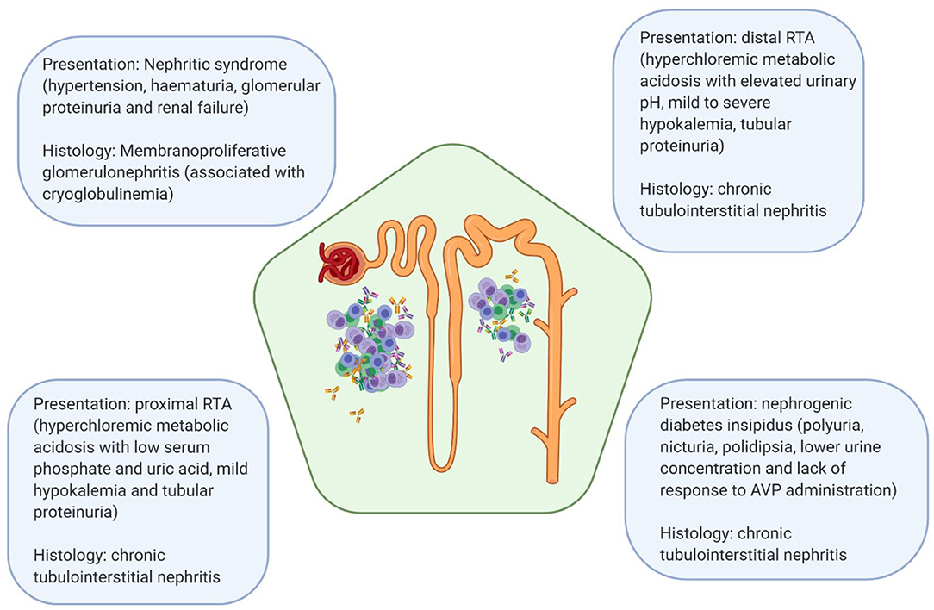
Membranoproliferative Glomerulonephritis in primary Sjogren’s Syndrome
Michelle Livitz DO¹, Maria Rodriguez DO¹, Nahida Baigam MD², Farshid Yazdi MD²
1. Department of Internal Medicine, LSUHSC- NO, 2. Department of Nephrology, LSUHSC-NO
Introduction
Discussion
Primary Sjogren’s syndrome (pSS) is an autoimmune disease that causes lacrimal and salivary gland dysfunction via lymphocytic infiltration, resulting in xerophthalmia and xerostomia.
Extraglandular features can be exhibited, including renal involvement, which is noted in only 5% of pSS patients. The most common histological pattern of renal disease in pSS is tubulointerstitial nephritis, while glomerular disease in these patients is uncommon.
Of the glomerular diseases that this population is most susceptible to, Membranoproliferative glomerulonephritis (MPGN) is the most prevalent. It is an immune-related renal condition and can be seen due to deposition of immune-complexes, C4 consumption due to activation of the classical complement pathway, and cryoglobulinemia, all of which can take place in pSS.
While renal involvement in pSS is rare, MPGN is an even rarer manifestation within that same population. The glomerular involvement in this patient noted by the proteinuria, substantial hematuria, and the evidence of dysmorphic RBCs in the urine after centrifugation, was enough to suggest that this was not the typical presentation of tubular dysfunction.
Renal biopsy was an essential diagnostic component in this case. Due to confirmation of this immune-complex process, the patient’s treatment course was altered to include immunosuppressive therapy, instead of a course of steroid monotherapy, which is the standard treatment for tubulointerstitial nephritis.
Despite the low incidence of renal involvement in pSS patients, regular monitoring of urinalysis studies and urine protein/creatinine ratios might be of benefit in this patient population.
As this patient only had a transient increase in her creatinine while her blood pressure was elevated and resolved with blood pressure control, regular metabolic panels may not be sufficient for kidney function monitoring.
A
B
Case Presentation
C
D
67 y/o F with PMHx primary Sjogren’s Syndrome (diagnosed in 2007, not on therapy), HTN, and right renal angiolipoma presented for persistent bilateral leg swelling for 5 days prior to admission. She noted some BLE swelling in the past, but never this severe. She also reported not taking her blood pressure medications that day and was noted to have her systolic BP into the 170s.
The patient reported that she had been having foamy urine for the past few months, but otherwise denied any other urinary symptoms.
Upon further evaluation, she was found to have substantial proteinuria and hematuria in the setting of an AKI with a creatinine 1.15 (baseline 0.8) and 2+ pitting edema in BLE. Her total urine protein/creatinine ratio was 1231 with numerous dysmorphic RBCs and RBC casts.
This prompted further investigation with renal biopsy, which showed a membranoproliferative pattern glomerulonephritis, immune-complex type. The patient’s AKI resolved with blood pressure control, and she subsequently followed up with Rheumatology and Nephrology to initiate immunosuppressive therapy to prevent further renal damage.
A
E
F
G
H
References
https://www.frontiersin.org/journals/immunology/articles/10.3389/fimmu.2020.562101/ful
https://link.springer.com/article/10.1007/s40744-020-00264-x
https://www.frontiersin.org/journals/immunology/articles/10.3389/fimmu.2020.562101/full

