Slide 1
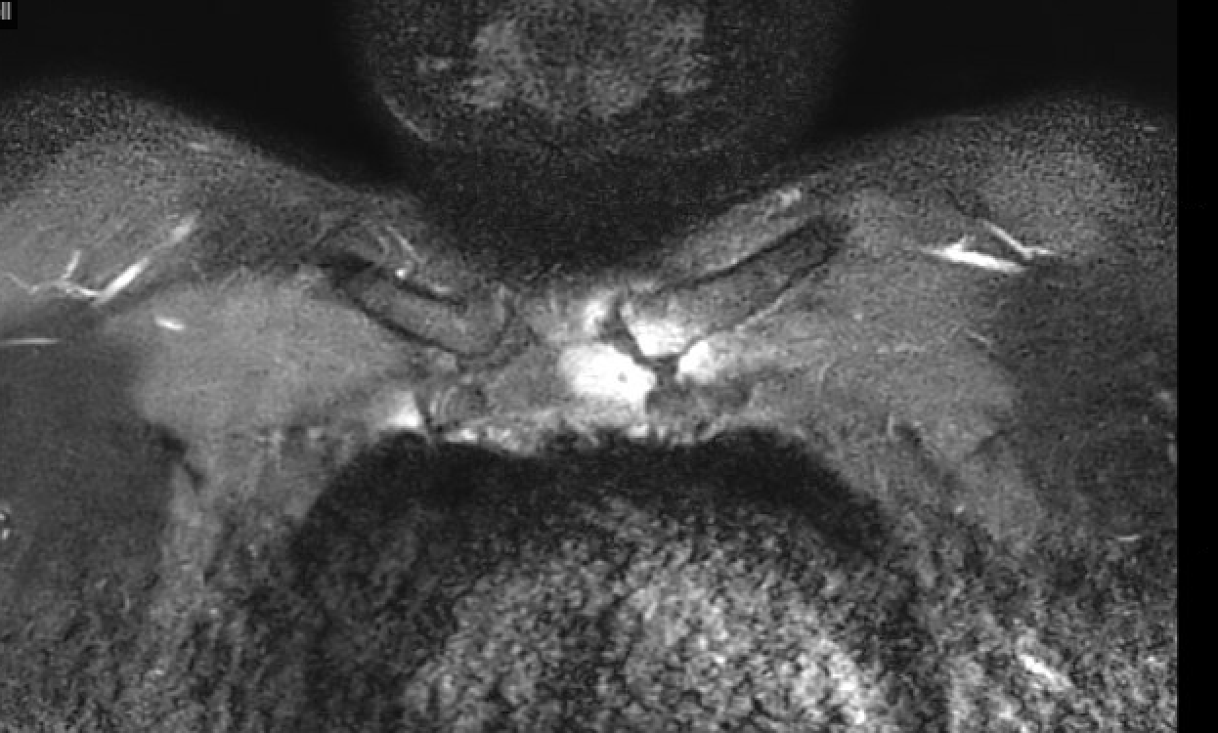
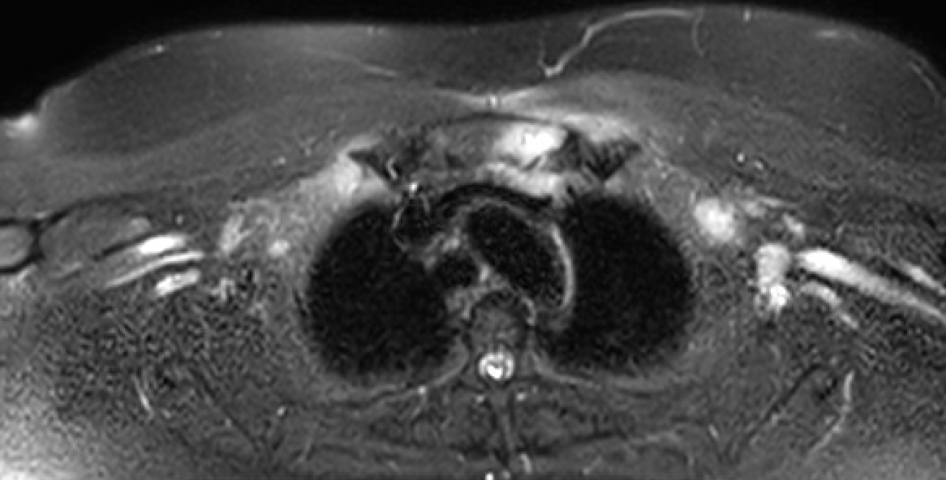
Under the Collarbone: A Case of Primary Sternal and Clavicular Osteomyelitis
Nikki Arceneaux M.D., Vivek Patel D.O., Ross McCarron M.D. Department of Internal Medicine, Louisiana State University School of Medicine, New Orleans, LA
Introduction
Primary sternal osteomyelitis (PSO) is a rare but life-threatening condition. This case underscores the diagnostic challenges of PSO, highlighting the significance of early culture-based pathogen identification and the potential success of conservative management when patients respond well to antibiotics.
Case Presentation
Imaging
Discussion
A 41-year-old female with a past medical history of obesity, uncontrolled type 2 diabetes, hypertension, and intravenous drug use complicated by necrotizing fasciitis of the left forearm presented to the Emergency Department for acute left chest pain and purulence of left forearm wounds for two days. Her exam was significant for tenderness to palpation to the anterior chest, left shoulder, and purulence of the left forearm. The patient was started on broad spectrum antibiotics after blood cultures were obtained. Blood cultures rapidly revealed methicillin-resistant staphylococcus aureus (MRSA). Despite the initiation of broad-spectrum antibiotics, the patient's blood cultures remained positive for MRSA after two days. Transthoracic and transesophageal echocardiography did not show vegetations. Without source control for four days on the proper antibiotic regimen, further imaging with computed tomography (CT) of the chest, abdomen, and pelvis was performed. These CT studies failed to identify an obvious source of infection. However, CT of the cervical spine revealed an inflammatory process in the left sternoclavicular joint, along with joint effusion and periarticular soft tissue swelling. Magnetic resonance imaging was ordered to further assess revealing septic arthritis of the left sternoclavicular joint with clavicular and manubrial osteomyelitis. The cardiothoracic surgery team was consulted for potential debridement of clavicular and manubrial osteomyelitis. Blood cultures were collected again and showed no growth. Following extensive discussion with the patient and surgical team, a conservative treatment plan including IV antibiotics and close follow-up was chosen.
Primary sternal osteomyelitis is an infection of the sternum without prior cardiac surgery or direct sternal trauma. It is thought that PSO arises through hematogenous seeding of the sternum, and the most common bacterial cause is methicillin-resistant staphylococcus aureus. Risk factors for this infection include intravenous drug abuse, diabetes mellitus, HIV and subclavian vein catheterization. Patients with PSO often present with non-specific symptoms such as chest pain, fever, tenderness, or erythema which can be diagnostically challenging for clinicians. Although these patients are typically treated with either culture-guided antibiotic therapy alone or antibiotics with debridement and closure, there is no standard of care due to scarcity of the literature.
A
Imaging
Fig 1: MRI chest showing markedly increased T2 signal within the medial aspect of the left clavicle and the manubrium at and around the left sternoclavicular joint.
References
1. Al Ani A, Abdelmonem K, Forsat K, Alqaderi N, Teir H. Primary sternal osteomyelitis: A case report. Int J Surg Case Rep. 2023 Sep;110:108654. doi: 10.1016/j.ijscr.2023.108654. Epub 2023 Aug 13. PMID: 37591189; PMCID: PMC10457543.
2. Lopez CD, Hill JB, Stavropoulos C, Lerman OZ. Primary Sternal Osteomyelitis: A Case Report and Review. Plast Reconstr Surg Glob Open. 2019 Jun 12;7(6):e2120. doi: 10.1097/GOX.0000000000002120.
3. Mir-Sepasi MH, Gazzaniga AB, Bartlett RH. Surgical treatment of primary sternal osteomyelitis. Ann Thorac Surg. 1975;19:698–703.
4. Zacharias A, Habib RH. Delayed primary closure of deep sternal wound infections. Tex Heart Inst J. 1996;23:211–216
Fig 2: MRI chest showing osteomyelitis of sternum

