Slide 1
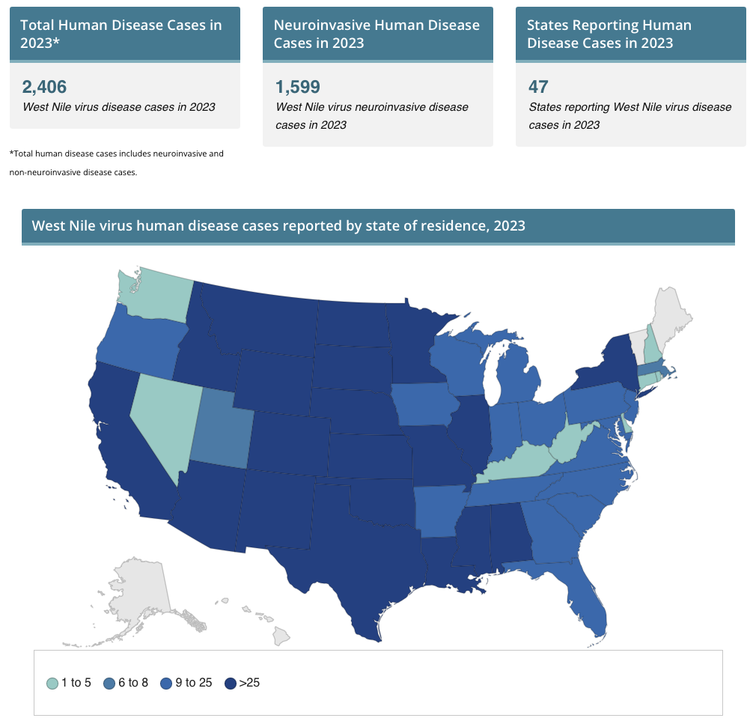
West Nile Virus Encephalitis: An Atypical Case Presentation
Sepehr Sadeghi, DO¹; Gurtaj Mahil¹, Oluwafemi Ajibola, MD²; Amita Krishnan, MD².
¹Department of Internal Medicine, LSU Health Sciences Center, New Orleans, LA
²Department of Pulmonary and Critical Care Medicine, LSU Health Sciences Center, New Orleans, LA
Introduction
Hospital Course
West Nile Virus (WNV) is the most common arbovirus infection in the United States
Clinical presentation ranges from a mild fever, neuropathy, acute flaccid paralysis, and severe encephalitis
Most important prognostic factor is age
10% mortality rate is seen in neuroinvasive WNV infection
WNV meningoencephalitis is typically associated with cerebrospinal fluid (CSF) studies consistent with lymphocytic predominance
We present a case of neuroinvasive WNV encephalitis with atypical CSF findings
Due to concern for non-convulsive status epilepticus, he was given IV lorazepam and intubated for airway protection. Loaded with Keppra and valproate; started on propofol. Started on empiric antibiotics (vancomycin, ceftriaxone, acyclovir). Placed on doxycycline given concern for rickettsial disease (rash and fever). Spot EEG demonstrated diffuse background slowing, consistent with widespread cerebral dysfunction and encephalopathy.
LP #1 (day 2): 528 WBC, 82% segmented neutrophils, 5% lymphocytes, 0 RBC, 165 protein, 83 glucose. Peripheral blood smear at the same time showed neutrophilia with lymphopenia and normal morphology without blasts. Initial CSF culture (-). CSF meningoencephalitis PCR panel (-). CSF arbovirus panel (-). While waiting for the pending culture results, the neurology team requested repeat LP due to concern for autoimmune encephalitis.
LP#2 (day 5): 84 WBC, 5% neutrophils, 87% lymphocytes, 0 RBC, 183 protein, 46 glucose. Autoimmune and paraneoplastic evaluation was (-). The patient was transferred to OSH for continuous EEG, which did not show seizure activity.
Antibiotics were stopped given (-) bacterial infectious workup. Serum IgM West Nile Virus specimen came back (+).
Patient was managed with supportive care. Patient underwent tracheostomy and PEG placement due to failure to liberate from the ventilator. Neuro exam improved over the following 2 weeks: Spontaneous eye-opening, appropriate eye tracking, cessation of gaze deviation, following simple commands, and improved strength against gravity
Case Presentation
ID: 60-year-old man
CC: Found unconscious in his backyard
HPI: Unable to obtain due to altered mental status. Collateral from his brother revealed he lived independently.
PMH: CVA with residual L-sided hemiparesis, seizure disorder, HTN, DM2, HLD, CAD s/p PCI
PE on initial presentation: AAO x1 to person, fixed rightward gaze, left hemineglect, increased muscle tone, generalized tremors with diffuse maculopapular rash
BP 160s-200s/100s-140s, HR in the 110s, Tmax 102.6, O₂ sat 99% on room air
Labs:
Normoglycemic
TSH, T4 free, T3 free normal
Lactate slightly elevated at 2.4
CK 414 initially, increased to 743 over the next day
UDS positive for cocaine/THC
Ethanol level wnl
COVID-negative
HIV negative
Stroke activated in the setting of right-sided gaze, tremors, HTN, and AMS
CT without contrast: no acute intracranial abnormalities.
MRI head: no acute findings but did show a large remote infarct with cystic encephalomalacia involving the posterior right MCA division and right PCA territory
Discussion
Figure 1: Distribution of West Nile Virus cases across the USA. Source: The Centers for Disease Control and Prevention (CDC). https://www.cdc.gov/westnile/statsmaps/current-season-data.html
This case of WNV encephalitis was characterized by a biphasic pattern of leukocyte composition in the CSF with a transition from neutrophilic to lymphocytic predominance in 3 days. With no approved first-line therapy, the mainstay is supportive treatment. This includes management of neurological sequelae, pain control for headaches, anti-emetics, monitoring ICP, airway support, and aggressive rehabilitation. Bakos et al. 2022 note that the majority of WNV encephalitis cases show lymphocytic predominance. However, Yu et al. 2020 revealed a case with initial neutrophilic predominance in CSF fluid. This case demonstrated the importance of considering WNV encephalitis, even when the initial CSF analysis reveals neutrophilic predominance, a finding typically correlated with bacterial infection.
References
1. Bakos I, Mahdi M, Kardos L, Nagy A, Várkonyi I. Clinical Spectrum and CSF Findings in Patients with West-Nile Virus Infection, a Retrospective Cohort Review. Diagnostics (Basel). 2022 Mar 25;12(4):805. doi: 10.3390/diagnostics12040805. PMID: 35453853; PMCID: PMC9032281.
2. Ellul M, Solomon T. Acute encephalitis - diagnosis and management. Clin Med (Lond). 2018 Mar;18(2):155-159. doi: 10.7861/clinmedicine.18-2-155. PMID: 29626021; PMCID: PMC6303463.
Gnann JW Jr, Agrawal A, Hart J, Buitrago M, Carson P, Hanfelt-Goade D, Tyler K, Spotkov J, Freifeld A, Moore T, Reyno J, Masur H, Jester P, Dale I, Li Y, Aban I, Lakeman FD, Whitley RJ. Lack of Efficacy of High-Titered Immunoglobulin in Patients with West Nile Virus Central Nervous System Disease. National Institute of Allergy and Infectious Diseases Collaborative Antiviral Study Group. Emerg Infect Dis. 2019;25(11):2064.
3. Kal S, Beland A, Hasan M. West Nile Neuroinvasive Disease Treated With High-Dose Corticosteroids. Cureus. 2022 Nov 28;14(11):e31971. doi: 10.7759/cureus.31971. PMID: 36589189; PMCID: PMC9795833.
4. Pyrgos V, Younus F. High-dose steroids in the management of acute flaccid paralysis due to West Nile virus infection. Scand J Infect Dis. 2004;36(6-7):509.
5. Saraya AW. Wacharapluesadee S. Petcharat S, et al. Normocellular CSF in herpes simplex encephalitis. BMC Res Notes. 2016;9:95.
6. Srivastava R, Ramakrishna C, Cantin E. Anti-inflammatory activity of intravenous immunoglobulins protects against West Nile virus encephalitis. J Gen Virol. 2015;96(Pt 6):1347. Epub 2015 Feb 9.
7. Stonedahl S, Leser JS, Clarke P, Potter H, Boyd TD, Tyler KL. Treatment with Granulocyte-Macrophage Colony-Stimulating Factor Reduces Viral Titers in the Brains of West Nile Virus-Infected Mice and Improves Survival. J Virol. 2023 Mar 30;97(3):e0180522. doi: 10.1128/jvi.01805-22. Epub 2023 Feb 21. PMID: 36802227; PMCID: PMC10062152.
8. Yu A, Ferenczi E, Moussa K, Eliott D, Matiello M. Clinical Spectrum of West Nile Virus Neuroinvasive Disease. The Neurohospitalist. 2020;10(1):43-47. doi:10.1177/1941874419868636

