Slide 1
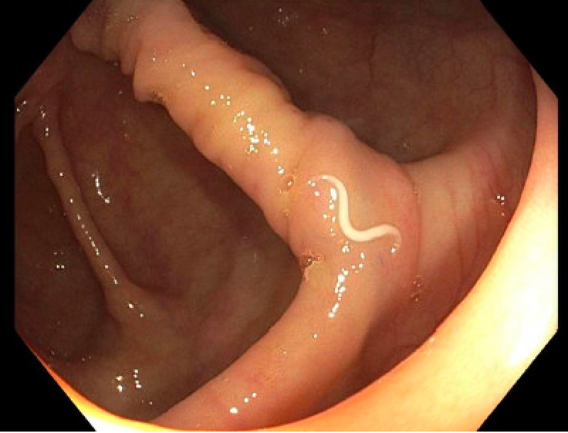
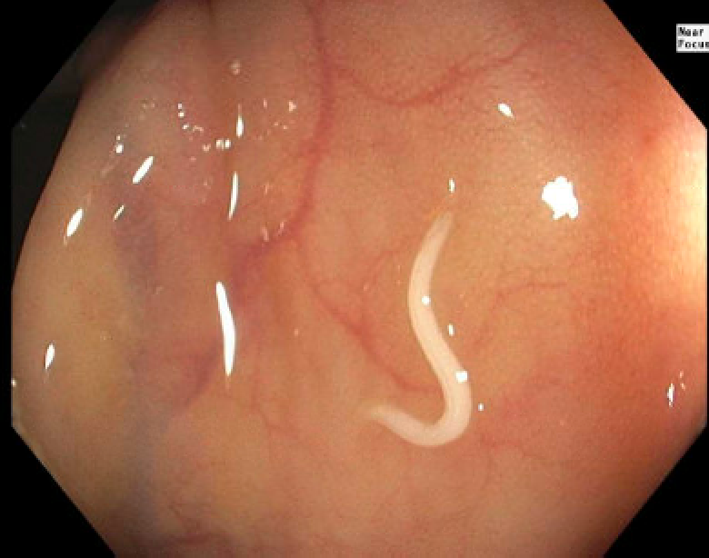
What Swims Within: A Case of Enterobius Vermicularis Discovery Wayne Wheeler MD¹, Will Chastant MD², John Hutchings MD FACG² ¹Department of Internal Medicine, LSU Health Sciences Center, New Orleans, LA ²Department of Gastroenterology, LSU Health Sciences Center, New Orleans, LA
Introduction
Discussion
With increasing tourism and immigration into the United States, the incidence of intestinal helminth infections will rise.
These parasitic worms can remain asymptomatic for years, causing increased morbidity and mortality if left undetected ⁽¹⁾. When intestinal parasites are suspected, the laboratory testing of stool samples is typically diagnostic.
In addition to microscopic evaluation, recent studies have highlighted the utility of endoscopy in making a diagnosis of intestinal parasite infection ^{(2,3)}.
This case is an example of asymptomatic enterobiasis diagnosed through endoscopy.
The more commonly diagnosed helminths in North America include Enterobius vermicularis, Trichuris trichiura, Ancylostoma duodenale, Ascaris lumbricoides, and Taenia saginata⁽⁴⁾. Of this group, Enterobius vermicularis, the common pinworm, is the most prevalent ⁽⁵⁾. Pinworms prefer the cecum and have previously been reported to mimic appendicitis ⁽⁶⁾. Other helminths may harbor anywhere throughout the intestinal lumen, mucosa, lymphatics, vasculature, or biliary tracts ⁽⁷⁾. Although most patients are asymptomatic, intestinal helminths can cause anemia, nutritional malabsorption, secondary bacterial infection, and even perforation ⁽⁸⁾. When suspected, helminths are classically diagnosed through tissue biopsy or the observation of ova, cysts, and larvae within stool samples. Although it is not the initial diagnostic test of choice, endoscopy has been useful in directly visualizing worms in unsuspecting patients. Pinworms, roundworms, tapeworms, hookworms, and whipworms have all previously been visualized during endoscopic evaluations ^{(3,5, 9-13)}. If encountered, the worms should be removed and evaluated by a parasitologist for proper identification and treatment guidance. This case represents the versatility of endoscopy for diagnosing gastrointestinal tract pathogens in an unsuspecting, asymptomatic individual.
Image 1. Enterobius vermicularis discovered in the cecum during colonoscopy.
Case Description
A 68-year-old female with a past medical history of hypertension and gastroesophageal reflux, presented for routine colorectal cancer screening.
During colonoscopy a parasitic worm was visualized in the cecum (Images 1,2).
The worm was removed with jumbo forceps and delivered to the parasitology lab for further identification.
The specimen was identified as Enterobius Vermicularis.
The patient had denied prior symptoms of pruritis ani or abdominal pain.
She was treated with oral albendazole therapy and advised to encourage close contacts to seek similar treatment in hopes of preventing re-transmission. She remains well.
References
Kucik CJ, Martin GL, Sortor BV. Common intestinal parasites. Am Fam Physician. 2004 Mar 1;69(5):1161-8.
Azab, H.M.M., Bayoumy, A.M.S., Zaalouk, T.K. et al. Endoscopic procedure as a diagnostic tool for intestinal parasitic pathological changes. Parasitol Res 121, 245–254 (2022).
Do KR, Cho YS, Kim HK, Hwang BH, Shin EJ, Jeong HB, Kim SS, Chae HS, Choi MG. Intestinal helminthic infections diagnosed by colonoscopy in a regional hospital during 2001-2008. Korean J Parasitol. 2010 Mar;48(1):75-8.
Juckett G. Common intestinal helminths. Am Fam Physician. 1995 Nov 15;52(7):2039-48, 2051-2.
Goldenberg SP, Marignani P. The endoscopic diagnosis of colonic enterobiasis. Gastrointest Endosc. 1990 May-Jun;36(3):309-10.
Ariyarathenam AV, Nachimuthu S, Tang TY, Courtney ED, Harris SA, Harris AM. Enterobius vermicularis infestation of the appendix and management at the time of laparoscopic appendectomy: case series and literature review. Int J Surg. 2010;8(6):466-9.
Abd El Bagi ME, Sammak BM, Mohamed AE, Al Karawi MA, Al Shahed M, Al Thagafi MA. Gastrointestinal parasite infestation. Eur Radiol. 2004 Mar;14 Suppl 3:E116-31.
Hechenbleikner EM, McQuade JA. Parasitic colitis. Clin Colon Rectal Surg. 2015 Jun;28(2):79-86.
Eckardt AJ, Barnard GF. Endoscopic diagnosis and removal of Ascaris lumbricoides during colonoscopy for polyp surveillance (with video). Gastrointest Endosc. 2006 Apr;63(4):708-9, discussion 709.
Chandra B, Long JD. Diagnosis of Trichuris trichiura (whipworm) by colonoscopic extraction. J Clin Gastroenterol. 1998 Sep;27(2):152-3.
Chergui H, Akhoundi M, Marteau A, Bejou B, Lekhal C, Deutsch D, Mantelet S, Benamouzig R, Izri A. Severe iron-deficiency anaemia due to hookworm infection diagnosed by capsule endoscopy. Int J Infect Dis. 2021 Mar;104:271-272.
Nussinson E, Yair-Sabag S, Shibli F. Detection of Taenia saginata infection mimicking Crohn's disease using video capsule endoscopy. Clin Case Rep. 2018 Mar 4;6(4):741-744.
Patra AA, Nath P, Pati GK, Panigrahi SC, Mallick B, Acharya JCK, Adhya A. Strongyloides Infection Presenting as Proximal Small Intestinal Obstruction. ACG Case Rep J. 2019 Jun 25;6(6):e00124.
Image 2. Enterobius vermicularis incidentally discovered during colonoscopy

