Slide 1
Purine and Pyrimidine anabolism

Slide 2
OBJECTIVES:
Nomenclature of nucleic acids:
  a. nucleosides*
  b. nucleotides
Structure and function of purines and pyrimidines.
Origin of atoms in the purine ring and in the pyrimidine ring.
Essential features of purine and pyrimidine metabolism (anabolism and catabolism).
Diseases associated with metabolic malfunction.
*Keywords are highlighted in yellow

Slide 3
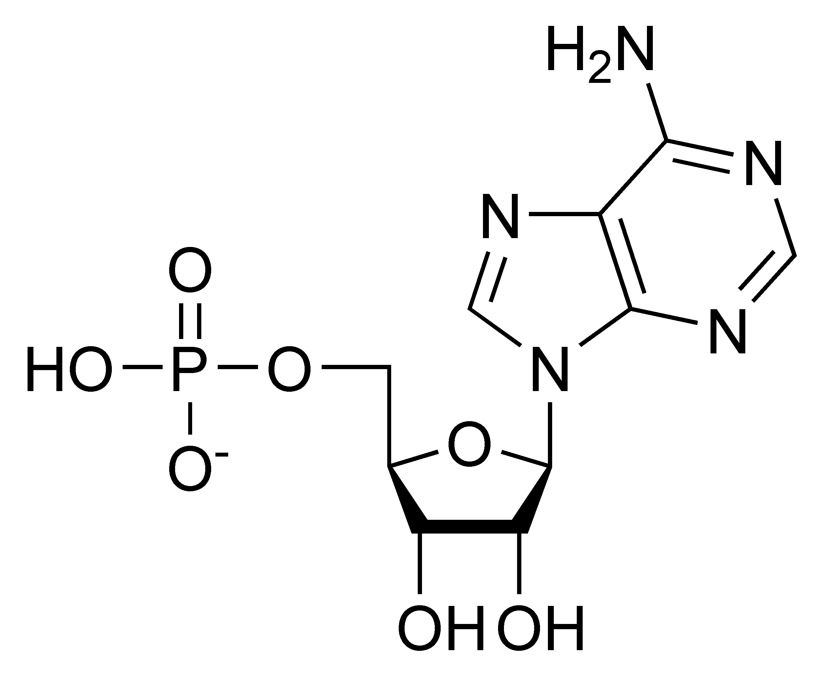
Nucleotides
Chemical compound composed of three components: (1) heterocyclic base; (2) sugar (pentose; ribose); and (3) one or more phosphate groups
Glycosidic bond
Base
Phosphate
Pentose sugar
Adenosine monophosphate (AMP)

Slide 4
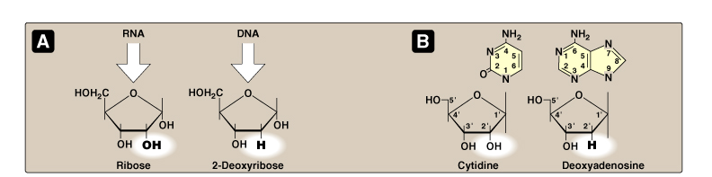
RNA is sensitive to alkaline degradation
Base | Ribonucleoside | Ribonucleotide | Deoxyribonucleotide
Adenine | Adenosine | Adenylate | Deoxyadenylate
Guanine | Guanosine | Guanylate | Deoxyguanylate
Cytosine | Cytidine | Cytidylate | Deoxycytidylate
Thymine | Thymidine | Ribothymidylate | Thymidylate
Uracil | Uridine | Uridylate | Deoxyuridylate
Hypoxanthine | Inosine | Inosinate | Deoxyinosinate
Xanthine | Xanthosine | Xanthylate | Deoxanthylate

Slide 5
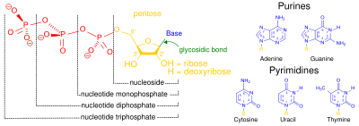

Slide 6
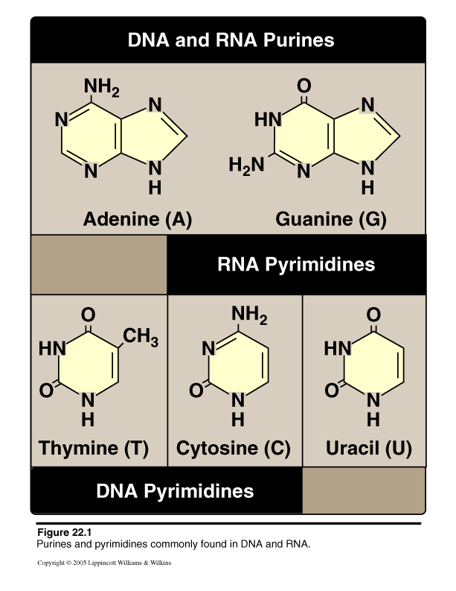
The Nitrogenous Bases
In DNA:
Adenine
Guanine
*Thymine*
Cytosine
In RNA:
Adenine
Guanine
*Uracil*
Cytosine

Slide 7
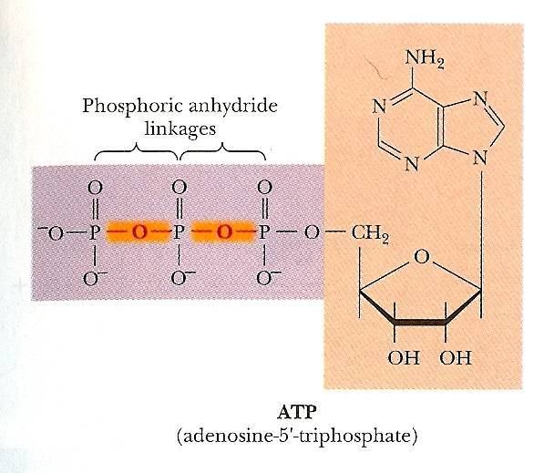
Energy Currency

Slide 8
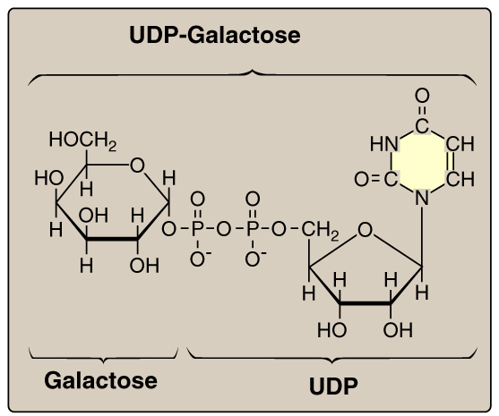
Carriers for Activated Intermediates

Slide 9
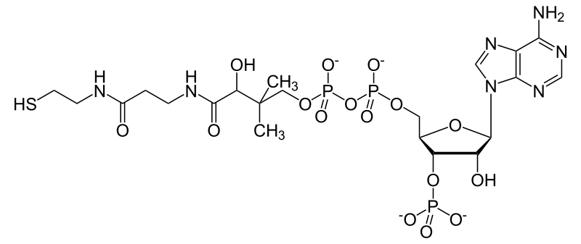
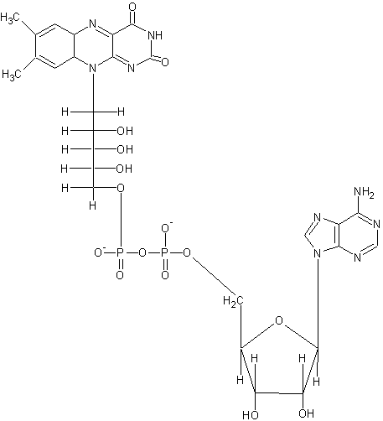
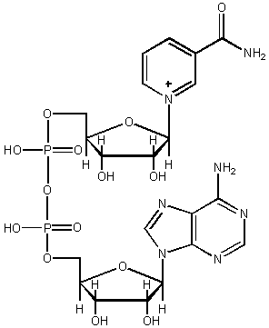
Structural Components of:
Coenzyme A
Flavin adenine dinucleotide (FAD)
NAD(P)⁺

Slide 10
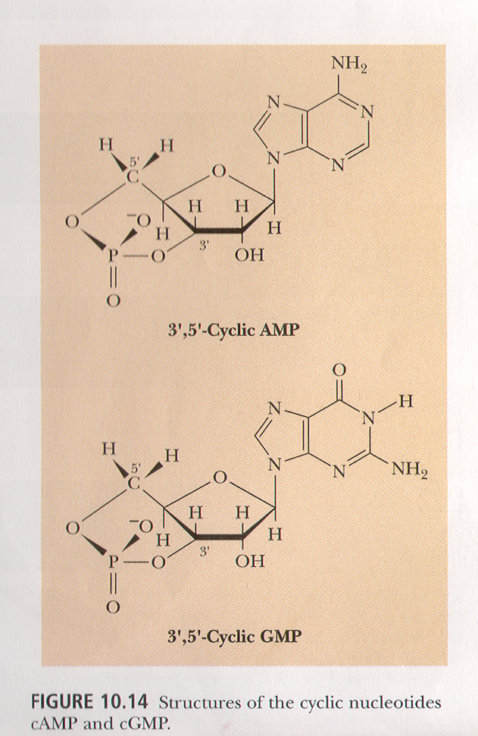
Signaling Molecules

Slide 11

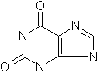
Important metabolic intermediates; not typically
found in either DNA or RNA.
Hypoxanthine
Xanthine

Slide 12
Purine synthesis

Slide 13
Purine Synthesis
Two ways:
  De Novo Pathway: means from scratch; nucleotide bases are produced from simpler compounds
    Purines: base is synthesized in segments, in order, directly onto the ribose structure
    Pyrimidines: base is synthesized first and then assembled onto the ribose structure
  Salvage Pathway: “a process whereby a metabolite is reutilized for biosynthesis of a compound from which the metabolite was derived”

Slide 14
De novo purine synthesis
AMP
ADP
ATP
Adenosine
monophosphate
kinase
Adenosine
diphosphate
kinase
IMP
GMP
GDP
GTP
Guanosine
monophosphate
kinase
Guanosine
diphosphate
kinase
De novo pyrimidine synthesis
UMP
UDP
UTP
Uridine monophosphate kinase
Uridine
diphosphate
kinase
dUMP
dUDP
CTP
Thymidylate synthase
dTMP
dTDP
Thymidine
diphosphate
kinase
dTTP
Thymidine monophosphate kinase

Slide 15
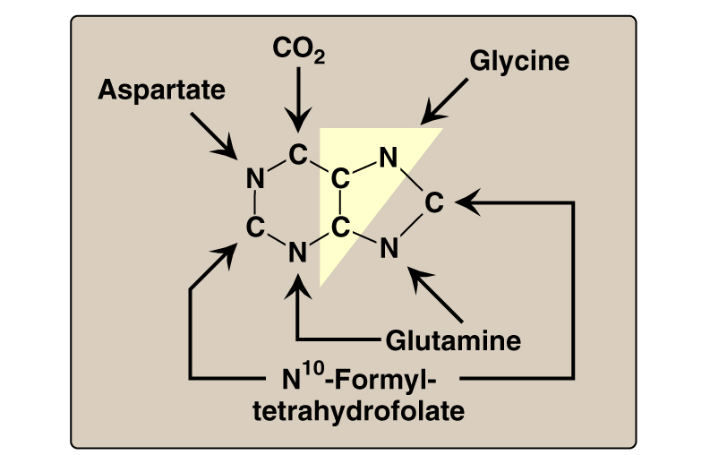
De novo purine synthesis

Slide 16
De novo purine synthesis
Purine ring: synthesized by a series of 12 reactions; carbon and nitrogen atoms added to a pre-formed ribose-5-phosphate.
Ribose-5-phosphate: Hexose MonoPhosphate Pathway.
In humans: enzymes found in the cytoplasm of the cell.

Slide 17
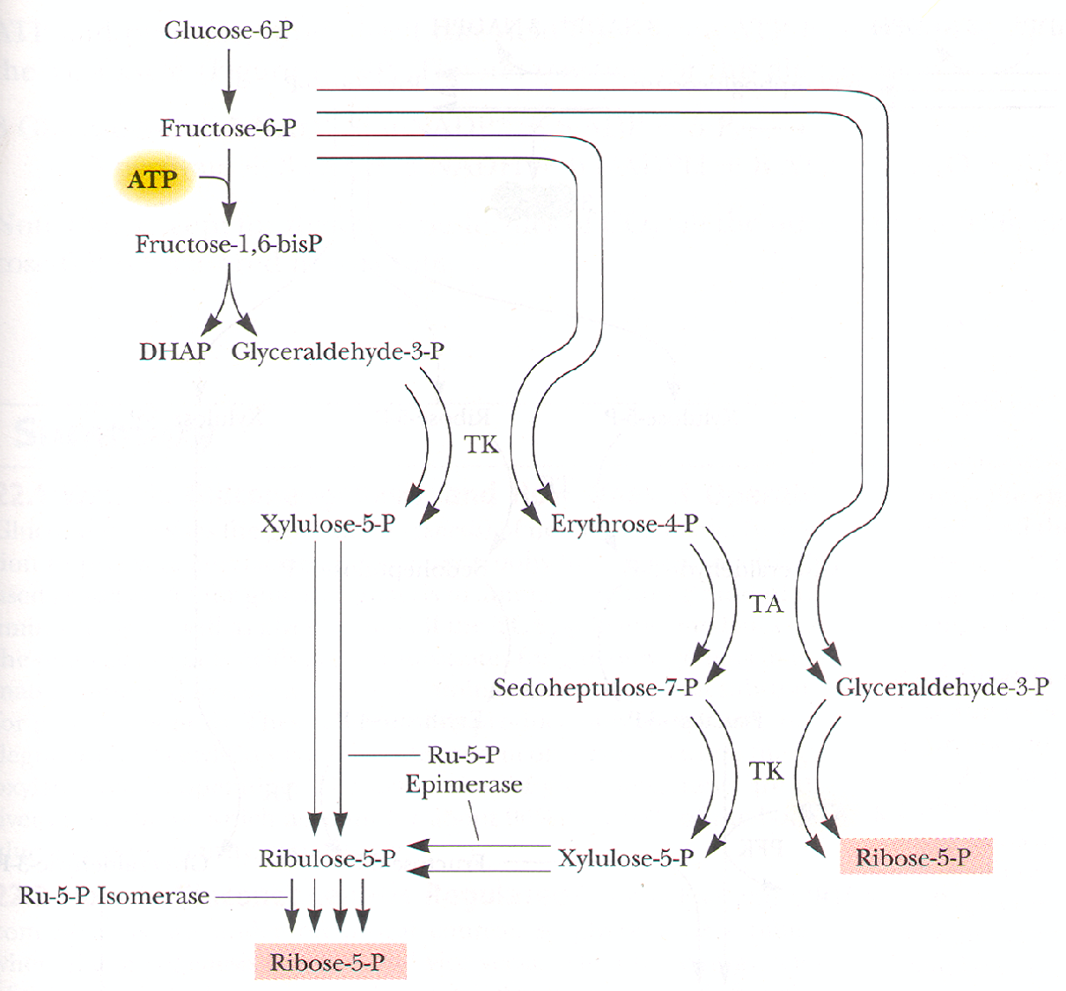
Source For Ribose-5-Phosphate

Slide 18
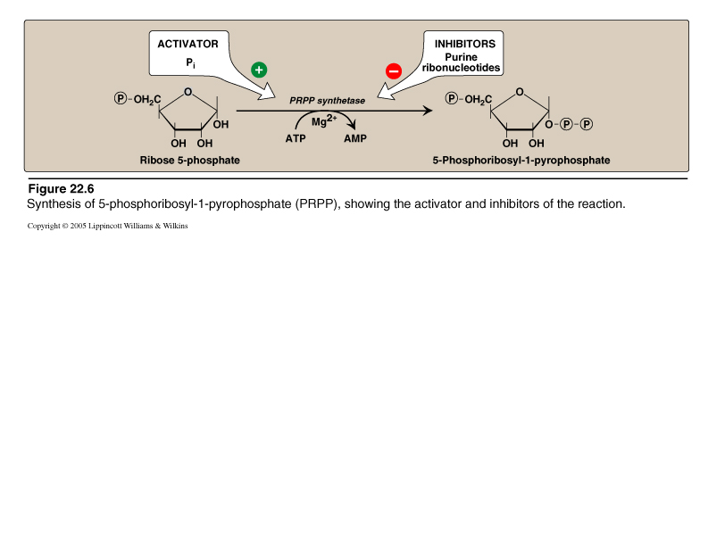
Conversion of Ribose-5-phosphate to PRPP
Ribose: Pentose sugar; may be reduced to deoxyribose (DNA).
5-Phosphoribosyl-1-pyrophosphate (PRPP): also involved in pyrimidine synthesis, NAD⁺, and histidine biosynthesis.

Slide 19
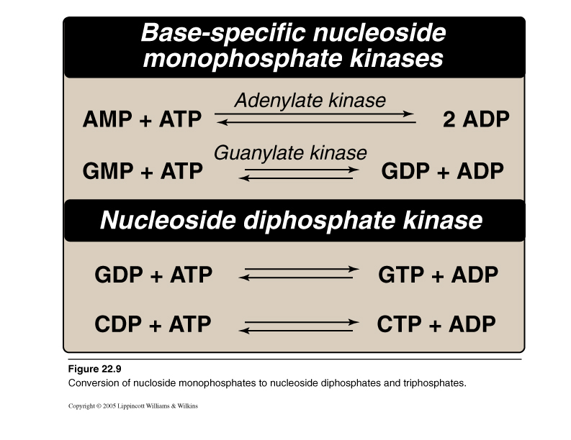

Slide 20
Purine Salvage Pathway
From normal turnover of cellular nucleic acids
Obtained from the diet
Reutilization of adenine, hypoxanthine, and guanine
  Two enzymes:
    1. Adenine phosphoribosyltransferase
    2. Hypoxanthine-guanine
    phosphoribosyltransferase

Slide 21
Methotrexate and Cancer
Mode of Action
  Dihydrofolate reductase
Adverse events:
  Anemia, scaly skin, GI tract disturbances (diarrhea), Baldness
Resistance: Amplification of dihydrofolate reductase gene
Other indications:
  Rheumatoid arthritis
  Psoriasis (lower doses; inhibition of salvage pathways; increased
    adenosine, inhibits T cell activation.

Slide 22
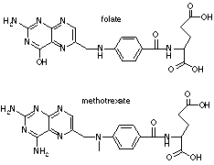

Slide 23
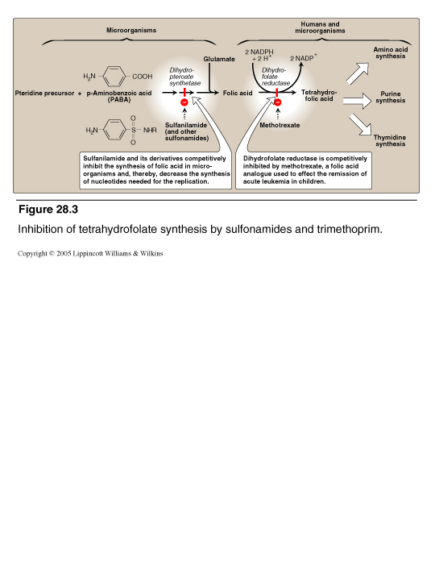
Can synthesize folate
Cannot synthesize folate

Slide 24
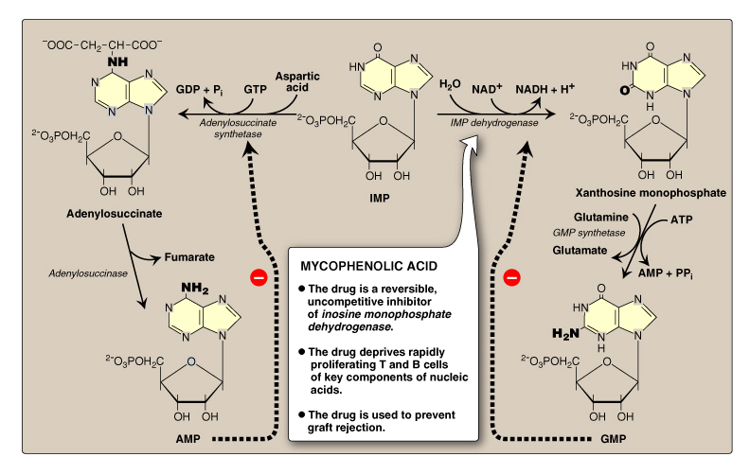
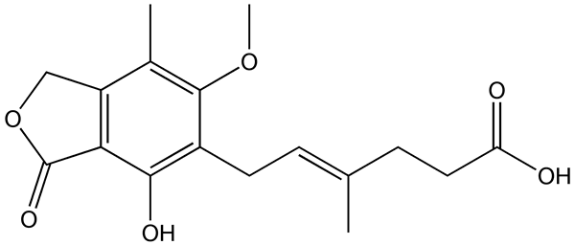
High levels shut down de novo purine synthesis
Mycophenolic acid

Slide 25
Regulation
KEY: Feedback Inhibition
  Purine biosynthesis: 3 sites:
    1) glutamine phosphoribosyl amidotransferase
    2) the reactions leading away from inosinate
    3) the reciprocal substrate relationship between GTP and ATP

Slide 26
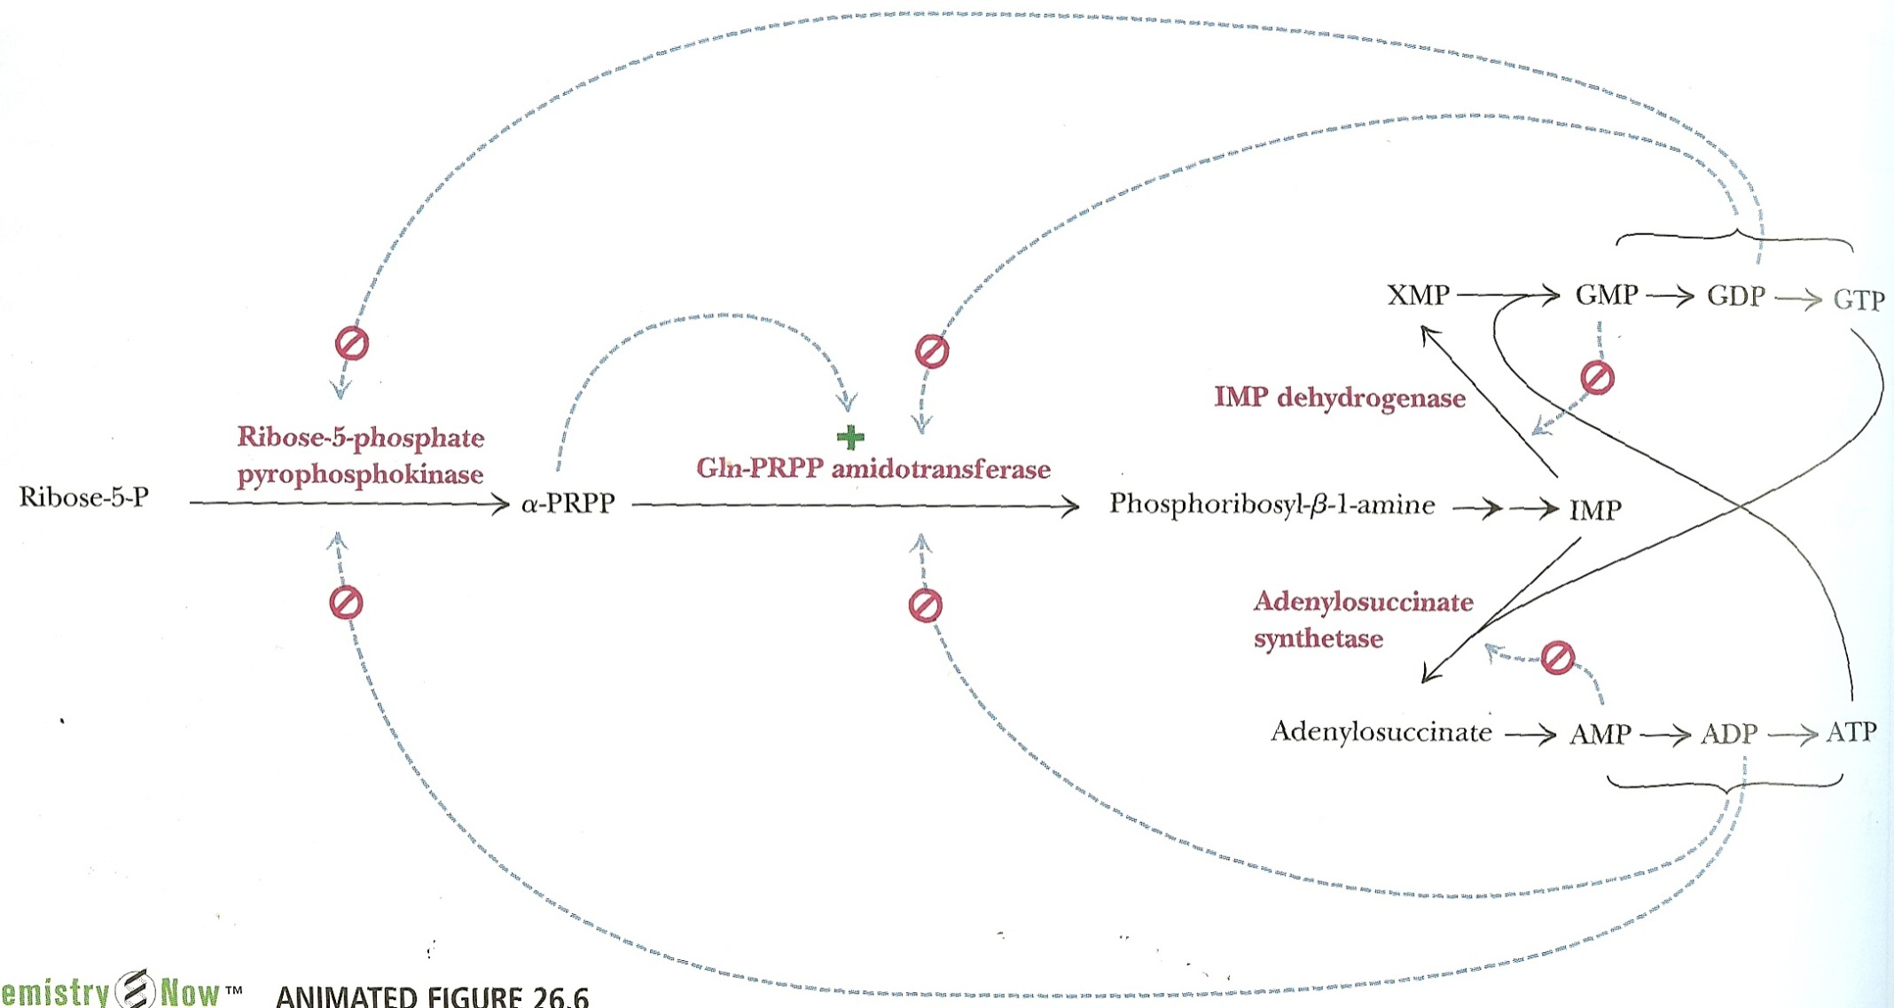
Another Look at Regulation
Fig 26.6

Slide 27
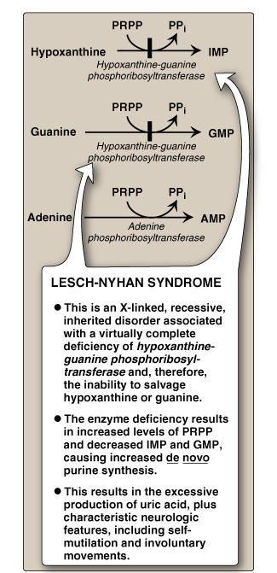
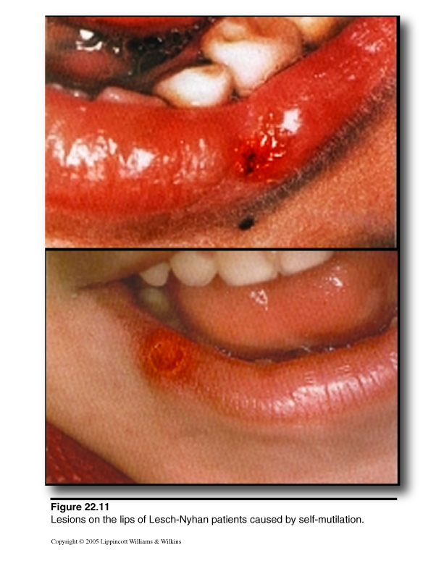
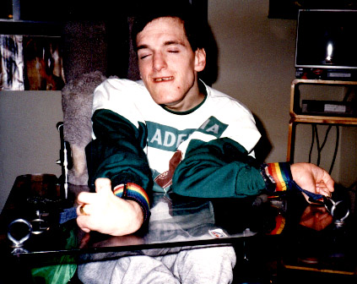
Lesch-Nyhan Syndrome
Build up of hypoxanthine and guanine
Degradation of hypoxanthine and guanine results in increased uric acid
Excess uric acid in urine often results in orange crystals in the diaper of affected children
Severe mental retardation
Self-mutilation
Involuntary movements
Gout

Slide 28
Purine Biosynthesis Summary:
Sulfonamides inhibit purine synthesis in bacteria by interfering with folate synthesis.
Methotrexate inhibits dihydrofolate reductase.
IMP, end product of de novo purine synthesis.
AMP, GMP, and IMP inhibit; PRPP is an activator.
Rate limiting step of the pathway and source of atoms for the purine ring.
Requires 4 ATP molecules.

Slide 29
Pyrimidine synthesis

Slide 30
Pyrimidine Synthesis
Pyrimidine ring: completely synthesized, then attached to a ribose-5-phosphate donated by PRPP
Source of carbons and nitrogens less diverse than purines.

Slide 31
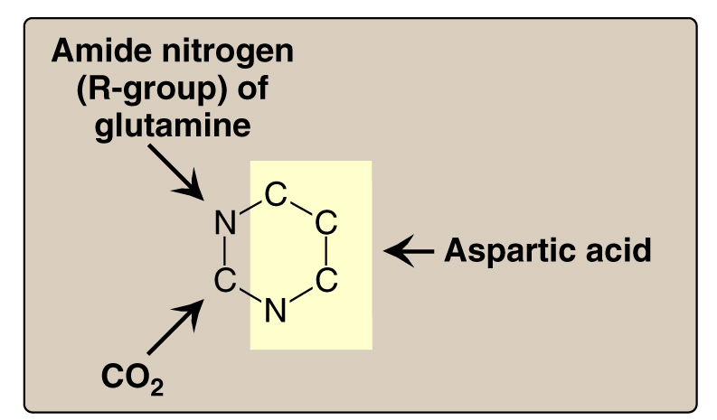
(Carbamoyl-P)

Slide 32
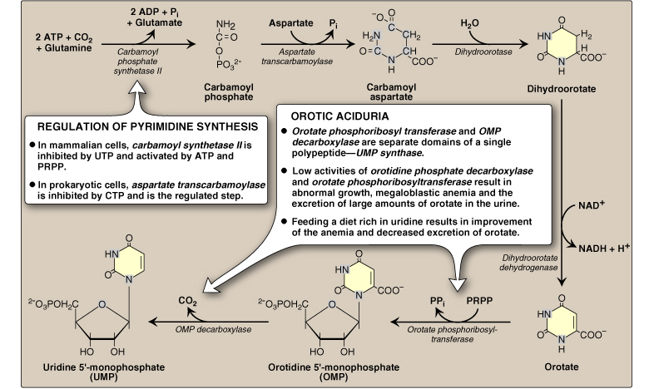
Enzymatic functions from one large protein (215,000 Mr)
Enzymatic functions from one large protein

Slide 33
Pyrimidine synthesis
Carbamoyl-phosphate synthetase II, Aspartate transcarbamoylase, Dihydroorotase, i.e. the CAD Complex (in mammals); located on the outer face of the inner mitochondrial membrane.
Orotate phosphoribosyltransferase and Orotidylate decarboxylase, i.e., the
  UMP Synthase

Slide 34
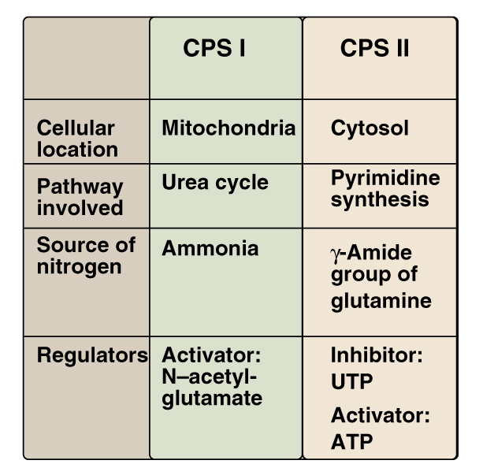
Urea Synthesis
Pyrimidine Synthesis

Slide 35
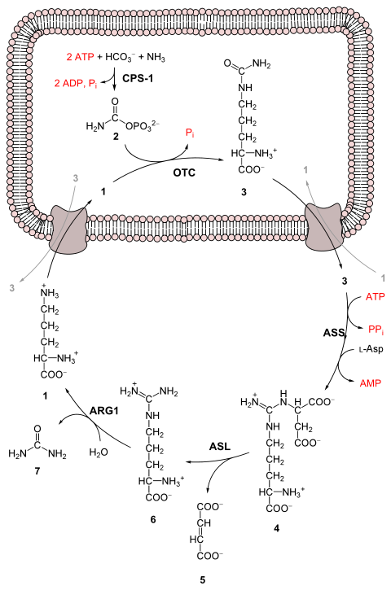
The Urea Cycle
CPS-1 carbamoyl phosphate synthetase I
OTC Ornithine transcarbamylase
ASS argininosuccinate synthetase
ASL argininosuccinate lyase
ARG1 arginase 1

Slide 36
    The reactions of the urea cycle
Step | Reactants | Products | Catalyzed by | Location
1 | NH₄⁺ + HCO₃⁻ + 2ATP | carbamoyl phosphate + 2ADP + P_{i} | CPS1 | mitochondria
2 | carbamoyl phosphate + ornithine | citrulline + P_{i} | OTC | mitochondria
3 | citrulline + aspartate + ATP | argininosuccinate + AMP + PP_{i} | ASS | cytosol
4 | argininosuccinate | Arg + fumarate | ASL | cytosol
5 | Arg + H₂O | ornithine + urea | ARG1 | cytosol

Slide 37
Regulation
KEY: Feedback Inhibition
  Pyrimidine Biosynthesis
    In bacteria: Aspartate Transcarbamoylase
    In both prokaryotes and eukaryotes: Carbamoyl phosphate synthetase

Slide 38
Pyrimidine Biosynthesis summary
CPSII, aspartate transcarbamoylase, and dihydroorotase are three enzymatic functions in one protein.
Orotate phosphoribosyltransferase and OMP decarboxylase are two enzymatic functions in one protein; deficiency = Orotic Aciduria.
Orotate, 1st pyrimidine base made, then attached to a PRPP.

Slide 39
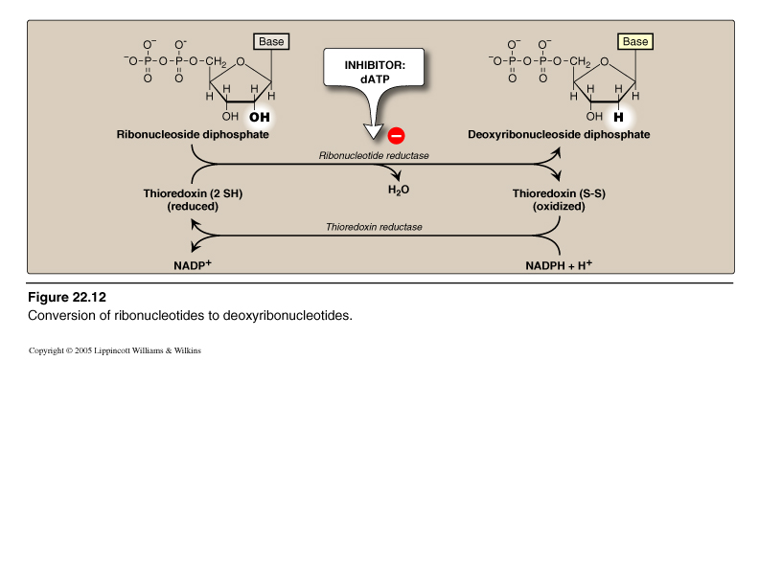
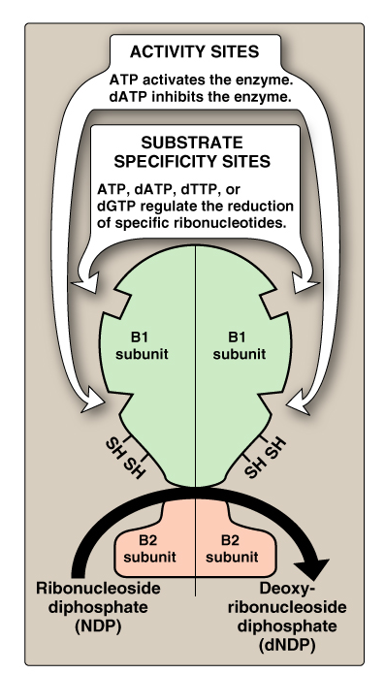
Ribonucleotides to Deoxyribonucleotides
Very Important!

Slide 40
Basis for Deoxyribonucleotide synthesis
High [ATP]
  plenty of energy, make DNA
  activation of ribonucleotide reductase is active (ON)
ATP
  in specificity site S favors CDP or UDP in catalytic site C → [dCDP] and [dUDP] ↑
dCDP and dUDP become metabolized to dTTP
[dTTP]↑, occupies specificity site favoring GDP in catalytic site; [dGP]↑ → [dGTP]↑
[dGTP]↑,occupies specificity site, favors ADP in catalytic site, [dADP]↑ → replace ATP in activity site and turn enzyme off

Slide 41
Overall Summary
Purines:
  Synthesis begins with PRPP, from Ribose 5-PO₄
  12 steps, from nine sources
  2 nucleotides
  Two-ringed structures
Pyrimidines:
  Synthesis begins with the pyrimidine ring, then attached to Ribose 5-PO₄
  6 to 7 steps, from three sources
  3 nucleotides
  Single ringed structures

