Slide 1
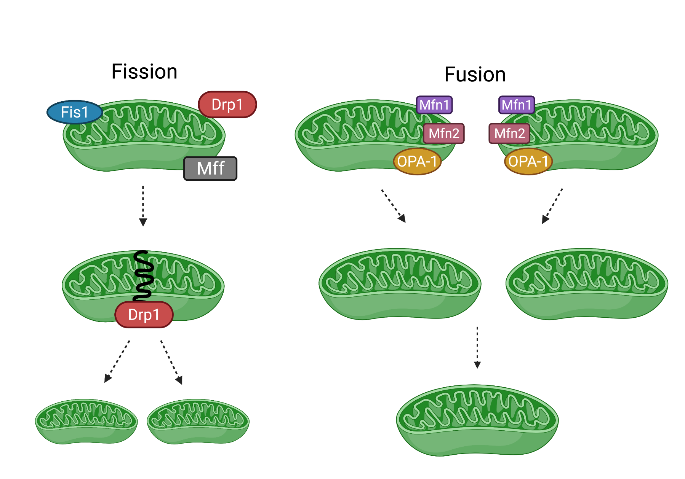
Alcohol-mediated changes in mitochondrial dynamics proteins in skeletal muscle of SIV-infected rhesus macaques
Mayrimar Marcano Santana, Danielle E. Levitt, Liz Simon, Patricia E. Molina
Department of Physiology, Comprehensive Alcohol-HIV/AIDS Research Center, Louisiana State University Health Sciences Center, New Orleans, LA
Background
Fission proteins
In the US, there are approximately 1.2 million people living with human immunodeficiency virus (PLWH).
PLWH have near normal life expectancies.
Heavy alcohol use is 2x as prevalent among PLWH.
May increase risk for myopathy.
Mitochondria are necessary to maintain skeletal muscle (SKM) mass.
Quality is controlled by fusion and fission.
Our recent work shows decreased expression of mitochondrial dynamics genes and bionenergetic health in SKM.
Naïve VEH CBA
Naïve VEH CBA
pDRP1
MFF
DRP1
β-Tub
β-Tub
Figure 2. Dynamin-related protein (DRP1) 1 phosphorylated at S616 (pDRP1) (left), total DRP1 (center) and mitochondrial fission factor (MFF) (right) normalized to β-Tubulin.
Fusion proteins
Summary & Conclusions
Chronic binge alcohol (CBA) did not dysregulate the expression of mitochondrial dynamic proteins in SKM of SIV infected female rhesus macaques.
It is possible that differences in pDRP1 at S616 would have been detected with a larger sample size. It is also possible that other post-translational modifications (e.g., pDRP1^{S637}, pMFF^{S155}, pMFF^{S172}) are more robustly affected by CBA.
Future experiments are planned to explore ex vivo SKM mitochondrial dynamic to discern the effects CBA on SKM in the context of SIV/HIV.
Hypothesis
Chronic binge alcohol decreases SKM expression of mitochondrial dynamics proteins in SIV infection.
Methods
MFN1
OPA1
Acknowledgements
Figure 1. Female rhesus macaque study design. Daily intragastric alcohol administration.
β-Tub
β-Tub
NIH/NIAAA
P60AA009803 (PEM)
F32AA027982 (DEL)
Conditions:
Naïve (N=8)
VEH/SIV/ART (N=8)
CBA/SIV/ART (N=7)
Figure 3. Mitofusin 1 (MFN1) (left) and Optic atrophy (OPA1) (right) normalized to β-Tubulin.
This research project was supported through the LSU Health Sciences Center, School of Medicine.

