Slide 1
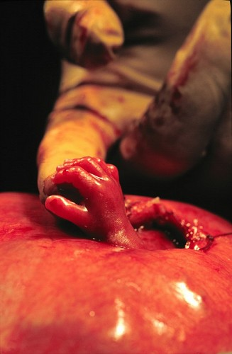
Outcomes and Controversies in fetal repair of myelomeningoceles
Lindsay Mayet Lasseigne
LSU School of Medicine, Class of 2014
September 13, 2013

Slide 2
Objectives
Discuss the basics of MMC
Overview of the MOMS Trials
Overview of the Endoscopic Trials
Summarize controversies of fetal repair

Slide 3
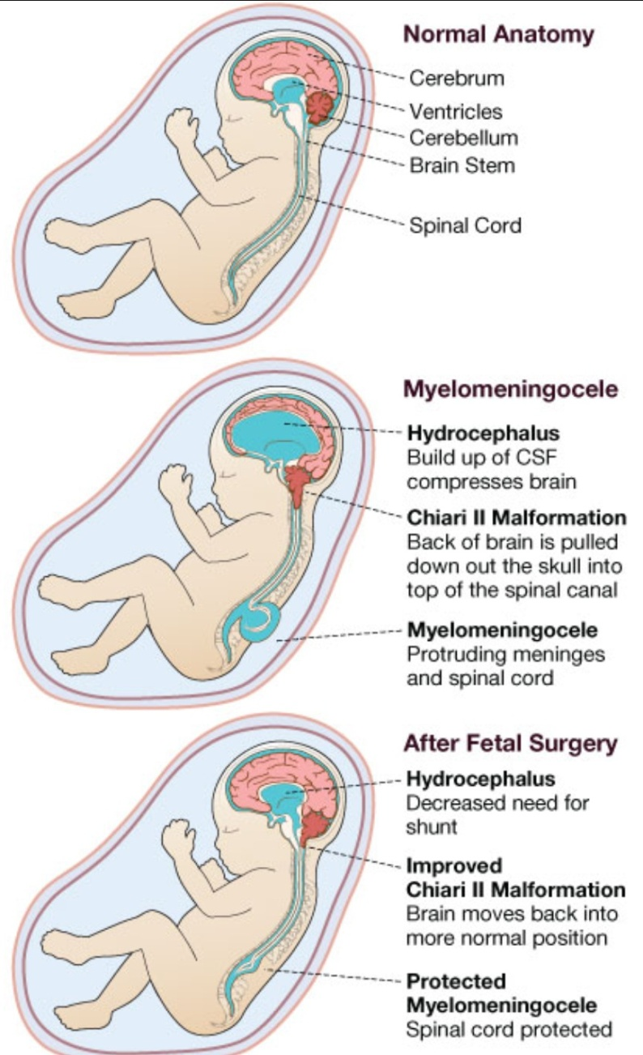
Facts about Spina bifida
#1 congenital CNS anomaly compatible with life - MMC is most common and severe - Lifelong disability
Chiari II Malformation:
Hindbrain herniation
brain stem abnormalities
low lying venous sinuses
small posterior fossa
motor/CN/cognitive dysfunction
Hydrocephalus

Slide 4
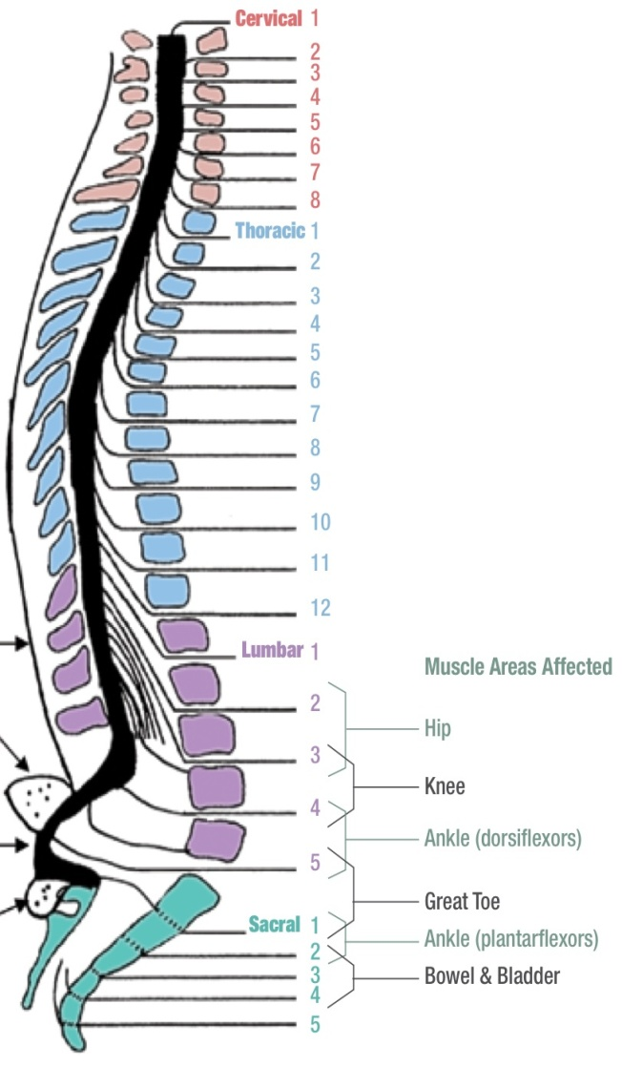
Facts about myelomeningocele
Caused by failure of the NT to close
1 in 2000 live births
14% die before age 5
2/3 due to complications of hindbrain herniation complications
85% require shunts
45% develop complications within 1 year
MMC can occur at any level in the developing spine
Most commonly lumbosacral

Slide 5
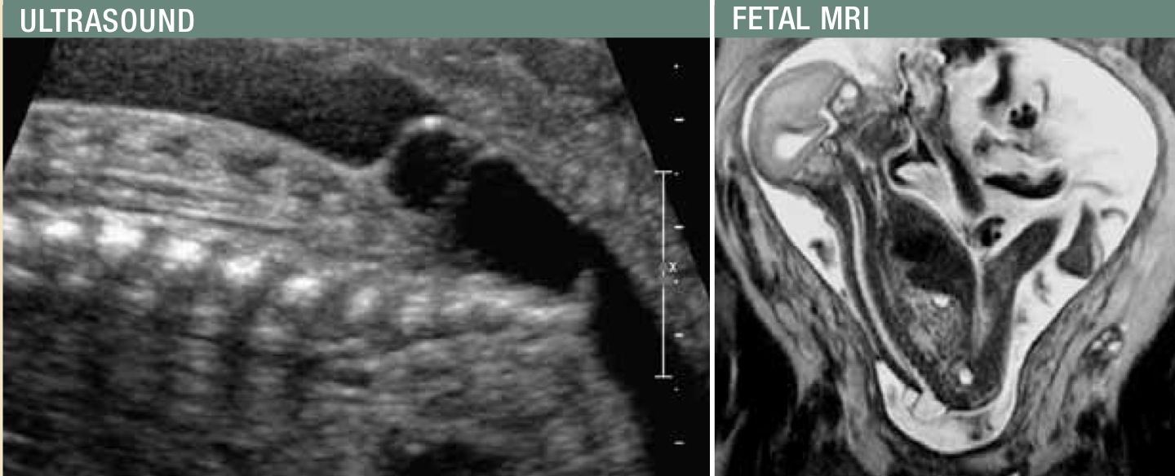
Diagnosing Fetal mmc
MSAFP
abnormally high can suggest NTD
Level II US:
to confirm spinal defect, determine level, and assess other characteristics
Amniocentesis
confirm elevated AFAFP and AChE

Slide 6
History of fetal interventions
1960s
Intrauterine Transfusions
1970s
Open Fetal Surgery
1997
First Open Repair of MMC
2004
>200 Open fMMC repairs
‘03-’10
MOMS & Endoscopic Trials

Slide 7
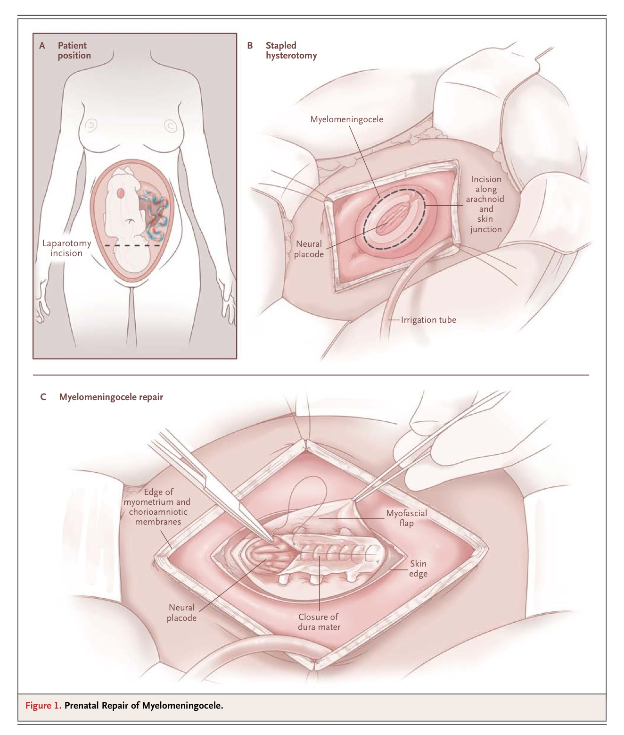
General
Anesthesia
Laparotomy
Hysterotomy
Fetal rotation
MMC resection
Closure +/- Graft
Closure of uterus
and abdomen

Slide 8
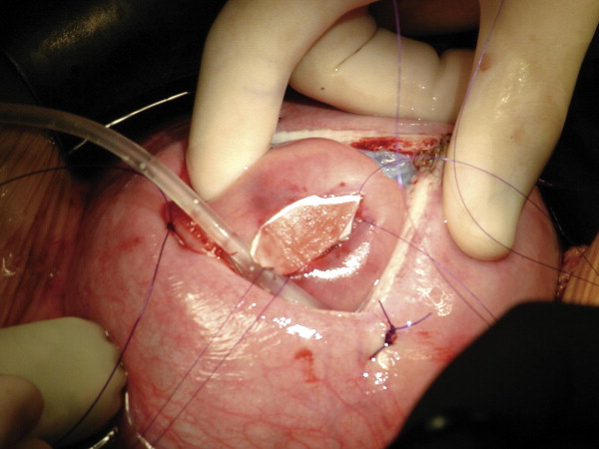
Open prenatal repair vs. postnatal repair of mmc
The MOMS Trials

Slide 9
Moms trials
- Inclusion criteria: singleton pregnancy, MMC with upper boundary b/w T1-S1, hindbrain herniation, <26 WGA, normal karyotype, US residency, maternal age >18
- Exclusion criteria: other fetal anomalies, severe kyphosis, risk of PTL, maternal BMI >35, contraindication to surgery
- Methods: Randomized 1:1 and Blind. Both groups: Same surgical teams and CS @ 37WGA

Slide 11
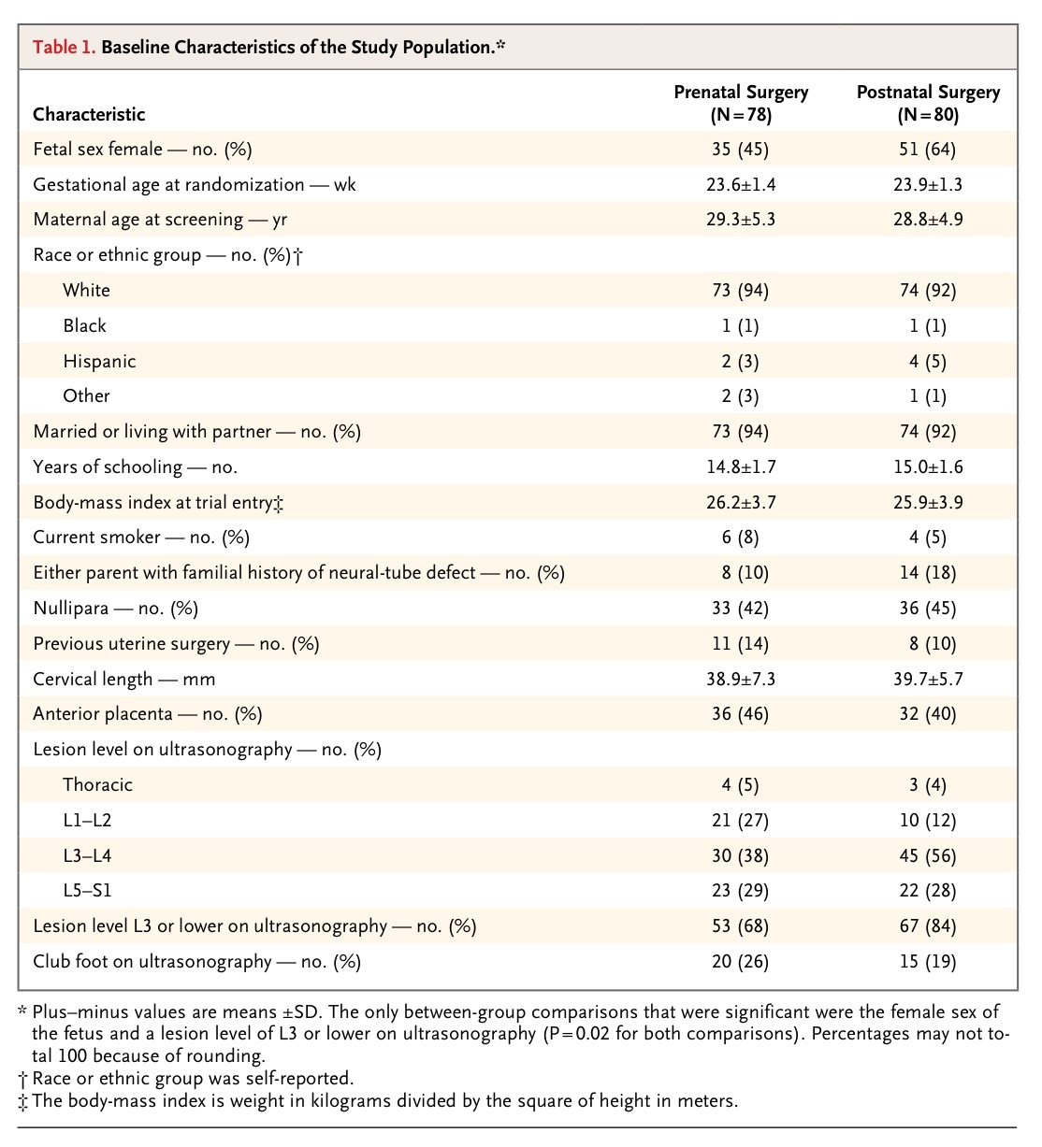
Study and control groups well matched for maternal and fetal factors with two major differences.
- The fetally repaired MMC subgroup had:
1. More female fetuses
2. More severe lesion levels

Slide 12
Outcomes to be measured
Primary outcomes
1) 12 months:
fetal or neonatal death
need for CSF shunt.
2) 30 months:
Mental Developmental Index of the Bayley Scales of Infant Development II
child’s motor function with adjustment for lesion level.
Secondary outcomes
surgical and pregnancy complications
neonatal M/M, Chiari II Malformation, time to first shunt placement
Locomotion
Functional impairment on PE
Motor and Functional Scores
Psychomotor Development Index of the Bayley Scales
Peabody Developmental Motor Scales
Disability measured by WeeFIM (functional independence measure for children) instrument

Slide 13
Maternal outcomes
Increased risks in prenatal surgery cohort:
Spontaneous membrane rupture (46% vs 8%)
Hysterotomy site dehiscence/ thinning (36% v 0%)
Spontaneous premature labor (38% vs 14%)
Chorioamniotic membrane separation (20% vs 0%)
Oligohydramnios (21% vs 4%)
Blood transfusions at delivery (9% v 1%)
Placental abruption (6% vs 0%)
Pulmonary edema (6% vs 0%)
Notes:
No maternal deaths

Slide 14
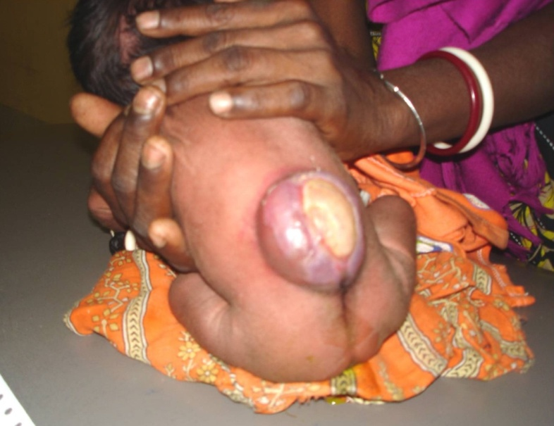
Neonatal outcomes
Increased risk in prenatal surgery cohort:
Preterm Labor (avg 34.1 WGA vs 37.3 WGA)
Respiratory Distress Syndrome (21% vs 6%)
Low birth weight (avg 2383 vs 3039g)
Apnea (36% vs 22%)
Bradycardia during repair (10% vs 0%)
Dehiscence at repair site (13% vs 6%)
Sepsis (5% vs 1%)
Patent Ductus Arteriosus (4% vs 0%)

Slide 15
12 month outcomes
Improvement of outcomes in fetally repaired group
First primary outcome: death/ shunt (68% vs 98%)
Shunt placement (40% vs 82%)
No evidence of hindbrain herniation (36% vs 4%)
Mod-severe hindbrain herniation (25% vs 67%)
Syringomyelia (39% vs 58%)

Slide 16
30 month outcomes
Improvement in fetally repaired group:
Second Primary Outcome:
Bayley Mental Development Index (89.7 vs 87.3)
Difference in motor function & anatomical levels
2 or more levels better (32% vs 12%)
1 level better (11% vs 9%)
2 or more levels worse (13% vs 28%)
Secondary Outcomes:
Bayley Psychomotor Development Index (64% vs 58%)
Peabody Developmental Motor Scales (7.4 vs 7.0)
Walking independently on exam (42% vs. 21%)

Slide 17
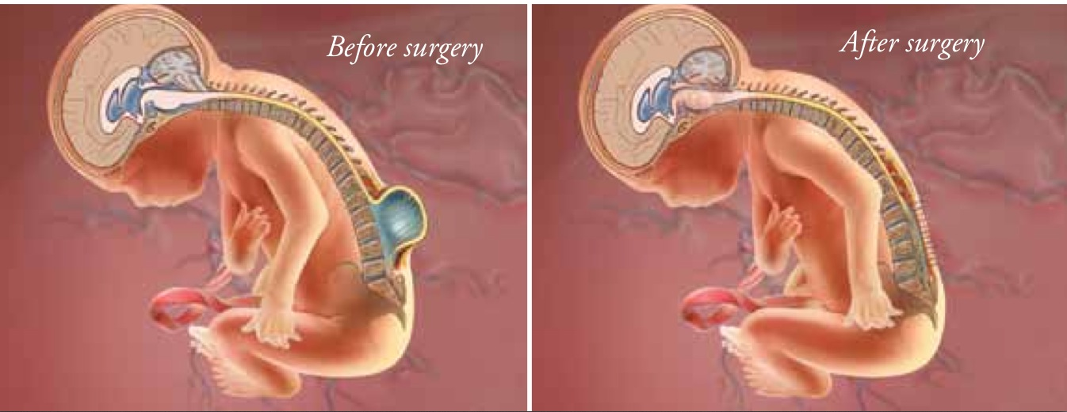
Moms trials summary
Convincingly shows open fetal surgery can improve neurologic outcomes
Associated with iatrogenic maternal and fetal risks
Continued follow up is needed to assess:
durability of early benefits
effects of prenatal intervention on bowel and bladder continence, sexual function, and mental capacity

Slide 18
Fetal endoscopic MMC closure & Segmental neurologic function

Slide 19
Endoscopic trials
13 of 19 surviving fetal patients repaired between 20-24 WGA
Compared with matched neonatal patients repaired during first week of life
All fSBA born by CS and all nSBA born vaginally.
To study potential influence by CS, included another 13 age and lesion matched pairs of nSBA delivered by CS

Slide 20
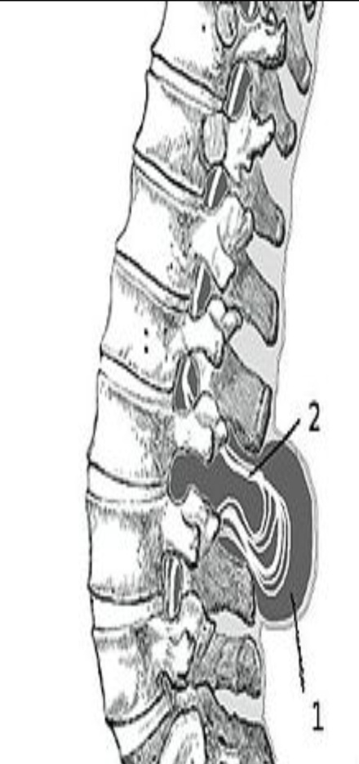
Background info
Leg movement distal to MMC are often present as fetus but can disappear shortly after birth.
Goal is to maintain leg motor function by preserving innervations
Aimed to elucidate effect of fetal endoscopic MMC repair on segmental neurological function caudal to MMC.
Investigation enhanced by recently advanced MRI techniques and noninvasive muscle US density

Slide 21
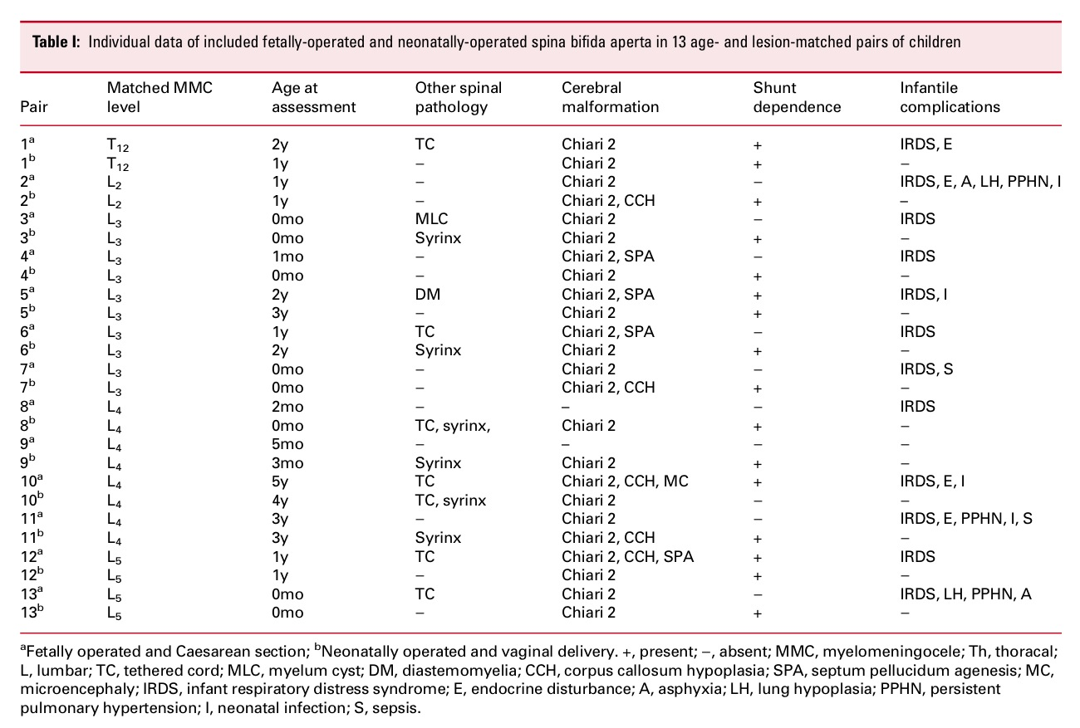

Slide 22
Endoscopic fetal vs. neonatal repair outcomes: motor/sensory
Segmental Motor Function
Segmental Sensory Function

Slide 23
Endoscopic fetal vs. neonatal outcomes: Muscle Ultrasound density
Notes:
?

Slide 24
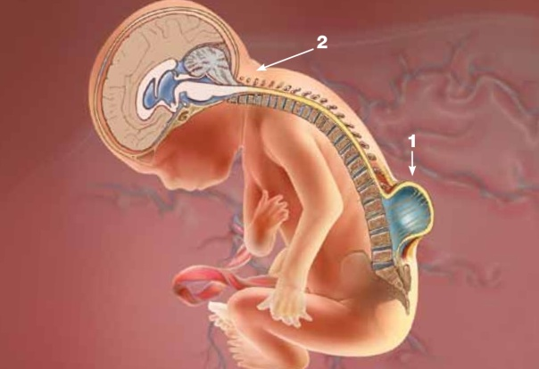
Discussion on endoscopic repair
Fetal endoscopic repair can provide fetal spinal neuroprotection
As with open surgery, observed severe iatrogenic complications
Limitations:
Infant age at time of study
Small number of cases assessed
Not blinded
Small differences between matched pairs
Only one pair with thoracic MMC

Slide 25
Fetal vs neonatal repair
A Discussion on Controversies

Slide 26
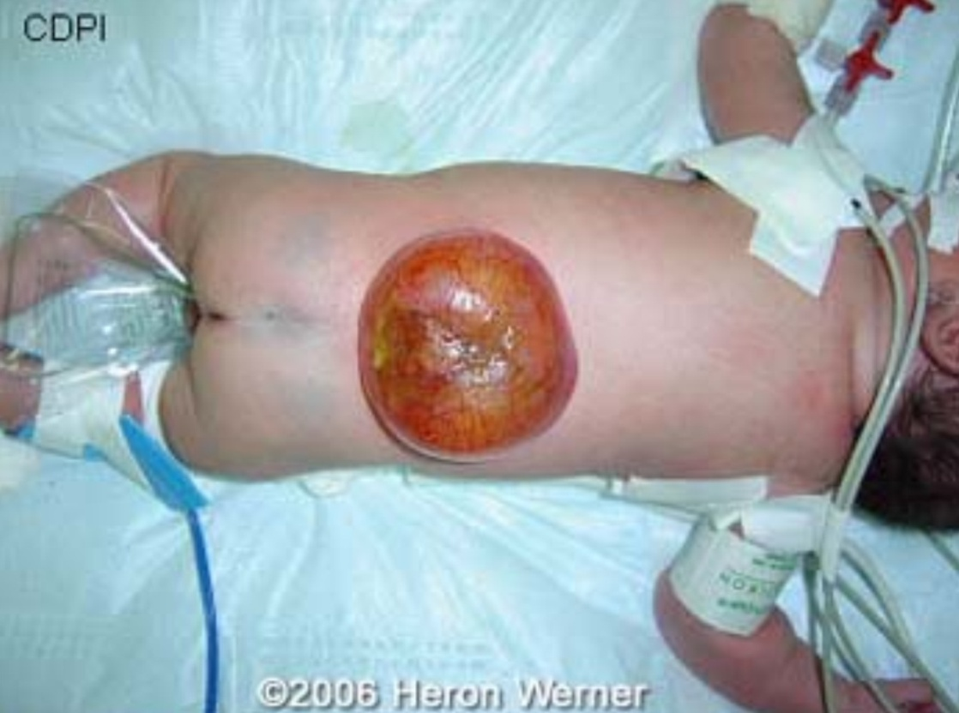
Current controversies

Slide 27
Professor mark johnson (supports fetal repair of mmc)
Prevents further traumatic and toxic injury to the exposed spinal cord
Improves neuromotor function and independent ambulation rates
Reduces the need for VPS and shunt related morbidity
Reduces Chiari II malformation and related morbidity and mortality secondary to reversal of hindbrain herniation
Decreases progressive ventriculomegaly and the need for shunting improves cognitive and neurodevelopmental outcomes

Slide 28
Professor Doug wilson (against fetal repair of mmc)
Primary prevention of NTDs is the major goal of perinatal counseling and preconception care.
New surgical innovations are required to decrease maternal and fetal risk in addition to improved genetic fetal triage for greater benefit from MMC repair
Complex informed consent is required. The risk and benefit balance for newborn and mother is a personal choice.
A limited number of open maternal fetal surgical centers should be supported with clear regulations and restrictions to decrease risks

Slide 29
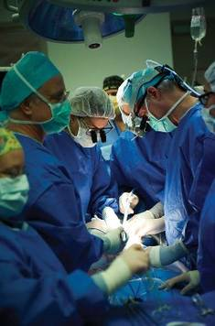
Both debaters
Primary prevention
is always best
Folic Acid
Fetal surgery has
to be offered in
the case of fMMC

Slide 30
Input from a pediatric neurosurgeon
Dr. Stephen Fletcher

Slide 31
Technical aspects
Fetal vs. Neonatal Closure
FETAL: 1. Fetal Graft → 2. Repair skin at birth →
3. Tissue expander → 4. Flap
+/- Hydrocephalus procedures: 5. Endoscopy → 6. Shunt
NEONATAL: 1. Closure → 2. Endoscopic
If fails → 3. Shunt
Time of Repair: Risk of preterm labor
Uterine stimulation is proportional to risk of PTL
Whether open or endoscopically repaired, both predispose uterus to similar amounts of stimulation

Slide 32
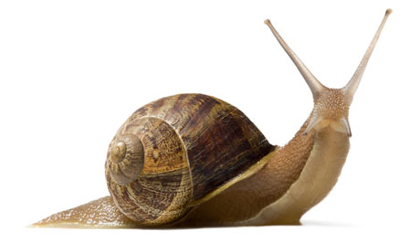
An example of research
To determine if fetal endoscopic placement of a patch without repair followed by neonatal repair provides neuroprotective benefit while decreasing iatrogenic risks
Technical aspects: “underwater glue” must be water tight
Sandcastle Snail

Slide 33
Dr. Fletcher’s Sheep trials
1. 1st delivery: Create MMC in fetal sheep via multilevel laminectomy and opening dura
2. Allow fetus to mature
3. 2nd delivery: patch placement with photoactivation
4. Allow fetus to mature
5. 3rd and final delivery of sheep
6. Sacrifice sheep
7. Assess with electron microscope
Total of 6 sheep
appears water tight (Proof of Concept)

Slide 34
Thoughts on fetal repair

Slide 35
Resources
Adzick NS, Thom EA, Spong CY, Brock JW, Burrows PK, Johnson MP, Howell LJ, Farrell JA, Dabrowiak ME, Sutton LN, Gupta N, Tulipan NB, D'Alton ME, Farmer DL; the MOMS Investigators. A Randomized Trial of Prenatal versus Postnatal Repair of Myelomeningocele. N Engl J Med. (2011)
Renate J RJ Verbeek, Axel Heep, Natalia NM Maurits, Reinhold Cremer, Eelco W EW Hoving, Oebele F OF Brouwer, Johannes JH van der Hoeven, and Deborah A DA Sival. Fetal Endoscopic Myelomeningocele Closure Preserves Segmental Neurologic Function. Developmental Medicine and Child Neurology 54(1):15 (2012)
M. Van Lith Jan M, Mark P. Johnson, R. Douglas Wilson. Current Controversies in Prenatal Diagnosis 3: Fetal Surgery after MOMS: Is Fetal Therapy Better than Neonatal? Prenatal Diagnosis 33, 13-16 (2013)
Children’s Hospital of Philadelphia; Fetalsurgery.chop.edu, <accessed 08/24/2013>
Dr. Stephen Fletcher, Associate Professor of Pediatric Neurosurgery , University of Texas Medical School and Memorial Hermann Children’s Hospital

