Slide 1
Seizures and Coma
Stephen Deputy, MD, FAAP
LSU School of Medicine
Children’s Hospital,
New Orleans, LA
John K. Willis, MD

Slide 2
Seizures
● Lifetime Prevalence
Single seizure: 9%
Recurrent seizure: 0.5%*
* The definition of epilepsy is that of a chronic condition characterized by the occurrence of recurrent, unprovoked
seizures

Slide 3
International Classification
of Seizures
Partial: local onset
- Simple: no LOC
- Complex: LOC
- Secondarily generalized
Generalized: bilateral onset

Slide 4
Classification of Epilepsies
Localization related
- Primary
- Secondary
Generalized
- Primary
- Secondary

Slide 5
Classification of Epilepsies
 | Focal Focal Seizures Focal EEG changes Normal EEG up to 60% “Narrow Spectrum AED” | Generalized Generalized Seizures EEG Abnormal “Always” Generalized Discharges “Broad Spectrum AED”
Idiopathic Normal Development Normal Exam Normal EEG Background Normal Neuroimaging Family History “Channelopathy” Easy to Treat | Rolandic Epilepsy | Childhood Absence Juvenile Myoclonic Epilepsies
Symptomatic Abnormal +/- Exam, Development, EEG Background, Neuroimaging Difficult to Treat | “Lesional Epilepsies” | Infantile Spasms Lennox-Gastaut Syndrome

Slide 6
EEG in Epilepsy
Usually only confirmatory
Treat patient, not EEG
Characteristic EEGs:
- Absence
- Lennox-Gastaut
- Infantile spasms
- Rolandic seizures

Slide 7
Seizure History
Aura, onset
Eye movements
Limb movements
Duration
Consciousness:
- To voice, pain
- Injury
- Incontinence
- Amnesia

Slide 8
Simple Partial Seizure Features:
“Focal motor seizure “/
“Focal sensory seizure”
Consciousness intact
Signs/symptoms variable
Motor
Somatosensory
Autonomic
Psychic
May have focal EEG abnormality

Slide 9
Partial Complex Seizures
● “Psychomotor,”
“temporal lobe”
● Limbic origin: frontal
or temporal
● Perceptual/emotional aura;
Carbamazepine to start
● Ictal starring
● Automatisms
● Postictal confusion

Slide 10
Benign Rolandic seizures
● “BERS”
● School age, normal child
● Partial: face, arm
Generalized: tonic-clonic
● Sleeping >waking
● EEG: mid-temporal/central spikes
● Outgrown in adolescence
● Rx: limit side effects
Carbamazepine, Benzodiazepines qhs

Slide 11
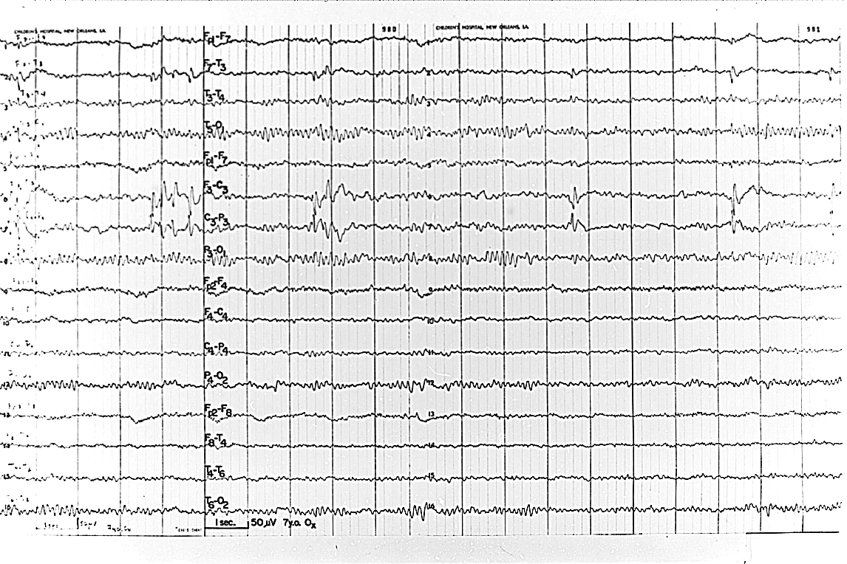
Rolandic Spikes

Slide 12
Classification of Epilepsies
 | Focal Focal Seizures Focal EEG changes Normal EEG up to 60% | Generalized Generalized Seizures EEG Abnormal “Always” Generalized Discharges
Idiopathic Normal Development Normal Exam Normal EEG Background Normal Neuroimaging Family History “Channelopathy” Easy to Treat | Rolandic Epilepsy | Childhood Absence Juvenile Myoclonic Epilepsies
Symptomatic Abnormal +/- Exam, Development, EEG Background, Neuroimaging Difficult to Treat | “Lesional Epilepsies” | Infantile Spasms Lennox-Gastaut Syndrome

Slide 13
Absence Seizures
Hyperventilation for Dx
Often clinical: daydreams
Automatisms
Brief, frequent
No postictal state
Normal child: 4-10 y.o.
May resolve in adolescence
Later epilepsy: 30%
Rx: Ethosuximide, Lamotrigine, valproic acid

Slide 14
JME
Juvenile myoclonic epilepsy
of Janz
Idiopathic/genetic: normal child
First convulsion after sleep loss/alcohol
Antecedent early-a.m. myoclonus:
incoordination, jerking
90% relapse off meds

Slide 15
JME
Normal exam/image
EEG: Generalized spike and wave: 3-6 hertz
Prior absence: 1/3
Photosensitive: 1/3
Valproic acid: first choice (?)
- Lamotrigine - Benzodiazepines - Barbiturates - Felbamate
- Ethosuximide - Topiramate
- Zonisamide

Slide 16
Classification of Epilepsies
 | Focal Focal Seizures Focal EEG changes Normal EEG up to 60% “Narrow Spectrum AED” | Generalized Generalized Seizures EEG Abnormal “Always” Generalized Discharges “Broad Spectrum AED”
Idiopathic Normal Development Normal Exam Normal EEG Background Normal Neuroimaging Family History “Channelopathy” Easy to Treat | Rolandic Epilepsy | Childhood Absence Juvenile Myoclonic Epilepsies
Symptomatic Abnormal +/- Exam, Development, EEG Background, Neuroimaging Difficult to Treat | “Lesional Epilepsies” | Infantile Spasms Lennox-Gastaut Syndrome

Slide 17
Infantile Spasms
Flexor/extensor spasms
Hypsarrhythmic EEG
Mental retardation: 90%
Symptomatic versus idiopathic:
Treatment: R/O tuberous sclerosis
- ACTH
- Steroids
- Valproate
- Vigabatrin

Slide 18
Lennox-Gastaut Syndrome
● “Minor motor seizures”
- Akinetic
- Myoclonic
- Absence
- Other
● Diverse etiologies
● Mental retardation
● Difficult control: try Valproate, Lamotragine, Topiramate

Slide 19
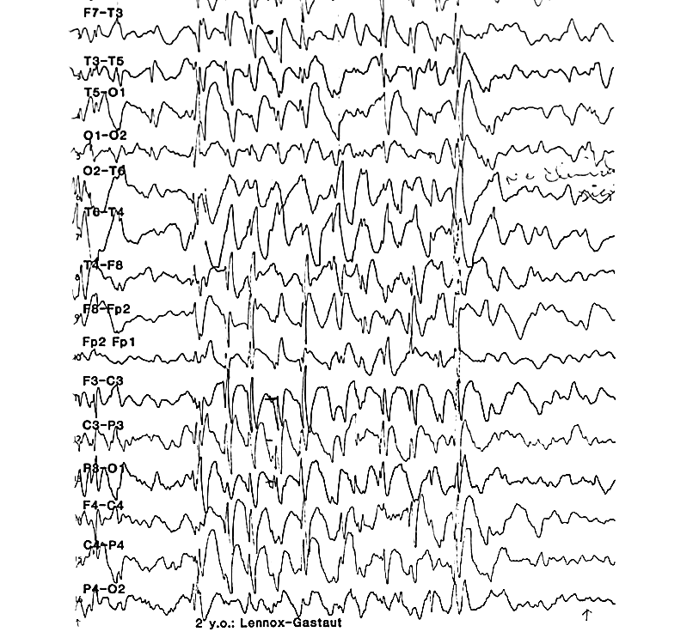
EEG: slow spike-wave

Slide 20
Classification of Epilepsies
 | Focal Focal Seizures Focal EEG changes Normal EEG up to 60% “Narrow Spectrum AED” | Generalized Generalized Seizures EEG Abnormal “Always” Generalized Discharges “Broad Spectrum AED”
Idiopathic Normal Development Normal Exam Normal EEG Background Normal Neuroimaging Family History “Channelopathy” Easy to Treat | Rolandic Epilepsy | Childhood Absence Juvenile Myoclonic Epilepsies
Symptomatic Abnormal +/- Exam, Development, EEG Background, Neuroimaging Difficult to Treat | “Lesional Epilepsies” | Infantile Spasms Lennox-Gastaut Syndrome

Slide 21
Anticonvulsants
Attempt monotherapy
Follow levels?
Watch cognition:
- Barbiturates
- Phenytoin
- Benzodiazepines
- Topiramate
- Valpoic
- Levetiracetam
(Any AED!)

Slide 22
Drug Issues
Neuroleptics, antihistamines: seizures (?)
Phenytoin/Carbamazepine toxicity
seizures
Interactions:
□ Valproate: [barbiturates] [lamotrigine]
□ Enzyme inducers
Levels (e.g., barbiturates, carbamazepine, phenytoin)

Slide 23
Drug Issues
Drugs that Lower Seizure Threshold
Anti-Histamines
Certain Psychotropic Meds
? Stimulants
Drug-Drug Interactions
Cytochrome P450 Inducers (Pb, DPH,
CBZ, Warfarin OCP’s, etc)
Macrolide Antibiotics and Carbamazepine

Slide 24
Drug Discontinuation
1-2 years seizure free:
75% without seizures off drug
Taper over 6 weeks
Recurrence: □ severe prior seizures
□ underlying disease
□ severe EEG abnormality

Slide 25
Initial Drugs (I)
● Seizure: partial or generalized
● EEG: normal or focal spikes
Carbamazepine (CBC, Na⁺) (Trileptal)
Barbiturates (Lamotrigine)
Phenytoin (CBC, LFT’s) (Topiramate)
Valproic acid (CBC, LFT’s) (Zonisamide)
(Keppra)

Slide 26
Initial Drugs (II)
● Seizure: generalized
● EEG: generalized spike-wave
Ethosuximide Felbamate (CBC, LFT’s)
Valproic acid Vigabatrin
Benzodiazepines Lamotrigine
Phenobarbital Topiramate
Zonisamide

Slide 27
Status Epilepticus
● Continual seizures
● May damage brain
● A medical emergency
● Remain calm:
- History, PE
- BS, Na, Ca, Mg
- Drug levels
- Supportive care

Slide 28
Status Epilepticus: Drugs
Glucose IV
Rectal Diastat 0.5 mg/kg
Lorazepam 0.05 mg/kg IV (Max 4mg)
or
Diazepam 0.3 mg/kg IV (Max 10mg)
Phenobarbital 20 mg/kg IV
over 20 minutes

Slide 29
Status Epilepticus: Drugs
Phenytoin 20 mg/kg IV ≤50 mg/min
(Fosphenytoin: up to 150 mg/min)
Infusions IV:
Midazolon 0.15 mg/kg bolus
≥1 μg/kg/min
Pentobarbital 10-15 mg/kg bolus
0.5-1.5 mg/kg/hR
EEG: burst-suppression

Slide 30
Neonatal Seizures
Fragmentary, multifocal, antonomic (apnea, HR)
Usually brief, not life-threatening
Etiology not pharmacology : structural, vascular, infectious, metabolic
EEG : rhythmic discharges

Slide 31
Febrile Seizures <5% incidence: 20% if familial
Age 6 month to 6 years
Brief, generalized: “simple”
Long, focal, repeated: “complex”
30% recurrence after One
(Risk Factors for Recurrence: Early Age, Family Hx, Low Fever, Multiple Prior FSz’s)
R/O meningitis
(LP if altered MS, nuchal rigidity, prior antibiotic use, age <12 months)

Slide 32
Febrile Seizures
? Treat if recurrent or prolonged
- Phenobarbital maintenance
(Concerns about Cognition)
- Valproate maintenance
(Concerns about hepatotoxicity)
- PRN Diazepam
(Concerns about tolerability and timing of dose)

Slide 33
Febrile Seizures (II)
EEG: not useful
CT/MRI: not useful
Look for Cause of Illness

Slide 34
Febrile Seizures (III)
Later epilepsy:
- 1%: no risk factors
- 10%: two risk factors
Risk factors:
Abnormal child
Complex Febrile Seizures
Family history of epilepsy
Multiple Febrile Seizures

Slide 35
Epilepsy: Imaging
Ultrasound: poor
CT
MRI: better than CT
PET: glucose metabolism
- EEG correlation

Slide 36
Pertussis
Disease produces neurologic morbidity and disease
Vaccine poorly linked to neurologic morbidity
Defer vaccine only after a reaction: controversy (unjustified)

Slide 37
Breath-Holding Spells (I)
5% incidence
Familial: ? dominant
Anemia/iron deficiency
Resolve spontaneously: 5 years old
Sequel: neurocardiac syncope (17%)

Slide 38
Breath-Holding Spells (II)
Stereotyped sequence:
Pain/fright/anger
Cry briefly
Hold breath
Cyanosis or pallor (bradycardia)
Loss of consciousness
Limp/stiff/jerking
Rare lengthy seizure

Slide 39
Breath-Holding Spells (III)
If sequence atypical:
- R/O seizure: EEG
- R/O arrhythmia (long Q-T): EKG
Consider iron therapy
Horizontal position
Anticonvulsants for long seizure
Reassurance (“My kid did that.”)

Slide 40
Tics
● Rapid movements:
Stereotypic
in sleep
Brief voluntary suppression
● Rx: Haloperidol (usually unnecessary)

Slide 41
Masturbation
(Infantile Gratification Syndrome)
● Boys: obvious
● Girls: rubbing legs together
pelvic movements
● Dx often not welcome

Slide 42
Sleep Disorders
▪ Hypnic Jerks
▪ Sleep Apnea
▪ Parasomnias
Night Terrors
Sleep Walking/Talking
▪ ? polysomnogram

Slide 43
Syncope
▪ Brief LOC (< 2 min)
▪ No subsequent confusion
▪ Rare tonic-clonic movements
▪ May convulse if held upright

Slide 44
Syncope (Continued)
▪ Precipitants:
- Dehydration, fasting
- Prolonged standing/arising: adolescents
- Noxious stimuli:
Ven. Puncture
Hair-pulling
▪ With exercise, swimming: R/O cardiac
▪ EKG appropriate

Slide 45
Pseudoseizures
▪ Psychogenic (Conversion Disorder)
▪ some may also have epilepsy
▪ 1/3 females had sexual abuse
▪ Dx:
No EEG change during seizure
Interrupt or Bring On with
Distraction or Suggestion

Slide 46
Clinical Tips
Continued crying ≠ seizure
Continuing activity (feeding, play) ≠ seizure
Interruption by pain (pinch finger) ≠ seizure
Parental history (?): video
Not post-ictal after generalized shaking: ?? seizure

Slide 47
Coma
Coma Substrate
Both cerebral hemispheres
and/or
Brainstem (ARAS)

Slide 48
Basis for Coma
Metabolic disease
versus
Structural disease

Slide 49
Coma Exam I
Observe, document
Avoid jargon
Repeat
Think anatomy

Slide 50
Coma Exam II
Alertness:
Spontaneous, induced
Movement:
Spontaneous, induced
Respirations
Reflexes
Cranial nerves

Slide 51
Motor Patterns
Hemiparesis
Decorticate
Decerebrate
Decerebrate & flaccid legs

Slide 52
Respirations
Cheyne - Stokes: diencephalon
Central neurogenic HV: midbrain ─ rare
Apneustic/cluster: pons
Ataxic: medulla

Slide 53
Reflexes
DTRs
Plantars
Superficial

Slide 54
Cranial Nerves
▪ EOM:
Spontaneous
Doll's eyes
Calorics
▪ Pupils:
Size
Reaction
▪ Corneal reflex
▪ Facial movement
▪ Gag reflex

Slide 55
Uncal Herniation
Temporal lobe hits
▪ 3rd nerve
▪ Peduncle (midbrain)
▪ Post. cerebr. art.

Slide 56
Cerebellar Herniation
Uncommon
Brainstem signs
Cushing's triad

Slide 57
Metabolic Screens
Sugar ABG
Sodium toxins
Potassium drugs
BUN NH3
Calcium LFT

Slide 58
Structural Disease
Infarct Blood
Edema Demyelination
Tumor Inflammation/ Infection
Pressure Degeneration

Slide 59
Pitfalls
Metabolic needs
Evolving structural
Vital functions
Psychogenic: response to pain/airway occlusion

Slide 60
Lumbar Puncture
Indication: ? Meningitis
Defer with:
Structural disease
Increased intracranial pressure

Slide 61
Coma
EEG
- Cerebral state
- Metabolic state
- Non-Convulsive Status
Evoked potentials
Predictive if insult diffuse
Intracranial pressure:
Direct monitoring

Slide 62
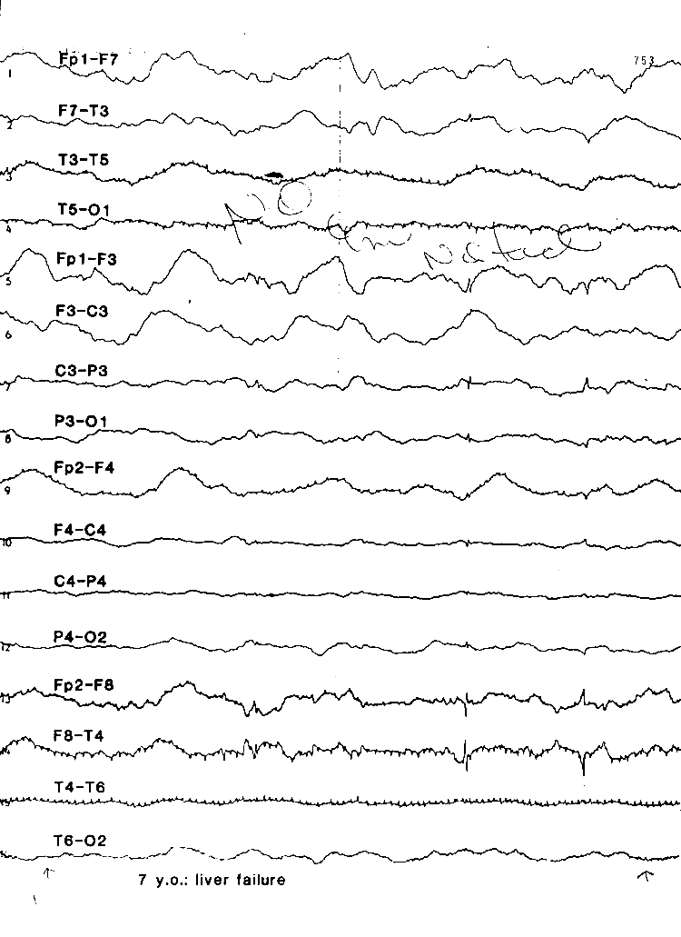
EEG: diffuse slowing suggests generalized cerebral dysfunction. EEG cannot identify etiology.

Slide 63
Intracranial Pressure Treatment
Hyperventilation (pCO₂< 30)
Steroids
Hypothermia
Osmotic (mannitol)
Barbiturate coma
Surgical

Slide 64
Herpes Simplex Encephalitis
HSV I, HSV II
Fulminant
Temporal lobe after age 2 years;
Anywhere in infants and newborns

Slide 65
Herpes Simplex Encephalitis
Diagnosis:
CSF: PCR
CT/MRI →
EEG →
Biopsy →
Treatment: acyclovir
Biopsy usually unnecessary

Slide 66
Brain Death
Clinical criteria
No movement
No respiration (pCO2 = 60)
No brainstem reflexes
No sedative toxicity
No hypothermia (92°F)

Slide 67
Brain Death
Acceptable clinical events
Deep tendon reflexes
Limbs withdraw to pain
Agonal movement

Slide 68
Brain Death
Ancillary tests
EEG: activity may persist
Cerebral perfusion: may persist
Evoked potentials:
SEP: peripheral components
BAER: wave I only
VEP: absent

Slide 69
Thank You sdeput@lsuhsc.edu

