Slide 1
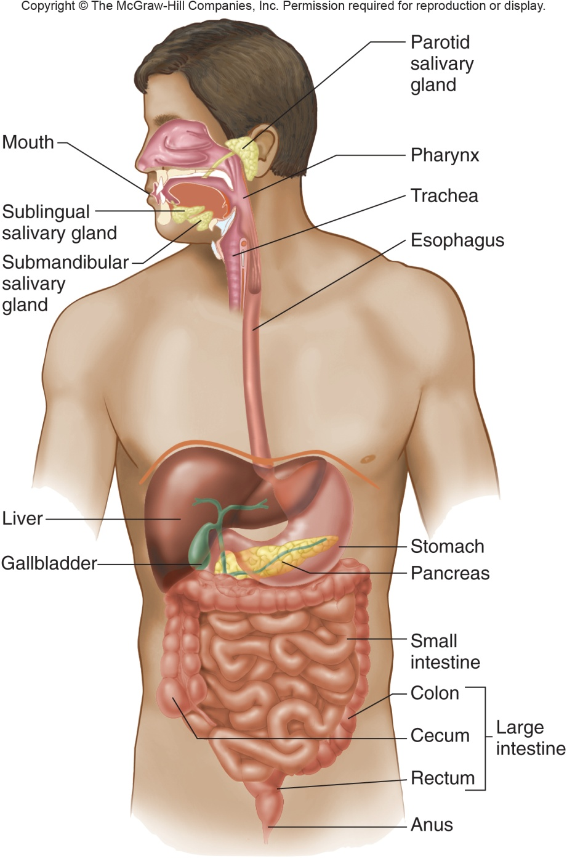
Digestion and Absorption
Water, Electrolytes and Carbohydrates
GI PHYSIOLOGY
Gregory J. Bagby, PhD
Rozas Professor of Physiology
CSRB Rm 3B9/310
gbagby@lsuhsc.edu
504-568-6188

Slide 2
Text for Lectures
Raff and Levitzky
  Lecture 1 – Ch 49
  Lecture 2
    Ch 51, pp 522-525
    Ch 50
  Lecture 3
    Ch 51, pp 517-522
    Ch 55-56
  Lectures 4-5
    Ch 54
  Lectures 6-7
    Ch 58-59
Barrett
  Lecture 1 – Ch 1 and 2
  Lecture 2
    Ch 4, pp 70- 76
    Ch 3
  Lecture 3
    Cp 4, pp 57-69
    Ch 10-12
  Lectures 4-5
    Ch 7-9
  Lectures 6-7
    Ch 15-16

Slide 3
CHO and Protein Digestion and Absorption
Lecture 6: Objectives
Understand mechanisms and regulation of water and electrolyte secretion and absorption
Understand the barriers to assimilate dietary water-soluble carboydrates and proteins into the body
Describe dietary sources of carbohydrate, pathways of digestion and absorption of CHO polymers, dietary disaccharides and monosaccharides
Compare protein digestion and absorption with CHO
Describe protein digestion and absorption, and the importance of dietary essential amino acids
Describe pathways leading to absorption of vitamin C and vitamin B₁₂

Slide 4
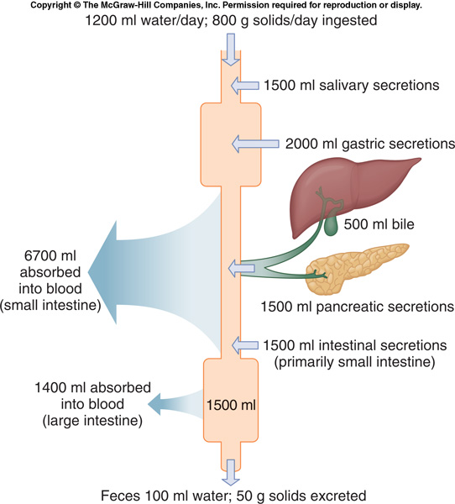
Ins and Outs of Water Along the GI Tract
Ins ~ 8,200 ml/day
  Ingested ~1,200 ml/day
  Secreted via salivary glands, gastric, pancreas,
  liver and intestines ~ 7,000 ml/day
Outs ~ 8,200 ml/day
  Absorbed by small intestines and colon ~8,100 ml/day
  Excreted in feces ~100 ml/day
1500
2000
500
6700
1500
1500
1400

Slide 5
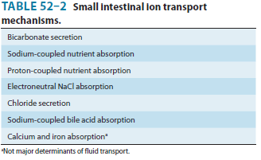
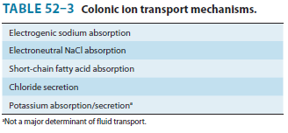
Postprandial and Interdigestive Period
Secretion and Absorption of Water
Water transported passively in response to osmotic gradients created by electrolyte and/or nutrient transport
Postprandial period – Absorption predominates over secretion
  Fluid absorption passively driven by electrolyte and nutrient absorption
Interdigestive period – Secretion matched to absorption
Absorption predominates secretion regulated
*
*

Slide 6
Location of Water Secretion and Absorption
Absorption
  Villi epithelial cells
  Follows Na⁺ coupled
  nutrient transport
Water Secretion
  Crypt epitheial cells
  Follows Cl⁻, HCO₃⁻
Digestive phase
  Postprandial phase – regulated independently
  Interdigestive phase – in balance

Slide 7
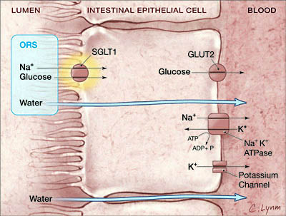
Cellular Basis of Water Absorption: Osmotic Gradient Created by Electrolyte and Nutrient Absorption
Na⁺ coupled nutrient absorption
  Glucose-coupled sodium absorption
    Galactose
  Specific amino acids similar to glucose
Water follows
  Transcellular
  Paracellular with anions (Cl⁻)
Small intestine
Cl⁻
Duggan et al JAMA 291: 2628, 2004
Notes:
In proximal tubule cell it’s SGLT-2 according to L H-B but otherwise similar

Slide 8
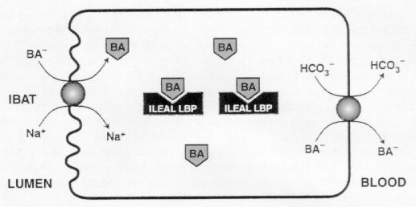
Na⁺- Coupled Bile Acid Absorption in the Terminal Ileum
OST
Bahar RJ and Stolz A. Bile Salts: Metabolic pathologic, and therapeutic considerations, Gastroenterology Clinics 28: 27-57, 1999 {Copyright © 1999 W. B. Saunders Company}
Notes:
sodium-dependent ileal bile acid transport (IBAT) same as apical sodium-dependent bile salt transporter (asbt)
ileal lipid binding protein (I-LBP)
OST – basolateral organic solvent tramsporter

Slide 9
Interdigestive Phase of Na⁺-Coupled
Water Absorption in the Small Intestines and/or Colon – Replaces SGLT-1
Small intestine and colon
Electroneutral NaCl absorption with water paracellular absorption
Colon
Electrogenic Na⁺ absorption (ENaC) with Cl⁻ and water paracellular absorption

Slide 10
Cl⁻-Coupled Water Secretion: Osmotic Gradient Created by Chloride Secretion
Na+-coupled Cl⁻ secretion in the
cryptic epithelial cells
  Basolateral membrane
    Na⁺/K⁺/2 Cl⁻ cotransporter
    (NKCC1)
    K⁺ recycled via channel
    Na⁺/K⁺ ATPase pump is
    driving force
  Apical membrane
    CFTR Cl⁻ channel
    Electrogenic – Paracellular Na⁺ secretion
    Paracellular osmosis
water
Notes:
First sign of CF in neonates in that they don’t poop – constipated. No delivery of fluid to the GI tract from the gut and pancreas.

Slide 11
Stimulators of Chloride (& Bicarbonate) Secretion
Neural (stretch, stroke by
contents)
  Short reflex (ENS) – VIP,
  ACh (Cl⁻ & HCO₃⁻)
  Long reflex (vagovagal) –
  stretch receptors -ACh
  CNS initiated probable
Paracrine (stroke by contents)
  5-HT via enterochromaffin cells (Cl⁻ burst)
  Prostaglandins via myofibroblasts – Cl⁻ & HCO₃⁻
  Histamine
Luminal stimulators
  Guanylin – a peptide that stimulates Cl⁻ & HCO₃⁻ secretion
  Bile acids – acts in the colon to stimulate chloride secretion (responsible for bile acid induced diarrhea seen with disease)
Chloride

Slide 12
Regulation of Intestinal Chloride Secretion
Cl⁻ active transport (continued)
  Apical CFTR channel
  regulated to secrete Cl⁻
    VIP and prostaglandins via
    cAMP and PKA phosphorylates
    to open CFTR
  Open basolateral NKCC1 channels promote Cl⁻ secretion
    ACh and histamine (bile acids) increase cytosolic Ca⁺⁺ which opens NKCC1 channel
    Relies on open CFTR channel
  Synergistic
Ca⁺⁺
K⁺
ACh
Histamine

Slide 13
Regulation of GI Bicarbonate Secretion
Prominent in the proximal duodenum
Protect against injurious acidic gastric juice
    Stimulus – decreased pH
    Mediators: Prostaglandins, ACh, guanylin
    Intracellular signals: cAMP, cGMP or calcium
    Mechanism of secretion of HCO₃⁻
      Electroneutral CFTR Cl⁻ coupled counter transport
      Electrogenic HCO₃⁻ via the CFTR channel (replaces chloride)

Slide 14
Pathophysiology: Increased Chloride Secretion
Results in Severe Diarrhea
Ordinary
  Postprandial - Absorption predominates
  Interdigestive period – Matched
Cholera-induced diarrhea
  Toxin irreversibly activate Gs to cAMP and Cl-/water secretion (20 l/day)
  Dehydration
  Nutrient-coupled absorption not opposed by pathways that stimulate Cl⁻ secretion
    Oral-rehydration solutions (contain nutrients like glucose) effective in treating dehydration accompanying severe diarrhea
glucose
Vibrio cholerae, toxin - incr Gs protein – cAMP – Cl⁻ secretion
Notes:
Diarrhea can result from increased chloride ion secretion – luminal load exceeds absorption capacity. Colera caused by the bacterium Vibrio cholerae secretes a toxin irreversibly activates the Gs G-protein thereby increasing cAMP. This stimulates chloride ion secretion and inhibits electroneutral NaCl absorption

Slide 15
Other Diarrheas
Infectious diseases
  Salmonella
  Clostridium difficile (antibiotic-disrupted microflora) – toxin that increases iCa⁺⁺
  E. coli – heat-stable toxin homology with guanylin
Noninfection (immune and inflammatory mediators) - Inflammatory bowel diseases
  Crohn/s disease
  Ulcerative colitis

Slide 16
CHO Digestion and Absorption
Role and Significance
Major source of calories
  CHO – glucose – energy
  Storage - glycogen
Building blocks for molecules needed by the body
  Proteins – amino acids (esp. essential a.a.)
Excess to fat

Slide 17
CHO Digestion and Absorption
The Carbohydrates
Main digestible CHO
  Dissacharides - sucrose, lactose
  Starch (polymers of glucose) – two forms
    Amylose – straight-chain of glucose (no branching)
    Amylopectin – branched polymer of glucose
“Nondigestible CHO (fiber) - can’t be degraded by mammalian digestive enzymes
  Provides bulk to stool
  Bacterial hydrolases can breakdown
    Energy for bacteria
    Absorbable byproduct - short-chain fatty acids

Slide 18
CHO Digestion and Absorption
Barriers to CHO Absorption
Molecular size and polarity prevents flux across membranes of the gut epithelial cells
To prepare for absorption, macromolecular forms of CHO must be broken down to transportable forms by digestive enzymes
  Lumen of the small intestines
  Membrane bound hydrolases in the microvillus epithelial cell apical membrane (or brush boarder)

Slide 19
CHO Digestion and Absorption
Luminal and Brush Boarder Digestion
Luminal amylases
  Salivary amylase
  Pancreatic amylase
Brush boarder hydrolases (synthesized by and anchored to apical membrane of enterocytes)
  Sucrase
  Isomaltase
  Glucoamylase
  Lactase
Salivary amylase (decreased by acidic pH)
Protected by substrate binding
Infants (important)
Pancreatic insufficiency (CF)
Notes:
Anchored by a single transmembrane segment. Heavily glycosylated (protect)

Slide 20
CHO Digestion and Absorption
Substrates and Enzymes of CHO Digestion
Luminal
Brush boarder hydrolases
Glucose
α1,4 bond
Amylose
Glucoamylase
Sucrase
Isomaltase
Amylase
Amylopetin
Glucoamylase
α1,6 bond
Isomaltase**
Glucoamylase
Sucrase
Isomaltase
Absorbable monosaccharides

Slide 21
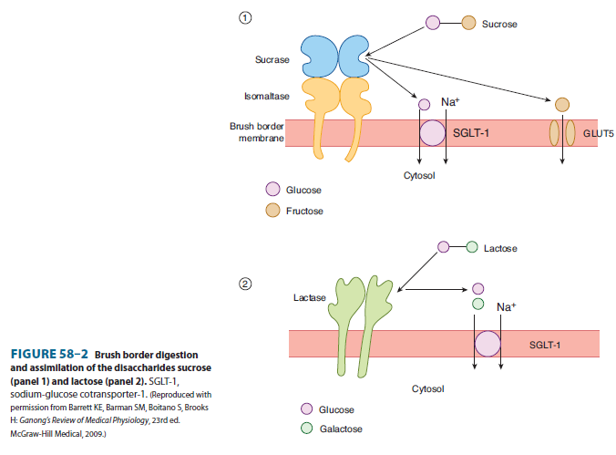
CHO Digestion and Absorption
Villus Enterocytes Disaccharide Digestion and Absorption
Disaccharide digestion by brush boarder enzymes
  Sucrase – sucrose
  Lactase – lactose
Uptake is rate-limiting step for products of sucrose
Lactase activity can be rate-limiting for lactose
  Declines with development
  Glucose inhibits
Basolateral membrane – GLUT2 and -5
Sucrose
Sucrase
GLUT5
Brush boarder membrane
glucose
fructose
cytosol
Lactose
glucose
galactose
cytosol

Slide 22
CHO Digestion and Absorption
Developmental Effects
Brush boarder enzymes in place before birth
Pancreatic amylase low in infants (increases gradually over the first year) – importance of salivary amylase
Lactase declines after weaning
Diet plays a role for expression of both enzymes

Slide 23
CHO Digestion and Absorption
Regulation of CHO Digestive Enzymes
Short-term – digestive state
  Enzymes degraded by pancreatic proteases at the end of each meal
  True of other brush boarder digestive enzymes,
  e.g. proteases
Long-term – dietary regulation
  Hydrolases, transporters and amylase adjust to changes in CHO in diet
  Insulin suppress synthesis of these enzymes
    Increased in Type 1 diabetes mellitus

Slide 24
Protein Digestion and Absorption
Protein Assimilation
Comparisons to CHO
  Similarities
    Requires luminal and brush boarder enzymes
    Requires specific apical membrane transports
  Differences
    Proteins requires broader spectrum of peptidases and transporters
      20 a.a. represent more diverse set of substrates than the 3 monosaccharides
    Enterocytes capable of transporting oligomers (di-, tri- & perhaps tetra-peptides)
    Final stage of protein digestion takes place in the cytosol of enterocytes

