Slide 1
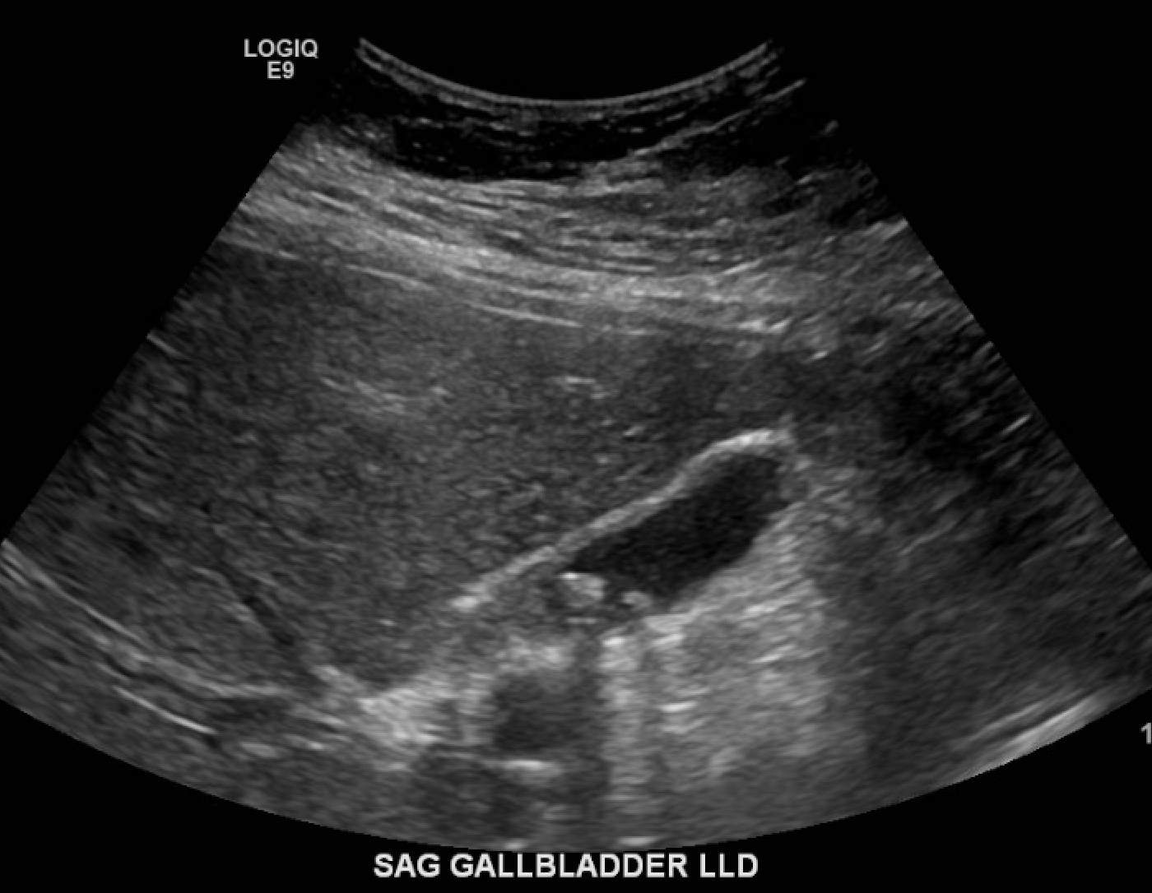
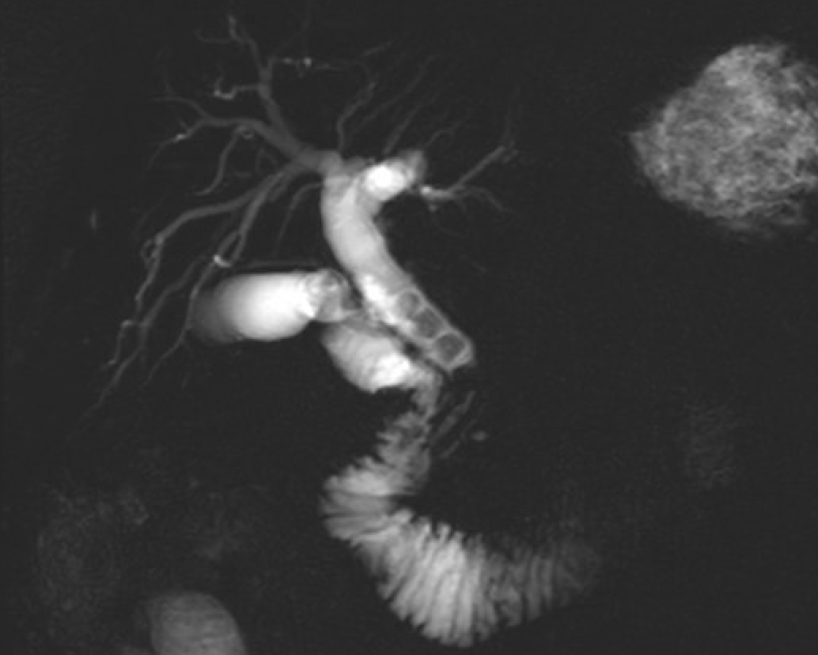
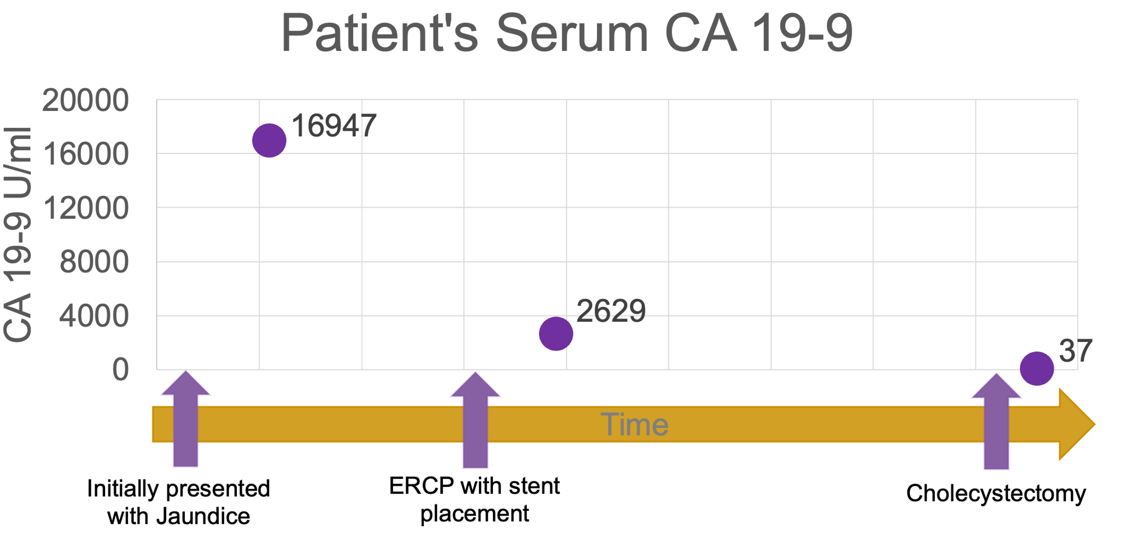
Jaundice with markedly elevated carbohydrate antigen 19-9 (CA 19-9): Biliary stones or malignancy?
Brianna Bourgeois¹, Pamela Wiseman, MD¹
LSU Health Department of Medicine
Introduction
Laboratory Findings
Serum carbohydrate antigen 19-9 (CA 19-9) is used as a cancer marker for pancreatic or biliary tree malignancies
CA 19-9 is not recommended for screening of asymptomatic patients, but it is unclear when to measure CA 19-9 in symptomatic patients
Detailed history of present illness could help determine the usefulness of serum CA 19-9
Table 1. Laboratory findings
ALT – 90 (H) , AST – 58 (H), GGT - 1,164 (H), alkaline phosphatase - 460 (H)
Bilirubin - 20.5 (H)
Hemoglobin -10.9 (L), hematocrit - 33.2 (L), and MCV - 73.7 (L)
Hemoglobin A1C - 7.1% (H)
Lipase - 49
Hepatitis A, B, C - nonreactive
(A)
(B)
History & Physical
Figure 1. (A) Cholelithiasis on ultrasound. (B) Stones in common bile duct on MRCP, increased signal near pancreatic duct.
History
59-year-old male with past medical history of untreated type 2 diabetes mellitus, hypertension, and hyperlipidemia presents to the UMC Family Medicine clinic for a follow up for chronic conditions after being lost to follow up for about 2.5 years
On initial observation, the patient was clearly jaundiced
Denied nausea, vomiting, diarrhea, or constipation
Endorsed generalized pruritus
Denied any pain during initial visits, but admitted to severe pain episodes during 3rd Family Medicine visit
Physical Exam
Marked scleral and palmar icterus
10cm liver span, no abdominal tenderness, negative Murphy’s sign, smooth liver edge
No telangiectasias or distended surface collateral veins noted
Normal bowel sounds
Concluding Remarks
Labs and imaging suggest cholelithiasis and choledocholithiasis
Endoscopic ultrasound findings revealed a pancreatic mass with inconclusive pathology
CA 19-9 level was concerning for malignancy
It is unclear whether the markedly elevated CA 19-9 could be explained by the stones in the biliary tree; however, the patient’s CA 19-9 levels are continuing to decline with intervention (Figure 2)
Figure 2. The patient’s serum Ca 19-9 levels following therapeutic procedures
Discussion
Social Factors
Studies suggest limited sensitivity (72%) and specificity (86%) of CA 19-9 as a tumor marker; however, the cutoff used is typically 37 U/ml (Zhao et al., J Gastro & Hepatology, 2022)
One study found that the median CA 19-9 in benign pancreatic disease was 15 (interquartile range 6-39) (Boyd et al., Cancers, 2022)
A previous case report found that a patient with cholelithiasis and choledocholithiasis had markedly high CA 19-9 (9586 U/ml) levels that rapidly declined following treatment (Korkmaz et al., Turk J Gastroentero, 2010) , which is consistent with this patient
Further investigation is still warranted on this patient due to the suspicious findings in his pancreas found during workup
Fear of missing work for financial concerns discouraged the patient from being upfront about his pain on initial presentations
Jaundice, initially thought to be painless, caused malignancy to be higher on the differential
Thus, a CA 19-9 lab was ordered and found to be markedly elevated; however, this measure may have resulted in unnecessary concern

