Slide 1
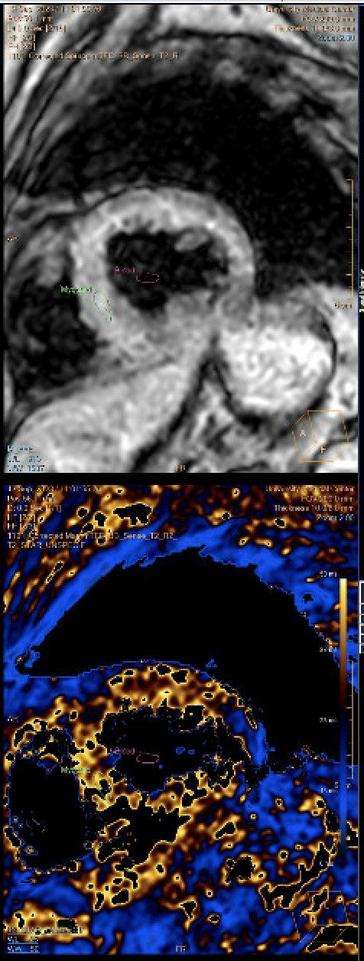
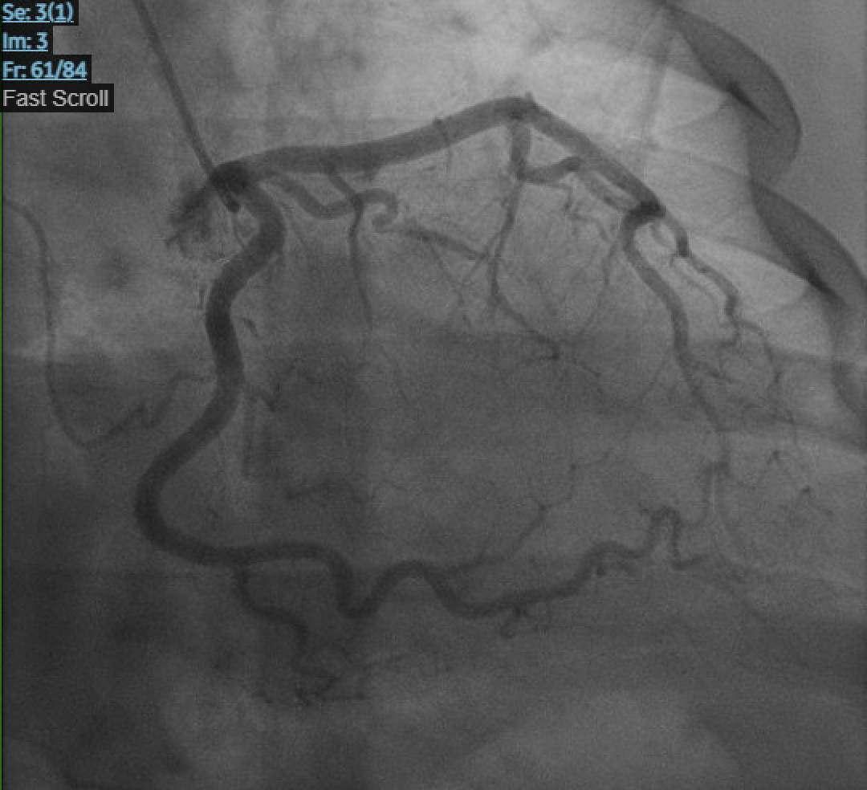
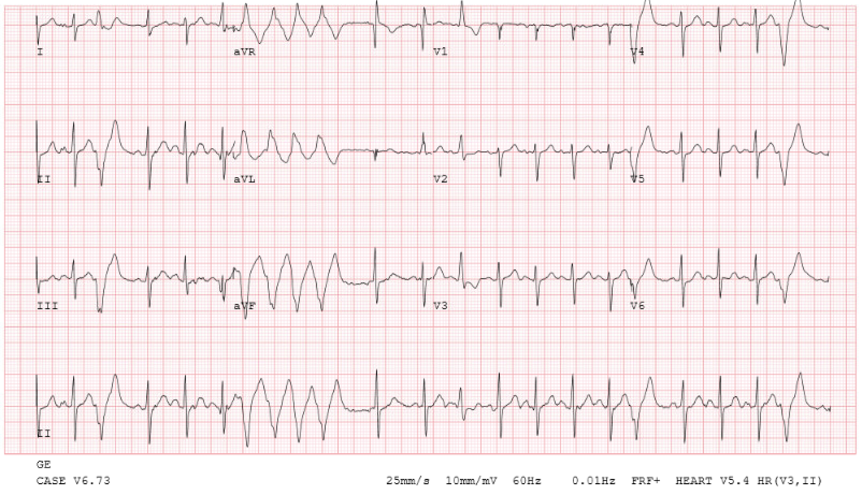
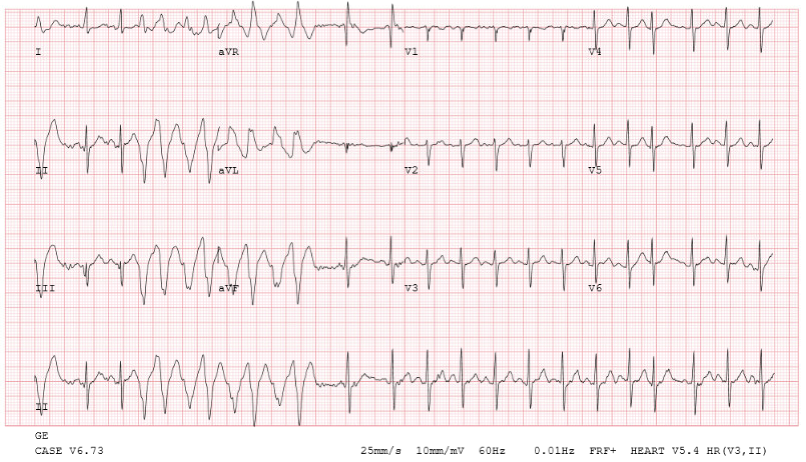
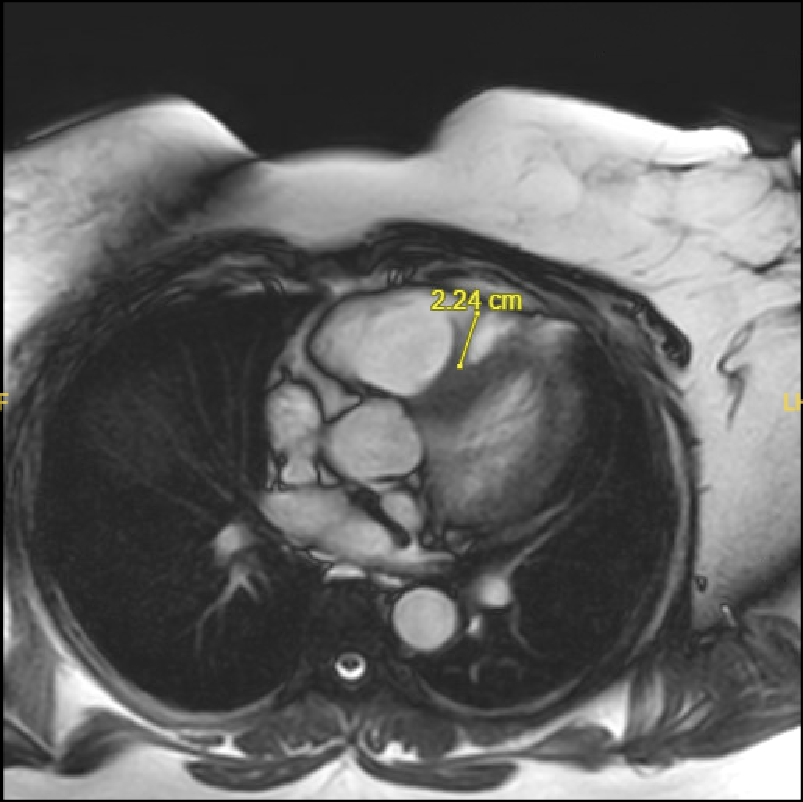
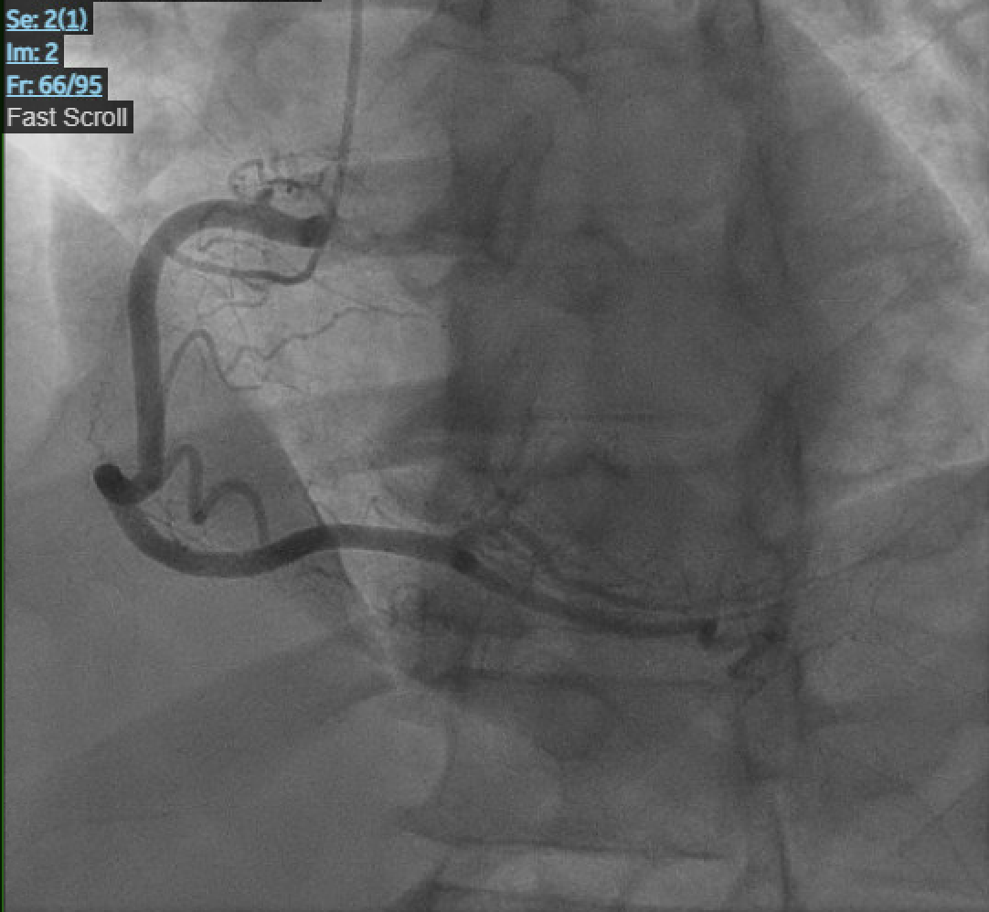
A Case of Symptomatic Tachyarrhythmia of Unknown Etiology
Coleen Leslie¹, Michael Olejniczak, M.D.², Ilija Zecevic M.D.², Alexander Glaser M.D.²
¹LSUHSC School of Medicine, New Orleans, LA ²Department of Medicine, LSU Health Sciences Center, New Orleans, LA
Introduction
Case Presentation
Tachyarrhythmias, namely supraventricular tachycardias, are a significant source of distress and discomfort for many around the world and frequently necessitate hospital admission. Although these arrhythmias can be relatively asymptomatic, a subset of patients experience significant symptomatology when having this rhythm. Infrequently, supraventricular tachycardia is also a cause of sudden cardiac death. Preventative treatment of this rhythm has demonstrated excellent prognosis for at-risk patients²; therefore, prompt diagnosis and treatment are imperative with focused structural evaluation. In this report, we will detail a case of significant symptomatology and puzzling etiology.
A 42-year-old African American female with a relevant past medical history of essential hypertension, pre-diabetes, and polycystic ovarian syndrome presented with new onset chest pain upon exertion. The first episode of symptoms occurred while the patient was performing her regular duties as a housekeeping manager, when she suddenly experienced palpitations, diaphoresis, and an overall sense of warmth that dissipated with rest. A little less than one week later, the patient experienced her second episode of palpitations while grocery shopping. However, these palpitations were accompanied by a sudden pain in her left shoulder, radiating up to her jaw and down into her chest, unlike anything she had experienced before. Treadmill stress EKG was ordered and the patient was only able to complete 3 minutes of the test before experiencing the same pain in her left shoulder and jaw, along with dizziness, lightheadedness, and palpitations. Interestingly, the onset of symptoms coincided exactly with a run of pleomorphic non-sustained ventricular tachycardia captured on EKG. The stress test was terminated immediately, and the patient was admitted by the cardiology team for further evaluation. The electrocardiogram (EKG) recorded during the stress test exhibited non-sustained ventricular tachycardia, a heart rate of 280 beats per minute, and variable morphology closely coupled to a T wave with a superior axis. She was taken for coronary angiography later that afternoon to assess any ischemic etiology of her new unstable angina. However, the study was negative. Following a series of unrevealing imaging studies, including TTE, non-contrast chest CT, and cardiac MRI, the evaluation concluded with a cardiac MRI showing evidence of dilated cardiomyopathy with an accessory myocardial band bridging across the RVOT but lacking an infiltrative disorder. The patient was ultimately discharged with a LifeVest defibrillation device and scheduled for follow-up in the electrophysiology clinic after completing a repeat treadmill stress test while on 50 mg of metoprolol succinate without triggering another run of ventricular tachycardia.
Figure 1: Stress induced non-sustained monomorphic ventricular tachycardia which resolved with rest. Patient had limiting chest pain correlated to onset of arrhythmias.
Figure 2: Coronary angiogram, RAO Caudal view showing absence of any obstructive disease in Left Main Coronary and Left Circumflex arteries.
Discussion
Figure 2: Cardiac MRI, showing no evidence of background myocardial edema or lipid storage disorder.
This case is remarkable in the extent of symptomatology experienced by the patient, presenting similarly to obstructive coronary disease, as well as the lack of supporting evidence for a physical abnormality or pathologic process that may have contributed to the patient’s presentation. While the findings of the myocardial bridging seen on cardiac MRI were suggestive of a potential anatomic etiology, their presence was not correlated with any evidence of ischemic changes on cardiac catheterization which would be expected.³
Figure 4: Cardiac MRI showing an accessory myocardial band bridging across the RVOT.
Figure 5: Cardiac MRI with mapping with no evidence of iron deposition.
References:
Kotadia ID, Williams SE, O'Neill M. Supraventricular tachycardia: An overview of diagnosis and management. Clin Med (Lond). 2020 Jan;20(1):43-47. doi: 10.7861/clinmed.cme.20.1.3. PMID: 31941731; PMCID: PMC6964177.
Wang Y, Scheinman M, Chien W, et al. Patients with supraventricular tachycardia presenting with aborted sudden death: Incidence, mechanism and long-term follow-up. J Am Coll Cardiol. 1991 Dec, 18 (7) 1711–1719.
Corban MT, Hung OY, Eshtehardi P, Rasoul-Arzrumly E, McDaniel M, Mekonnen G, Timmins LH, Lutz J, Guyton RA, Samady H. Myocardial bridging: contemporary understanding of pathophysiology with implications for diagnostic and therapeutic strategies. J Am Coll Cardiol. 2014 Jun 10;63(22):2346-2355. doi: 10.1016/j.jacc.2014.01.049. Epub 2014 Feb 26. PMID: 24583304; PMCID: PMC4065198.
Figure 3: Coronary Angiography, LAO Cranial view showing absence of any obstructive disease of the Left Anterior Descending artery.

