Slide 1
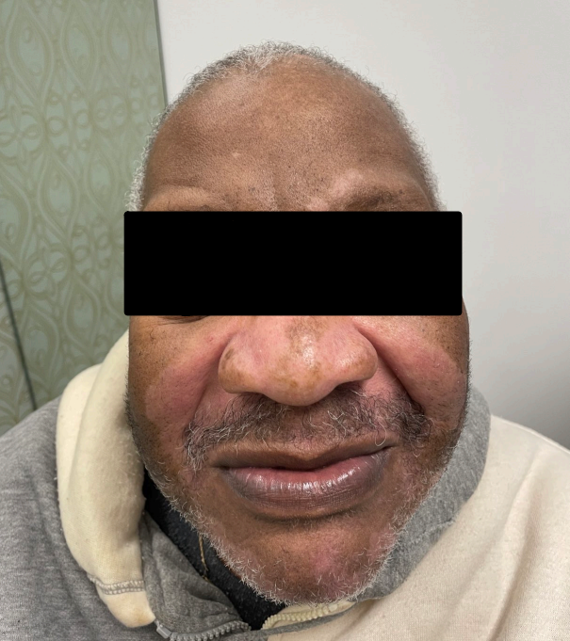
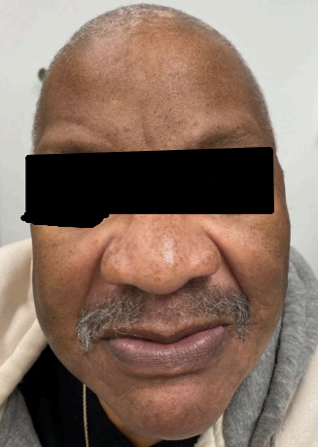
“Hypopigmented Seborrheic Dermatitis Masquerading as Vitiligo in Skin of Color” Gavin Dennis; John Miller, MD; Brian Lee, MD LSUHSC, Department of Dermatology
Introduction
Discussion
Seborrheic dermatitis (SD) is a chronic, inflammatory skin condition common in skin of color populations, particularly African Americans
The pathogenesis of SD involves the proliferation of commensal yeast genus, Malassezia, the host immune response, and the composition of sebaceous gland secretions.
SD diagnosis is traditionally based on lesion location and morphology. However, in skin of color, it often presents differently, such as with hypopigmentation and minimal scaling, complicating accurate diagnosis.
Treatment approaches for SD in skin of color need to be tailored, considering the potential for hypopigmentation, hair type, and washing practices.
Case Description
Patient Profile: 63-year-old African-American male with history of renal cell carcinoma, post-nephrectomy, undergoing adjuvant immunotherapy with Nivolumab.
Presentation: Reported development of "white spots" on the nose, chin, and cheeks after first dose of Nivolumab.
Initial Diagnosis: Nivolumab-induced vitiligo, based on history and physical examination. No treatment initiated.
Condition Worsening: Upon return after 3 months, observed well-circumscribed hypopigmented patches with underlying erythema on glabella, perinasal, perioral regions, and scalp.
Treatment: Prescribed daily ketoconazole shampoo, clobetasol solution twice daily to the scalp, and ketoconazole cream plus hydrocortisone 2.5% cream.
Outcome: Dramatic improvement in one month confirmed the diagnosis of hypopigmented seborrheic dermatitis.
Conclusion
The associated hypopigmentation seen in this case may lead to similar social and psychological implications, including decreased self-esteem and quality of life, as can be seen in vitiligo patients.
Our case highlights the need for providers to understand the unique presentations and treatment considerations of SD in skin of color patients, and to provide culturally competent care to improve patient outcomes.
References:
Alexis AF, Sergay AB, Taylor SC. Common dermatologic disorders in skin of color: A comparative practice survey. Cutis. 2007;80(5):387-394.
Gupta A, Bluhm R. Seborrheic dermatitis. In. Vol 18. Oxford, UK2004:13-26.
Berk T, Scheinfeld N. Seborrheic dermatitis. P t. 2010;35(6):348-352.
Halder RM, Nootheti PK. Ethnic skin disorders overview. J Am Acad Dermatol. 2003;48(6):S143-S148.
Ogunbiyi AO, Daramola OOM, Alese OO. Prevalence of skin diseases in Ibadan, Nigeria. Internat J Dermatol. 2004;43(1):31-36.

