Slide 1
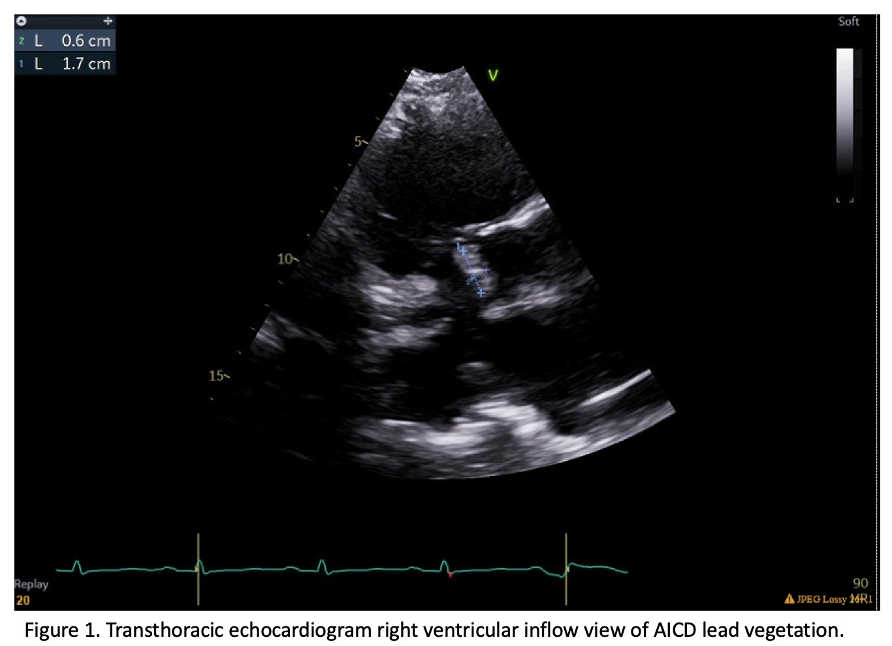
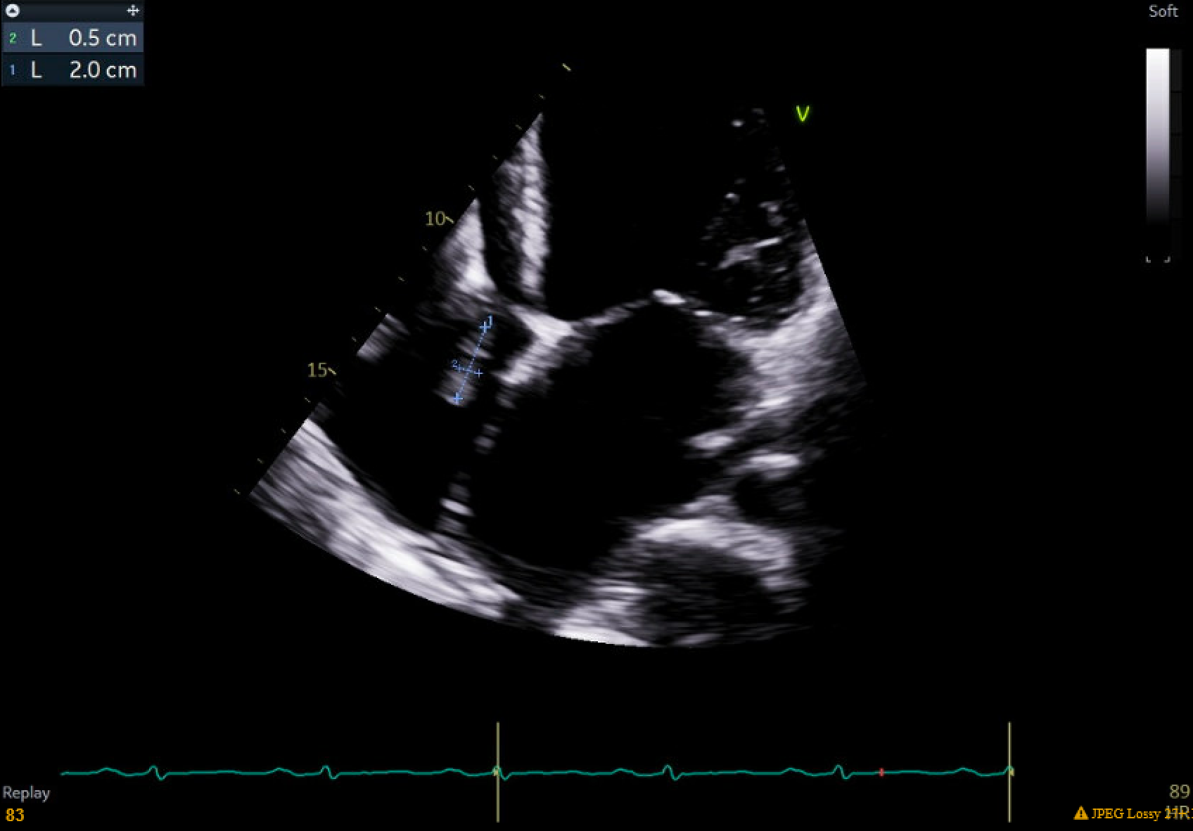
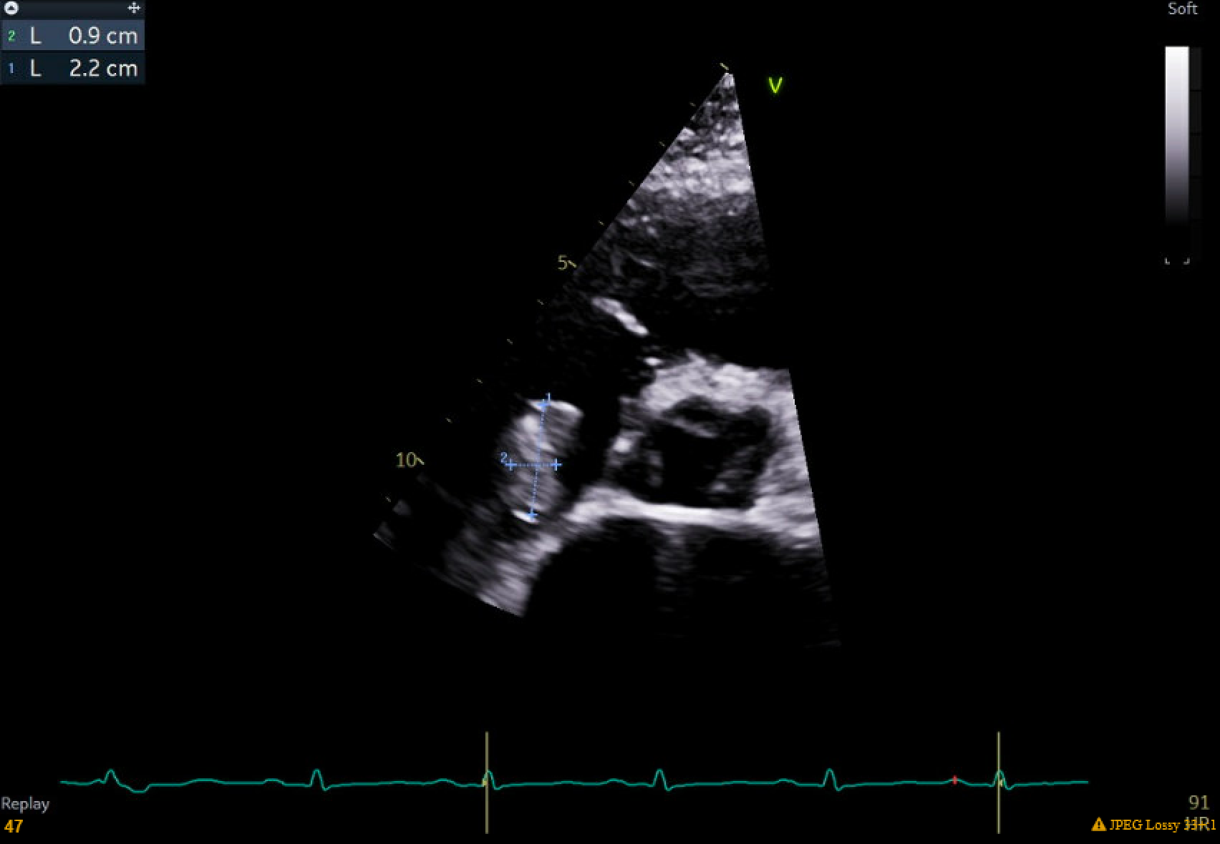
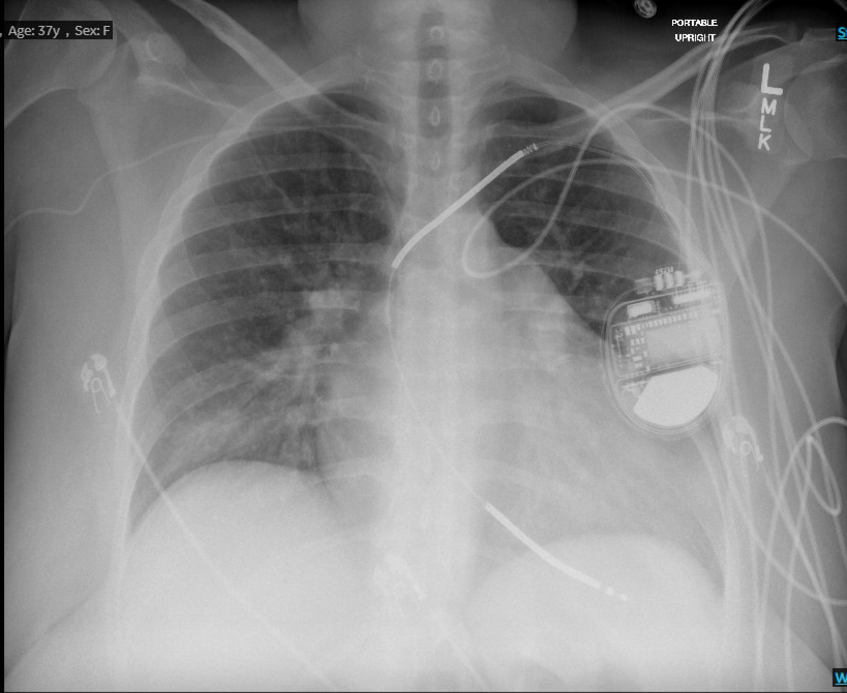
MRSE Bacteremia via PICC Line with AICD Lead Vegetation in Heart Failure Patient on Ambulatory Milrinone Elizabeth Long¹, Sarah C. Forsythe¹, Chantal Wickman, M.D.², Jorge A. Martinez, M.D., J.D.² ¹LSUHSC School of Medicine, New Orleans, LA ²Department of Medicine, LSU Health Sciences Center, New Orleans, LA
Introduction
Case Presentation
Inotropic agents such as milrinone have been used for many years in managing symptoms and hemodynamics in those with advanced heart failure. These therapies can be used as a bridge to heart transplantation, or for patients ineligible for transplantation, be used chronically as palliative therapy. Despite improvements in quality of life while on these medications, they are not without risks. Inotropes can cause arrhythmias, as well as infections due to long-term indwelling catheters such as peripherally inserted central catheters (PICC). A previous meta-analysis showed that in all patients with PICC lines, the rate of the most common type of infection, bacteremia, occurred in 5.2% of hospitalized patients and 0.5% of outpatients.¹ Likewise, there are low rates of infection, particularly endocarditis, associated with cardiac implantable electronic devices (CIED). One study determined that electrode lead endocarditis was reported in less than 1% of over 4000 implanted pacemakers and implantable cardio-defibrillators (AICD).²
A 37-year-old female was transferred from an outside hospital for evaluation and management of possible sepsis. She had been treated at the transferring hospital for 3 to 4 days of fever, chills, and nausea along with non-bloody, non-bilious emesis and elevated HR of 140-150 bpm. Her past medical history included cardiomyopathy, attributed to four-vessel CAD with a DES of circumflex artery in 2014, as well as postnatal cardiomyopathy. Her LVEF was 15%. She had an AICD and had been on ambulatory milrinone for four months. There was a concern for sepsis secondary to an infected PICC line. Blood cultures from two different specimens obtained at the outside hospital were positive for methicillin-resistant S. epidermidis (MRSE). She also had iron deficiency anemia and poorly-controlled diabetes mellitus. In the emergency department, she had a blood pressure of 91/55, a pulse of 92, and WBC of 14.2K/uL. Chest x-ray revealed cardiomegaly and a patchy airspace opacity in the right lower lung concerning for pneumonia. A chest CT with contrast confirmed a right lower lobe mass and consolidative density with right hilar adenopathy with concern for neoplasm or infection. A transesophageal echocardiogram was not obtained at this time. A subsequent transthoracic echocardiogram showed a large, highly mobile vegetation, approximately 1cm x 2cm, on one AICD lead. The patient was placed on intravenous vancomycin, cefepime, and metronidazole. Two different blood cultures on the day of admission resulted with as MRSE. Antibiotics were narrowed to IV vancomycin. Her PICC line was removed. A midline was placed to continue milrinone drip. Cardiology electrophysiology was consulted for AICD removal. In anticipation the patient was placed on a Zoll LifeVest. Transesophageal echocardiogram performed one week later showed no valvular vegetations. Blood cultures at the time of the extraction were no growth over 5 days. The infiltrate on chest x-ray was determined to be septic emboli. Infectious Disease determined the patient should remain on IV vancomycin for four weeks. The midline catheter was exchanged for a new double port PICC line for milrinone and intravenous vancomycin. Arrangements were made for home IV infusion of vancomycin and follow up with Cardiology, Infectious Disease, and weekly CBCs and CMPs.
Discussion
This patient’s bacteremia paired with co-morbidities such as diabetes mellitus increase her risk of AICD lead colonization and endocarditis.³ Importantly, the incidence of lead endocarditis while on long-term inotropic therapy is not widely reported. Nonetheless, one study of 200 patients found endocarditis in four patients, although not all subjects underwent a TEE to evaluate for lead endocarditis.¹ This case demonstrates the need to evaluate for sequelae of bacteremia such as lead endocarditis in patients with implanted devices.
Figure 2. Transthoracic echocardiogram apical 4-chamber view of AICD lead vegetation.
Conclusion
Device-related infections are an uncommon complication of AICDs. However, when it occurs it has been shown to increase mortality at five years in up to 35%.³ This patient was positive for MRSE on four different blood cultures. Published guidelines proclaim that in cases of high-grade bacteriemia by organisms such as MRSE (two or more separate positive blood cultures for the same pathogen), device removal, not just lead removal, is recommended. In situations such as this, the risks related to device removal are significantly lower than the rate of infection recurrence or mortality associated with lead retention with generator extraction or antibiotic therapy alone.³ Similarly, in patients with endocarditis, there is a 38% mortality at one year associated with device retention compared to 20% in those that had their AICD removed.⁴ Evaluation of the possible source of infection, organisms involved, the device, and its leads are essential to reducing disease recurrence and death in patients with bacteremia and AICDs.
Figure 3. Transthoracic echocardiogram aortic valve view of AICD lead vegetation.
References:
1. Acharya D, Sanam K, Revilla-Martinez M, et al. Infections, Arrhythmias, and Hospitalizations on Home Intravenous Inotropic Therapy. The American Journal of Cardiology. 2016;117(6):952-956. doi:https://doi.org/10.1016/j.amjcard.2015.12.030
2. del Río A, Anguera I, Miró JM, et al. Surgical treatment of pacemaker and defibrillator lead endocarditis: the impact of electrode lead extraction on outcome. Chest. 2003;124(4):1451-1459. doi:10.1378/chest.124.4.1451
3. Toriello F, Saviano M, Faggiano A, et al. Cardiac Implantable Electronic Devices Infection Assessment, Diagnosis and Management: A Review of the Literature. 2022;11(19):5898-5898. doi:https://doi.org/10.3390/jcm11195898
4. Lakkireddy DR, Segar DS, Sood A, et al. Early Lead Extraction for Infected Implanted Cardiac Electronic Devices: JACC Review Topic of the Week. Journal of the American College of Cardiology. 2023;81(13):1283-1295. doi:https://doi.org/10.1016/j.jacc.2023.01.038
Figure 4. Chest x-ray on admission showing cardiomegaly and opacity in right lower lung.

