Slide 1
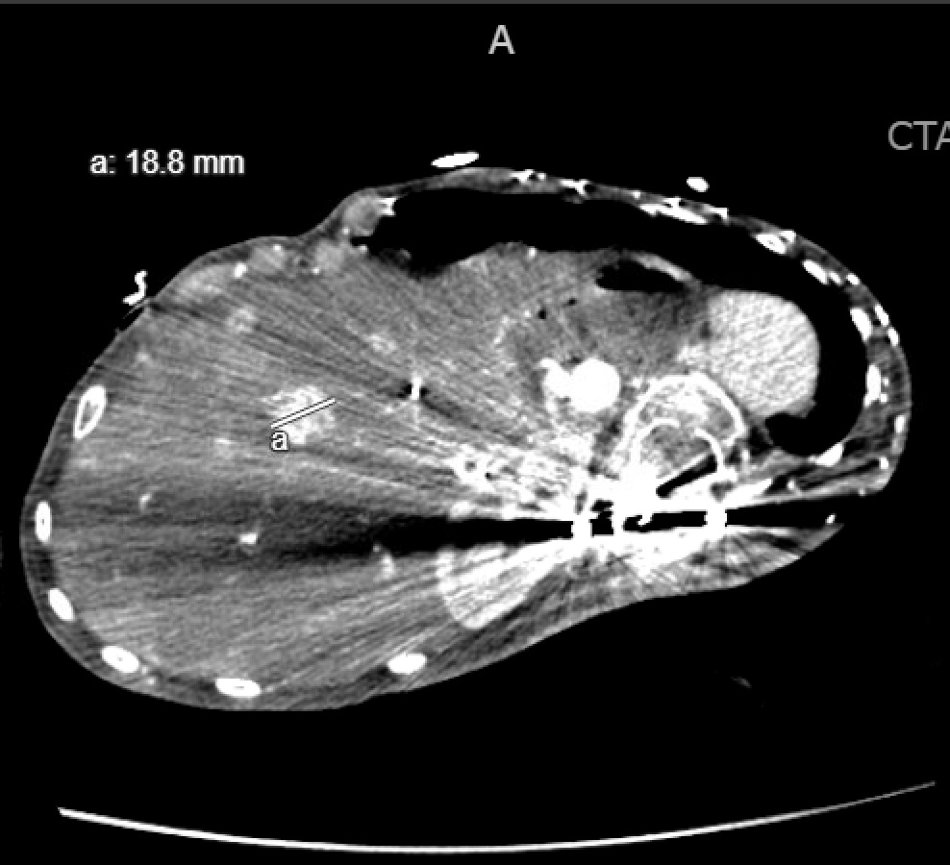
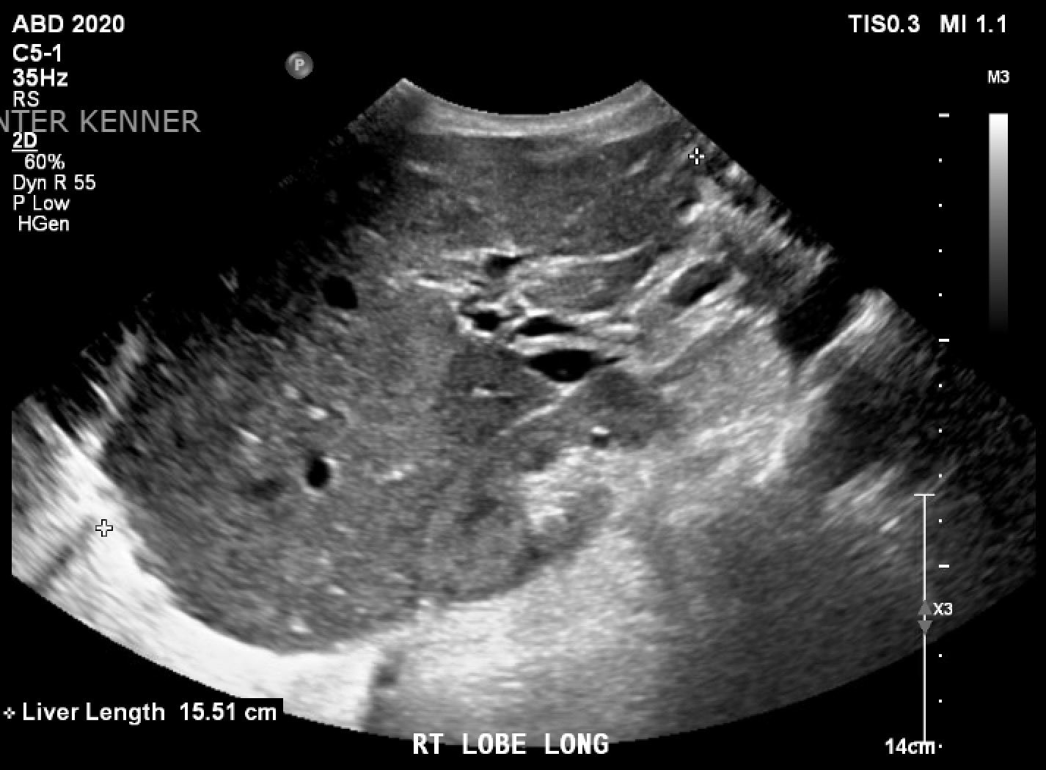
Incidental Finding of Multiple Enhancing Liver Lesions in the Setting of Mitochondrial Myopathy
Sepehr Sadeghi, DO; Gurtaj Mahil; Oluwafemi Ajibola, MD; Bennett deBoisblanc, MD.
Department of Medicine, LSU Health Sciences Center, New Orleans, LA
Introduction
Discussion
Mitochondrial diseases can affect a wide range of organ systems including the nervous and musculoskeletal system. Additionally, mitochondrial hepatopathies are very common in these patients due to the high density of mitochondria within the liver. The resultant liver involvement can lead to various complications including neonatal liver failure, hepatic steatosis, hepatocellular carcinoma, cholestasis, and others. While mitochondrial hepatopathies commonly arise, the work-up of clinically silent hepatic lesions in this patient population has not been previously characterized.
Previous studies have estimated the abundance of mitochondria in the liver to be in the range of 13-20% of the liver volume¹. For this reason, there has been significant interest in elucidating the link between hereditary mitochondrial diseases and liver dysfunction. Some studies have estimated the prevalence of liver involvement in mitochondrial diseases in children to be as high as 20%². Neonatal liver failure is the most severe which has an acute onset and is characterized by lethargy, vomiting, and hypotonia¹. It is associated with significant neurological decline and results in death within weeks to months¹. On the other hand, Alpers's Disease starts in infancy and has a slow onset¹. It is characterized by “hepatomegaly, cholestasis, transaminitis, cirrhosis and progressive liver failure”¹. However, incidentally found liver lesions in patients with hereditary mitochondrial myopathy have not been previously described. Small, enhancing liver lesions found incidentally on routine CT abdomen of patients without risk factors for liver disease can be a common finding and generally do not require follow up³. The most common of these lesions include hepatic cysts and hemangiomas³. Although it might be possible to distinguish between benign and malignant lesions via multiphasic CT or MRI imaging, the routine, single venous portal phasic CT may not be as informative³. This presents a challenge when attempting to differentiate between benign lesions, HCC and metastasis. Studies have shown that the size of the lesions is an important diagnostic clue and may guide further work-up³. These studies highlight that enhancing lesions smaller than 1.5 cm are likely benign in low-risk patients and those larger than 1.5 cm may require further imaging such as MRI or multi-phase CT³. Another important consideration is the presence or absence of cirrhosis⁴. In the presence of cirrhosis, the clinical suspicion for HCC rises significantly⁴. If the diagnosis remains uncertain, it is appropriate to proceed with fine needle biopsy, follow up imaging, or resection for lesions larger than 5 cm⁴.
Case Presentation
A 28-year-old gastrostomy tube, tracheostomy, foley catheter-dependent female with a past medical history of mitochondrial myopathy and chronic neuromuscular respiratory failure presented with acute onset of shortness of breath and blood-tinged tracheal aspirate. On arrival, the patient was saturating at 60% on room air. Arterial blood gas analysis revealed acidosis and hypercapnia. The patient was stepped up to the ICU given increasing oxygen requirements. Her respiratory status improved after suctioning the tracheostomy tube and the patient was gradually transitioned to her home ventilation settings. Computed tomography of the chest with contrast ruled out a pulmonary embolism but did reveal bilateral lower lobe consolidations suggestive of pneumonia. Incidentally, multiple small enhancing lesions throughout the liver were also identified; the largest of which was 1.88 cm. Initially, liver function tests revealed an AST 63, ALT 48, and alkaline phosphatase 136, all of which normalized within a week of hospitalization. Abdominal ultrasound revealed a non-enlarged, homogeneous echotexture of the liver and a significantly dilated bladder. Urinalysis findings suggested a urinary tract infection (UTI) in the setting of urinary retention. Urine cultures grew Providencia UTI and blood cultures grew methicillin-resistant Staphylococcus aureus (MRSA). The patient was started on broad-spectrum empirical antimicrobial therapy with vancomycin, ceftriaxone, and azithromycin for ventilator-associated pneumonia (VAP), UTI, and MRSA bacteremia. Throughout this hospital stay, the patient also required vasopressor support in the ICU setting for worsening hypotension secondary to septic shock. The patient continued to improve clinically and steadily improved to her baseline prior to discharge with antibiotics.
CTPE revealing multiple enhancing lesions noted throughout the liver which are indeterminate. The largest labelled a at 18.8 mm.
Figure 1:
Conclusion
Mitochondrial hepatopathies can range from acute liver failure in the neonatal period to Alpers disease in young adults characterized by hepatomegaly, transaminitis, and cirrhosis. Although incidentally found enhancing liver lesions are generally benign and generally not followed up, the multiple lesions found in this patient in the setting of mitochondrial myopathy may be worth investigating with further imaging.
References
15.5 cm, non- enlarged liver. Homogenous echotexture without discrete lesions.
Figure 2:
Zhang, C., Zhao, Y., Yu, M., Qin, J., Ye, B., & Wang, Q. (2022). Mitochondrial Dysfunction and Chronic Liver Disease. Current issues in molecular biology, 44(7), 3156–3165. https://doi.org/10.3390/cimb44070218
Lee, W. S., & Sokol, R. J. (2007). Liver disease in mitochondrial disorders. Seminars in liver disease, 27(3), 259–273. https://doi.org/10.1055/s-2007-985071
Corwin, M. T., DiGeronimo, R. T., Navarro, S. M., Fananapazir, G., Wilson, M., & Loehfelm, T. W. (2021). Clinical Importance of Incidentally Detected Hyperenhancing Liver Observations on Portal Venous Phase Computed Tomography in Patients Without Known Malignancy or Liver Disease. Journal of computer assisted tomography, 45(4), 516–521. https://doi.org/10.1097/RCT.0000000000001154
Assy, N., Nasser, G., Djibre, A., Beniashvili, Z., Elias, S., & Zidan, J. (2009). Characteristics of common solid liver lesions and recommendations for diagnostic workup. World journal of gastroenterology, 15(26), 3217–3227. https://doi.org/10.3748/wjg.15.3217

