Slide 1
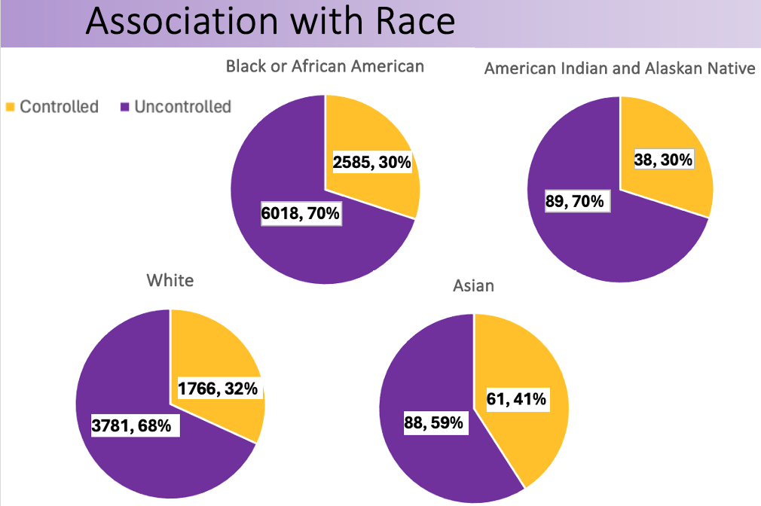
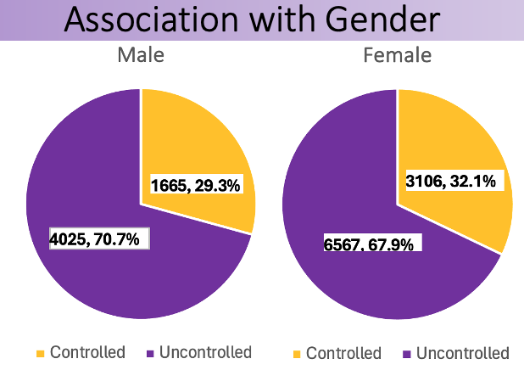
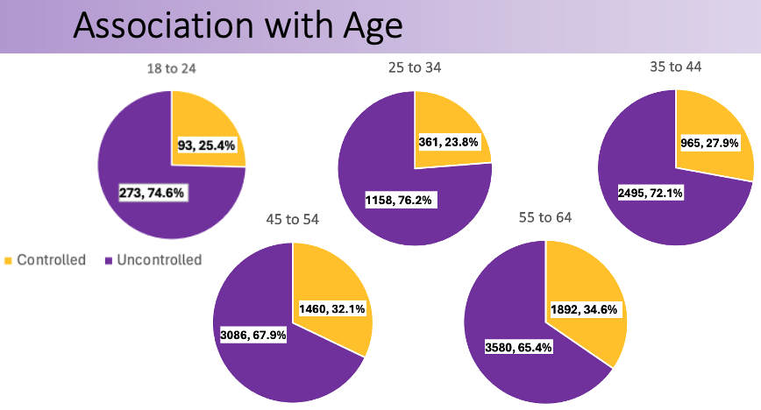
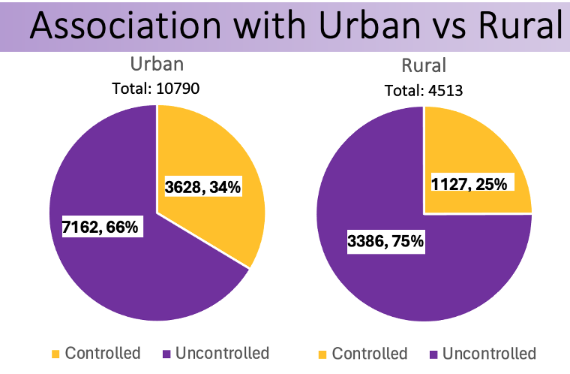
Demographic factors affecting hypertension control in Medicaid populations in Louisiana Alex Wandler¹, Sarah Corley Forsythe¹, Greg Randolph, MD MPH² Louisiana State University Health School of Medicine^{1,} LSU Health Sciences Center²
Background
Results
Conclusion
Uncontrolled hypertension is a highly prevalent disease state in Louisiana and is known to lead to increased long-term health risks, such as stroke, heart failure, vision loss, and kidney disease.
Investigating associations between populations with and without controlled hypertension, we can emphasize long-term health outcomes for at risk populations, consider external factors that may be protective, and investigate disparities that reduce access to care and education.
Of the 15,363 patients investigated, majority of patients had uncontrolled hypertension (68.9%) compared to controlled patients (31.1%).
Younger individuals, aged 18-24, had lower rates of controlled hypertension (25.4%) and fewer visits (2.8), compared to older individuals, aged 55- 64, who were controlled (34.6%) and had a higher average of office visits (3.3).
Males had a lower rate of controlled hypertension (29.3%) compared to females (32.1%), although both genders averaged the same number of office visits (3.2).
Regarding race, Asian Americans had the highest percentage of controlled hypertension (race: Asian American [41%, N= 149], White [32%, N=5,547], Black or African American [30%, N=8,603], American Indian or Alaskan Native [30%, N=127]).
Urban parishes had better rates of hypertension control (34%) than rural parishes (25%). The total average number of office visits were similar between urban (3.12) and rural parishes (3.18).
Following the removal of outliers, rural parish average visits decreased (2.99).
We found that younger age groups, males, Black or African Americans and Native Americans, and those living in rural parishes had poorer blood pressure control.
These variations in control between populations suggests that certain factors such as age, gender, race, and geographic location influence an individual’s success in achieving controlled hypertension.
To address the issue of uncontrolled blood pressure, we recommend the utilization of social media and other accessible platforms to educate and emphasize the long-term risks associated with uncontrolled hypertension to younger, at-risk populations.
Although a small subset, further investigation of factors contributing to the success rates of Asian Americans can be identified and applied to at- risk populations.
By recognizing factors that decrease education and accessibility to treatment in rural areas, we can combat this gap.
Objectives
This study aims to evaluate the associations between factors such as age, gender, race, provider visits, and urban-rural location, and their impact on blood pressure management in Medicaid patients.
Methods
Using 2022 member data from AmeriHealth Caritas Louisiana, one of the 6 Medicaid managed care organizations in Louisiana, we evaluated the rates of individuals between 18 and 65 years of age who had a diagnosis of hypertension and adequate control (<140/90mmHg) during the measurement year.
We also assessed the relationship between adequate control and the number of provider visits per year as well as stratifying the data by age, gender, race, and patients’ geographic location to assess for disparities.
References
Health threats from high blood pressure. American Heart Association. https://www.heart.org/en/health-topics/high-blood-pressure/health-threats-from-high- blood-pressure. Accessed Nov. 12, 2023.
Hypertension. Louisiana Department of Health. https://ldh.la.gov/page/hypertension. Accessed Nov. 12, 2023.

