Slide 1
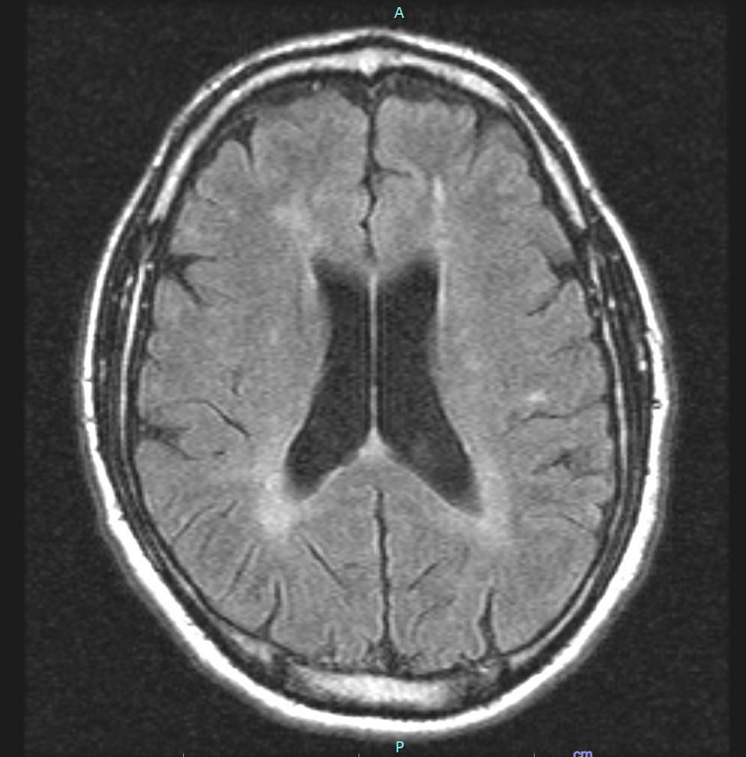
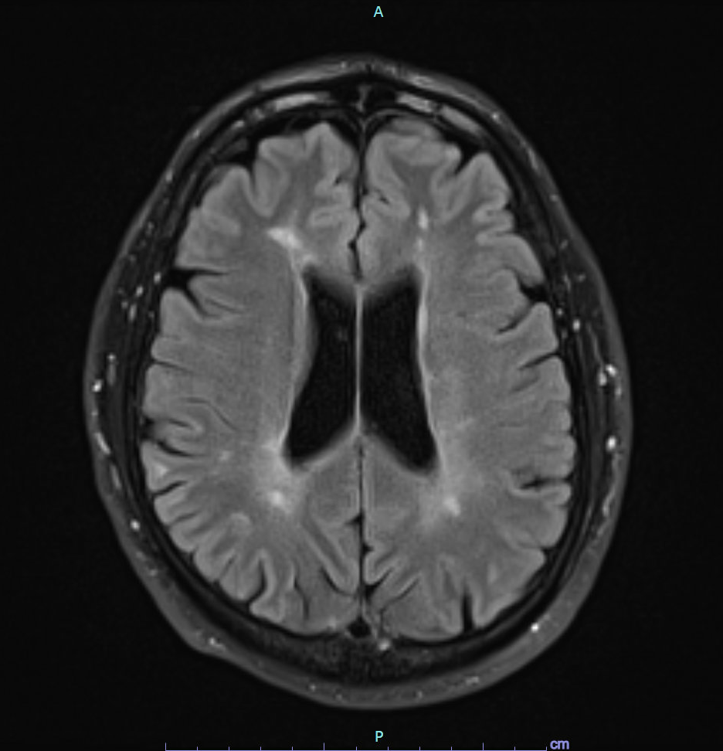
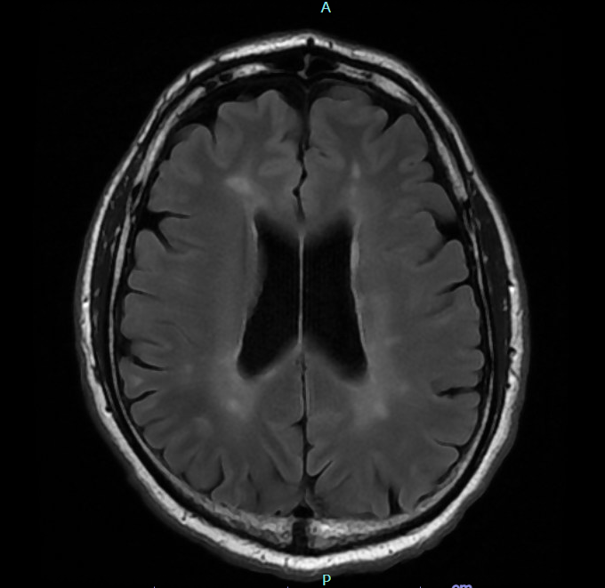
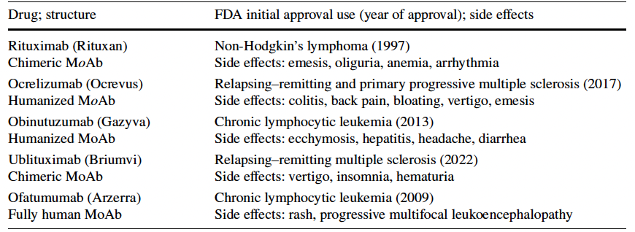
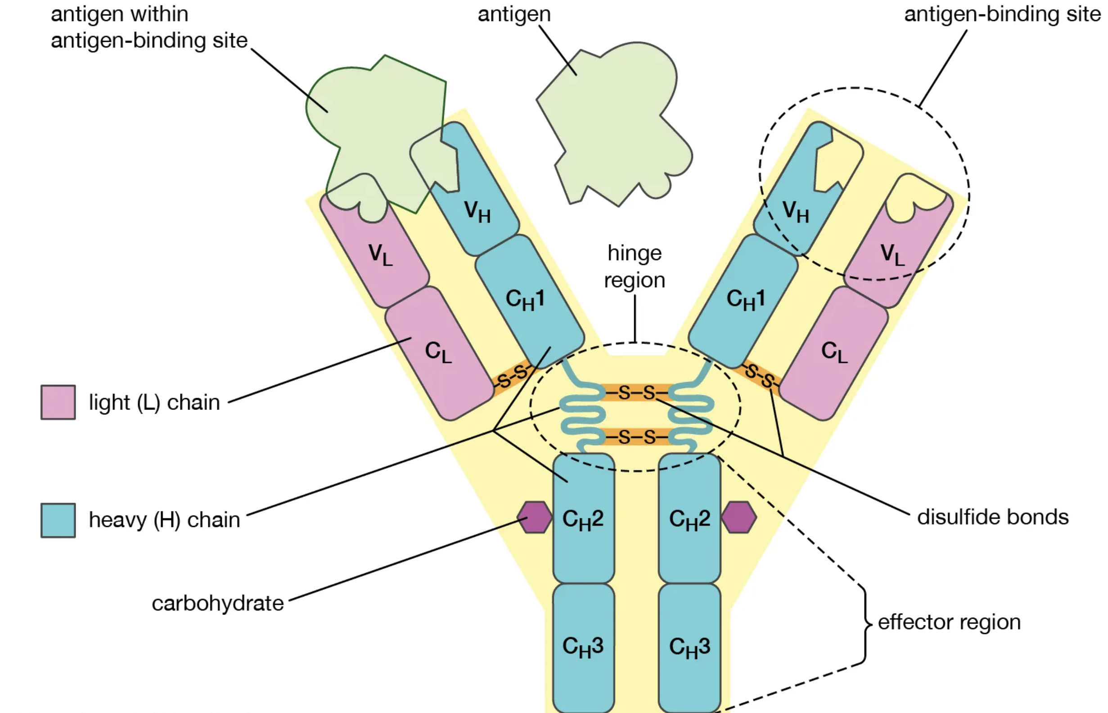
Ofatumumab: A Novel Anti‑CD20 Monoclonal Antibody for Multiple Sclerosis: A Review of Clinical Considerations William T. Barham¹ · Kathryn M. Dillman¹ · Joseph D. Hebert¹ · Christian K. Kerut¹ · Rachel J. Klapper² · Shahab Ahmadzadeh³ · Sahar Shekoohi³ · Elyse M. Cornett³ · Alan D. Kaye^{3,4} 1. LSU Health Sciences School of Medicine at New Orleans 2. Department of Radiology, Louisiana State University Health Sciences Center at Shreveport 3. Department of Anesthesiology, Louisiana State University Health Sciences Center at Shreveport 4. Department of Pharmacology, Toxicology, and Neurosciences, Louisiana State University Health Sciences Center at Shreveport
Background
Methods
Results & Conclusions
▻ Multiple sclerosis (MS) is an antigen-specific, cell-mediated chronic autoimmune disease of the central nervous system (CNS).
▻ The disease is characterized by immune infiltration, progressive demyelination, and subsequent axonal loss, leading to a coterie of degenerative neurological symptoms, including, but not limited to, optic neuritis, partial myelitis, sensory disturbances, and internuclear ophthalmoplegia.
▻ While the exact inciting cause of the body’s autoreactivity in MS is not fully understood, it has been linked to genetic, environmental, and infectious factors.
▻ Among the FDA-approved medications for the treatment of relapsing–remitting multiple sclerosis (RRMS) anti-B cell monoclonal antibodies (mAbs) show particular promise in decreasing relapses and diminishing neural inflammation, as measured by T1- or T2-gadolinium-enhanced MRI.
▻ A literature review was conducted on the NIH’s PubMed database of all known published clinical trials examining the use of anti-CD20 mAb ofatumumab (brand name Kesimpta) for multiple sclerosis, including both independent and industry sponsored studies.
▻ Preliminary clinical trials have shown beneficial effects of ofatumumab in relapsing–remitting multiple sclerosis, such as a reduction in new brain lesion formation on MRI, a reduction in rates of clinical relapse, and prolonged duration of efficacy with no evidence of rebound activity after stopping the treatment [2].
▻ A favorable safety profile has been noted relative to other immunomodulator treatments for RRMS [2].
▻ High-dose, intravenous ofatumumab used as an RRMS treatment in a phase II randomized, double blind placebo-controlled trial has shown few serious adverse effects, with decreased relapse incidence relative to placebo control [3].
▻ In a phase II, manufacturer-sponsored study (the MIRROR Study), a 65% reduction in the rate of new brain lesions on gadolinium-enhancing T1 MRI imaging was seen in groups taking differing medication dosages, including 3 mg, 30 mg, and 60 mg relative to the placebo group, supporting the efficacy of subcutaneous ofatumumab [4].
Figure 2: MRI Brain Axial FLAIR (T2 attenuated inversion recovery) of one MS patient in 2016.
Figures 3,4: MRI Brain Axial FLAIR images from 2020 and 2023 respectively in one patient using subcutaneous ofatumumab injections starting in 2020.
References
[1] Monoclonal antibody | Definition, Hybridoma, & Human Monoclonal Antibody | Britannica. Published March 5, 2024. Accessed March 17, 2024. https://www.britannica.com/science/monoclonal-antibody
[2] Sorensen PS, Lisby S, Grove R, Derosier F, Shackelford S, Havrdova E, et al. Safety and efficacy of ofatumumab in relapsing-remitting multiple sclerosis: a phase 2 study. Neurology.2014;82(7):573–81.
[3] Bar-Or A, Grove RA, Tolson JM, Derosier FJ, Lopez MC, Kavanagh ST, et al. Author response: subcutaneous ofatumumab in patients with relapsing-remitting multiple sclerosis: The MIRROR study. Neurology. 2019;92(11):543.
[4] Śladowska K, Kawalec P, Holko P, Osiecka O. Comparative safety of high-efficacy disease-modifying therapies in relapsing-remitting multiple sclerosis: a systematic review and network metaanalysis. Neurol Sci Off J Ital Neurol Soc Ital Soc Clin Neurophysiol. 2022;43(9):5479–500. 38. de Sèze J, Maillart E, Gueguen A.
Figure 1. Monoclonal Antibody Structure [1]
Table 1. Timeline for development of anti-CD20 mAbs used for Multiple Sclerosis

