Slide 1
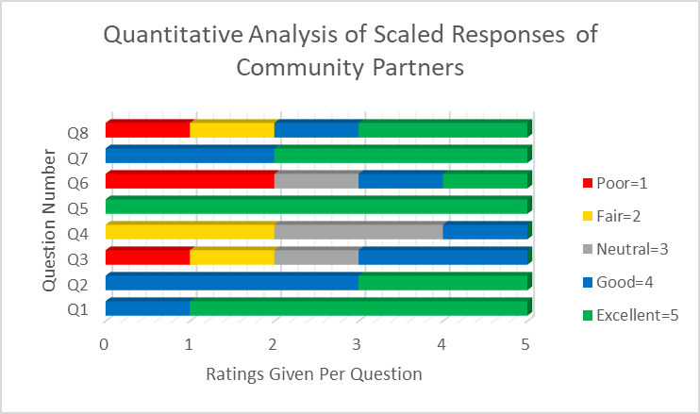
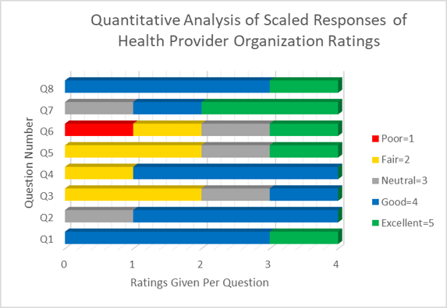
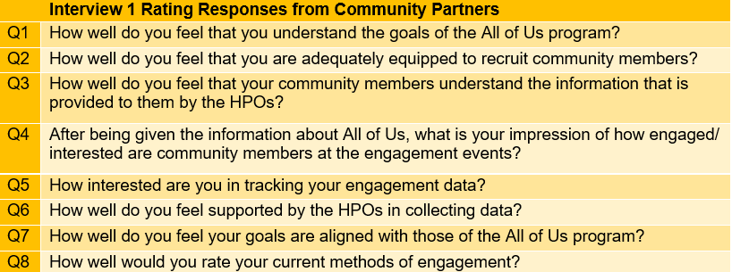
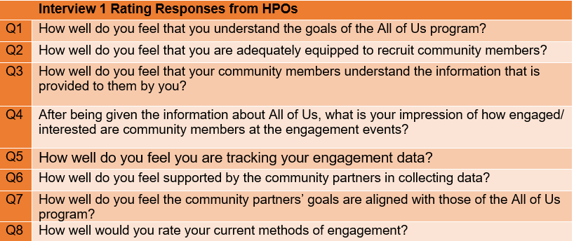
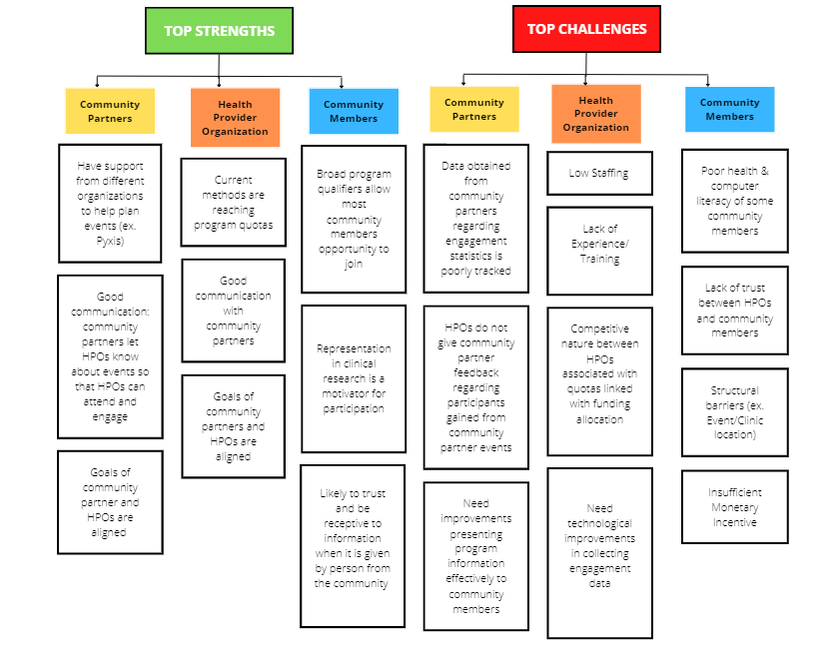
Analysis of Strengths and Barriers of Engaging a Diverse Population in a Biobank Program
Betsiti Araya* of Albert Einstein College of Medicine
Danielle Despanie* of Louisiana State University School of Medicine in New Orleans Tayler Payton* of Louisiana State University School of Medicine in New Orleans
Hailey Phillips* of Tulane University School of Medicine
Kailen Turner* of Morehouse School of Medicine
Lynn-Caelle Valere* of the University of Central Florida College of Medicine
Dr. Lucio Miele of Louisiana State University Health Science Center in New Orleans, LA
*All authors equally contributed to this project
BACKGROUND
RESULTS
CONCLUSION
The All of Us program aims to expand precision medicine by collecting genomic, environmental, and lifestyle information from a population that is representative of the country’s demographics[1].
At LSUHSC, the All of Us program works with various community partners to connect with community members in New Orleans and surrounding areas.
Each community partner has unique engagement strategies that cater to community members.
Main strength of the All of Us program engagement enterprise comes from its partnerships with community organizations that have well established relationships with the community members and this partnership should be reinforced.
A majority of the HPOs feel that there is work to be done with the community members understanding the information that they are providing.
Both HPOs and community partners believe that data is not tracked thoroughly and that better methods of tracking metrics would better the performance of engagement events and retention.
Further research can be done in evaluating the efficiency of engagement strategies used by HPOs and community partners
OBJECTIVES
Identify current All of Us strategies to engage diverse communities in Louisiana​
Analyze the strengths and barriers of the All of Us research program community engagement enterprise
Identify suggestions for improvement
The graphs above depicts the responses of both the Community Partners(CP) and The Health Provider Organizations(HPO)
These responses indicated that in terms of understanding the goals of the All of Us Program, both the CPs and HPOs feel they have a very good understanding.
HPOs feel like the understanding of the community members of the information presented is lacking.
CPs feel that they have a poor amount of support from the HPOs in collecting data to track effectiveness
RECOMMENDATIONS
Thorough training of HPOs and community partners on the details of the All of Us program
Expand HPO staff and partner with more community organizations
Track enrollment and retention data and make it available for community partners
Provide resources and materials that are specific to the community being engaged
METHODOLOGY
Sample
4 representatives of the Health Provider Organization (HPOs)
5Community Partners
Measures
Answers were translated to a 5-point scale
1= Poor; 5= Excellent
Design
Series of 2 interviews conducted with both HPOs and Community Partners
Interview 1 focused on progress already made
Interview 2 focused on improvements that Community Partners and HPOs suggested
ACKNOWLEDGEMENTS
The Robert A. Winn Clinical Investigator Pipeline Program (CIPP)
All of Us at LSUHSC, New Orleans, LA
Dr. Lucio Miele
Robert A. Winn Clinical Investigator Pipeline Program Award (Winn CIPP)
References
[APA format of any references used or quoted in poster]
This chart depicts the common qualitative response to the non-scaled questions during the interviews

Slide 2
Tayler D. Payton
L3

Slide 3
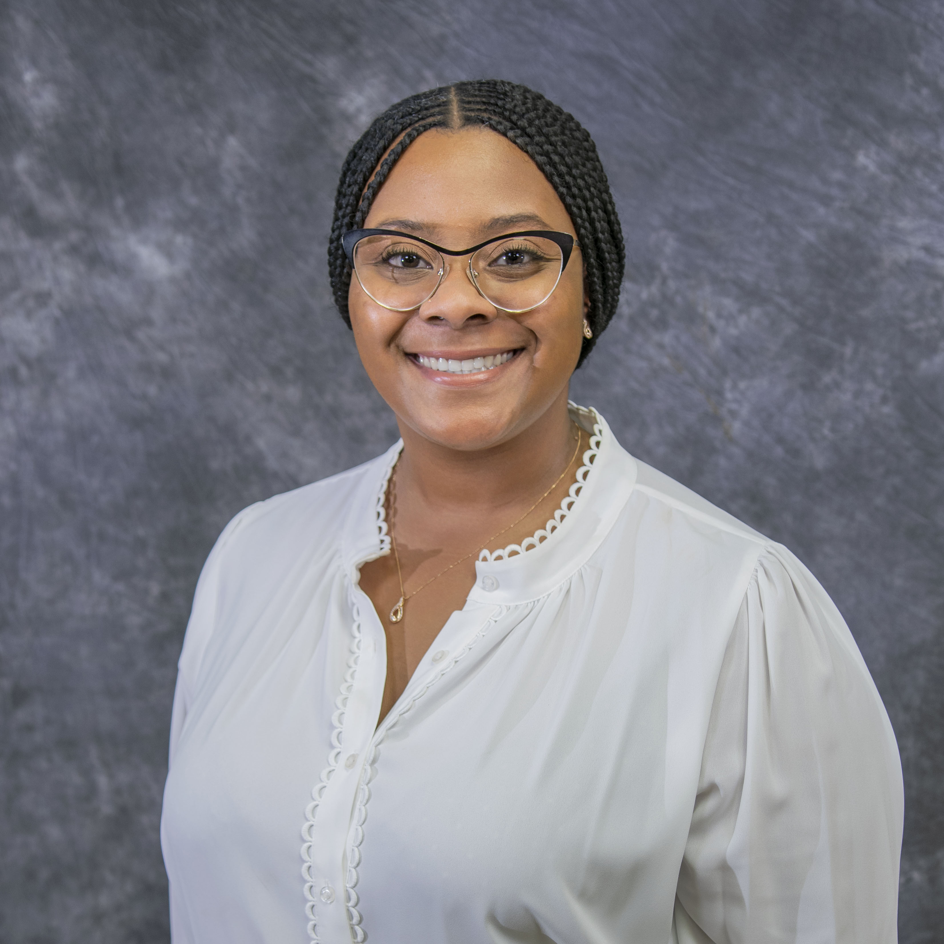
Danielle J. Despanie
L2

