Slide 1
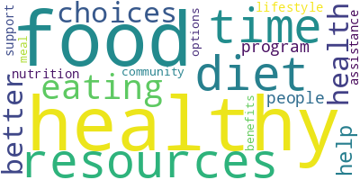
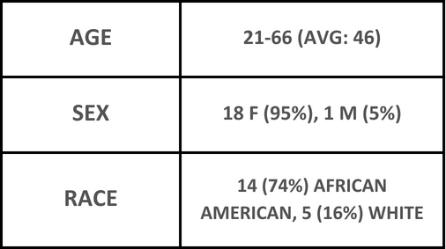
Failure to Follow-Up, There’s More to the Story Emily Dubuisson¹, Emma Domangue¹, Greggory Davis PhD², Tiffany Ardoin MD² ¹LSU Health Sciences Center, School of Medicine, New Orleans, LA ²LSU Health Sciences Center, Department of Internal Medicine, Baton Rouge, LA
Introduction
Objective
Results
Food insecurity is the uncertainty or limitation of access to nutritious food for a healthy lifestyle with normal growth and development.
Food insecurity leads to negative health outcomes, poor development, and lower life expectancy.
Elective health programs aimed to address food insecurity do exist, such as the Geaux Get Healthy Clinical Program at Our Lady of the Lake.
However, literature regarding attendance and utilization of these elective health programs is scarce.
This project aims to investigate reasons behind lack of enrollment or completion of eligible, food insecure individuals of the Baton Rouge community into the Geaux Get Healthy Clinical Program at Our Lady of the Lake.
Additionally, this project seeks to delineate the demographic characteristics of the food insecure population in Baton Rouge, Louisiana.
19 participants were interviewed.
See figure below for patient demographics.
Most study participants did not enroll in or complete Geaux Get Healthy due to a lack of knowledge of the program. Majority did not know about the program (63%) or why they qualified (79%).
Other reasons for not participating included a sense of embarrassment, a lack of transportation, and other evening priorities.
Conclusions
Methods​
While community funded programs aim to address food insecurity, little progress can be made if participants are not enrolling and completing the programs.
Investigating why people do not take advantage of these programs helps us address barriers to enrollment and enhance participation in future projects.
This project is the first step in correcting issues within elective health programs to ensure maximization of resources.
Future studies should aim to find effective methods for program advertisement and communication with participant follow-up.
This prospective qualitative study used semi-structured phone interviews lasting approximately 45-60 minutes per participant. The interviews were audio recorded and transcribed for qualitative thematic analysis.
Demographic data of the study population were extracted from the Epic database and statistically analyzed.
The target population was comprised of individuals screened positive for food insecurity who did not enroll in or complete the Geaux Get Healthy Clinical Program at Our Lady of the Lake.
Patient Demographics
1
This research project was supported through the LSU Health Sciences Center, School of Medicine.

