Slide 1
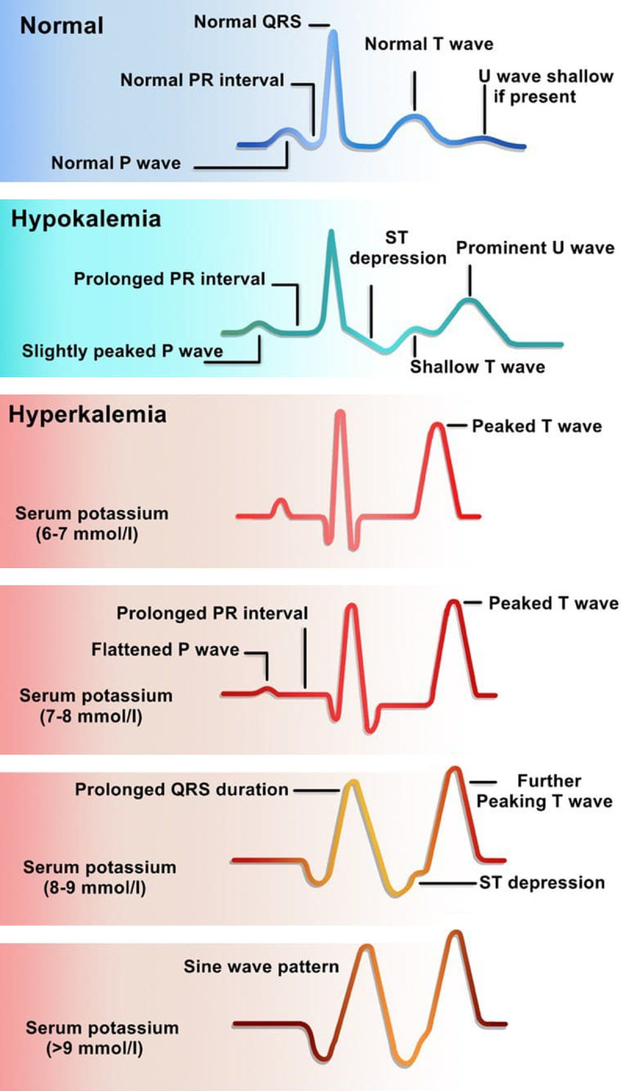
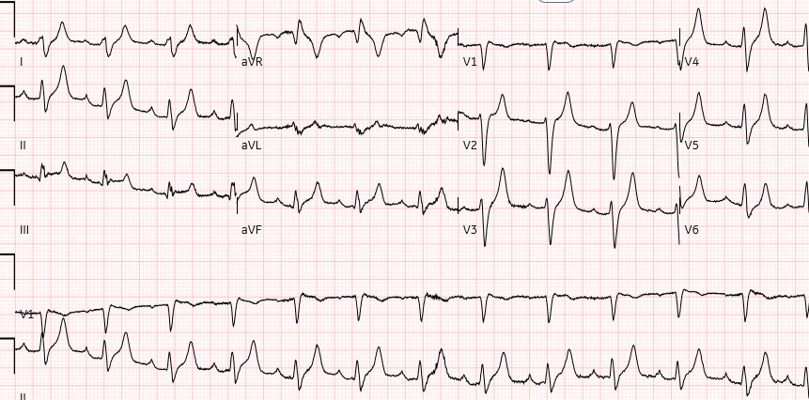
An Ironic Electrolyte Imbalance: A Hyperkalemic Emergency in Primary Hyperaldosteronism
Ahmed Fazal-ur-rehman,B.S.¹; Asad Mussarat, MD¹; Luke Yesbeck, DO¹; Angus Harper, MD¹; Ashley Van, MD¹; Sumrita Bindra, DO¹; Rebecca Maitski¹; Brian Mackel, MD¹; Seth Vignes, MD¹
¹Department of Internal Medicine
LSU Health Sciences Center, New Orleans, LA
Introduction
Discussion
Hyperkalemia is an electrolyte imbalance that can lead to dangerous arrhythmias such as ventricular fibrillation, and ventricular tachycardia, as well as symptoms of generalized muscular weakness, syncope, fatigue, or palpitations. This electrolyte abnormality can occur as a result of different disease processes such Diabetes mellitus or renal disease, as well as due to iatrogenic causes, such as medications such as ACE inhibitors or Spironolactone. The following case highlights how hyperkalemia may present, as well as the importance of swift treatment and patient education on medication self- administration.
Hyperkalemia is an important complication following medical treatment of primary hyperaldosteronism. Surgically and medically treated patients with primary hyperaldosteronism have been studied to develop hyperkalemia more likely when older and have a poorer renal function. Hyperkalemia in outpatient settings has been found to have an elevated all-cause mortality risk with HR~1.08. Similarly, hyperkalemia in the inpatient setting also has an elevated all-cause mortality risk with HR~1.66. Therefore, rapid recognition and action is indicated for hyperkalemic emergencies. More importantly, it is imperative to educate patients not only on adherence to medications prescribed but on the dangers of overdose.
Case Presentation
Case: A 52-year-old female with a past medical history of primary hyperaldosteronism, hypertension, and PTSD presented with 3 days of emesis and diarrhea. With history of hypokalemia and her GI losses, she tripled her home doses of lisinopril 25 mg, spironolactone 25 mg , and potassium-chloride 20 mg the morning of her admission. Her main symptoms during admission day were generalized muscle weakness, fatigue, and anxiety. She denied chest pain or palpitations. Admission vitals included a BP 159/98, pulse 97 beats/minute, and a respiratory rate 16 breaths/minute. Physical exam was significant for bilateral lower extremity pain, abdominal pain, and back pain. Otherwise, no pertinent findings on cardiovascular physical exam. Admission labs confirmed a potassium of 9.5 mEq/L, a bicarbonate of 19 mEq/L, and a creatinine of 4.07 mg/dL. Patient was diagnosed with drug-induced hyperkalemic emergency complicated by a Type 4 renal tubular acidosis. Her electrocardiogram demonstrated new-onset peaked T waves, a prolonged PR interval, and a normal QTc interval. In the ED and ICU, she received multiple injections of calcium gluconate for cardiac stabilization, aggressive IV fluids, and Lokelma. She was further shifted with IV insulin, IV sodium bicarbonate, and albuterol nebulizers. Her potassium levels and creatinine level had slowly downtrended to baseline over the next 3 days without urgent hemodialysis. Home lisinopril, spironolactone, and potassium chloride were discontinued until nephrology follow up. Most importantly, patient was counseled on adherence to medication and was discharged in stable condition.
Conclusion
While disease processes such as Diabetes mellitus and Renal disease are common causes of hyperkalemia, this patient, while having a history of hyperaldosteronism, was found to have hyperkalemia secondary to incorrect medication self-administration. The importance of patient education cannot be over-emphasized as this case shows that hyperkalemia can present with relatively mild symptoms, despite having grave potential consequences. The insidious nature of this patient’s disease secondary to her medication use was brought to a swift halt when detected. However, thorough education on the adverse effects of medications, as well as of self-medicating, can help prevent episodes such as that of this patient.
Figure 1: EKG findings seen in normal vs hypokalemic vs hyperkalemic settings
References
Hougen I, Leon SJ, Whitlock R, Rigatto C, Komenda P, Bohm C, Tangri N. Hyperkalemia and its Association With Mortality, Cardiovascular Events, Hospitalizations, and Intensive Care Unit Admissions in a Population-Based Retrospective Cohort. Kidney Int Rep. 2021 Mar 17;6(5):1309-1316. doi: 10.1016/j.ekir.2021.02.038. PMID: 34013109; PMCID: PMC8116905.
Simon LV, Hashmi MF, Farrell MW. Hyperkalemia. [Updated 2023 Sep 4]. In: StatPearls [Internet]. Treasure Island (FL): StatPearls Publishing; 2024 Jan.
Teymouri N, Mesbah S, Navabian SMH, Shekouh D, Najafabadi MM, Norouzkhani N, Poudineh M, Qadirifard MS, Mehrtabar S, Deravi N. ECG frequency changes in potassium disorders: a narrative review. Am J Cardiovasc Dis. 2022 Jun 15;12(3):112-124. PMID: 35873184; PMCID: PMC9301030.
Figure 2: Patient’s EKG findings upon presentation to the ED. Most notably, spiked T waves diffusely.

