Slide 1
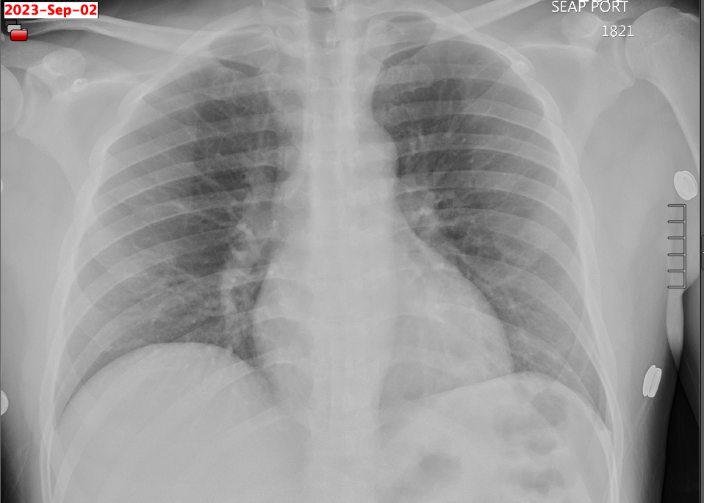
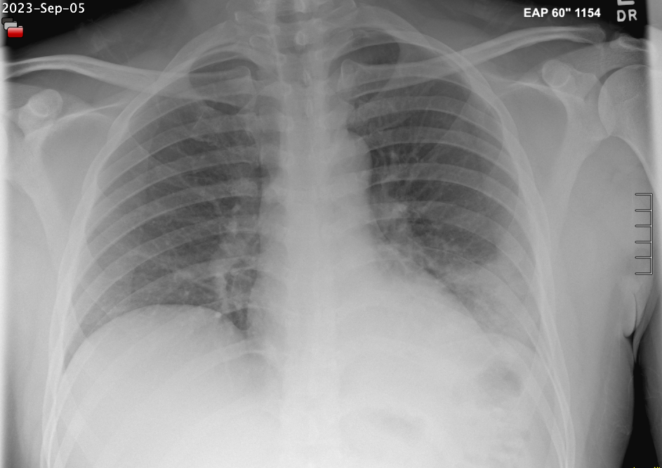
Aseptic Meningitis as the Sole Presenting Symptom of Legionnaire’s Disease Michael Forte¹ William Benton, M.D.^{1,2} 1School of Medicine, Louisiana State University Health Science Center, New Orleans. 2Department of Internal Medicine, Louisiana State University Health Sciences Center, Baton Rouge
Introduction
Imaging
Case Con’t
Aseptic meningitis is the most common form of meningitis, with an incidence of 7.6 per 100,00 adults
Characterized by signs and symptoms of meningeal inflammation without bacterial growth on cultures of the CSF (1).
Most cases of aseptic meningitis are viral but can occasionally occur in bacterial infections with negative CSF cultures (2,3)
CXR on admission:
Multitarget PCR of spinal fluid negative for common causes of menigitis
CSF sent for culture and abx d/c given LP findings
HD #2: WBC rose to 14,200/µL, and fevers continued, so ceftriaxone and vancomycin were reinitiated
West Nile and AFB cultures were added to cerebrospinal fluid studies
HD #3: Crackles and egophony in the left lower lung zone were auscultated
CXR confirmed an airspace opacity and Lvofloxacin added
HD #4: Urine Legionella antigen test returned positive
patient improved w/ levofloxacin
discharged to his facility to complete a a 14-day PO course of levofloxacin for Legionella pneumonia
Case
A 41-year-old incarcerated male with a PMH of migraines and prior tobacco use presented in late summer with fevers to 104, headaches, neck stiffness, and body aches for 4 days.
On exam, (AF, VSS), patient was diaphoretic, and neck flexion elicited pain. Lungs CTAB, no focal neurologic deficits.
Laboratory studies showed a WBC of 12,000/µL (74% PMN, 14% lymphocytes). CMP WNL
HD #1: multitarget respiratory PCR swab was negative for any pathogens.
Patient started on IV steroids, vancomycin, and ceftriaxone.
LP showed 14 WBC/µL (2% PMN, 85% lymphocytes, and 13% monocytes). Total protein and glucose WNL
CXR on HD#3:
Conclusions
Pneumonia is the most common symptom
40-50% of legionella pneumophila infections present with neurological symptoms (5)
should be considered in the workup of patients presenting with meningitis or other unexplained neurologic symptoms when initial CSF cultures and viral meningitis panels are negative.
Reference
1. Mount HR, Boyle SD. Aseptic and Bacterial Meningitis: Evaluation, Treatment, and Prevention. Am Fam Physician. 2017 Sep 1;96(5):314–22.
2. de Almeida SM, Nogueira MB, Raboni SM, Vidal LR. Laboratorial diagnosis of lymphocytic meningitis. Braz J Infect Dis. 2007 Oct;11(5):489–95.
3. Sigurdardóttir B, Björnsson OM, Jónsdóttir KE, Erlendsdóttir H, Gudmundsson S. Acute bacterial meningitis in adults. A 20-year overview. Arch Intern Med. 1997 Feb 24;157(4):425–30.
4. Castillo NE, Rajasekaran A, Ali SK. Legionnaires’ Disease: A Review. Infect Dis Clin Pract. 2016 Sep;24(5):248–53.
5. Johnson JD, Raff MJ, Van Arsdall JA. Neurologic Manifestations of Legionnairesʼ Disease: Medicine. 1984 Sep;63(5):303–10.
Notes:
Legionnaires’ disease is a severe form of pneumonia associated with extrapulmonary manifestations caused by the facultative intracellular bacteria Legionella pneumophila. This bacteria is ubiquitous in the environment worldwide, mainly isolated from soil and natural or artificial aqueous reservoirs, including freshwater streams, lakes, showers, pools, sprinklers, or air conditioning cooling towers. Legionnaire’s disease presents with a wide array of symptoms, including fever, cough, dyspnea, nausea, vomiting, and diarrhea (1). While the pulmonary and gastrointestinal symptoms are well understood, the neurologic manifestations of Legionnaires’ disease are less elucidated in the literature. Reported neurologic involvement in Legionnaires’ disease includes encephalitis, meningitis, peripheral nerve demyelination, cerebral abscesses, and brain stem lesions (2–4). Patients with Legionnaires’ disease may develop peripheral and central neurologic dysfunction during the acute phase of the illness that may vary in intensity and presentation. Neurologic symptoms include dysarthria, cerebellar ataxia, and hallucinations. Altered mental status is one of the most prominent findings consisting of confusion, disorientation, behavioral or personality changes, depression, and somnolence. Headache is the second most commonly reported symptom, and neck stiffness has been reported as well (5). We report a case of an immunocompetent middle-aged male presenting with signs and symptoms of atypical meningitis, ultimately found to be Legionella pneumophilla pneumonia
A 41-year-old incarcerated male with a PMH of migraines and prior tobacco use presented in late summer with fevers to 104, headaches, neck stiffness, and body aches for 4 days.
On exam, (AF, VSS), patient was diaphoretic, and neck flexion elicited pain. Lungs CTAB, no focal neurologic deficits.
Laboratory studies showed a WBC of 12,000/µL (74% PMN, 14% lymphocytes). CMP WNL
HD #1: multitarget respiratory PCR swab was negative for any pathogens.
Patient started on IV steroids, vancomycin, and ceftriaxone.
LP showed 14 WBC/µL (2% PMN, 85% lymphocytes, and 13% monocytes). Total protein and glucose WNL
Multitarget PCR of spinal fluid negative for common causes of menigitis
CSF sent for culture and abx d/c given LP findings
HD #2: WBC rose to 14,200/µL, and fevers continued, so ceftriaxone and vancomycin were reinitiated
West Nile and AFB cultures were added to cerebrospinal fluid studies
HD #3: Crackles and egophony in the left lower lung zone were auscultated
CXR confirmed an airspace opacity and Lvofloxacin added
HD #4: Urine Legionella antigen test returned positive
patient improved w/ levofloxacin
discharged to his facility to complete a a 14-day PO course of levofloxacin for Legionella pneumonia
Neurological symptoms of legionella pneumophila infections often lead to extensive, time-consuming diagnostic workups and may considerably influence patient outcomes. Mental status changes, dysarthria, and hallucinations are the most frequent neurological findings, while headache and neck stiffness have also been reported. The exact pathogenic mechanism of legionella-induced neurological dysfunction is unknown. However, it has been hypothesized that immunologic effects or toxin accounts for neurological symptoms (5). Although most cases of Legionnaires disease present with normal CSF leukocyte counts and sterile cultures with few exceptions(6,7), our patient presented with a physical exam and lab findings concerning aseptic meningitis ultimately determined to be neurological symptoms secondary to Legionella pneumonia infection with late-onset pulmonary symptoms confirmed with urinary antigen testing for legionella pneumophila
Although pneumonia is the most commonly described feature of a Legionella infection, it can cause a broad spectrum of illness, and respiratory symptoms may not be present at onset (4). Around 40-50% of legionella pneumophila infections present with neurological symptoms regardless of pulmonary involvement and may be considered in the workup of patients presenting with physical exam and lab findings concerning for meningitis or other unexplained neurologic symptoms (5).

