Slide 1
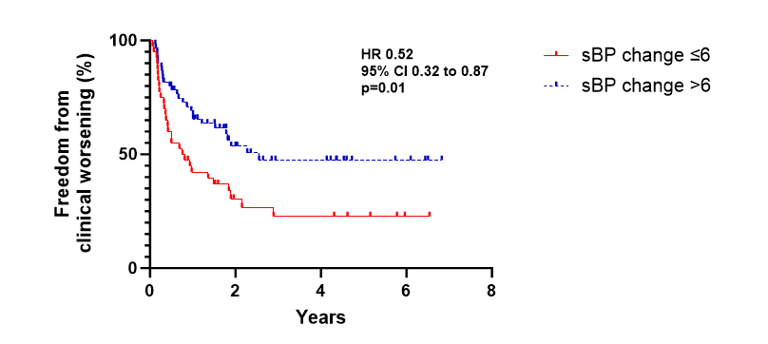
Hai Vu Tran MD¹, Christopher Van Dreumel MD¹, Alison Schafer BS¹, Bennett deBoisblanc MD¹, Matthew Lammi MD² ¹Section of Pulmonary/Critical Care & Allergy/Immunology, Department of Internal Medicine, LSU Health Sciences Center, New Orleans, LA ²Pulmonary and Critical Care, Johns Hopkins School of Medicine, Baltimore, MD
Blood Pressure Change During Six-Minute Walk Test is an Independent Predictor of Clinical Worsening in Patients with Pulmonary Hypertension
Introduction
Results
Risk stratification has emerged as standard of care in treating patients with pulmonary hypertension (PH), but further refinements may improve patient care.
Six-minute walk tests (6MWT) are routinely used to monitor patients, but there are parameters beyond walking distance that may be informative.
Our aim was to investigate blood pressure response to exercise during a 6MWT in PH.
One hundred two patients with PH were studied (80% Group 1, 13% Group 4, age 54 ± 15 years, pulmonary vascular resistance 7.5 ± 4.5 Wood units). ​
Median sBP change post-exercise was 9mmHg (interquartile range 4, 16). sBP change did not significantly correlate with TAPSE (r=0.14, p=0.22). ​
While sBP change was similar in those with or without RV dysfunction (p=0.18), those with RV enlargement showed a smaller increase in sBP (p=0.02). Fifty-six percent of patients had a worsening event. Patients unable to generate a sBP change >6 mmHg during 6MWT had approximately a 2-fold increased risk of clinical worsening (hazard ratio 1.92, 95% confidence interval [CI], 1.15 to 3.13, p=0.01, Figure). ​
When adjusting for REVEAL lite 2, there remained a significant association of sBP change with TTCW (hazard ratio, 1.82; 95% CI, 1.07-3.03, p=0.03).​
Methods
Figure 1: Plot depicting correlations of RV dysfunction & RV enlargement to change in sBP
This retrospective study included outpatients in a single comprehensive PH center evaluated from August 2016 to December 2022.
Patients had a 6MWT performed at that facility within 6 months of their initial visit. ​
Pre-exercise and immediate post-exercise systolic blood pressures (sBP) were recorded, with sBP change calculated as sBP(post)-sBP(pre). ​
We compared sBP change in patients with and without right ventricular (RV) dysfunction or enlargement using Mann Whitney U, and sBP change was correlated to TAPSE using Spearman correlation. ​
Receiver operating characteristics curve analysis determined the optimal cutoff of sBP change for clinical worsening events, defined as the first occurrence of death, lung transplant, PH-related hospitalization, or worsened functional class leading to PH medication escalation.​
Cox regression models were used to assess the relationship between change in sBP and time to clinical worsening (TTCW), adjusted for REVEAL lite 2 risk score.
Model | HR | 95% CI | p value
sBP change | 0.91 | 0.81 to 1.02 | 0.11
sBP change (1000 bootstraps) | 0.91 | 0.80 to 1.03 | 0.15
sBP change + age | 0.91 | 0.81 to 1.02 | 0.11
sBP change + REVEAL | 0.93 | 0.84 to 1.05 | 0.24
sBP change + HTN hx | 0.92 | 0.92 to 1.04 | 0.18
sBP change + BP med | 0.91 | 0.91 to 1.02 | 0.11
sBP ≤ 6 or >6 | 0.52 | 0.32 to 0.87 | 0.01
sBP ≤ 6 or >6 + REVEAL | 0.55 | 0.33 to 0.93 | 0.03
sBP ≤ 6 or >6 + HRR | 0.48 | 0.24 to 0.84 | 0.01
Discussion
While BP response during a 6MWT in PH patients are variable and does not strongly correlate with RV dysfunction, insufficient sBP change in response to exercise independently predicted time to clinical worsening in PH patients.​
If externally validated, this easily obtained parameter may be useful for risk stratification.
Future Studies?
Future Studies
Analysis of additional dataset (PVDOMICS) which has collected data from multiple centers
If confirmed, would validate our single center study
References
Blumberg FC, Arzt M, Lange T, Schroll S, Pfeifer M, Wensel R. Impact of right ventricular reserve on exercise capacity and survival in patients with pulmonary hypertension. Eur J Heart Fail. 2013 Jul;15(7):771-5. doi: 10.1093/eurjhf/hft044. Epub 2013 Mar 18. PMID: 23507788.
Forfia PR, Fisher MR, Mathai SC, Housten-Harris T, Hemnes AR, Borlaug BA, Chamera E, Corretti MC, Champion HC, Abraham TP, Girgis RE, Hassoun PM. Tricuspid annular displacement predicts survival in pulmonary hypertension. Am J Respir Crit Care Med. 2006 Nov 1;174(9):1034-41. doi: 10.1164/rccm.200604-547OC. Epub 2006 Aug 3. PMID: 16888289.
Grünig E, Eichstaedt CA, Seeger R, Benjamin N. Right Heart Size and Right Ventricular Reserve in Pulmonary Hypertension: Impact on Management and Prognosis. Diagnostics (Basel). 2020 Dec 21;10(12):1110. doi: 10.3390/diagnostics10121110. PMID: 33371372; PMCID: PMC7767391.
Miyamoto S, Nagaya N, Satoh T, Kyotani S, Sakamaki F, Fujita M, Nakanishi N, Miyatake K. Clinical correlates and prognostic significance of six-minute walk test in patients with primary pulmonary hypertension. Comparison with cardiopulmonary exercise testing. Am J Respir Crit Care Med. 2000 Feb;161(2 Pt 1):487-92. doi: 10.1164/ajrccm.161.2.9906015. PMID: 10673190.
Yogeswaran A, Richter MJ, Sommer N, Ghofrani HA, Seeger W, Tello K, Gall H. Advanced risk stratification of intermediate risk group in pulmonary arterial hypertension. Pulm Circ. 2020 Oct 7;10(4):2045894020961739. doi: 10.1177/2045894020961739. PMID: 33088480; PMCID: PMC7545769.
Table 2: Hazard Ratios of sBP change and when adjusted for multiple variables
Figure 2: Cox regression models for TTCW (sBP changes are per 5mmHg)

