Slide 1


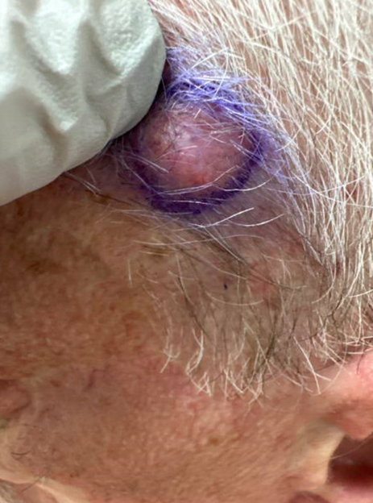
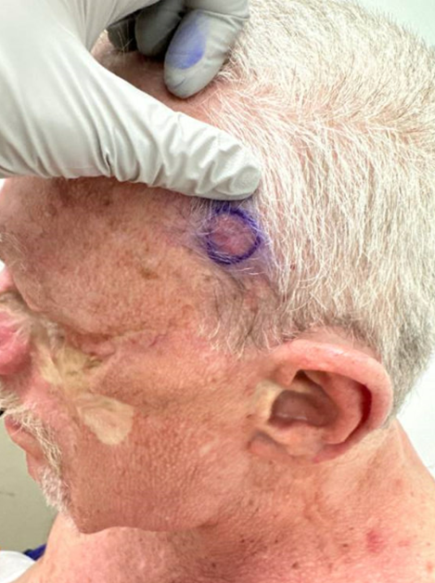
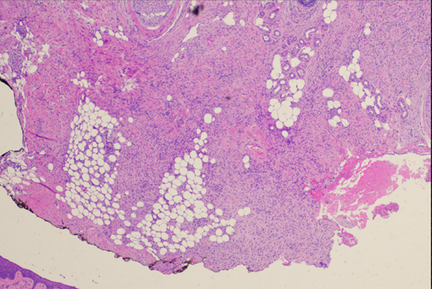
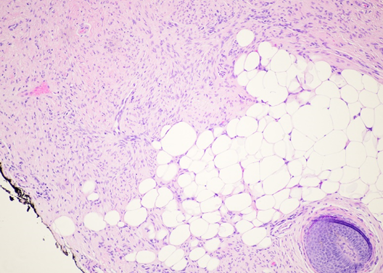
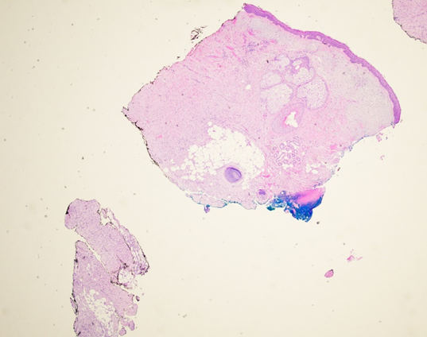
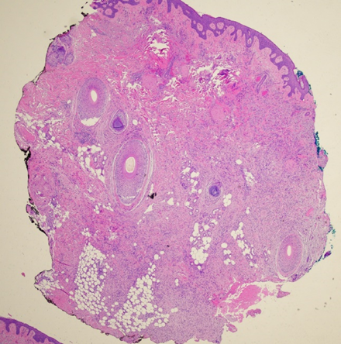
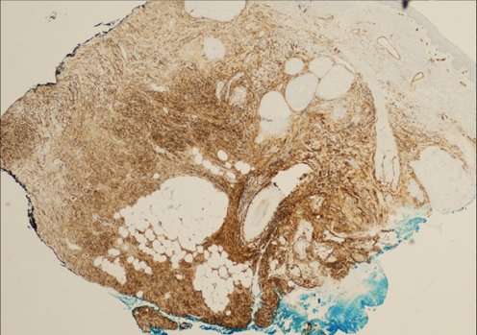
A Case of Recurrent Head and Neck Dermatofibrosarcoma Protuberans (DFSP)
Kathryn Dillman¹ · Nicholas Culotta² · Rosemary Prejean² · Christopher Haas² ·
Deborah Hilton² · Pam Martin²
1. LSU Health Sciences School of Medicine at New Orleans
2. Department of Dermatology, Louisiana State University Health Sciences Center at New Orleans
Background
Clinical and Pathological Images
Discussion and Future Directions
▻ DFSP is a rare (0.8-4.5 cases per million person-years) soft tissue tumor that typically involves the dermis and subcutaneous fat.
▻ It most commonly presents as an asymptomatic, slow growing, skin-colored or red-brown plaque on the trunk or pelvic region of young adults.
▻ 90% of cases of DFSP are thought to be the result of a chromosomal translocation (between 17 and 22) resulting in the COL1A1-PDGFB fusion protein which promotes excess production of PDGF.
▻ Diagnosis is made with an incisional or excisional biopsy along with an immunohistochemical panel. Treatment involves surgical removal through Mohs micrographic surgery (MMS) or wide local excision.
Figures 1,2: Clinical images featuring the patient’s left skin-colored scalp nodule.
▻ Differential diagnoses included cutaneous melanoma, keloid scarring, epidermal inclusion cyst, dermatofibroma, dermatologic metastatic carcinoma, and morphea.
▻ Following his shave biopsy which confirmed DFSP recurrence, the patient underwent wide local excision with one centimeter margins with both circumferential and deep margins displaying positive results for DFSP.
▻ He then underwent mapping punch biopsies (negative for DFSP) and an MRI face with and without contrast along with re-excision with positive circumferential margins.
▻ The MRI displayed a 0.5 cm ovoid enhancing nodule in the superficial soft tissues immediately caudal to the left zygomatic arch along with a 1.5 cm enhancing nodule overlying the left SCM.
▻ The current plan for treatment was extended to involve both medical and radiation oncology due to the consistently positive margins.
▻ Future therapies include tyrosine kinase inhibitors like Imatinib. Eligibility for these therapies would involve tyrosine kinase inhibitor testing.
[1]
[2]
Case Description
▻ The patient is a 68 year old Caucasian male with a past medical history of hypertension, nephrolithiasis, Guillain-Barre syndrome, and actinic keratoses presenting for recurrent DFSP.
▻ His first occurrence of DFSP was in 1987 which involved multiple excisions including a previous pec-flap with failure and required left orbital enucleation.
▻ He had recurrences in both 2008 and 2014. Both led to re-excisions with the latter leaving positive margins. At this time, he elected for clinical monitoring.
▻ Most recently in the Fall of 2023, he presented for follow up at Dermatology clinic regarding several lesions.
[3]
[4]
References
Brooks J, Ramsey ML. Dermatofibrosarcoma Protuberans. [Updated 2023 Apr 14]. In: StatPearls [Internet]. Treasure Island (FL): StatPearls Publishing; 2024 Jan. Available from: https://www.ncbi.nlm.nih.gov/books/NBK513305/
Huis In 't Veld EA, van Coevorden F, Grünhagen DJ, Smith MJ, van Akkooi ACJ, Wouters MWJM, Hayes AJ, Verhoef C, Strauss DC, van Houdt WJ. Outcome after surgical treatment of dermatofibrosarcoma protuberans: Is clinical follow-up always indicated? Cancer. 2019 Mar 1;125(5):735-741. doi: 10.1002/cncr.31924. Epub 2019 Jan 15. PMID: 30644528.
Neff R, Collins R, Backes F. Dermatofibrosarcoma protuberans: A rare and devastating tumor of the vulva. Gynecol Oncol Rep. 2019 Jan 25;28:9-11. doi: 10.1016/j.gore.2019.01.006. PMID: 30733992; PMCID: PMC6357686.
[5]
[6]
[7]
Figures 3-6: Pathological images consistent with DFSP.
Figure 7: CD34 stained specimen.

