Slide 1
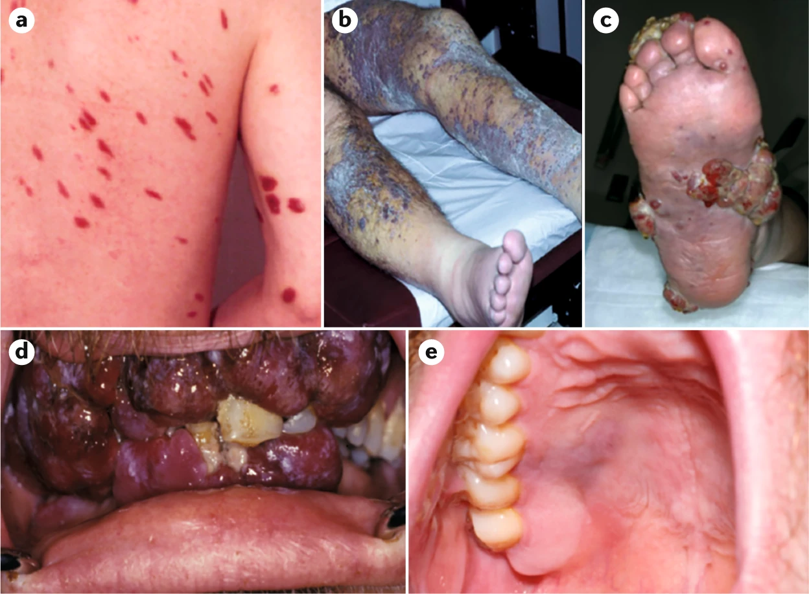
Simultaneous Diagnosis of HIV and Disseminated Kaposi Sarcoma
Catherine Loehr, MD; Giacomo Adoncecchi, BS; Alexandra Denys, PhD; Matthew Bennett,MD; Maren Bell, MD; Allison Pinner, MD
Department of Medicine, LSU Health Sciences Center, New Orleans LA
Introduction
Case Description
Kaposi sarcoma (KS) is an AIDS-defining illness characterized by the development of vascular tumors, often associated with infection by human herpesvirus-8 which is characterized by angiogenesis, inflammation and cellular proliferation.
KS is the most common tumor in individuals with HIV. Patients with AIDS-related Kaposi sarcoma usually respond well to HAART, which can cause regression of their sarcoma.
KS usually presents as a cutaneous manifestation but can involve a wide range of visceral organs, including the oral cavity, gastrointestinal tract, and lungs. Visceral involvement is typically a later manifestation of disease and is unusual as an isolated site for the initial presentation.
This case highlights a rare and challenging clinical scenario, involving the simultaneous diagnosis of HIV and KS with KS progressing despite HAART and chemotherapy.
26-year-old man with newly diagnosed HIV (on Biktarvy, recent undetected viral load, CD4 496) complicated by KS presented for gradual severe left lower extremity (LLE) pain and edema radiating to his groin for 2 weeks. Associated with subjective fever, chills and night sweats.
Previous episode of generalized swelling 7 months prior when his oropharyngeal mass was biopsied and found to be HIV positive with KS. He was initiated on antiretroviral therapy with Biktarvy and referred to oncology for KS management where he completed six cycles of Doxorubicin with swelling that gradually improved. After his final cycle, he was lost to follow up and did not undergo staging imaging.
Physical exam: tenderness and edema from LLQ abdomen to entire LLE with skin induration, hyperpigmentation, several raised lesions and excoriations. Extensive edema to penis and testicles. Bilateral inguinal lymphadenopathy.
Labs: WBC 6, Hgb 10.4, ESR 35, CRP 6.3. Blood and urine cultures negative.
Imaging: LLE ultrasound confirmed diffuse edema and lymphadenopathy, ruled out fluid collection. Pan CT notable for lesions on the bilateral chest wall and lumbar spine concerning for metastatic KS.
It was evident that lymphatic obstruction due to KS was the primary cause of his presentation, leading to severe pain and anasarca.
Management: Diuretics for edema. Vancomycin for cellulitis. Resumed Biktarvy. Since he progressed within 3 months of receiving doxorubicin indicating refractory disease, oncology planned for paclitaxel chemotherapy.
Discussion
Discussion
Figure 1. Different manifestations of Kaposi sarcoma: (a) macular lesions on the back and nodules on the arm; (b) extensive KS plaques on the legs with tumor-associated edema; (c) exophytic KS lesions on the foot; (d) extensive gingival KS nodules; and (e) flat, violaceous lesions on the hard palate. The image in (c) is of a patient with classic KS; all other images are of patients with AIDS-related KS.
This case report demonstrates the aggressiveness of KS, as the patient experienced metastatic spread to the oropharynx, spine, and other areas of the body despite apparent initial improvement. After completing chemotherapy, patient presented with LLE edema, groin pain, and systemic symptoms. Imaging indicative of progressive disease and lymphatic obstruction.
This case serves as a reminder about the potential aggressiveness of KS, even in the setting of HAART and chemotherapy.
It underscores the importance of a holistic approach to patient management, involving regular monitoring, patient education, and the incorporation of palliative care to improve the overall quality of life for patients facing the challenges of AIDS-related complications.
References
Groopman JE. AIDS-related Kaposi sarcoma: Clinical manifestations and diagnosis. UpToDate. October 11, 2022. Accessed February 25, 2024. https://www.uptodate.com/contents/aids-related-kaposi-sarcoma-clinical-manifestations-and-diagnosis?search=AIDS-related+Kaposi+sarcoma%3A+Clinical+manifestations+and+diagnosis&source=search_result&selectedTitle=1~36&usage_type=default&display_rank=1.
Ahad Azeem, Nida Majeed, Richard Swaney, et al. Kaposi Sarcoma: A Forgotten Complication in Well-Controlled HIV. AIM Clinical Cases.2022;1:e220845. [Epub 6 December 2022]. doi:10.7326/aimcc.2022.0845
Wagner, C., Preiswerk, B. & Weber, R. Disseminated Kaposi sarcoma in newly diagnosed HIV. Infection 39, 91 (2011). https://doi.org/10.1007/s15010-011-0083-y
Anjos, Diana & Sa, Ana & Paupério, André & Mesquita, Mari. (2017). Disseminated HIV-Associated Kaposi’s Sarcoma With High CD4 Cell Count And Low Viral Load. Galicia Clínica. 78. 178. 10.22546/46/1266.
Cesarman, E., Damania, B., Krown, S.E. et al. Kaposi sarcoma. Nat Rev Dis Primers 5, 9 (2019). https://doi.org/10.1038/s41572-019-0060-9
Notes:
write Figure 1,2,3 etc and: Type out image description
While this patient is an outlier because of advanced age, this case serves to exemplify the potential utility of this treatment modality versus the current standard of care (biliary stenting with adjuvant chemoradiation).
(2019). Cholangiocarcinoma. Genetics Home Reference. https://ghr.nlm.nih.gov/condition/cholangiocarcinoma
Rea DJ, Munoz-Juarez M, Farnell MB, et al. (2004). Major hepatic resection for hilar cholangiocarcinoma: analysis of 46 patients. Jama Surgery 139(5), 514-23. https://www.ncbi.nlm.nih.gov/pubmed?term=15136352
Klempnauer J, Ridder GJ, von Wasielewski R, et al. (1997). Resectional surgery of hilary cholangiocarcinoma: a multivariate analysis of prognostic factors. Journal of Clinical Oncology 15(3), 947-54. https://www.ncbi.nlm.nih.gov/pubmed?term=9060532
Tamandl D, Kaczirek K, Gruenberger B, et al. (2009). Lymph node ratio after curative surgery for intrahepatic cholangiocarcinoma. British Journal of Surgery 96(8), 919-25. https://www.ncbi.nlm.nih.gov/pubmed?term=19591163
Takada T, Amano H, Yasuda H, et al. (2002). Is postoperative adjuvant chemotherapy useful for gallbladder carcinoma? A phase III multicenter prospective randomized controlled trial in patients with resected pancreaticobilary carcinoma. 95(8), 1685-95. https://www.ncbi.nlm.nih.gov/pubmed?term=12365016
Junichi Shindoh. (2017). Ablative therapies for intrahepative cholangiocarcinoma. Hepatobiliary Surgery and Nutrition, 6(1), 2-6. https://www.ncbi.nlm.nih.gov/pmc/articles/PMC5332215/
Auriemma F, et al. (2019). Radiofrequency and malignant biliary strictures: an update. World Journal of Gastrointestinal Endoscopy 11(2):95-102. https://www.ncbi.nlm.nih.gov/pmc/articles/PMC6379741/
(2006). FDA clears RF Ablation System for Use in Nonresectable Liver Tumors. Oncology Journal 20(7). https://www.cancernetwork.com/oncology-journal/fda-clears-rf-ablation-system-use-nonresectable-liver-tumors
McCarty T, et al. (2018). New Indications for Endoscopic Radiofrequency Ablation. Clinical Gastroenterology and Hepatology 16:1007-1017. https://www.cghjournal.org/article/S1542-3565(17)31248-X/pdf

