Slide 1


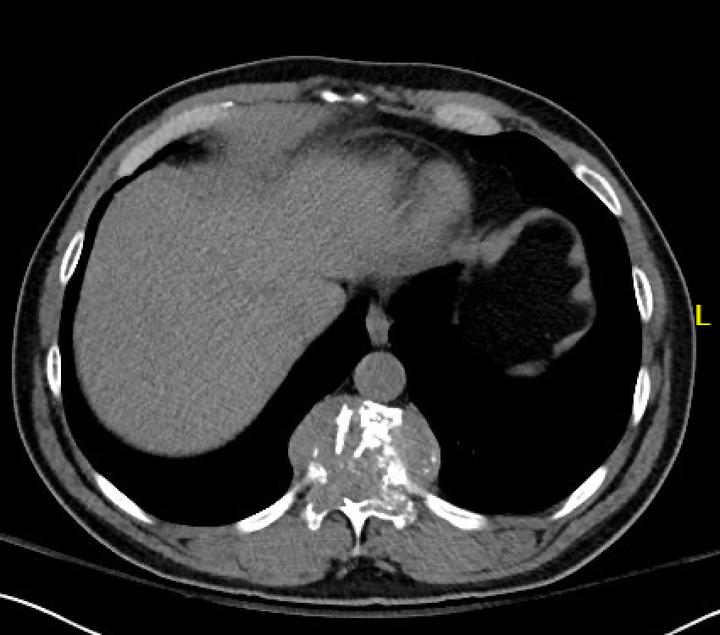
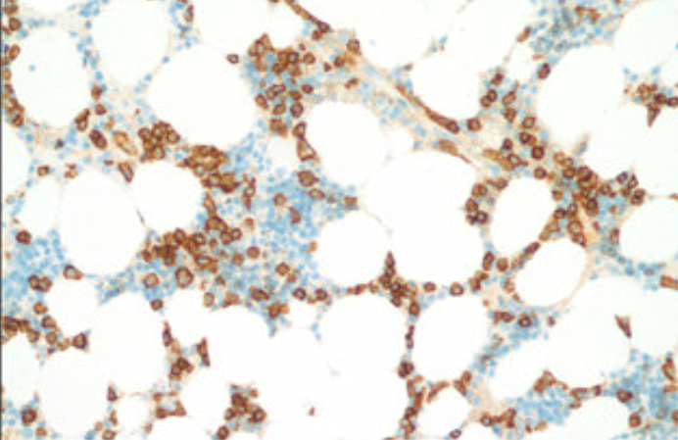
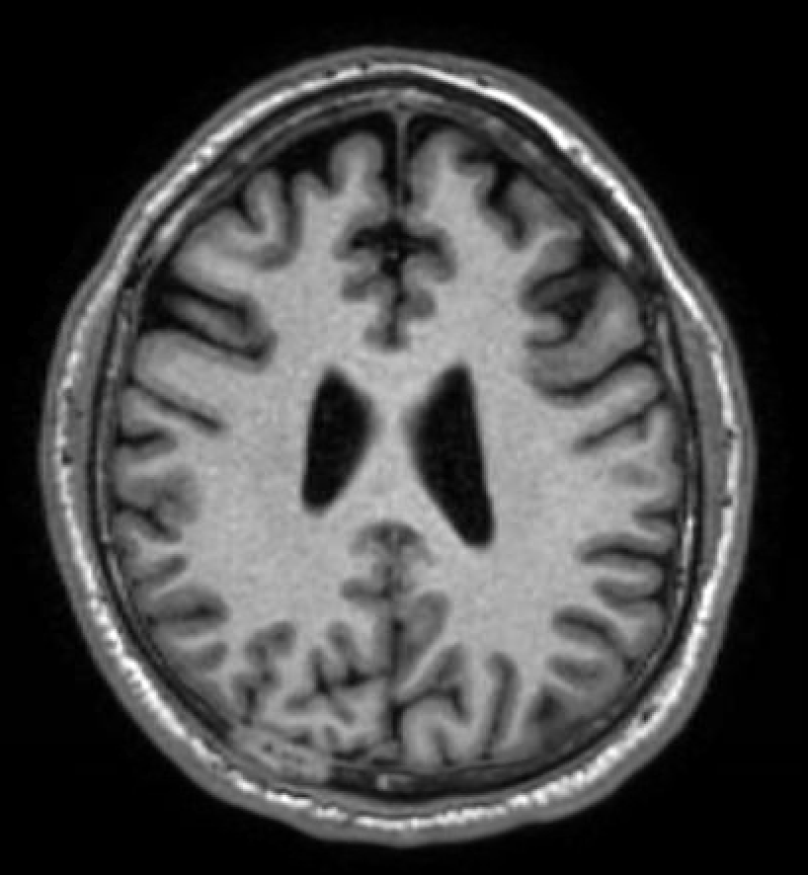
Macrofocal Multiple Myeloma: A Special Subgroup of Multiple Myeloma
Catherine Loehr, MD; Asad Mussarat, MD; Jennifer Hart, MD
Department of Internal Medicine
LSU Health Sciences Center, New Orleans, LA
Introduction
Imaging
Histopathology
Multiple solitary bone plasmacytoma (SBP) is a rare plasma cell dyscrasia, characterized by multiple lesions of neoplastic monoclonal plasma cells. Moreover, it is also coined macrofocal multiple myeloma (MM) which is an uncommon clinical subtype of MM that usually presents in younger patients with multiple lytic bone lesions and less than 10% bone marrow plasma cells. They usually have low tumor burden and favorable outcome. It differs from multiple myeloma by the lack of hypercalcemia, renal insufficiency, anemia and pathological monoclonal plasmacytosis on a random bone biopsy.
Figure 3: Bone marrow biopsy with + CD138 immunostaining plasma cells
Figure 1: CT with lytic destructive lesion involving the T11 vertebral body
Discussion
Case Presentation
A 45-year-old Honduran man with no prior medical history presented to clinic for left-sided rib pain radiating to his back. Pain first began after falling off a truck onto his back 6 years ago, previously relieved with pain medicine. However, he recently moved to the US and ran out of medicine. Spine x-ray showed compression fracture at T10-T11. Biopsy was performed at a T11 lytic lesion showing plasma cell neoplasm with no involvement in the bone marrow. There was successful treatment with focal radiation to the spine, thus no indication for chemotherapy or surgery. PET scan noted a right-sided lesion in the brain. MRI was done with enhancing lesion in the right parieto-occipital skull, indicating another likely plasmacytoma. Plan is to undergo another round of focused radiation.
For SBP, radiotherapy alone controls local lesions in most cases, sometimes recommended with adjunctive chemotherapy for tumors with poor prognostic factors. Higher risk of progression has been detected in patients with spine lesions and age ≥40 years, as seen in this case, after treatment. Despite curative treatment, up to two-third of cases are shown to eventually evolve to generalized myeloma or additional plasmacytomas. Despite that, macrofocal MM has been studied to have better survival than typical symptomatic multiple myeloma.
References
Saksena A, Mahajan N, Agarwal S, Jain S. Solitary bone plasmacytoma: An interesting case report with unusual clinico-cytological features. J Cytol. 2014;31(3):158-160. doi:10.4103/0970-9371.145650
Jianling Fan, Jian Hou, Juan Du, Lina Jin, Lihui Peng, Baoan Chen, Hao Xi, Hui Zhang, Hua Jiang, Fan Zhou, Weijun Fu; Macrofocal Multple Myeloma Is a Particular Subgroup of Multiple Myeloma. Blood 2015; 126 (23): 1855. doi: https://doi.org/10.1182/blood.V126.23.1855.1855
Metter, David & Maisel, Christopher & Krause, John. (2018). Simultaneous presentation of two distinct plasma cell neoplasms. Baylor University Medical Center Proceedings. 31. 1-2. 10.1080/08998280.2018.1496669.
Figure 2: MRI with enhancing lesion in the right parieto-occipital skull

