Slide 1
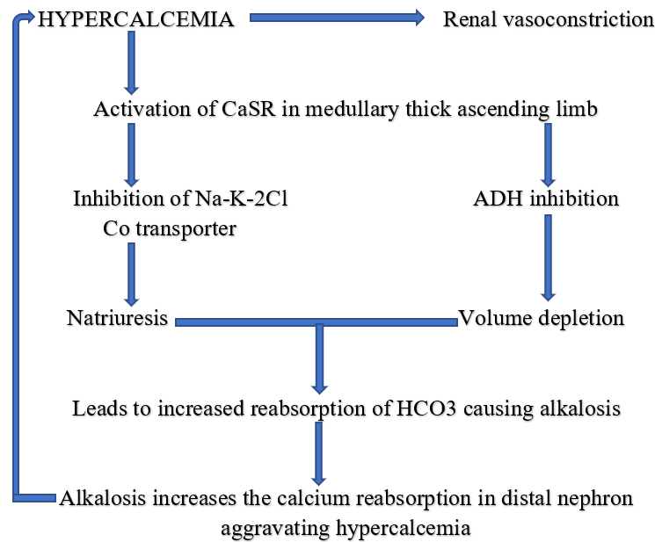
Milk-Alkali Syndrome, an udder failure of acid control
Michelle Livitz DO, Asad Mussarat MD, William Gibson MD, Daniel Holmes MD LSUHSC Department of Internal Medicine, LSUHSC School of Medicine, New Orleans, Louisiana
Introduction
Discussion
Milk-Alkali syndrome is characterized by:
elevated calcium levels
metabolic alkalosis
acute kidney injury
Found in the setting of substantial intake of calcium and an absorbable alkali
The metabolic alkalosis is due to increased alkali intake (such as carbonate) with concurrent hypercalcemia-mediated hypovolemia and decreased GFR.
The alkalosis then leads to increased calcium reabsorption from the nephron’s distal tubule, further creating a vicious cycle of calcium reabsorption and further kidney injury.
There has been a drop off in incidence in milk-alkali syndrome due to the prevalence of PPI therapy for GERD symptoms. In a study of patients that were hospitalized for emergent hypercalcemia, only 12% of the patients admitted over a 4-year period had milk-alkali syndrome as the underlying etiology². Another study that evaluated hospitalized patients from 1998-2003 with hypercalcemia as their primary diagnosis, found similar results with 8.8% in those without ESRD, and 9 out of 25 patients with severe hypercalcemia (>14) were found to have milk-alkali syndrome³.
A
B
C
D
A
https://shmabstracts.org/abstract/milk-alkali-syndrome-presenting-with-psychosis-due-to-an-excessive-intake-of-calcium-carbonate/
Case Presentation
Labs
Conclusions
37 y/o F with PMHx Sjogren Syndrome, Dandy-Walker Syndrome s/p VP shunt, and bipolar disorder presented for a gradual worsening and persistent weakness in her distal BUE and BLE for the 3 weeks prior to presentation.
She also noted numbness and paresthesias in her distal extremities, brain fog, and memory deficits. The pt had baseline sensory dysfunction due to her Sjogren’s, however she noticed new onset proximal progression of the deficits with associated new lower extremity weakness.
She not on immunosuppressives for her Sjogren’s and was only being treated for her peripheral neuropathy. She also took valproic acid for her bipolar disorder management.
With further interview, pt revealed that she had been taking 4 tablets of extra-strength TUMS 3x daily for 2 months due to her severe acid reflux symptoms.
133
83
17
15.9
7
72
This case shows the importance of keeping this syndrome on the differential while obtaining the history, because given her past medical history, there were other indications for possible tubular dysfunction such as a distal RTA secondary to her Sjogren’s or a nephrogenic diabetes insipidus from her valproic acid use.
2.5
41
2.22
3.9
15
15.4
6.6
73
10.3
255
43
0.3
Treatment
F
G
H
Started on aggressive fluid and electrolyte replacement with appropriate response and noted improvement in kidney and neurological function.
She was counseled to stop calcium supplementation, started PPI therapy, and arranged follow up with Gastroenterology for her severe GERD symptoms and her PCP for further monitoring.
References
¹https://www.ncbi.nlm.nih.gov/books/NBK557500/#:~:text=The%20milk%2Dalkali%20syndrome%20is,of%20calcium%20and%20absorbable%20alkali.
² https://read.qxmd.com/read/7891547/milk-alkali-syndrome-associated-with-calcium-carbonate-consumption-report-of-7-patients-with-parathyroid-hormone-levels-and-an-estimate-of-prevalence-among-patients-hospitalized-with-hypercalcemia?redirected=slug
³ https://read.qxmd.com/read/16268810/milk-alkali-syndrome-is-a-major-cause-of-hypercalcaemia-among-non-end-stage-renal-disease-non-esrd-inpatients?redirected=slug

