Slide 1
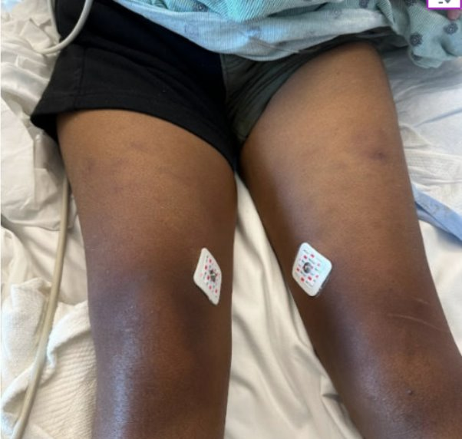
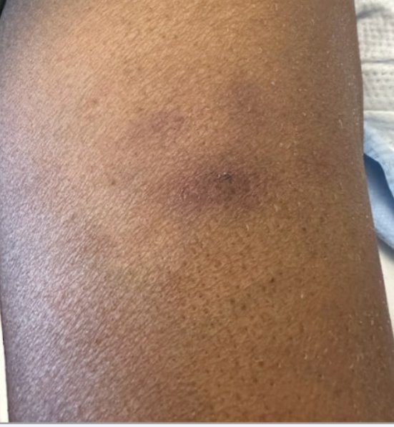
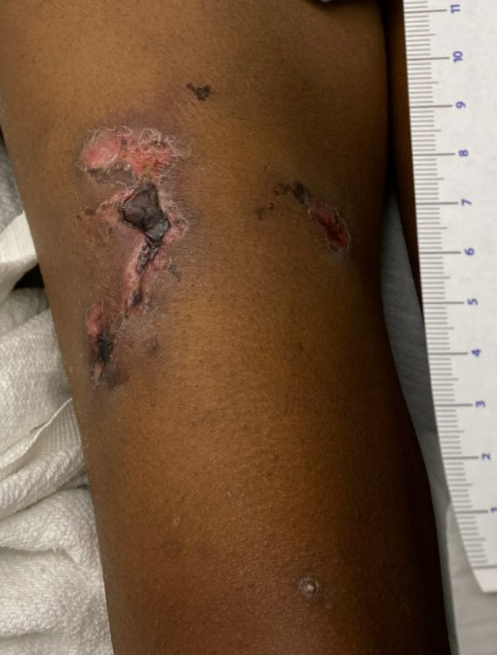
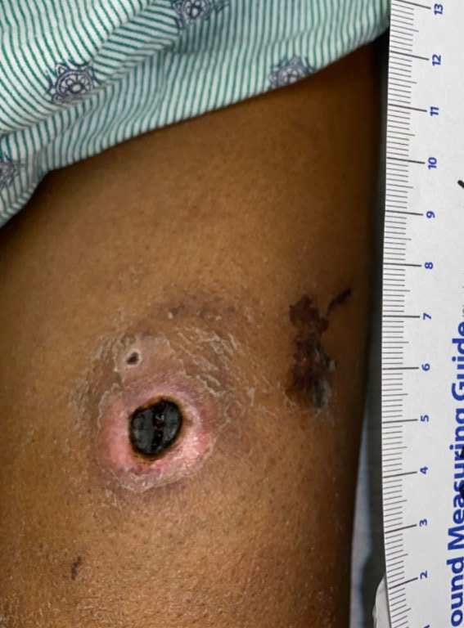
Calciphylaxis: an usual course of a rare condition
Michelle Livitz, Maren Bell, Mohammed Ziada
Department of Internal Medicine, LSU Health Sciences Center, New Orleans, Louisiana
Introduction
Imaging
Discussion
Calciphylaxis is a rare disorder, mostly seen in those with End-Stage Renal Disease (ESRD). It is characterized as calcification of arterioles and capillaries in the dermis and subcutaneous adipose tissue, leading to local ischemia and necrosis of the affected tissue. It is associated with a high mortality and morbidity with no definitive treatment or cure.
There was difficulty in making evidence-based decisions due to the rarity of this condition, but more so due to the high mortality and morbidity of the disease state. It has been established in many studies that warfarin precipitates worsening of calciphylaxis. However, due to the patient’s history of a mechanical valve replacement, warfarin is the standard anticoagulant for the use of stroke risk mitigation with DOACs shown to be inferior.
Given her young age, it made the most sense to provide her the mechanical valve at the time of placement. Retrospectively, with her non-adherence with HD, poor follow up, and then subsequent development of calcific valves, she had known risk factors for the development of calciphylaxis.
A question can be posed to considering bioprosthetic valve placement those with a similar presentation in the future given the high risk of warfarin use in these patients that are already at higher risk of developing this disease.
A
B
Case Presentation
35 y/o F with history of ESRD on hemodialysis (HD), HTN, STEMI s/p DES, and Mitral Valve Replacement presented to an outside hospital for squeezing chest pain and diffuse arthralgias and myalgias in the setting of hypertensive emergency.
The patient reported a history of systemic lupus erythematosus (SLE) with no current treatment plan in place, so after adequate blood pressure control was obtained, she was transferred for rheumatological evaluation. Upon arrival after transfer, she was found to have chronic, diffuse painful lesions, most notably on her distal extremities. She first noticed them five years prior, around the time dialysis was initiated, and noted a relapsing and remitting course of the lesions.
During her hospitalization, rheumatology evaluation revealed that she did not have SLE, nor was history consistent with it. Dermatology was consulted for punch biopsy of the lesions, which revealed calciphylaxis.
Relevant labs at this time included a severely elevated intact PTH 1994, Phosphorus 8.7, Calcium 8.6, Albumin 3.9, and elevated inflammatory markers.
Unfortunately, the patient had a history of a mechanical valve replacement (MVR) which required warfarin therapy, a known exacerbating factor of calciphylaxis.
Upon diagnosis, she underwent a parathyroidectomy, wound care, and palliative care given the extreme pain associated with the condition and high mortality rate.
C
D
B
A
A
E
Imaging Captions
A: Chronic, painful, hyperpigmented nodules on bilateral anterior thighs
B: Zoomed in perspective of one of the hyperpigmented nodules on the left anterior thigh
C-D: Development of ulcerated wounds from previous calciphylaxis nodules after several weeks of hospitalization on bilateral anterior thighs
F
G
H
C
D

