Slide 1
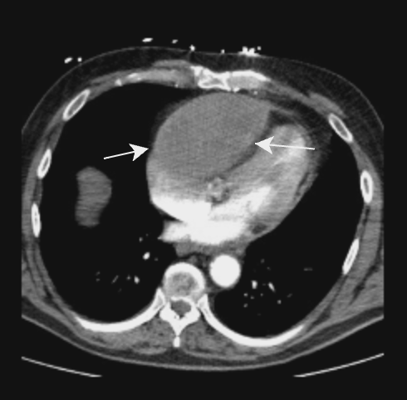
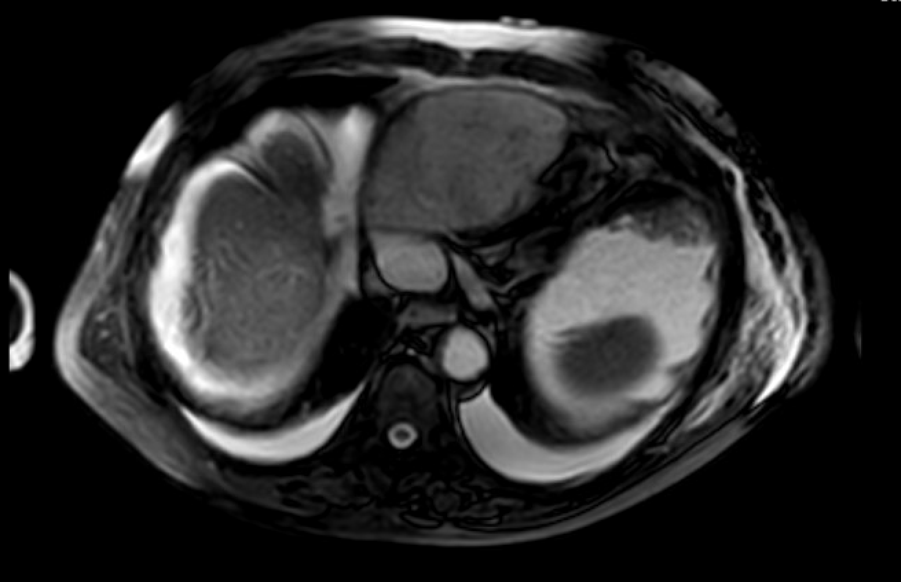
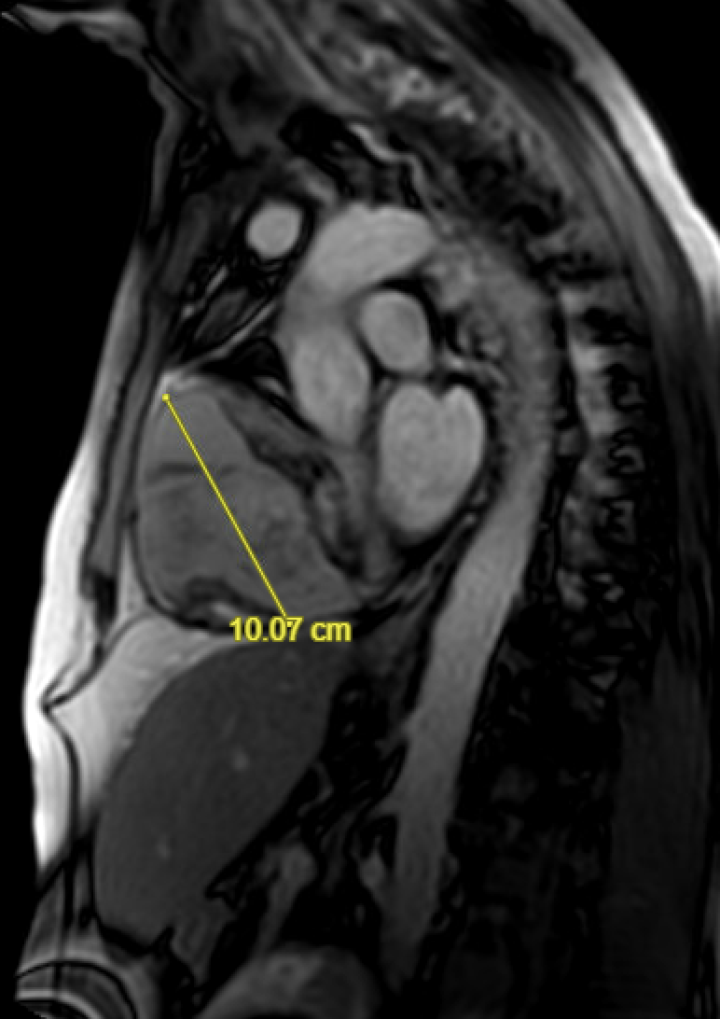
Unveiling the Uncommon: Obstructive Shock in the Setting of Massive Pericardial Hematoma
Asad Mussarat, MD¹; Sepehr Sadeghi, DO¹ ; Monica Klaybor, MD²; Briggs Welch, MD¹; Hannah Zulli, MD¹; Tammy Do, MD¹; Murtuza Ali, MD²; Neeraj Jain, MD², Shelby Macrae, MD¹
Department of Internal Medicine¹, Department of Cardiology²; LSU Health Science Center
Introduction
Discussion
Pericardial hematomas represent a unique, potentially life-threatening condition characterized by the accumulation of blood within the pericardial sac. Although relatively rare, pericardial hematomas can arise from slowly growing pericardial effusions. Therefore, they can pose significant diagnostic and therapeutic challenges due to their potential to compromise cardiac function and hemodynamics presentations vary from asymptomatic to life threatening emergencies. Potential etiologies for pericardial effusions and subsequent hematomas include prior heart trauma, post-infarction myocardial rupture, and post-cardiac injury syndrome.
Notably, reports have shown that the risks for coronary artery perforation remain even in the setting of a successful PCI with no contrast extravasation on coronary angiogram post-PCI. Such perforation can lead to rapid accumulation of sanguineous effusion into the pericardial space. On the other hand, gradual extravasation secondary to a smaller coronary artery perforation can develop into a hematoma as an accumulation of clots. Once it causes enough compression of the cardiac chambers and great vessels, the subsequent hematoma’s mass effect decreases stroke volume, resulting in shock, as demonstrated in this case. While pericardial hematomas typically prompt pericardiocentesis, aspiration becomes difficult when either the bleeding becomes too large or when it clots into a solid thrombus that significantly reduces diastolic function. While there have been few reports on cases of PCI-related pericardial effusions and hematoma, this is the first case documented for a pericardial hematoma large enough to require a cardiopulmonary bypass and pericardiectomy.
Figure 1: CT Chest initially interpreted as enlarged RV, but later corrected to be a mass
Case Presentation
The patient was a 68-year-old male with a history of stroke and CAD, s/p stent placement two years prior to admission. When lying in bed, he reported sudden substernal chest pain without radiation and shortness of breath, followed by a syncopal episode upon exertion. He reported cyanosis in his extremities, and chest pain when lying flat. Vitals were significant for hypotension at 80/50, tachycardia, and tachypnea. Physical exam was concerning for rapid shallow, breathing. EKG read sinus tachycardia, RAD, and T-wave inversions in the inferior lateral leads. Pertinent labs included lactic acid 6.9 mmol/L and mild transaminitis.Troponins peaked to 6200 ng/L within the first 24 hours. The patient was started on a heparin drip with suspicion of acute coronary syndrome vs. pulmonary embolism. CT chest instead discovered a 11.9 by 7.1 cm density that overlies the right ventricle. Cardiac MRI confirmed a predominantly hypo-enhancing mass with peripheral irregular enhancement collapsing on the right ventricle. Patient underwent a pericardiectomy, complete cardiopulmonary bypass, and excisional biopsy of the mass in the pericardium. Pathology revealed chronically inflamed fibroadipose tissue and fibro-hemorrhagic exudate. With history of prior PCI, the patient likely developed a large pericardial hematoma that had clotted into a thrombus that compressed the right ventricle. He was monitored in the ICU after surgery and discharged with cardiothoracic surgery follow-up.
.
Conclusion
This case emphasizes the consideration of a pericardial hematoma as a complication of prior cardiac injury. We also emphasize the importance of collaboration of cardiology, cardiothoracic surgery, and critical care to optimizing management.
Figure 2: Cardiac MRIs confirming irregular cardiac density
References
Criqui MH, Matsushita K, Aboyans V, Hess CN, Hicks CW, Kwan TW, McDermott MM, Misra S, Ujueta F; American Heart Association Council on Epidemiology and Prevention; Council on Arteriosclerosis, Thrombosis and Vascular Biology; Council on Cardiovascular Radiology and Intervention; Council on Lifestyle and Cardiometabolic Health; Council on Peripheral Vascular Disease; and Stroke Council. Lower Extremity Peripheral Artery Disease: Contemporary Epidemiology, Management Gaps, and Future Directions: A Scientific Statement From the American Heart Association. Circulation. 2021 Aug 31;144(9):e171-e191. doi: 10.1161/CIR.0000000000001005. Epub 2021 Jul 28. Erratum in: Circulation. 2021 Aug 31;144(9):e193. PMID: 34315230; PMCID: PMC9847212.
Gerhard-Herman MD, Gornik HL, Barrett C, Barshes NR, Corriere MA, Drachman DE, Fleisher LA, Fowkes FG, Hamburg NM, Kinlay S, Lookstein R, Misra S, Mureebe L, Olin JW, Patel RA, Regensteiner JG, Schanzer A, Shishehbor MH, Stewart KJ, Treat-Jacobson D, Walsh ME. 2016 AHA/ACC Guideline on the Management of Patients With Lower Extremity Peripheral Artery Disease: Executive Summary: A Report of the American College of Cardiology/American Heart Association Task Force on Clinical Practice Guidelines. Circulation. 2017 Mar 21;135(12):e686-e725. doi: 10.1161/CIR.0000000000000470. Epub 2016 Nov 13. Erratum in: Circulation. 2017 Mar 21;135(12 ):e790. PMID: 27840332; PMCID: PMC5479414.
Figure 3: Pericardial Thrombus resected

