Slide 1
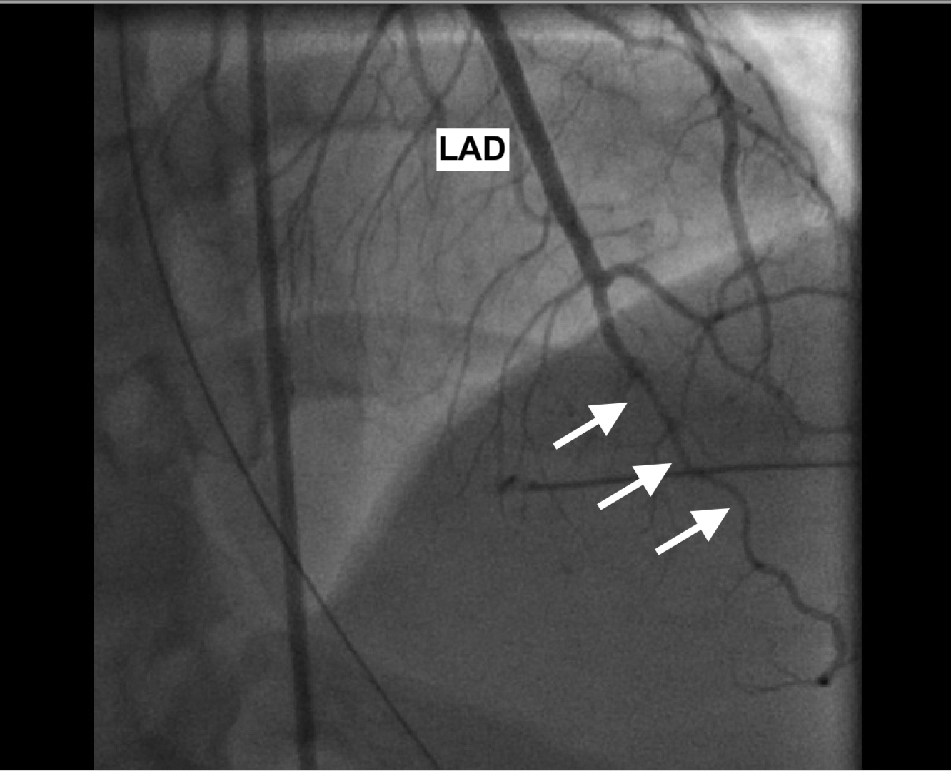
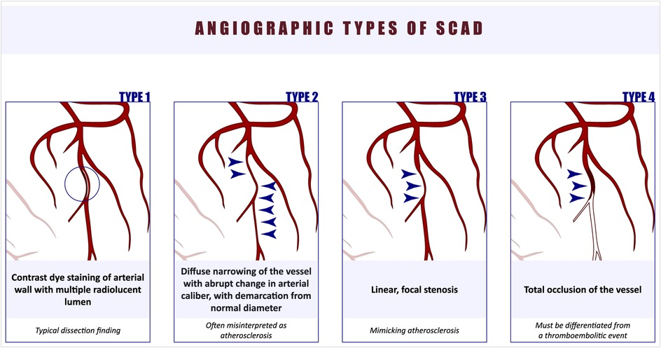
Spontaneous Coronary Artery Dissection: A Quite Unexpected Pregnancy Complication
Asad Mussarat, MD; Ahad Mussarat, MD; Ahmad Kasabali, MD; Shane Sanne, DO
LSU Health Science Center, Department of Internal Medicine
Introduction
Discussion
Spontaneous coronary artery dissection (SCAD) is a rare cause of ACS that clinically mimics a myocardial infarction. Case studies calculate an incidence of 0.1 to 0.4% of patients in the general population, with a vast majority of cases occurring in women younger than 50 years old. In fact, pregnancy-associated spontaneous coronary artery dissection (P-SCAD) is considered the most common cause of acute coronary syndrome in childbearing women. We present a case of a mother with multiple pregnancies leading up to a cardiac emergency.
Predisposing factors to pregnancy-related SCAD are those that increase coronary artery wall stress including multiparity, early postpartum state, and connective tissue disorders. Most P-SCAD events occur within the first month after delivery. Although P-SCAD's etiology is not fully understood, it is theorized that the increased level of estrogen during the third trimester enhances release of metalloproteinases. These matrix metalloproteinases are thought to weaken the vaso vasorum leading to the development of an intramural hematoma with or without intimal disruption. That hematoma can lead to compression of the coronary arteries and subsequent ischemia. Most SCAD patients heal spontaneously over time with conservative treatment, while coronary intervention would be reserved for cases with hemodynamic instability, involvement of large areas of the myocardium, and refractory ischemia. Unfortunately, pregnancy-associated SCAD carries a modest recurrence risk.
Case Presentation
A 44-year-old female G₁₁P₁₁ with no prior medical history presented to ED with left upper quadrant chest pain and shortness of breath that lasted 45 minutes while lying in bed. The pain was substernal, radiated from her chest to her left arm and neck, and reproducible when lying supine. She denied alleviating factors, numbness in her extremities, diaphoresis, or lower extremity edema. One week prior, she delivered her 11th child vaginally without complications. In the ED, she was afebrile and hemodynamically stable. Pertinent labs include elevated troponin at 2.79 ng/L and D-dimer at 744 ng/mL. No ST-changes or T-wave inversions were appreciated on initial EKG. Concern for NSTEMI prompted an aspirin load and coronary angiography which detected 40% luminal narrowing of the mid-vessel left anterior descending artery, consistent with a Type 2 coronary artery dissection. No additional coronary intervention was performed, and the patient was started on DAPT. CTA Head and Neck showed further nonocclusive vertebral artery dissection. Patient’s troponins had trended down since admission. She was discharged on DAPT and lifestyle recommendations, including avoiding subsequent pregnancy.
.
Figure 1: SCAD at mid-distal LAD
Conclusion
A multidisciplinary approach is imperative between a patient’s cardiologist and obstetrics-gynecologist regarding management and counseling regarding subsequent pregnancy.
References
Cade JR, Szarf G, de Siqueira ME, et al. Pregnancy-associated spontaneous coronary artery dissection: Insights from a case series of 13 patients. European Heart Journal – Cardiovascular Imaging. 2016;18(1):54-61.
Chan N, Premawardhana D, Al-Hussaini A, et al. Pregnancy and spontaneous coronary artery dissection: Lessons from survivors and nonsurvivors. Circulation. 2022;146(1):69-72.
Parekh JD, Chauhan S, Porter JL. Coronary Artery Dissection. In: StatPearls. Treasure Island (FL): StatPearls Publishing; June 19, 2023.
Saw J, Aymong E, Sedlak T, et al. Spontaneous coronary artery dissection. Circulation: Cardiovascular Interventions. 2014;7(5):645-655.
Tweet MS, Hayes SN, Codsi E, Gulati R, Rose CH, Best PJM. Spontaneous Coronary Artery Dissection Associated With Pregnancy. J Am Coll Cardiol. 2017;70(4):426-435.\
Tweet MS, Hayes SN, Pitta SR, et al. Clinical features, management, and prognosis of spontaneous coronary artery dissection. Circulation. 2012;126(5):579-588.

