Slide 1
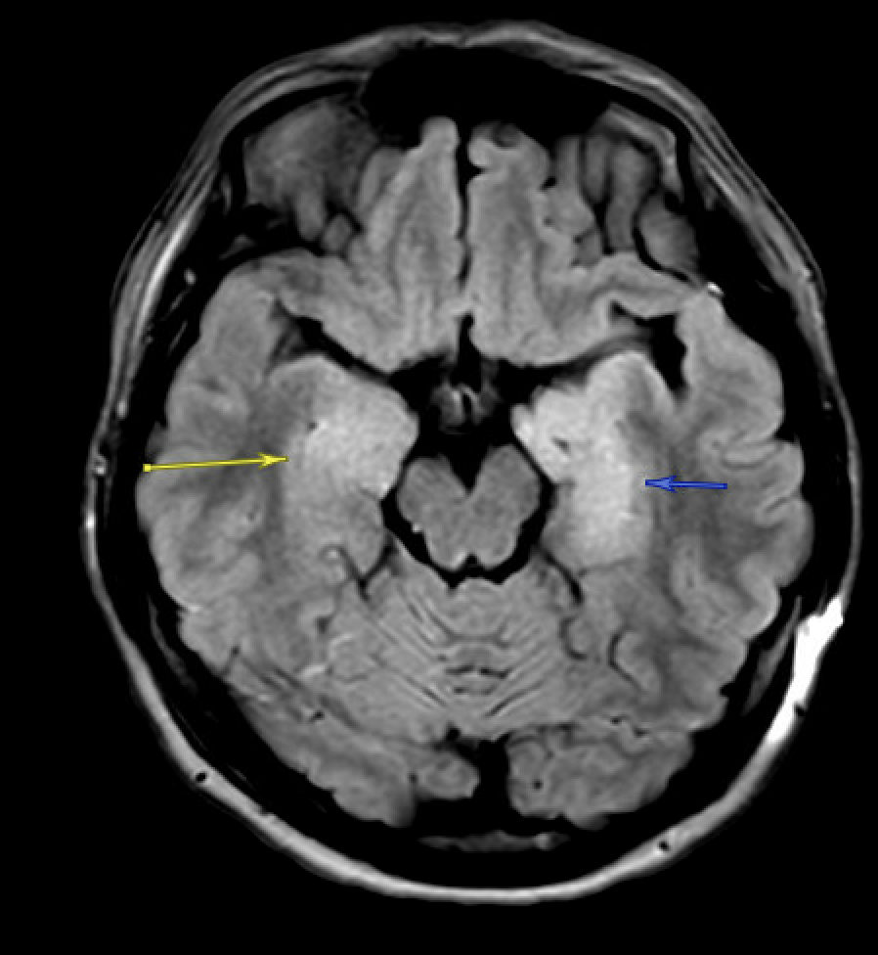
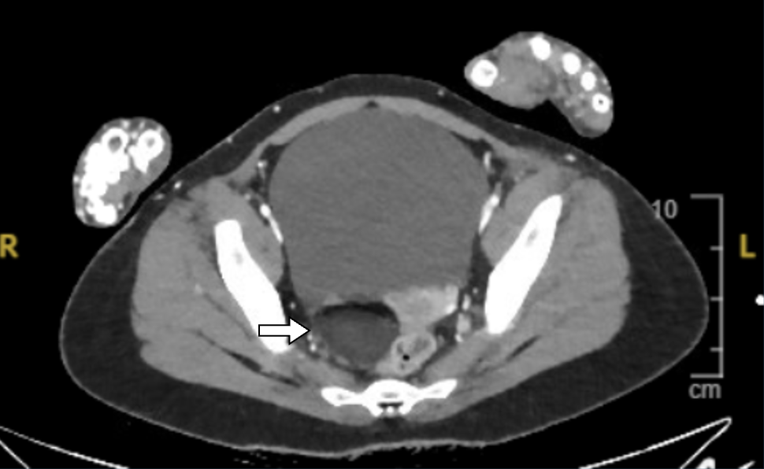
Paraneoplastic Anti-NMDAR Encephalitis: Mystery with an Ovarian Teratoma Twist
Asad Mussarat, MD; Catherine Loehr, MD; Michelle Livitz, DO; Will Gibson, MD, Taylor Lambert, MS4; Aliyah Pierre, MS4; Allison Pinner, MD; Daniel Holmes, MD
Department of Internal Medicine; LSU Health Sciences Center, New Orleans, LA
Introduction
Case Presentation
Discussion
Anti N-methyl D-aspartate receptor (NMDAR) encephalitis is one of the most common autoimmune encephalitis affecting young adults. It is characterized as neuropsychiatric syndrome and presence of autoantibodies in the cerebrospinal fluid (CSF). Generally followed by a viral prodrome, patients present with disturbances in sleep, behavior, memory, and autonomic stability; the latter would indicate ICU admission and possible ventilation. Since 2007, researchers have investigated the association between Anti-NMDAR encephalitis as a paraneoplastic syndrome secondary to ovarian teratomas. Hence, we present a case of a young female with Anti-NMDAR encephalitis in the setting of an ovarian teratoma.
.
A meta-analysis study indicated an incidence of 37% of women with ovarian teratoma among anti-NMDAR encephalitis. There are many hypotheses that attempt to explain their documented association. It was observed that anti-NMDAR-associated teratomas showed dysmorphic neurons, suggesting a possible antigen source that triggers an autoimmune defense mechanism. Therefore, a goal of early surgical resection should be prioritized given that the longer the exposure to the autoimmune effects of this paraneoplastic syndrome, the worse the prognosis and recovery period will be.
A 25-year-old woman with no medical history presented after a witnessed 30 second seizure. She reported 5 days of worsening headaches, fevers, and vomiting. Subsequently, her partner discovered her with a clenched jaw, eyes rolled back, and arms stiffened with jerking movements. The episode had self-terminated but was followed with recurring tonic-clonic seizure in EMS. Vitals notable for tachycardia and fever of 101.6°F. The neurological physical exam was unremarkable. EEG was negative. MRI brain showed bilateral temporal edema. CSF studies were significant for normal glucose, increased protein, pleocytosis, and increased RBCs, raising suspicion for HSV encephalitis. The patient was started on broad-spectrum antibiotics, acyclovir, and a trial of steroids, which resulted in initial improvement in her neurological symptoms. One week later, she became encephalopathic and agitated with hysteric crying and laughing episodes. CSF cultures and HSV tests were negative. She was in autonomic instability, requiring ICU observation and intubation. Autoimmune differentials prompted a CT abdomen/pelvis, revealing a right ovarian dermoid cyst. On surgical removal, it was confirmed to be an ovarian teratoma. Repeat autoimmune CSF studies tested positive for anti-NMDA receptor antibody. She was started on IVIG, steroids, cyclophosphamide and plasmapheresis with gradual improvement, but the patient remains to not be at baseline.
References
Li SJ, Yu MH, Cheng J, Bai WX, Di W. Ovarian teratoma related anti-N-methyl-D-aspartate receptor encephalitis: A case series and review of the literature. World J Clin Cases. 2022;10(16):5196-5207.
Mitra AD, Afify A. Ovarian teratoma associated Anti-N-methyl-D-aspartate receptor encephalitis: a difficult diagnosis with a favorable prognosis. Autops Case Rep. 2018;8(2):e2018019. Published 2018 Apr 18.
Syamlal, S; Patel, Khushboo; Haridas, Sarath. NMDA Receptor Encephalitis with Significant Autonomic Instability and PRES like MR Images. Annals of Indian Academy of Neurology 25(6):p 1244-1245, Nov–Dec 2022.
Wu CY, Wu JD, Chen CC. The Association of Ovarian Teratoma and Anti-N-Methyl-D-Aspartate Receptor Encephalitis: An Updated Integrative Review. Int J Mol Sci. 2021 Oct 9;22(20):10911.
Figure 2: Hypertense lesions of bilateral temporal lobes, L>R
Figure 1: CT abdomen/Pelvis revealing a R-sided Ovarian mass

