Slide 1
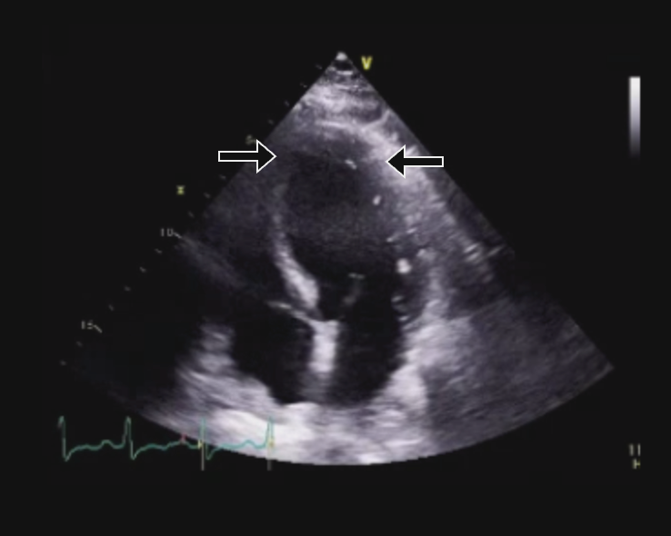
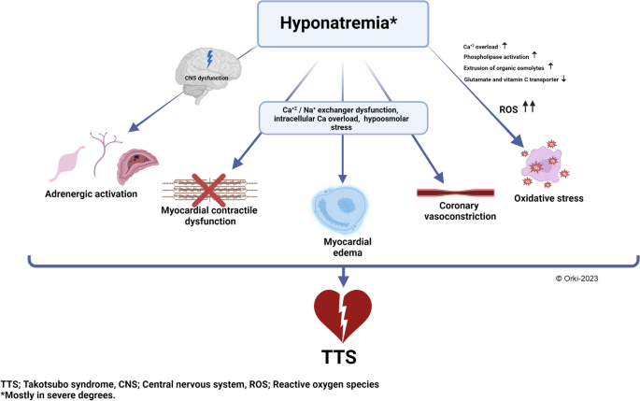
Takotsubo Cardiomyopathy: Severe Hyponatremia from SIADH, a Real Heart-Breaker
Asad Mussarat, MD; Calvin Rome, MD; Zachary Stielper, MD, PhD; Christopher Hayden, MD; Sepehr Sadeghi, DO; Shane Guillory, MD
Department of Internal Medicine; LSU Health Sciences Center, New Orleans, LA
Introduction
Discussion
Takotsubo cardiomyopathy (TTC), is defined as a sudden, temporary, stress-induced systolic abnormality of the left ventricular apex. TTC occurs predominantly in Asian or Caucasian postmenopausal women, following exposure to unexpected physical or emotional stress. In addition, triggers for Takotsubo cardiomyopathy can include medical, surgical, and pharmacological etiologies. We present a case of a 73-year-old female with severe hyponatremia secondary to SIADH concomitantly diagnosed with Takotsubo cardiomyopathy.
There are multiple hypotheses for the pathophysiology of TTC; catecholamine cardiac toxicity and microvascular dysfunction are the most widely accepted proposed mechanisms. Excess catecholamine levels following a stressful event are suggested to lead to myocardial stunning via calcium overload, production of reactive oxidative species, and mitochondrial dysfunction following activation of beta-adrenergic receptors. Fortunately, Takotsubo cardiomyopathy typically has a favorable prognosis with supportive treatment.
Case Presentation
Figure 1: Ultrasound showing ballooning of LV
Conclusion
A 73-year-old female with history of major depressive disorder , presented with encephalopathy. She displayed left-sided eye twitching, staring spells, and incoherent speech. Home medicines included hydrochlorothiazide, sertraline, and amitriptyline. Initial EKG was unremarkable. Patient was emotionally labile, oriented to name only, and had no focal neurologic deficits. The patient’s pertinent admission labs included WBC 29,300, Na 105 mmol/L, serum osm 237, urine osm 425, and urine Na 42. Patient was diagnosed with SIADH secondary to medication use and was started on hypertonic saline in the ICU. She later developed new-onset shortness of breath, hypoxia, and diffuse bibasilar crackles. Troponins peaked at 2,441 pg/mL within 24 hours. BNP was 1,909. CT chest was concerning for bilateral pulmonary edema. A transthoracic echocardiogram was obtained and revealed an ejection fraction of <20%, abnormal LV strain without thrombus, and hypokinetic contraction of the basal heart wall segments with complete akinesis of apical wall segments, consistent with Takotsubo cardiomyopathy. Three weeks prior, she had chest pain that prompted a coronary angiogram which revealed no obstruction and an ejection fraction of > 55%. Patient recovered gradually with supportive care, including fluid restriction and diuresis.
.
This case highlights the importance of considering severe hyponatremia as a potential precipitant of TTC. Early recognition and management of electrolyte disturbances are essential to mitigate the risk of cardiogenic complications associated with TTC, ultimately optimizing patient outcomes.
References
1. Amin HZ, Amin LZ, Pradipta A. Takotsubo Cardiomyopathy: A Brief Review. J Med Life. 2020;13(1):3-7.
Assad J, Femia G, Pender P, Badie T, Rajaratnam R. Takotsubo syndrome: A review of presentation, diagnosis and management. Clinical Medicine Insights: Cardiology. 2022; 16:117954682110657
2. Assad J, Femia G, Pender P, Badie T, Rajaratnam R. Takotsubo syndrome: A review of presentation, diagnosis and management. Clinical Medicine Insights: Cardiology. 2022; 16:117954682110657.
3. Akashi YJ, Goldstein DS, Barbaro G, Ueyama T. Takotsubo cardiomyopathy. Circulation. 2008;118(25):2754 2762.
4. Deshmukh A, Kumar G, Pant S, Rihal C, Murugiah K, Mehta JL. Prevalence of takotsubo cardiomyopathy in the United States. American Heart Journal. 2012;164(
Figure 2: Theory on TTC pathophysiology in relation to hyponatremia

