Slide 1
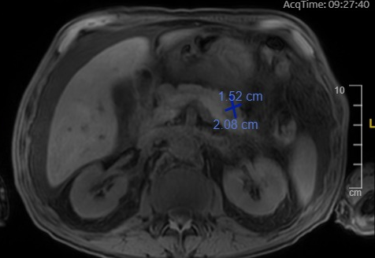
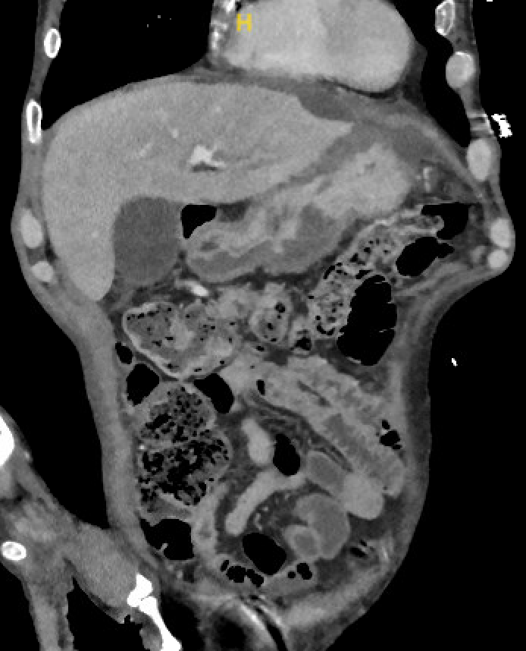
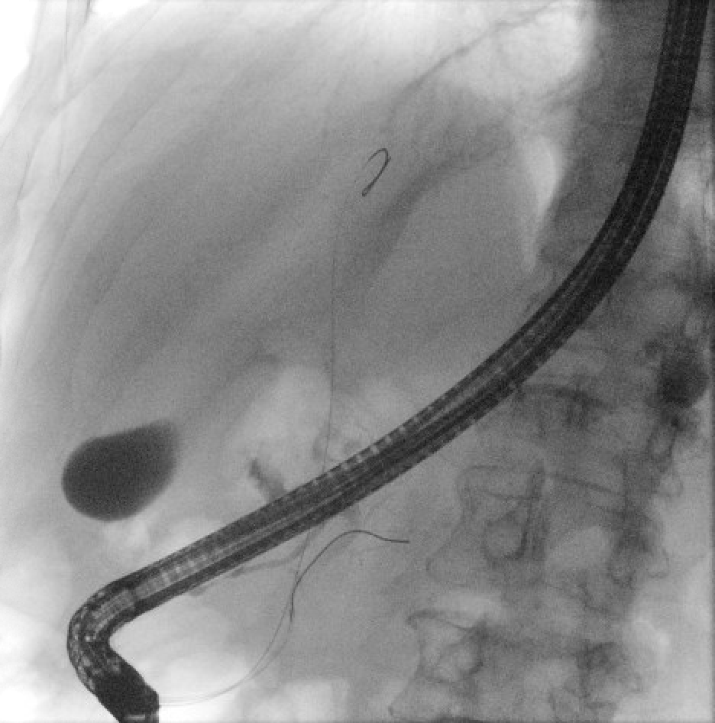
A Tail of a Pancreatic Duct Fistula
Nikki Arceneaux MD¹, Charles Woodall DO¹, Jason Stibbe MD², Stephen Landreneau MD² ¹Department of Medicine, LSU Health Sciences Center, New Orleans, LA
²Section of Gastroenterology, LSU Health Sciences Center, New Orleans, LA
Introduction
Pancreatic duct fistulas are characterized by an abnormal communication between the pancreatic duct and surrounding tissues or organs. This pathological entity poses significant challenges in clinical management due to its diverse etiology, variable clinical presentations, and potential for serious complications. Understanding the underlying mechanisms and clinical implications of pancreatic duct fistulas are essential for improving diagnostic accuracy, optimizing treatment strategies, and enhancing patient outcomes.
Case Presentation
Imaging
Discussion
A 70-year-old male with a past medical history of hypertension, alcohol use, and cataracts presented to the Emergency Department for one week of abdominal pain as well as decreased appetite for two weeks. Upon examination, the patient endorsed tenderness and discomfort in the abdominal region specifically in his left upper quadrant. Labs were notable for an elevated lipase of 1,138 units/liter. A computed tomography (CT) scan of the abdomen and pelvis was performed, which revealed findings consistent with subacute pancreatitis. The scan also indicated possible peripancreatic fluid collections with areas concerning for necrosis or abscess formation. At this time, there was suspicion of lobular tracking acute peripancreatic fluid collections (APFC) and potential ductal disruption in the junction of the pancreatic body and tail. A magnetic resonance cholangiopancreatography (MRCP) was ordered to provide a detailed assessment of pancreatic ductal anatomy and to evaluate for any disruption or communication of the fluid collection with the pancreatic duct. The MRCP showed a multiloculated collection in the body and tail of the pancreas measuring 2.1 x 1.5 x 1.9 cm with internal debris and a questionable communication with the pancreatic duct. Endoscopic retrograde cholangiopancreatography (ERCP) was performed, demonstrating a pancreatic duct of normal caliber with extravasation observed in the body/tail of the pancreas. Subsequently, a pancreatic stent was successfully placed to facilitate drainage and reduce the flow of pancreatic secretions, aiming to promote closure of the fistulous tract. Following the stent placement, an outpatient follow-up appointment was made for him to provide close monitoring and a repeat CT scan of the abdomen pelvis was ordered for one month following his initial ERCP. Unfortunately, he was lost to follow-up after his initial visit in clinic.
Pancreatic duct disruption is a well-established complication associated with both acute and chronic pancreatitis.⁵ The spectrum of complications arising from these disruptions includes pseudocysts, pancreatic ascites, disconnected duct syndrome, and pancreatic fistulas. These pancreatic leaks or fistulas are conventionally categorized as either internal or external.^{1,2,4} External leaks typically manifest as pancreatico-cutaneous fistulas and are commonly iatrogenic in origin. Internal leaks present in multiple forms, including pancreatic ascites, pleural effusions, and pseudocysts.¹ The prognosis and management of pancreatic leaks vary depending on the specific clinical presentation of the leak. The management of pancreatic fistulas includes supportive care as well as endoscopic intervention via endoscopic retrograde cholangiopancreatography (ERCP) for sphincterotomy with potential placement of pancreatic duct stent to drain secretions into a chosen internal drainage route. This will reduce flow through the fistula tract and promote closure. Following stent placement close monitoring and serial imaging studies are essential to assess treatment response, identify complications, and guide therapeutic decision-making throughout the management course. Timely recognition and appropriate management of pancreatic duct fistulas are crucial to mitigate the risk of complications and improve patient outcomes.
Image 1: Magnetic resonance cholangiopancreatography: 2.1x1.5cm fluid collection seen near the pancreatic body/tail
Image 2: CT Abdomen Pelvis showing focal exophytic fluid collection surrounding the pancreas
References
Image 3: Fluoroscopic imaging demonstrating extravasation of contrast from the pancreatic duct
Bansal A, Gupta P, Singh H, et al. Gastrointestinal complications in acute and chronic pancreatitis. JGH Open. 2019;3(6):450–55.
Gardner TB, Adler DG, Forsmark CE, et al. ACG Clinical Guideline: Chronic oancreatitis. Am J Gastroenterol. 2020;115(3):322–39
Unegbu FC, Anjum F. Pancreatic Fistula. [Updated 2023 Jul 31]. In: StatPearls [Internet]. Treasure Island (FL): StatPearls Publishing; 2023 Jan-.
Larsen M, Kozarek R. Management of pancreatic ductal leaks and fistulae. J Gastroenterol Hepatol. 2014;29(7):1360-70. doi: 10.1111/jgh.12574. PMID: 24650171.
Khiatah B, Huynh T, Frugoli A, Lyche KD. Acute Pancreatitis with an Ongoing Pancreatic Duct Leak Complicated by Refractory Pleural Effusion: A Case Report. Am J Case Rep. 2021 Jun 11;22:e931330.
Image 4: Fluoroscopic imaging showing stent placement within the pancreatic duct

