Slide 1
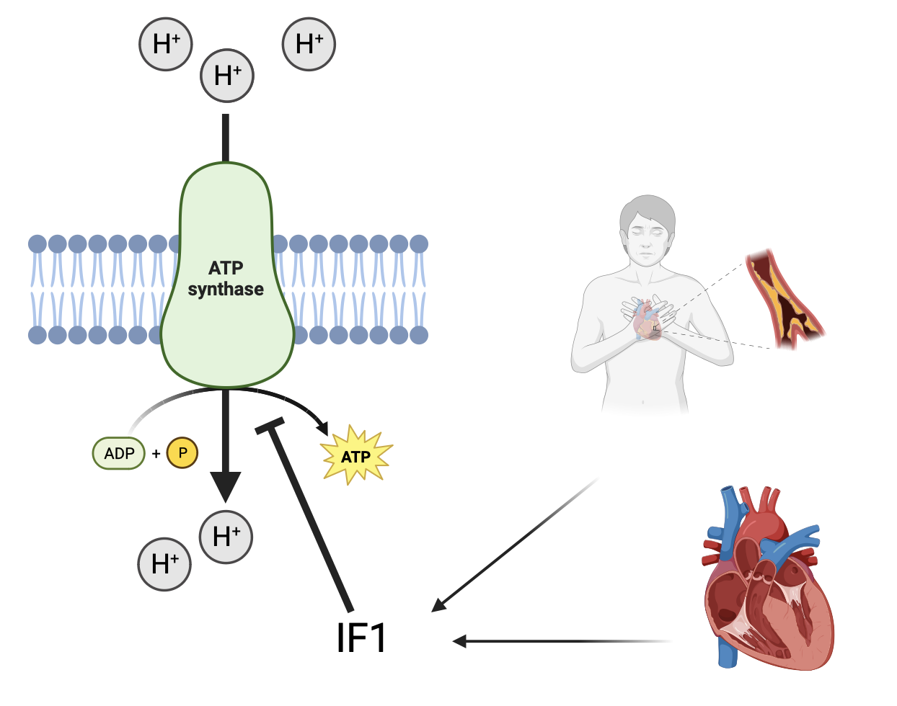
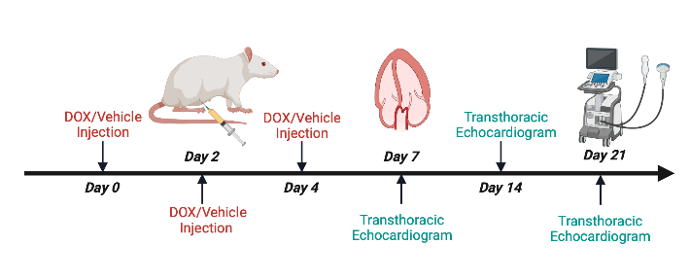
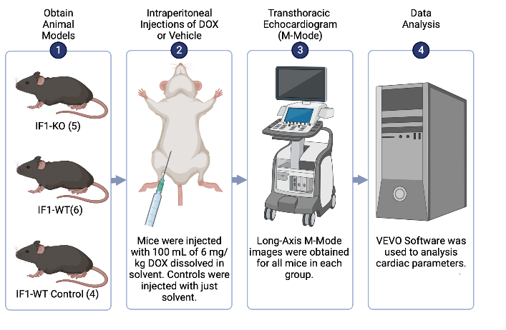
Analysis of the Role of ATPase Inhibitory Factor 1 (IF1) in Doxorubicin-Induced Cardiotoxicity Hinali Patel, Parnia Mobasheran, Qinglin Yang LSU School of Medicine, Cardiovascular Center of Excellence, Department of Pharmacology
Introduction
Cardiac Functions (0-3 weeks)
Results
ATPase Inhibitory Factor 1 (IF1) represents a nuclear-encoded ATP synthase-interacting mitochondrial protein. IF1 is known to be upregulated during periods of elevated stress, such as during myocardial infarctions or cardiac hypertrophy. Previously conducted lab research has demonstrated that in the absence of the protein IF1, mice models were protected against cardiac hypertrophy. To further investigate the extent of such findings, an experiment was designed to investigate the role of the IF1 protein in cardiotoxic conditions induced by Doxorubicin (DOX). DOX is known to induce cardiotoxicity through the generation of reactive oxygen species, increased levels of lipid peroxidation, as well as initiation of autophagy. Doxorubicin-induced cardiomyopathy is associated with a low prognosis and can serve to be fatal in certain populations. It is hypothesized that in the absence of IF1, mice will demonstrate more preserved cardiac functions in the presence of DOX. Experimental findings will allow for better personalization of chemotherapy treatment.
*: p < 0.05; **p < 0.01
The following changes were noted compared to baseline:
Ejection fraction significantly decreased in IF1-WT mice
Fractional shortening more significantly decreased in IF1-WT mice compared to IF1-KO mice
Left ventricle anterior wall thickness significantly decreased for both IF1-WT and IF1-KO; however, a more significant decrease was seen for IF1-WT
No significant changes were observed in left ventricle mass, left ventricle posterior wall thickness, or body mass.
Conclusion
Results indicate that in the absence of the IF1 protein, cardiac functions were better preserved with higher ejection fraction and fractional shortening observed three weeks post-treatment. Such results suggest that the upregulation of the IF1 protein during periods of elevated stress may be contributing to the development of doxorubicin-induced cardiomyopathy when DOX is administered for chemotherapy. Additionally, results also indicate that DOX may lead to a further decrease in heart size as wall thickness was found to be increased post-treatment.
As seen in the results section, DOX induces toxicity in the heart. As such, its use as a drug treatment is limited (Johnson-Arbor et al., 2022). Literature indicates that when acute left ventricular dysfunction occurs as a result of DOX, the toxic effects may be reversible (Johnson-Arbor et al.). Hence, future experiments can be designed to observe cardiac functions upon the cessation of DOX treatment. Upon continual use of DOX, however, irreversible cardiac dysfunction can occur within some months of treatment (Johnson-Arbor et al.). Such dysfunction can be lethal. Pre-existing conditions in patients can amplify the effects of developing chronic heart dysfunction upon treatment, such as a history of hypertension or previous radiation (Johnson-Arbor et al.).
All in all, experimental findings of this conducted experiment may yield new insights into the development of interventions to mitigate adverse effects of this drug in cancer patients under chemotherapy treatments.
Methods
Future Directions
Understand the effect of IF1 in DOX cardiotoxicity at increasing drug doses
Performance of echocardiograms for longer durations to observe change over time
Understanding if withdrawal from DOX leads to differences in cardiac functions between IF1-KO and IF1-WT
References
Johnson-Arbor, K. (2022, August 8). Doxorubicin. StatPearls - NCBI Bookshelf. https://www.ncbi.nlm.nih.gov/books/NBK459232/#:~:text=Rarely%2C%20acute%20left%20ventricular%20dysfunction,effect%20associated%20with%20doxorubicin%20therapy.
This research project was supported through the LSU Health Sciences Center, School of Medicine.

