Slide 1


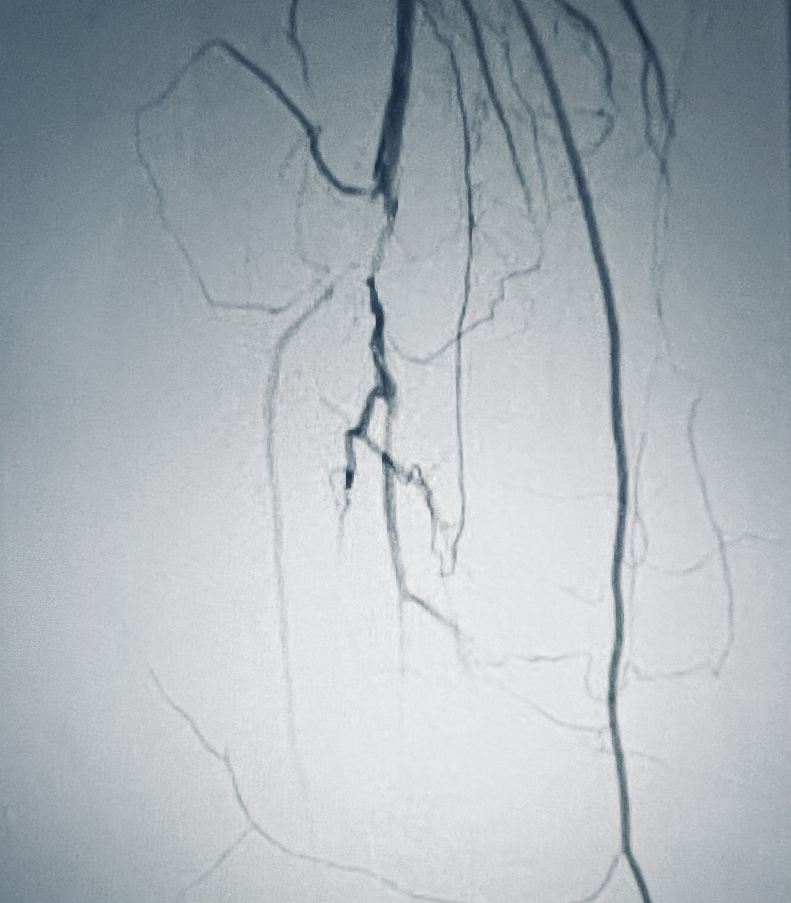
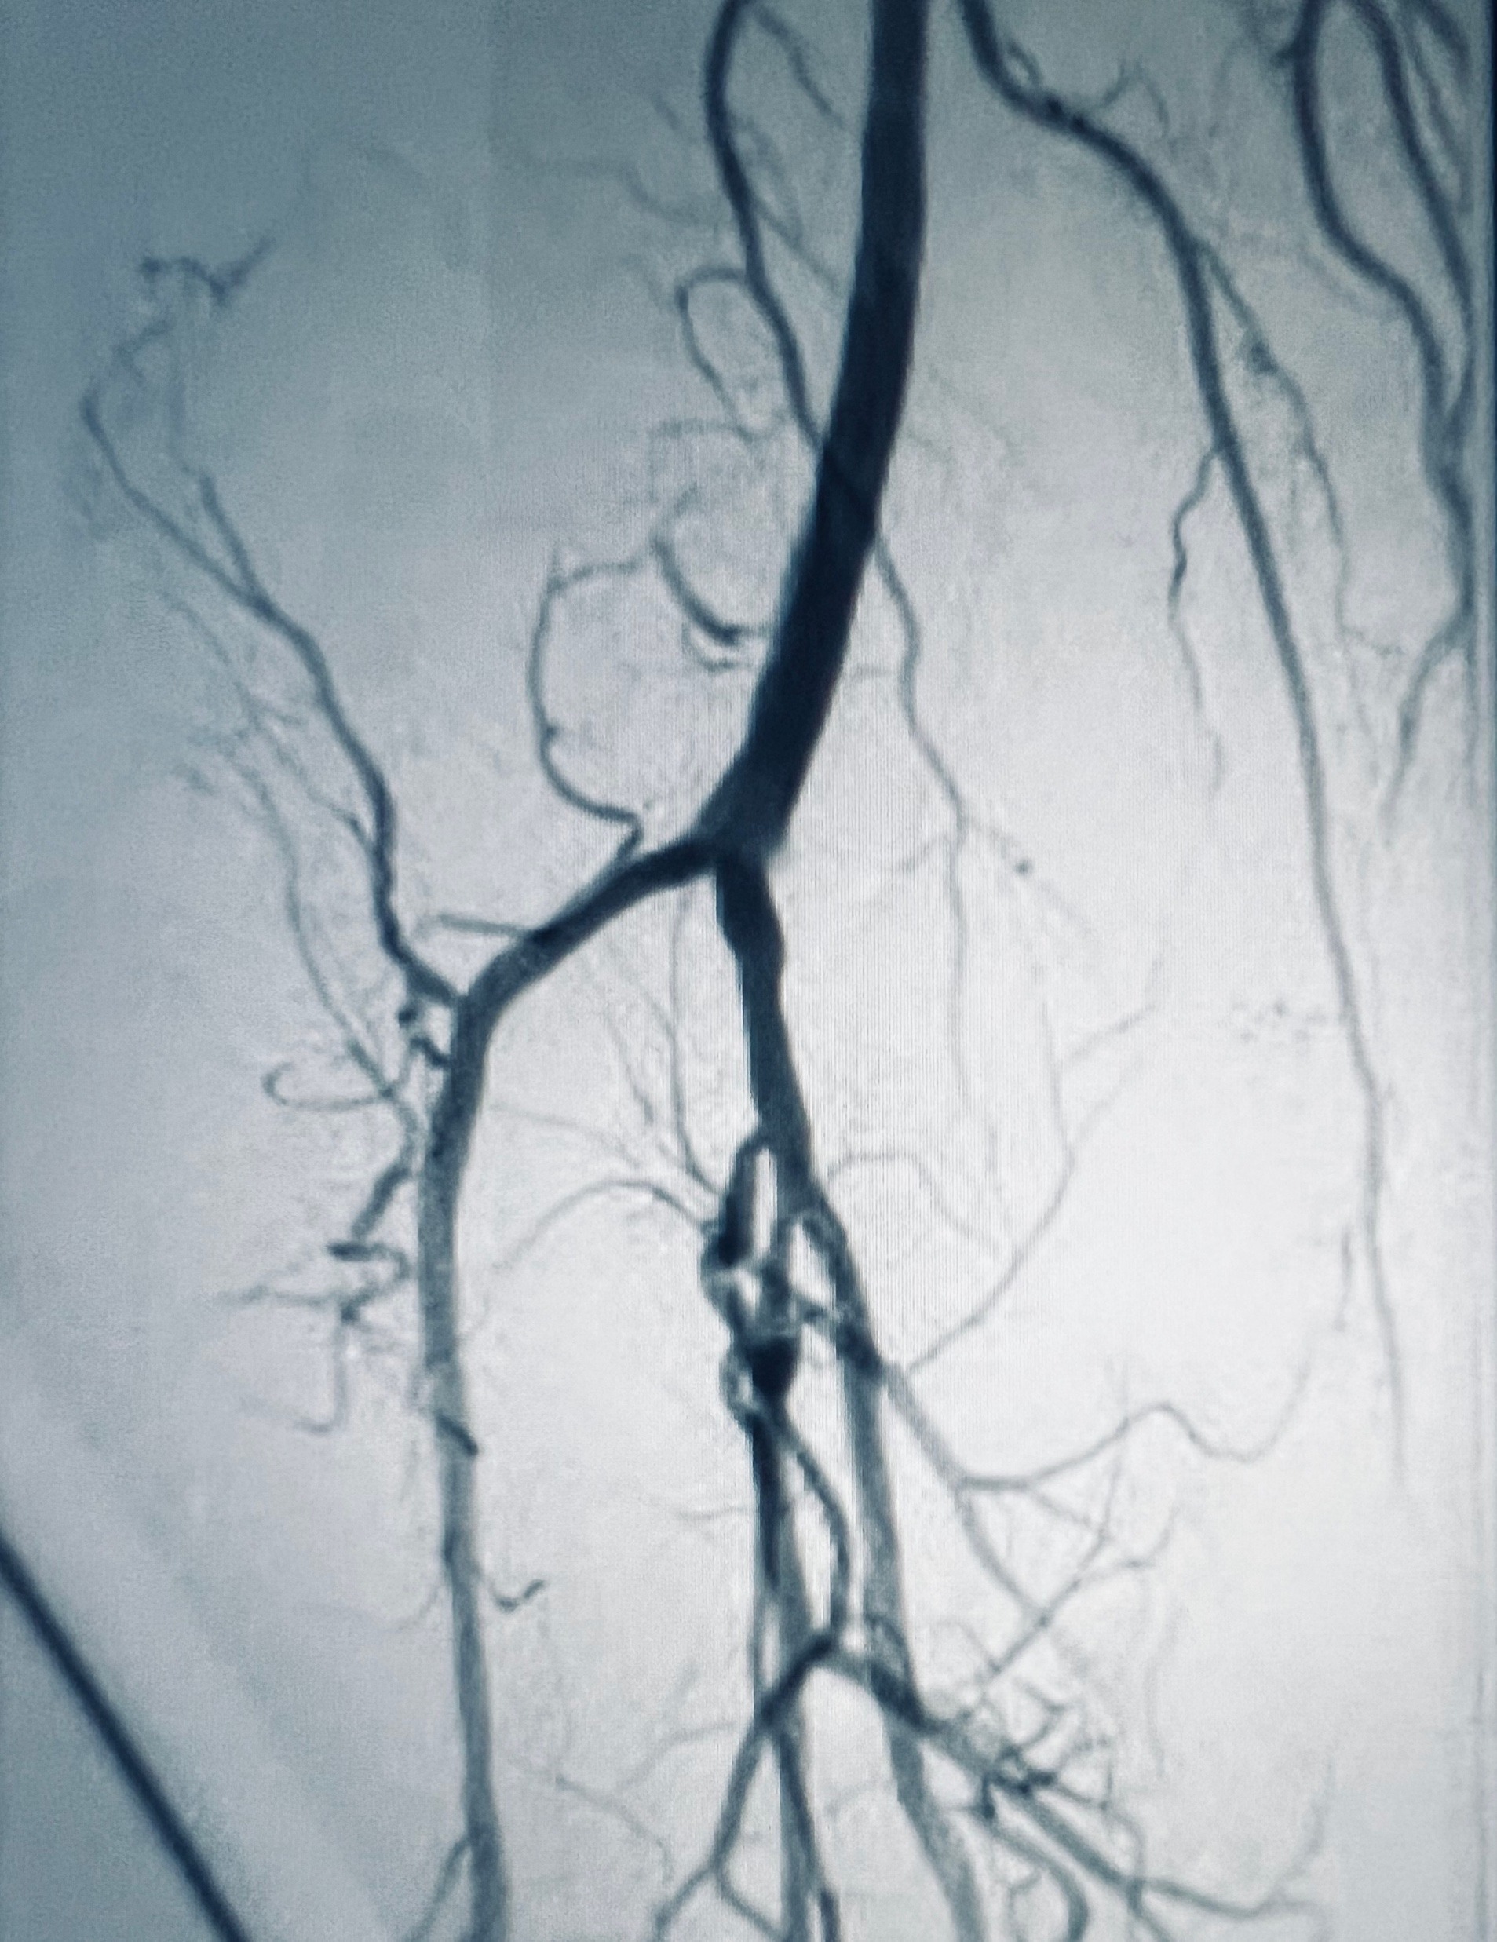
Percutaneous interventions in recurrent peripheral artery disease: A case of total popliteal artery occlusion addressed with a multi-modality approach
Sepehr Sadeghi, DO¹; Asad Mussarat, MD¹; Fernanda Correa, MD¹; Eduardo Venegas, MD²; Edward R Leonard, MD¹; Frank Wilklow, MD²; Leonard Glade, MD²
¹Department of Internal Medicine; ²Department of Cardiology
LSU Health Sciences Center, New Orleans, LA
Introduction
Discussion
Peripheral artery disease (PAD) is characterized by arterial narrowing due to atherosclerosis, commonly affecting the arteries in the lower extremities. Patients typically present with limb discomfort during physical activity, known as claudication, which improves at rest. Here, we present a compelling case highlighting the therapeutic significance of percutaneous peripheral intervention in managing acute limb ischemia (ALI).
The approach to managing PAD involves a step-wise advancement of treatments, beginning with conservative measures, with the first line being supervised exercise therapy. The intent is to relieve claudication symptoms and reduce the risks of a cardiovascular event. Clinical assessment of a patient’s symptoms is crucial to guiding the treatment modalities employed. Prior to considering revascularization, it is important to utilize all methods, including exercise rehabilitation and medical management. Minimally invasive advanced treatments, such as endovascular revascularization, can be considered in cases of recurrent severe PAD that have failed conservative modalities. Concurrently, it is crucial to manage comorbidities like type 2 diabetes and hypertension, as they lead to higher rates of re-stenosis post-stenting. Endovascular techniques typically involve angioplasty and stenting. In our case, we discussed a comprehensive approach involving the utilization of multiple concurrent endovascular procedures along with pulse device thrombectomy to successfully restore blood flow through the distal popliteal artery.
Case Presentation
A 67-year-old male with a medical history of hypertension, hyperlipidemia, and coronary artery disease with multiple prior interventions presented with acute-onset pain in his right lower extremity following bicycle exercise. Concurrent symptoms included dyspnea, chest pain, diaphoresis, and non-bloody emesis. Physical examination revealed notable pallor in the right lower limb, absent left pedal pulses, and an EKG indicating normal sinus rhythm with PVCs and signs of a prior inferior MI. Doppler ultrasound confirmed complete occlusion of blood flow beyond the popliteal artery. Lower extremity angiography was performed, revealing acute thrombosis in the right popliteal artery. Catheter-directed tPA thrombolysis cleared the thrombus, confirmed by peripheral vascular angiography demonstrating patent anterior and posterior tibial arteries. The right peroneal artery remained occluded in the proximal-to-middle segment. A month later, the patient returned with claudication symptoms secondary to ALI. The subsequent intervention included balloon angioplasty and mechanical thrombectomy with a pulse device at the distal popliteal artery into the anterior and posterior tibial trunk, resulting in a three-vessel runoff. The patient successfully regained ambulatory function and resumed cycling soon after the procedure.
Figure 1: Angiography indicating near-total blockage at the right distal popliteal artery (red arrow)
Conclusion
While thrombolysis followed by guideline-directed anticoagulation and antiplatelet therapy can yield favorable outcomes, the consideration of challenging, resistant cases remains imperative in optimizing patient care. This case underscores the importance of timely intervention employing balloon angioplasty and mechanical thrombectomy in the setting of ALI, particularly in total popliteal artery occlusion.
References
Figure 2: Angiography post angioplasty and mechanical thrombectomy with a pulse device, demonstrating total resolution of blockage at the right distal popliteal artery with three-vessel runoff
Criqui MH, Matsushita K, Aboyans V, Hess CN, Hicks CW, Kwan TW, McDermott MM, Misra S, Ujueta F; American Heart Association Council on Epidemiology and Prevention; Council on Arteriosclerosis, Thrombosis and Vascular Biology; Council on Cardiovascular Radiology and Intervention; Council on Lifestyle and Cardiometabolic Health; Council on Peripheral Vascular Disease; and Stroke Council. Lower Extremity Peripheral Artery Disease: Contemporary Epidemiology, Management Gaps, and Future Directions: A Scientific Statement From the American Heart Association. Circulation. 2021 Aug 31;144(9):e171-e191. doi: 10.1161/CIR.0000000000001005. Epub 2021 Jul 28. Erratum in: Circulation. 2021 Aug 31;144(9):e193. PMID: 34315230; PMCID: PMC9847212.
Gerhard-Herman MD, Gornik HL, Barrett C, Barshes NR, Corriere MA, Drachman DE, Fleisher LA, Fowkes FG, Hamburg NM, Kinlay S, Lookstein R, Misra S, Mureebe L, Olin JW, Patel RA, Regensteiner JG, Schanzer A, Shishehbor MH, Stewart KJ, Treat-Jacobson D, Walsh ME. 2016 AHA/ACC Guideline on the Management of Patients With Lower Extremity Peripheral Artery Disease: Executive Summary: A Report of the American College of Cardiology/American Heart Association Task Force on Clinical Practice Guidelines. Circulation. 2017 Mar 21;135(12):e686-e725. doi: 10.1161/CIR.0000000000000470. Epub 2016 Nov 13. Erratum in: Circulation. 2017 Mar 21;135(12 ):e790. PMID: 27840332; PMCID: PMC5479414.

