Slide 1
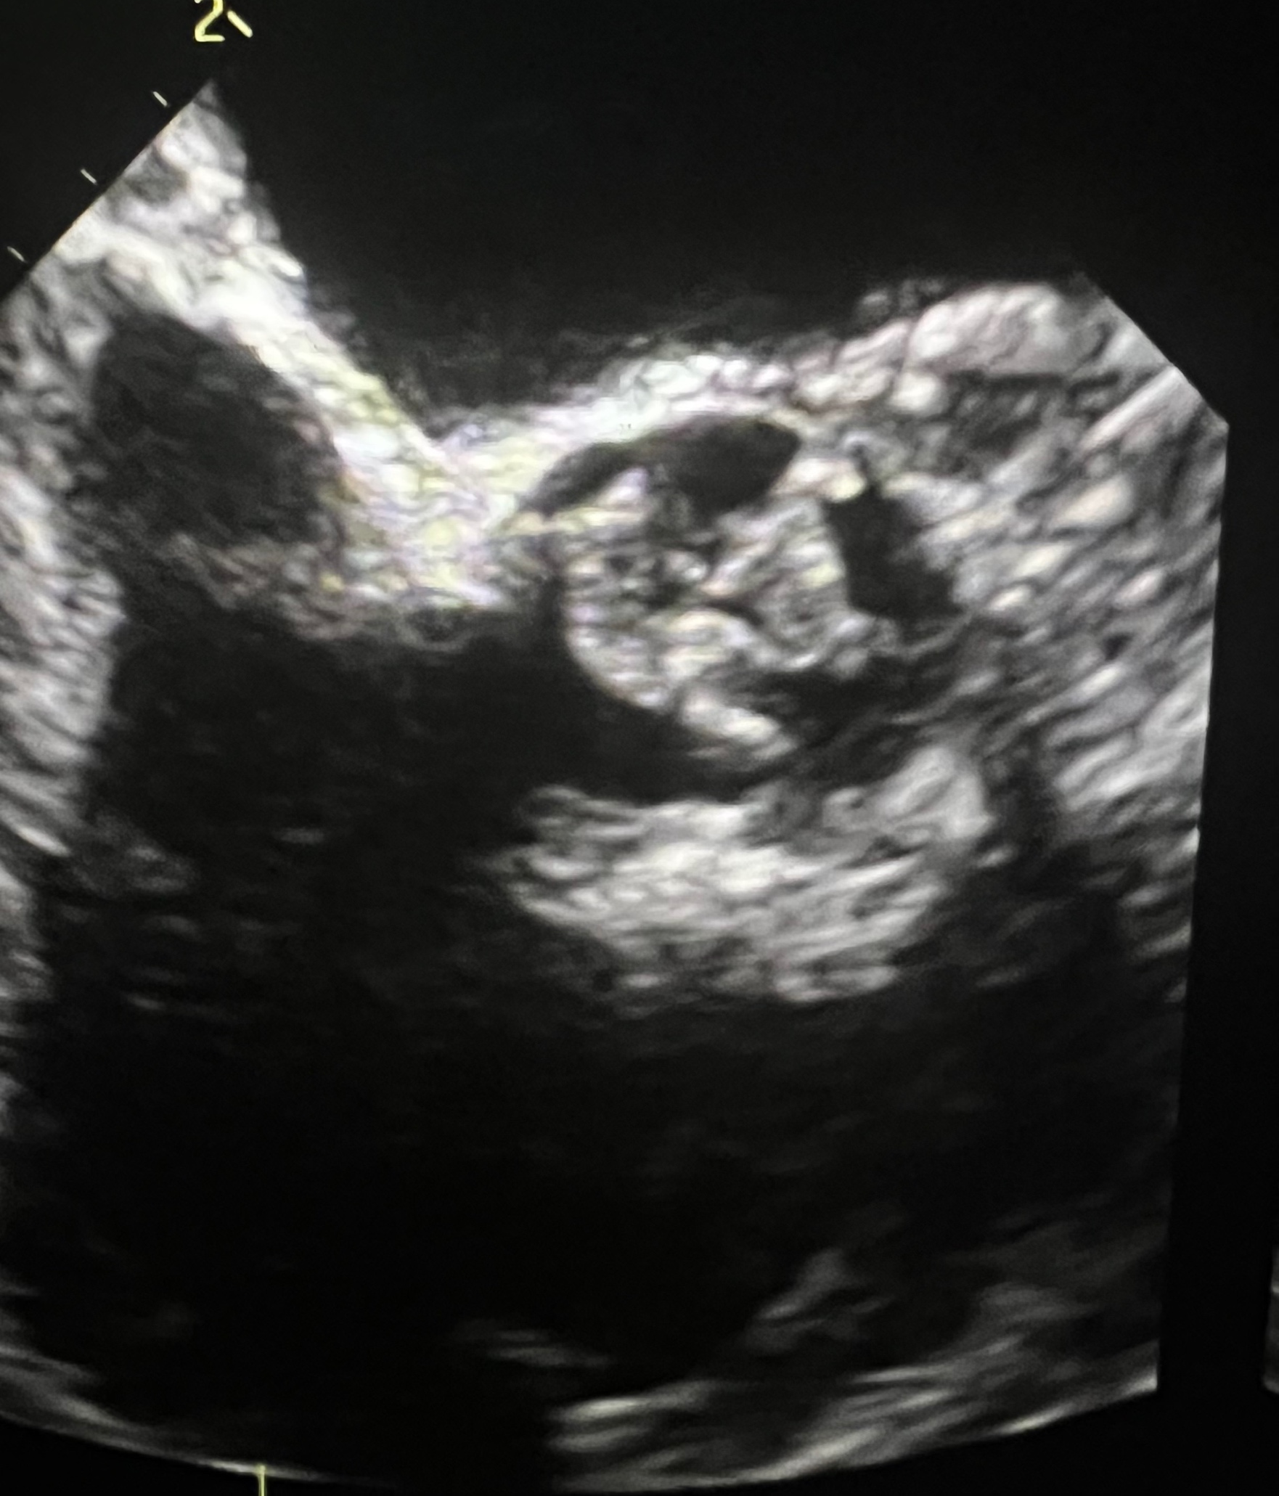
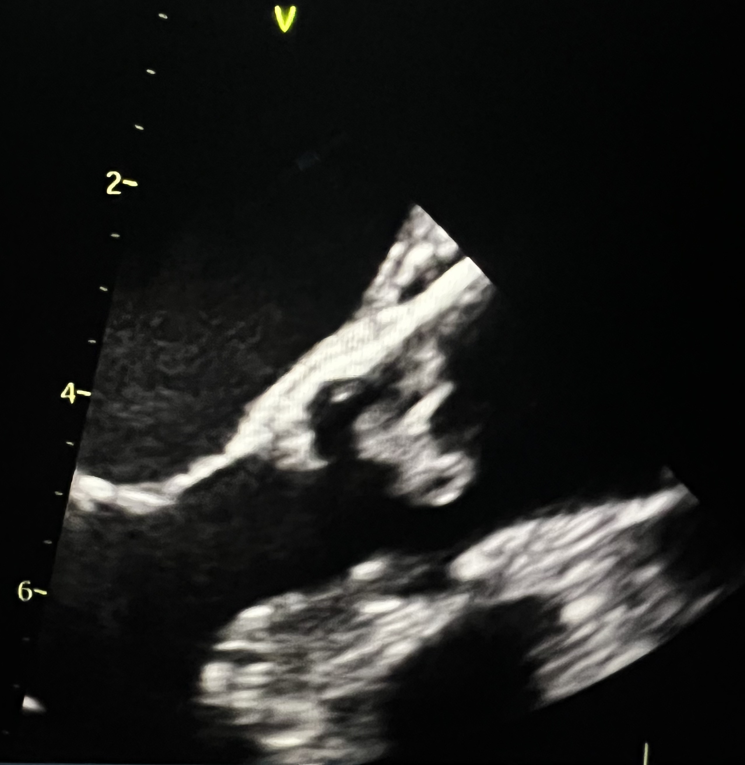
Sepehr Sadeghi, DO; Fernanda Correa, MD; Edward R Leonard, MD; Hsia-Man Chang, MS3; Eduardo Venegas, MD; Neeraj Jain, MD
Marantic endocarditis in antiphospholipid syndrome: An incidental discovery leading to aortic valve replacement
Department of Internal Medicine, LSU Health Sciences Center, New Orleans, LA
Introduction
Diagnostic Studies
Hospital Course
Marantic endocarditis or nonbacterial thrombotic endocarditis (NBTE) refers to platelet aggregates or large vegetations on previously undamaged heart valves in the absence of systemic bacterial infection. While the initiating factor related to pathogenesis is unknown, it is thought that endothelium injury in the setting of hypercoagulable state plays a critical role in pathogenesis. NBTE is a rare condition affecting mostly patients with advanced malignancy or systemic lupus erythematosus.
A
C
B
Patient successfully underwent a bioprosthetic SAVR and was transferred to ICU. Pathology of the aortic valve vegetation revealed myxoid degeneration with Lambl’s excrescences and fibrin thrombi. Her hospital course was complicated by a right frontal punctate infarct, and an acute right brachial arterial thrombus, the latter which was cleared with a heparin drip. She developed a left common femoral artery pseudoaneurysm 10 days following her SAVR, detected on physical exam and confirmed with ultrasound, which also resolved following intravascular thrombin injection. The patient was discharged on Fondaparinux and warfarin for lifelong anticoagulation.
B
D
Case Presentation
C
A 60-year-old female with a past medical history of left popliteal DVT, APS, pulmonary embolism with open embolectomy, and ischemic stroke presented to the hospital after being referred by her cardiologist after a large mobile aortic valvular vegetation was noted on a routine TTE. On presentation, patient was asymptomatic with unremarkable vital signs. Physical exam showed cyanosis and mottling in the left lower extremity, of which a venous doppler US was negative. Further workup resulted in negative blood cultures, severe thrombocytopenia, elevated PTT, and TEE showing a large 1.25cm x 1.02cm vegetation on the ventricular surface of the non-coronary aortic valvular cusp.
Discussion
Marantic endocarditis often presents insidiously with no warning signs or symptoms. A cardiac murmur is present in less than half of the cases and most patients do not exhibit valvular dysfunction or heart failure. The major clinical manifestation of NBTE is systemic emboli frequently to the spleen, kidney, skin, or extremities. A high index of suspicion is of paramount importance in the diagnosis of NBTE and should be kept on the differential in patients with acute stroke or coronary ischemia in the setting of underlying malignancy, systemic lupus erythematosus, or antiphospholipid syndrome as well as in patient presenting with widely distributed systemic emboli or those who are presumed to have infective endocarditis who fail to improve with antibiotic therapy.
References
Kenneth A Bauer, MD. Nonbacterial thrombotic endocarditis. In: UpToDate, Post TW (Ed), UpToDate, Retrieved September 23rd, 2023 https://www.uptodate.com/contents/nonbacterial-thrombotic-endocarditis?search=NBTE&source=search_result&selectedTitle=1~27&usage_type=default&display_rank=1

