Slide 1
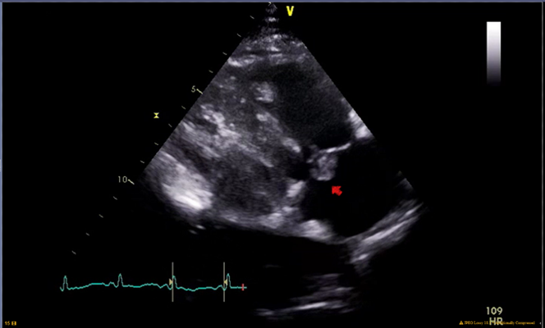
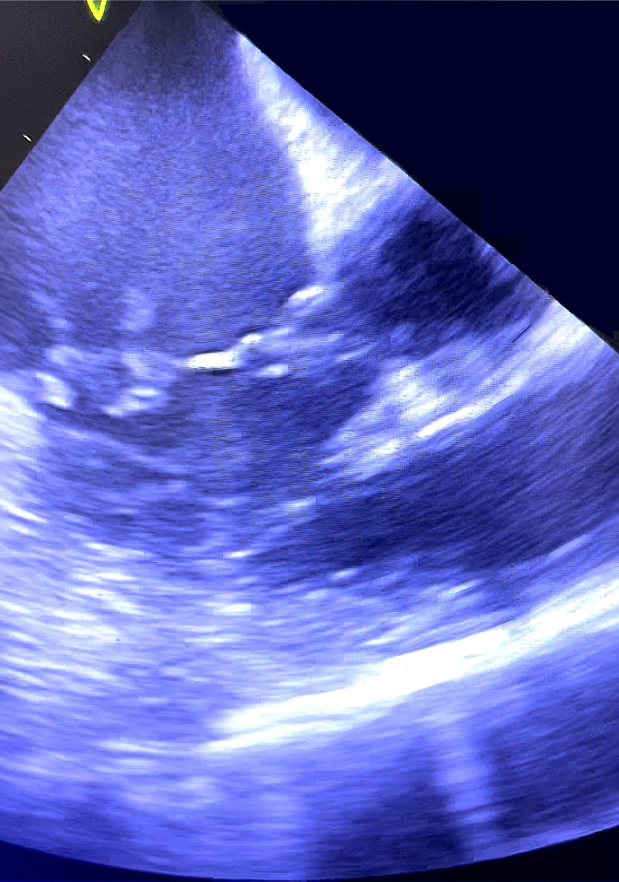
A Novel Approach To Vegetation Aspiration In Native Valve Infective Endocarditis with the AlphaVac System
Luke Sharrock, DO¹; Sepehr Sadeghi, DO¹; Fernanda Correa, MD¹; Walter B. Rentrop, MD²; Scott Laura, MD²; Frank Smart, MD²
¹Department of Internal Medicine; ²Department of Cardiology
LSU Health Sciences Center, New Orleans, LA
Introduction
Discussion
Vegetative valvular endocarditis from non-sterile injections in opioid-dependent patients presents a challenging dilemma for healthcare providers. Even when meeting guideline criteria, these patients are often not deemed appropriate candidates for valvular replacement/repair [2]; this decision is often multifactorial and includes increased risk of reinfection to the valve and risk of death from subsequent undertreated substance use disorder [3]. Therefore, these patients are often treated conservatively with long-term intravenous antibiotics alone. Alternatively, with the advancement of modalities such as endovascular aspiration thrombectomy, providers have been able to utilize the AngioVac system to remove vegetations without the need for surgical intervention. However, this more novel approach to treatment requires placing the patient on extracorporeal bypass [1]. Regardless, given the risk of treatment with IV antibiotic therapy alone, such as medical non-compliance, increasing size of vegetation, embolization, etc., the use of endovascular aspiration devices has become a more favorable approach. In particular, the AlphaVac from AngioDynamics Inc. has enhanced the process greatly from its predecessor, the AngioVac. This new system does not require the use of extracorporeal bypass, minimizes blood loss, allows for more targeted and controlled removal of thrombi/vegetations, and is exceedingly user-friendly. Although originally designed and FDA-approved for the extraction of venous thrombi/emboli with documented success in reports [1], this case demonstrates the AlphaVac’s ability to remove a large, mobile valvular vegetation in the native tricuspid valve without procedural or periprocedural complications.
Our case study demonstrates a new application of the AlphaVac system in extracting large, right-sided valvular vegetations from a patient diagnosed with infective endocarditis. In cases where valvular vegetations exceed 10 mm in size and septic pulmonary emboli are present, surgical removal is often recommended to minimize the risk of further pulmonary emboli, eliminate the bacterial nidus, and enable more effective antibiotic treatment [4]. Our patient had a particularly substantial vegetation measuring over 10 mm along with bi-apical septic emboli. Due to a poor prognosis for open-heart surgery, we opted to employ the AlphaVac system as an alternative solution.
The AngioVac and AlphaVac are primarily designed to remove thromboemboli from the venous system. The AngioVac also serves to eliminate solid substances like thrombi, tumors, or foreign bodies from the venous system [5]. Both systems can remove whole thrombi without relying on hemolytic agents. While the AngioVac has been utilized in the past to remove valvular vegetations in cases of right-sided infective endocarditis [6], the AlphaVac has not been employed for this purpose. What sets the AlphaVac apart is its unique ability to selectively aspirate a desired volume of material without requiring extracorporeal bypass, resulting in less stress on the body and a reduced need for procedural components. Additionally, the AlphaVac is equipped with a manual suction switch that limits the amount of aspirated material. This not only minimizes blood loss but also decreases the risk of damaging surrounding structures. This attribute makes the AlphaVac particularly well-suited for patients with significant valvular vegetations who require surgery but may not be suitable candidates for traditional open-heart procedures.
Figure 1: Transthoracic echocardiogram image of the 1.7 cm mobile vegetation on the anterior leaflet of the native tricuspid valve (red arrow)
A
B
C
Case Presentation
A 45-year-old female presented with fever and chills for one week. The patient had opioid dependence and self-reported receiving a non-sterile dose of intravenous heroin the week prior. She was septic on arrival and blood cultures were positive for methicillin-sensitive staph aureus (MSSA). CT of her chest was suspicious for bi-apical septic emboli, and a Trans-thoracic echocardiogram (TTE) revealed a 1.7 cm mobile vegetation on the anterior leaflet of her native tricuspid valve (TV). She was evaluated by cardiothoracic surgery, which deemed her not an appropriate surgical candidate due to a history of IV drug abuse. Without the possibility of surgical intervention, the patient was informed of her options including endovascular aspiration of the vegetation. She ultimately consented to the procedural removal of the entire vegetation via the novel AlphaVac system, as seen in Figure 2. The patient recovered appropriately in the post-operative period with no documented complications and was discharged 3 days later to a long-term acute care facility to complete 6 weeks of additional IV antibiotic therapy.
Conclusion
This case presents the AlphaVac as a novel modality used to aspirate valvular vegetations in the setting of right-sided infective endocarditis. This system exhibits remarkable versatility and potential in its application. Its distinct features, such as selective and targeted aspiration without the need for extracorporeal bypass, result in minimal blood loss while obtaining large amounts of suctioned material, making it a promising alternative to both open heart surgery and AngioVac for right-sided valvular vegetations. Importantly, the AlphaVac mitigates the risks associated with open-heart surgery while offering a more efficient and reliable method for vegetation removal compared to its predecessor.
Figure 2: Intraoperative echocardiogram showing tricuspid valvular vegetation before (A) and after (C) the AlphaVac aspiration. Tissue and vegetation detection using edge filter application (B).
References
1. Ranade, Mona, and John M. Moriarty. “Case Report: Use of the Alphavac System for the Removal of Right Atrial Thrombus.” Endovascular Today, 18 May 2022, evtoday.com/articles/2022-may/case-report-use-of-the-alphavac-system-for-the-removal-of-right-atrial-thrombus.
2. Baddour LM, Wilson WR, Bayer AS, et al. Infective Endocarditis in Adults: Diagnosis, Antimicrobial Therapy, and Management of Complications: A Scientific Statement for Healthcare Professionals From the American Heart Association. Circulation. 2015; 132(15): p.1435-1486. doi: 10.1161/CIR.0000000000000296.
3. Ryan Hall and others, Drug Use and Postoperative Mortality Following Valve Surgery for Infective Endocarditis: A Systematic Review and Meta-analysis, Clinical Infectious Diseases, Volume 69, Issue 7, 1 October 2019, Pages 1120–1129, https://doi.org/10.
4. Pettersson GB, Hussain ST. Current AATS guidelines on surgical treatment of infective endocarditis. Ann Cardiothorac Surg. 2019 Nov;8(6):630-644. doi: 10.21037/acs.2019.10.05. PMID: 31832353; PMCID: PMC6892713.
5. Behrens G, Bjarnason H. Venous Thromboembolic Disease: The Use of the Aspiration Thrombectomy Device AngioVac. Semin Intervent Radiol. 2015 Dec;32(4):374-8. doi: 10.1055/s-0035-1564792. PMID: 26622100; PMCID: PMC4640912.
6. Abubakar H, Rashed A, Subahi A, Yassin AS, Shokr M, Elder M. AngioVac System Used for Vegetation Debulking in a Patient with Tricuspid Valve Endocarditis: A Case Report and Review of the Literature. Case Rep Cardiol. 2017;2017:1923505. doi: 10.1155/2017/1923505. Epub 2017 Nov 7. PMID: 29238620; PMCID: PMC5697122.

