Slide 1
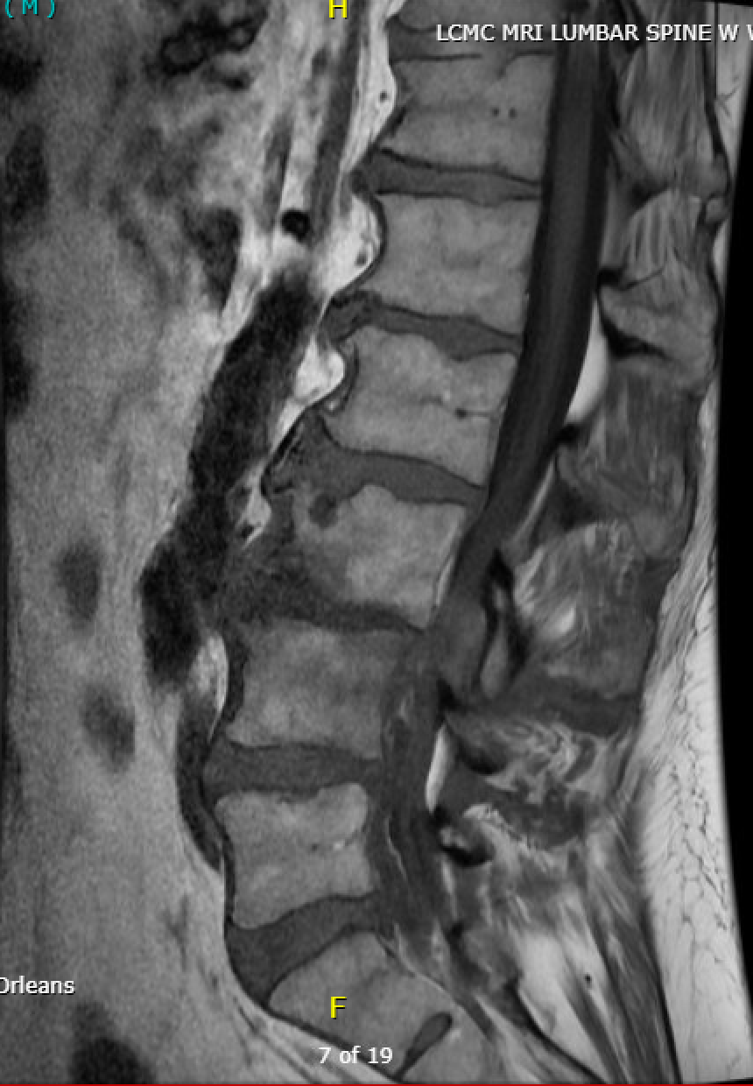
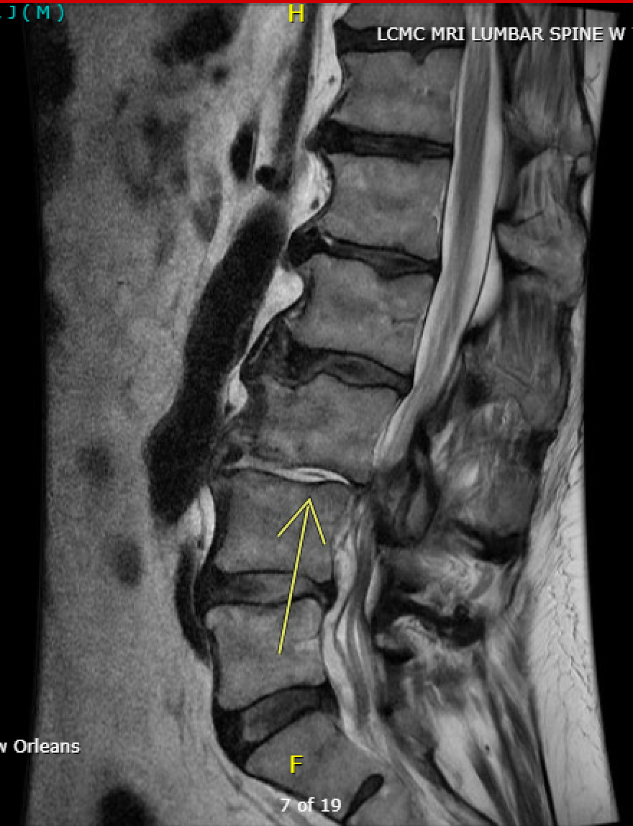
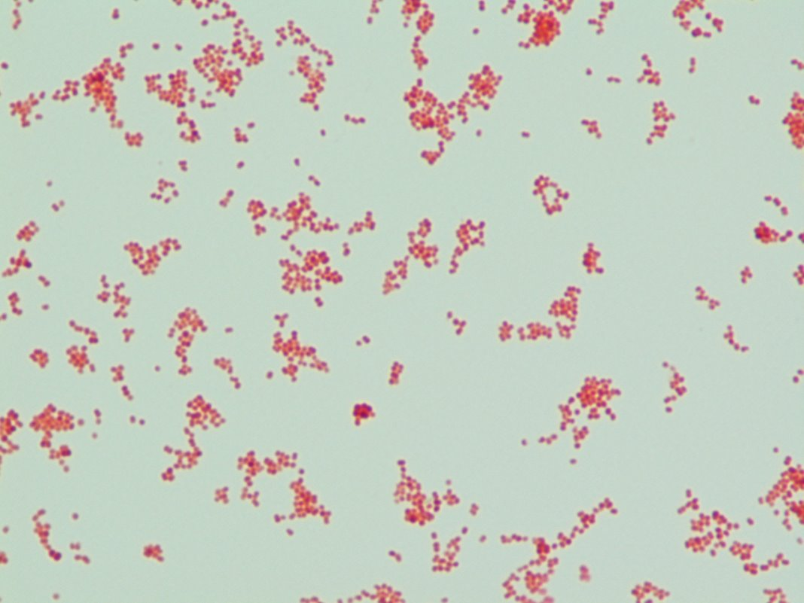
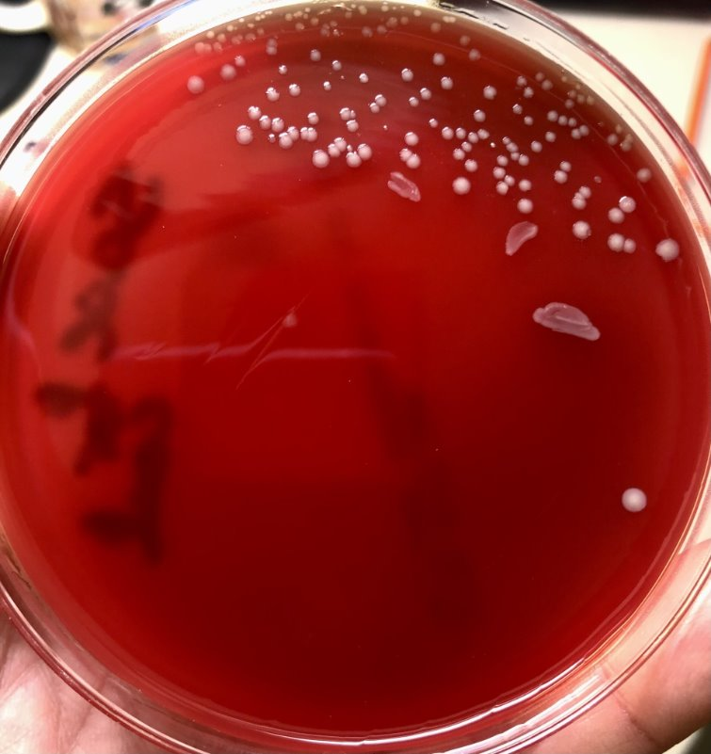
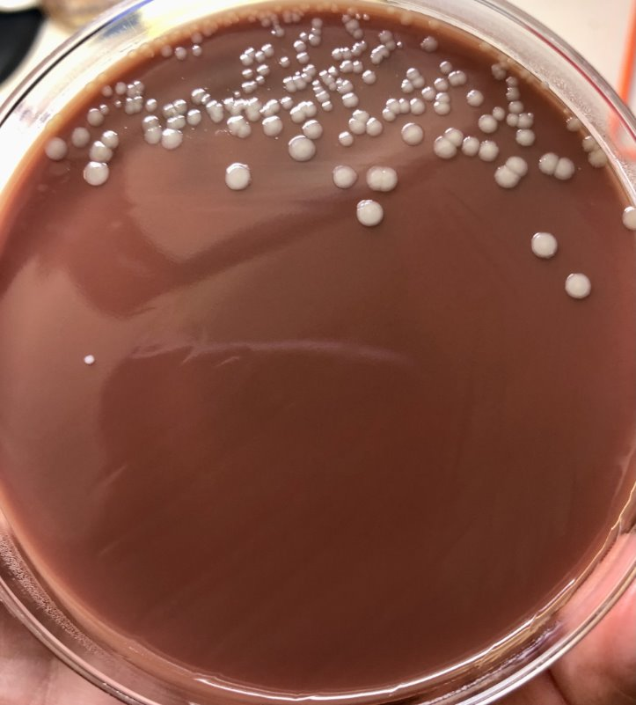
Commensal Neisseria: A Rare Cause of
Osteomyelitis and Discitis
Danielle Gilbert, DO, MPH, Hope Oddo-Moise, MD, Tat Yau MD, MPH
Section of Infectious Diseases, Department of Medicine
Louisiana State University Health New Orleans School of Medicine
Case Presentation
Discussion
68-year-old male with history of stroke, CAD, heart failure, essential hypertension, knee osteoarthritis, chronic lower back with recent radiofrequency ablation (RFA) and epidural steroid injections presented to the emergency department due to intractable back pain for one week duration
Review of systems negative for fevers, chills, urinary symptoms, weakness, sensory changes, recent trauma
Afebrile and hemodynamically stable with physical exam notable for midline point tenderness over lumbar spine with normal neurologic exam
Laboratory evaluation notable for:
WBC 15.5 10³/uL
ESR 49 mm/h
CRP 16 mg/dL
Blood cultures and urine culture: No Growth
MRI L-Spine (Figures 1-2) showed spondylodiscitis, osteomyelitis, paraspinal phlegmon, and extensive complex septated epidural abscess with mass effect at L3-L4
Monitored off antibiotics to improve culture yield and taken to OR for two stage procedure
Stage 1 (hospital day 2): Right complete discectomy at L3-L4 with removal of infected disc and interbody fusion with titanium cage
Stage 2 (hospital day 3): L3-4 posterior segmental instrumented fusion and laminectomy of L3-5 with decompression and evacuation of epidural abscess
Started on empiric vancomycin and ceftriaxone post-operatively after Stage 1 procedure
Post-procedurally with significant improvement in back pain
Surgical cultures (Figures 3-4) of infected disc, epidural abscess, and lumbar tissue from Stage 1 & 2 procedures grew gram negative diplococci later identified as Neisseria sicca/mucosa by MALDI-TOF, final identification and susceptibility pending
Vancomycin discontinued and he was discharged to home on ceftriaxone with plans for 6-week course
Patient presented with vertebral osteomyelitis, discitis, and epidural abscess due to Neisseria mucosa/sicca
Neisseria mucosa and sicca are slow-growing, fastidious gram-negative diplococci which are commensal within the human oropharynx and are rarely pathogenic
Invasive infections due to non-meningococcal, non-gonococcal Neisseria spp. are primarily described in case reports of endocarditis or meningitis, and are most often associated with N. mucosa
Risk factors for invasive disease include recent procedures (particularly dental), prosthetic devices, immunocompromised status
Iatrogenic invasive infection due to commensal oral flora have been described, however Neisseria has only been implicated in a single case report of a patient with N Sicca meningitis after intrathecal contrast injection with an unmasked proceduralist
Patient had no recent dental work and had excellent dentition
Etiology of patient’s presentation thought to be iatrogenic inoculation during RFA versus transient bacteremia in setting of epidural steroid use
N. mucosa and N. sicca are often misclassified with VITEK MS and MALDI-TOF and require advanced diagnostics to identify
One month later, still awaiting final identification and susceptibility of Neisseria spp. cultures
Figure 1. L-Spine MRI
Sagittal T1 FSE
Figure 2. L-Spine MRI
Sagittal T2 FrFSE
Figure 3. Gram Stain Gram Negative Diplococci
References
Entesari-Tatafi D, Bagherirad M, Quan D, Athan E. Iatrogenic meningitis caused by Neisseria sicca/subflava after intrathecal contrast injection, Australia. Emerg Infect Dis. 2014 Jun;20(6):1023-5. doi: 10.3201/eid2006.131117. PMID: 24856004; PMCID: PMC4036775.
Jin Y, Xu H, Yao Q, Gu B, Wang Z, Wang T, Yu X, Lu Y, Zheng B, Zhang Y. Confirmation of the Need for Reclassification of Neisseria mucosa and Neisseria sicca Using Average Nucleotide Identity Blast and Phylogenetic Analysis of Whole-Genome Sequencing: Hinted by Clinical Misclassification of a Neisseria mucosa Strain. Front Microbiol. 2022 Feb 21;12:780183. doi: 10.3389/fmicb.2021.780183. PMID: 35281306; PMCID: PMC8909641.
Walsh L, Clark SA, Derrick JP, Borrow R. Beyond the usual suspects: Reviewing infections caused by typically-commensal Neisseria species. J Infect. 2023 Dec;87(6):479-489. doi: 10.1016/j.jinf.2023.09.007. Epub 2023 Oct 4. PMID: 37797844.
Figure 4. Blood and Chocolate Agar

