Slide 1


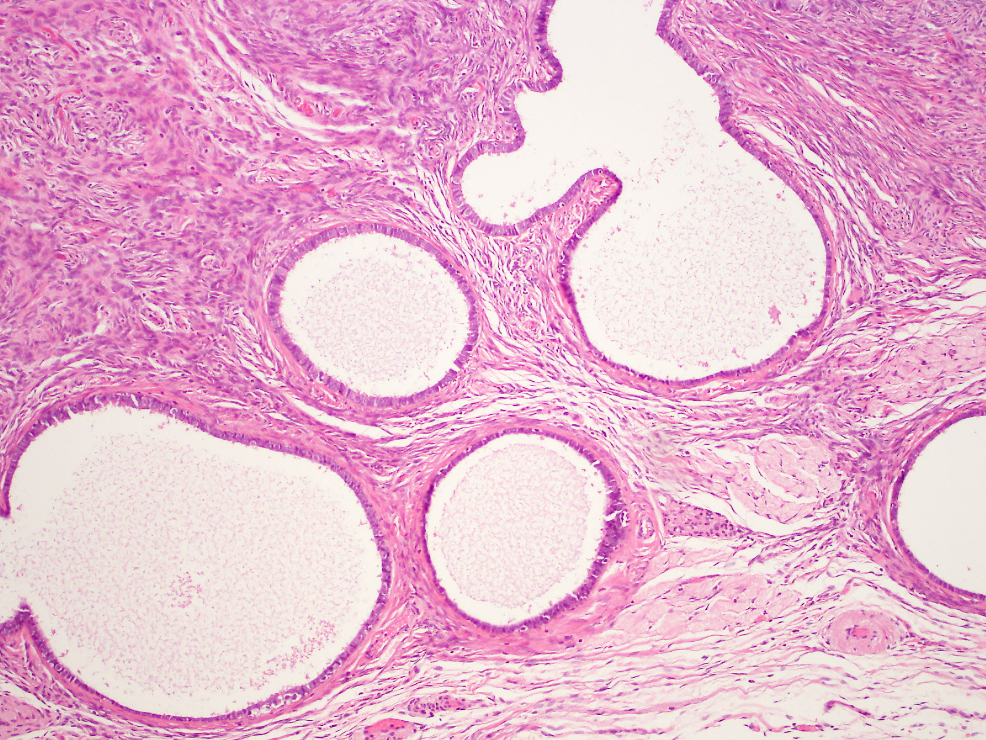
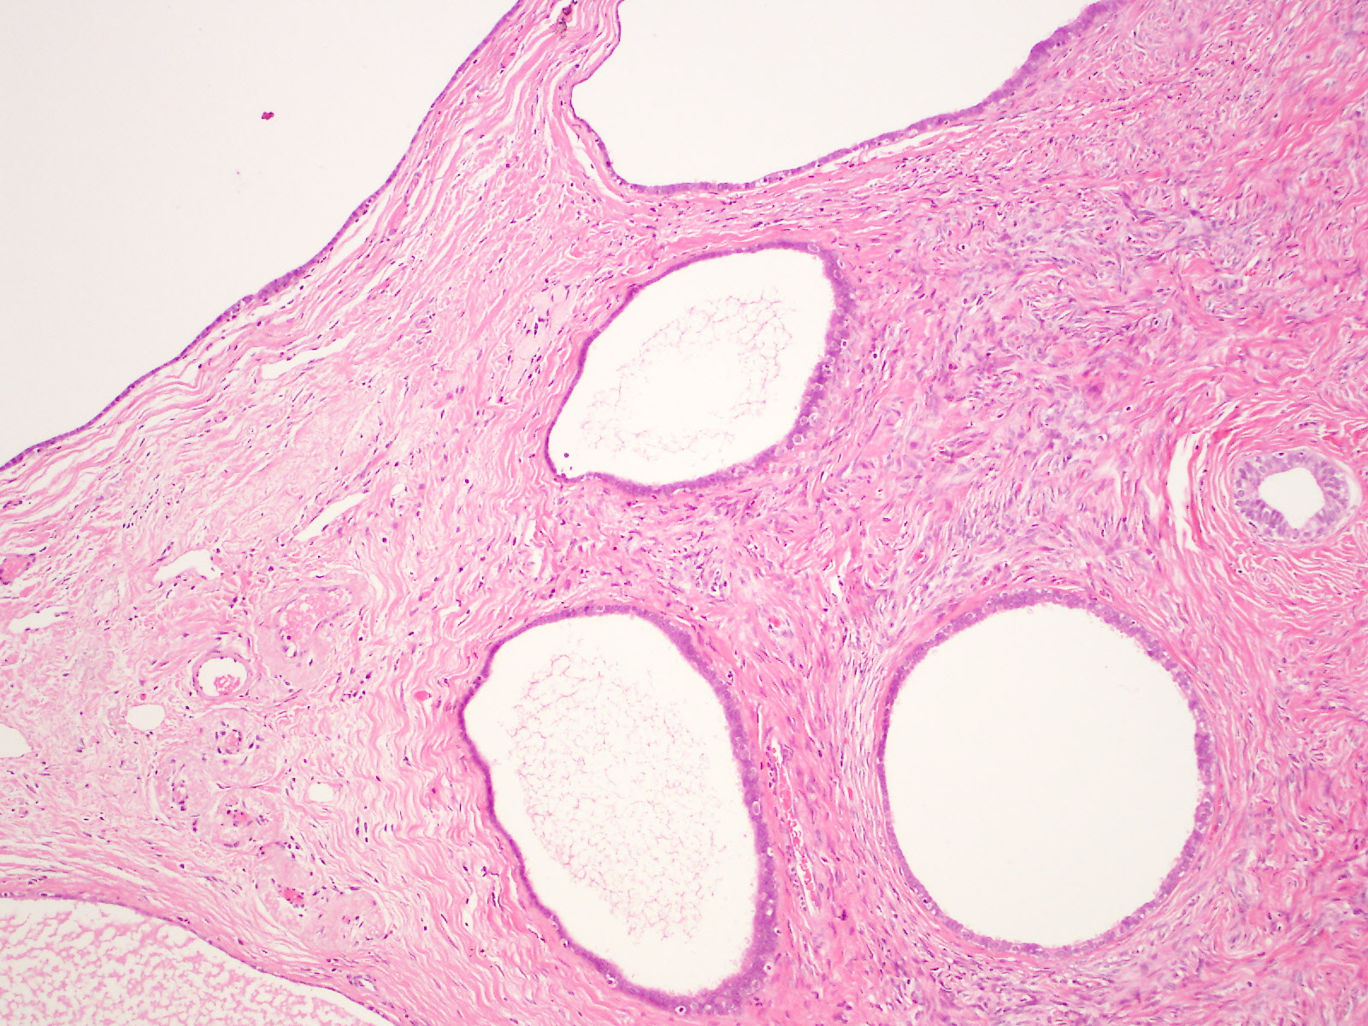
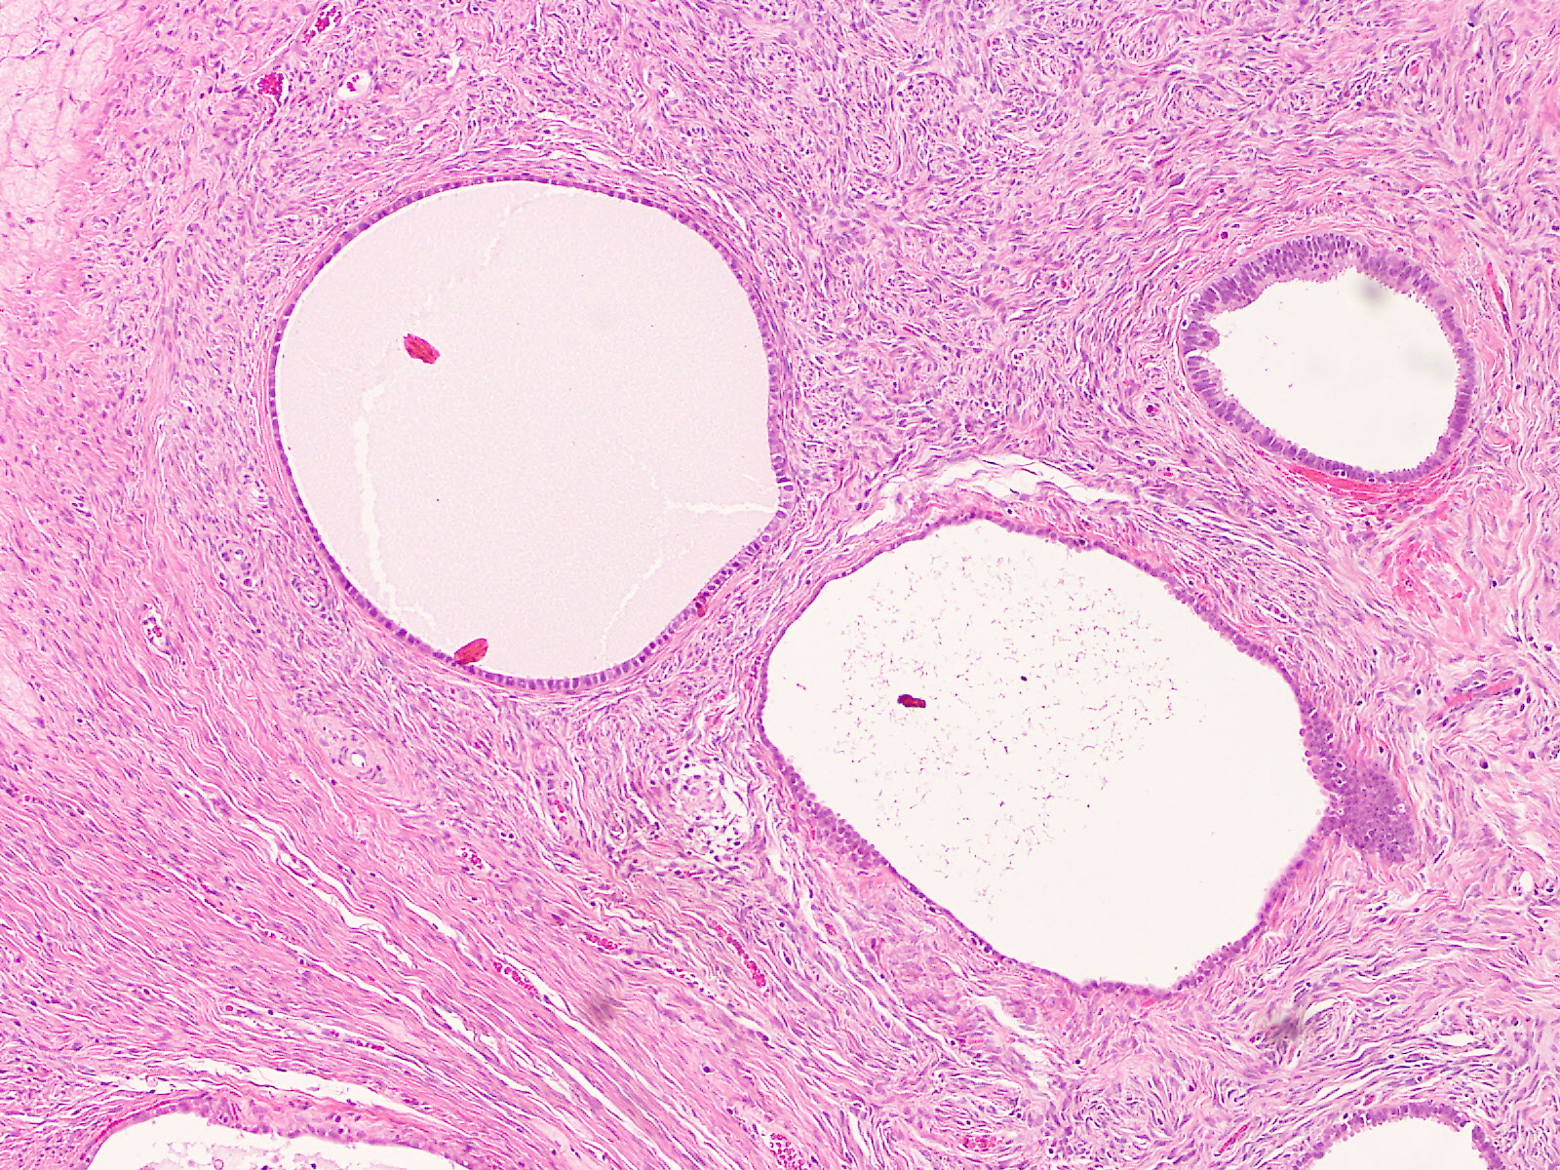
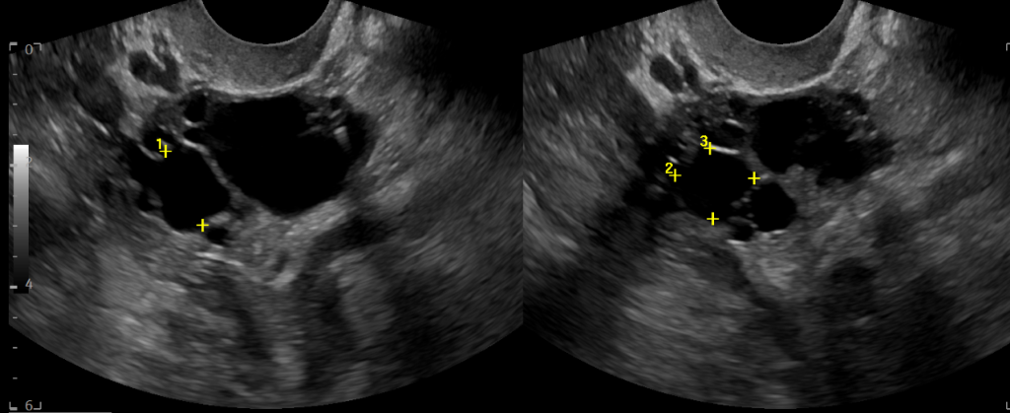
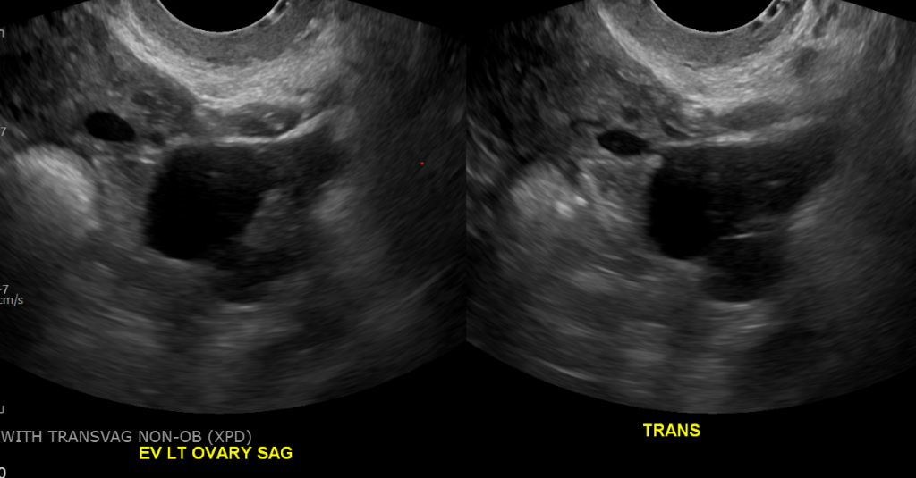

Characterization of Rare Ovarian Neoplasm Serous Cystadenofibroma
Isabel Baird¹, Mallory Brignac¹, Alexandra Hebert¹, Holly Provost, M.D.¹
¹LSUHSC School of Medicine - New Orleans
Introduction
Histology of Cystadenofibroma
Discussion
While cystadenomas of the ovary are one of the most common benign epithelial neoplasms, there is a rare, and comparatively poorly characterized, subtype, the cystadenofibroma. This tumor accounts for about 1.7% of all ovarian neoplasms (1). According to the literature, the etiology of this type of tumor in some cases is likely a mullerian duct remnant rather than a proliferative neoplasm (1,2). Cystadenomas contain both a dominant cystic component and sometimes a fibrostromal component. In contrast to the cystadenoma, the cystadenofibroma demonstrates a dominant fibrous component. These tumors are classified by epithelial cell types, yielding four categories: serous, mucinous, clear cell, and mixed (3). This case describes a serous cystadenofibroma, one of the more common subtypes.
Distinguishing cystadenofibromas from other chronic adnexal masses is necessary to rule out malignancy and determine treatment course. Differential diagnosis includes ovarian cyst, tubo-ovarian abscess, teratoma, cystadenoma, endometrioma, and malignant tumor. Patients may present with a variety of symptoms that are non-specific. Symptoms that are common in patients with an adnexal mass include pelvic or abdominal pain, dyspareunia, irregular vaginal bleeding, bloating, and symptoms of mass effect such as urinary frequency, constipation, and pelvic pressure (4,5). A mass may be palpable on physical exam.
To further characterize the adnexal mass, imaging may be performed. Transvaginal ultrasound is recommended in the evaluation of adnexal masses. Cystadenofibromas appear as uni- or multilocular masses with thin walls, anechoic cystic contents, and hyperechoic solid components (3, 6). Blood flow, if detected, is typically peripheral. MR imaging is sometimes performed for adnexal masses. Characteristics of cystadenofibromas include solid portions with low-intensity T2 signal, thickening of septations with low-intensity T2 signal, and multiple high-intensity T2 signal cysts with low-intensity solid components that has a sponge-like appearance (3, 7). Ultimately, definitive diagnosis is made via biopsy.
Treatment of cystadenofibroma is surgical resection. The importance in accurate diagnosis of cystadenofibroma is that, due to its benign nature, surgery could be avoided if the mass is asymptomatic (8). Future considerations for cystadenofibromas include the association of these masses with other gynecologic pathologies such as endometriosis.
1
2
Figures 1-3: H&E images from serous cystadenofibroma. Small cysts lined by a single layer of columnar ciliated epithelium (resembling normal fallopian tube) or cuboidal non-ciliated epithelium (resembling ovarian surface epithelium), surrounded by fibrous stroma. Histological study revealed findings consistent with serous cystadenofibroma.
Clinical Presentation
64-year-old female, G3P3000, who presented with chronic intermittent sharp pelvic pain that typically lasted several minutes with spontaneous resolution. The complex left ovarian mass had been stable on imaging over the previous 2 years with normal tumor markers. The patient had concern over possible malignancy and requested surgical excision. Obstetric history included one vaginal delivery and two cesarean sections. The patient underwent menopause at 41 with an unimpressive menstrual history and denies endometriosis. She has no family history of breast, ovarian, uterine, or colon cancer. Physical examination revealed tenderness in the left adnexal region. Transvaginal ultrasound showed a left ovary 3.7 x 3.4 x 3.3 cm with a cystic area that measured 1.6 x 1.6 x 1.8 cm (Figure 2.5), the uterus measured 6.4 x 2.6 x 4 cm, and the right ovary was not visualized due to bowel gas.
On pelvic examination, the patient had diffuse hypertonicity and pain to palpation over left pyriformis and levator. Tumor markers were within the normal range with CEA <1.73, CA-19.9 12.14 and CA-125 13.6.
Ultimately patient underwent laparoscopic bilateral salpingoophorectomy. On intraoperative exam, left ovary visualized with multiple clear fluid-filled vesicles. Similar fluid filled vesicles noted along the posterior cul-de-sac. A small portion of peritoneum of posterior cul-de-sac sent to pathology for frozen; specimen confirmed to be old endometriosis lesions. The patient’s operative course was otherwise unremarkable. Pathology revealed the surface of the left ovary measured 3.8 x 2.5 x 3 cm and had multiple clear fluid-filled cysts. Histopathologic findings of the left ovary (Figure 1.1-1.3) revealed serous cystadenofibroma, numerous cortical inclusion cysts, and no evidence of atypia or malignancy. Postoperative course was uncomplicated and patient is doing well on follow-up.
3
TVUS
Conclusions
Due to rarity and lack of research, the cystadenofibroma can be mistaken for malignancy. The value of this case report lies in further characterization as well as delineation of this benign mass from malignant masses that require more aggressive management. In regards to cystadenofibroma, the mass may appear multiloculated with serous and fibrous compinents, but histopathologcally without evidence of malignancy or atypia. Further areas of research beyond characterization of the neoplasm could be exploring the correlation of the cystadenofibroma to other pathologic specimen findings, such as incidental endometriosis found concurrently in this patient.
4
References
5
Erra S, Costamagna D. Serous cystadenofibroma of the fallopian tube: case report and literature review. G Chir. 2012 Jan-Feb;33(1-2):31-3. PMID: 22357436.
Vinson NM and Kauffman RP. Laparoscopic Management of Large Serous Cystadenofibroma of the Fallopian Tube: A Case Report. Journal of Minimally Invasive Gynecology, Volume 23, Issue 7, S225 – S226.
Choi JI, Park SB, Han BH, Kim YH, Lee YH, Park HJ, Lee ES. Imaging features of complex solid and multicystic ovarian lesions: proposed algorithm for differential diagnosis. Clin Imaging. 2016 Jan-Feb;40(1):46-56. doi: 10.1016/j.clinimag.2015.06.008. Epub 2015 Jul 17. PMID: 26277385.
Biggs WS, Marks ST. Diagnosis and Management of Adnexal Masses. Am Fam Physician. 2016 Apr 15;93(8):676-81. PMID: 27175840.
Attanucci CA, Ball HG, Zweizig SL, Chen AH. Differences in symptoms between patients with benign and malignant ovarian neoplasms. Am J Obstet Gynecol. 2004 May;190(5):1435-7. doi: 10.1016/j.ajog.2004.01.077. PMID: 15167861.
Alcázar JL, Errasti T, Mínguez JA, Galán MJ, García-Manero M, Ceamanos C. Sonographic features of ovarian cystadenofibromas: spectrum of findings. J Ultrasound Med. 2001 Aug;20(8):915-9. doi: 10.7863/jum.2001.20.8.915. PMID: 11503928.
Wasnik A, Elsayes K. Ovarian cystadenofibroma: A masquerader of malignancy. Indian J Radiol Imaging. 2010 Nov;20(4):297-9. doi: 10.4103/0971-3026.73538. PMID: 21423907; PMCID: PMC3056629.
American College of Obstetricians and Gynecologists’ Committee on Practice Bulletins—Gynecology. Practice Bulletin No. 174: Evaluation and Management of Adnexal Masses. Obstet Gynecol. 2016 Nov;128(5):e210-e226. doi: 10.1097/AOG.0000000000001768. PMID: 27776072.
Figure 2: Comparing TVUS in 2022 (4) to preoperative TVUS in 2024 (5). Left ovarian complex cyst measuring 2.6 x 1.8 x 2.5 cm imaged in 10/13/22 ( 4), and 5 demonstrates a stable complex cyst at 1.6 x 1.6 x 1.8 cm cm almost two years later on 6/18/24.

