Slide 1


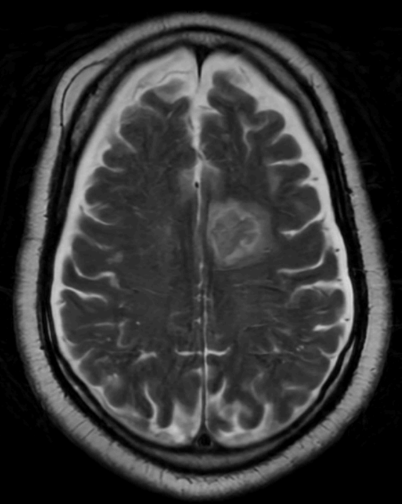
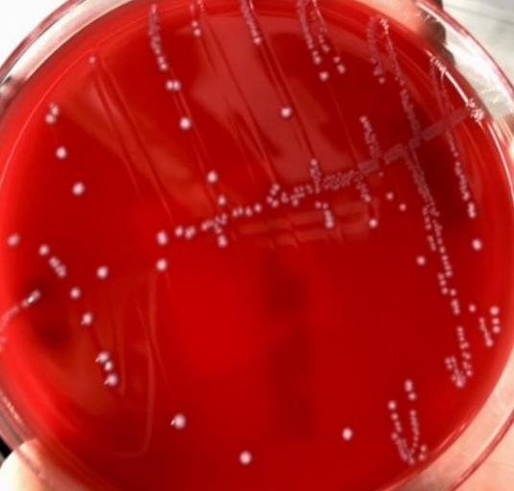
Non-Small Cell Lung Cancer with Metastasis to Brain complicated by Enterococcus Meningitis
Kaitlyn G. Calabresi¹, Danielle L. Gilbert², Tat Yau²
1. Louisiana State University School of Medicine, New Orleans, LA
2. Louisiana State University Department of Medicine, Section of Infectious Diseases, New Orleans, LA
Introduction
Management and Clinical Course
This case is an uncommon presentation of enterococcal meningitis, as it seemingly occurred as a spontaneous, community-acquired meningitis in an immunocompromised male with structural abnormalities due to underlying metastasis.
The patient was started on intravenous ampicillin, ceftriaxone, and gentamicin for Enterococcal meningitis and high-dose steroids for possible meningeal carcinomatosis. His mentation improved over 24-48 hours. CSF studies were repeated with a decrease in WBC to 22 cells/uL and protein to 140 mg/dL. Treatment was complicated by suspected gentamicin-induced nephrotoxicity leading to discontinuation of gentamicin on day 16. He was discharged to home upon completion of a 21-day course of ampicillin and ceftriaxone but returned to the ED a week after discharge with fever of 102.6°F and altered mental status. He was restarted on empiric ampicillin and ceftriaxone. Workup during the second hospital stay was negative for reinfection, with no growth on CSF or blood cultures. CT of head was significant for increase in size of left frontal lobe metastasis. Patient was discharged with home hospice.
Case Description
Background:
The patient was a 61-year-old man with a past medical history of seizure disorder and non-small cell lung cancer diagnosed and treated with radiation and chemotherapy in 2017, later with progression of disease to the brain necessitating radiation and checkpoint inhibitor therapy with chronic steroids.
Presentation:
One-day history of severe headache without neurologic changes, fevers, chills, or abdominal or urinary complaints
Waxing and waning mental status and stuttering dysarthria without other neurologic deficits
Afebrile and hemodynamically stable
Initial Workup:
CBC: WBC 16.4x10³ cells/uL, 94% neutrophils
CT and MRI of the brain: bifrontal cystic hygromas and subtle increase in proteinaceous fluid in the left frontal and parietal sulci from prior imaging
Lumbar puncture CSF: WBC 17.2x10³ cells/uL (84% neutrophils), protein 328 mg/dL, glucose wnl
Meningitis/Encephalitis PCR panel negative
CSF cultures: few colonies of ampicillin-susceptible E. faecalis, cytology suggestive of carcinoma.
Blood cultures: no growth
CSF Findings Comparison
 | CSF Day 2 | CSF Day 8
Color, Clarity | Colorless, turbid | Colorless, clear
WBC (cells/uL) | 17,246 | 22
% neutrophils | 87% | 11%
% lymphocytes | 6% | 82%
% monocytes | 7% | 7%
RBC (cells/uL) | 526 | 12
Protein (mg/dL) | 328 | 140
Glucose (mg/dL) | 60 | 51
Discussion
Figures
Enterococcus species are resident flora of the gastrointestinal tract, and are better known to cause urinary tract infections, bacteremia, and endocarditis. Enterococcal infections of the CNS are extremely rare and are thought to make up only 0.3-4% of bacterial meningitis, with E. faecalis accounting for 76% of cases.
Enterococcal meningitis presents with fever, mental status changes, and purulent meningitis. Cases typically occur in the setting of CNS hardware or secondary infection from bacteremia (58%) or other enterococcal infections. Risk factors include cardiovascular disease, congenital heart abnormalities, diabetes, immunocompromised status, head trauma, CNS structural abnormalities, and CNS hardware.
Due to its rarity, minimal data exists to guide treatment for ampicillin-susceptible enterococcal meningitis, though studies suggest at least dual therapy with IV ampicillin and ceftriaxone with gentamicin or streptomycin for 14-21 days. This case also highlights the need for updated treatment recommendations for enterococcal meningitis related to aminoglycoside toxicity.
1
2
References
Bayer AS, Seidel JS, Yoshikawa TT, Anthony BF, Guze LB. Group D enterococcal meningitis. Clinical and therapeutic considerations with report of three cases and review of the literature. Arch Intern Med. 1976 Aug;136(8):883-6. doi: 10.1001/archinte.136.8.883. PMID: 821410.
Çay Ü, Alabaz D, Özgür Gündeşlioğlu Ö, Kibar F, Çetin C, Oktay K. Experience with enterococcal meningitis/ventriculitis in children. Pediatr Int. 2023 Jan-Dec;65(1):e15398. doi: 10.1111/ped.15398. PMID: 36305209.
Centers for Disease Control and Prevention. (n.d.). Public health image library - Enterococcus faecalis. Centers for Disease Control and Prevention. https://phil.cdc.gov/Details.aspx?pid=12803
Khanum I, Anwar S, Farooque A. Enterococcal Meningitis/Ventriculitis: A Tertiary Care Experience. Asian J Neurosurg. 2019 Jan-Mar;14(1):102-105. doi: 10.4103/ajns.AJNS_260_17. PMID: 30937018; PMCID: PMC6417351.
Mass General Brigham. (n.d.). Enterococcus Faecalis. Infectious disease images - EMICROBES digital library. https://www.idimages.org/images/organismdetail/?imageid=1895&altimageid=
Pintado V, Cabellos C, Moreno S, Meseguer MA, Ayats J, Viladrich PF. Enterococcal meningitis: a clinical study of 39 cases and review of the literature. Medicine (Baltimore). 2003 Sep;82(5):346-64. doi: 10.1097/01.md.0000090402.56130.82. PMID: 14530784.
Stevenson KB, Murray EW, Sarubbi FA. Enterococcal meningitis: report of four cases and review. Clin Infect Dis. 1994 Feb;18(2):233-9. doi: 10.1093/clinids/18.2.233. PMID: 8161632.
Van Tyne D, Martin MJ, Gilmore MS. Structure, function, and biology of the Enterococcus faecalis cytolysin. Toxins (Basel). 2013 Apr 29;5(5):895-911. doi: 10.3390/toxins5050895. PMID: 23628786; PMCID: PMC3709268.
Zhang, X., Jiang, C. & Zhou, C. Diagnosis of Enterococcus faecalis meningitis associated with long-term cerebrospinal fluid rhinorrhoea using metagenomics next-generation sequencing: a case report. BMC Infect Dis 21, 1105 (2021). https://doi.org/10.1186/s12879-021-06797-y
Figure 1: MRI brain showing cystic hygromas and layering proteinaceous material
Figure 2: Blood agar plate with few cultures of E. faecalis isolated from lumbar puncture CSF

