Slide 1


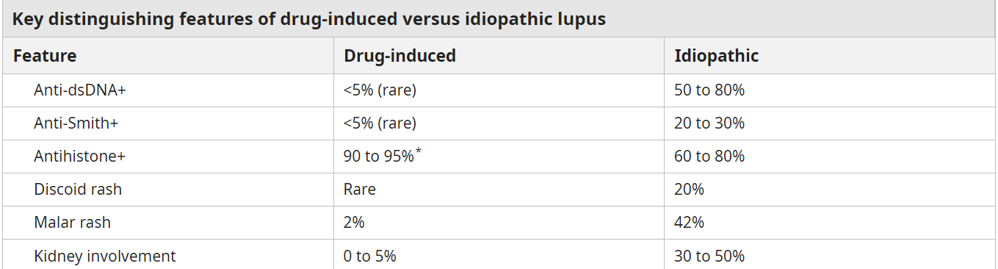
Drug-Induced Lupus with Ethosuximide Use in a Pediatric Patient: A Case Report
Landon Krone, BS; Jantzen Collette, MD
Louisiana State University Section of Pediatrics
Introduction
Drug-induced lupus (DIL) is a side effect of certain drugs, whereby a patient develops lupus-like symptoms after at least one month of medication initiation.
Symptoms can include myalgias, arthralgias, fever, rash, malaise.
Distinguishing features of DIL include positive anti-histone antibodies and resolution of symptoms after discontinuation of the causal drug.
Discussion
Once anti-histone antibodies came back positive and pathology results ruled out an oncologic process, rheumatology confirmed diagnosis of DIL with recommendation that ethosuximide remain withheld.
Patient was discharged home on naproxen for joint pain without need for steroids.
The recent initiation of ethosuximide is an important feature not to miss in this patient’s case.
Ethosuximide was discontinued on admission, and the patient remained stable throughout hospital course without development of new or worsening symptoms.
Procainamide, hydralazine, isoniazid, minocycline, and quinidine are most associated with DIL, but there are increasing case reports of other drugs causing a DIL clinical picture.
Pediatric patients presenting with lupus-like symptoms should prompt a consideration of DIL as the diagnosis, with thorough review of medication history.
Physical Exam
A
A
Notable for bilateral conjunctival injection, bilateral anterior and posterior cervical adenopathy (posterior nodes most significant in size), and several non-pruritic papules to medial aspect of right knee.
Case
B
B
A 10-year-old male presented to rheumatology clinic after referral from outside hospital with a 1-month history of daily fevers, intermittent rash, polyarthralgias, bilateral conjunctival injection, cervical lymphadenopathy, and weight loss of 8 pounds.
He had multiple hospitalizations during symptom course with a diagnosis and treatment of acute rheumatic fever early in symptom onset. However, symptoms persisted.
His past medical history was notable for epilepsy and absence seizures, with initiation of Ethosuximide for increased staring spells 2 months prior to symptom onset.
He was admitted to the hospital for further workup, with discontinuation of Ethosuximide at that time due to concern for DIL.
Consultation/Workup
Hematology-oncology was consulted for concern of lymphoma; a right cervical lymph node was biopsied, with pathological results showing reactive lymph nodes of benign origin.
Opthamology was consulted, with diagnosis of bilateral episcleritis and uveitis.
A full rheumatologic workup was initiated.
Lab workup was notable for mild microcytic anemia, elevated CRP and ESR, and normal C3 and C4 complement.
Anti-nuclear antibody (ANA), anti-double-stranded (ds) DNA antibody, anti-chromatin antibody, anti-ribonucleoprotein (RNP) antibodies, and anti-histone antibodies were positive.
II
D
References
Robert L. Rubin, Chapter 56 - Drug-induced lupus, Editor(s): George C. Tsokos, Systemic Lupus Erythematosus (Second Edition), Academic Press, 2021, Pages 535-547.
Kaya Akca U, Sener S, Batu ED, Balik Z, Basaran O, Bilginer Y, Ozen S. Drug-induced lupus erythematosus in childhood: Case-based review. Lupus. 2024 Jun;33(7):737-748.
Aly R, Zeng X, Upadhyay K. Drug-Induced Lupus Secondary to Ethosuximide in Association with Acute Tubulointerstitial Nephritis and Nephrotic Syndrome. Pediatr Rep. 2022 Apr 14;14(2):190-199.
Augusto Vaglio, Peter C. Grayson, Paride Fenaroli, Davide Gianfreda, Valeria Boccaletti, Gian Marco Ghiggeri, Gabriella Moroni, Drug-induced lupus: Traditional and new concepts, Autoimmunity Reviews, Volume 17, Issue 9, 2018, Pages 912-918.
E

