Slide 1
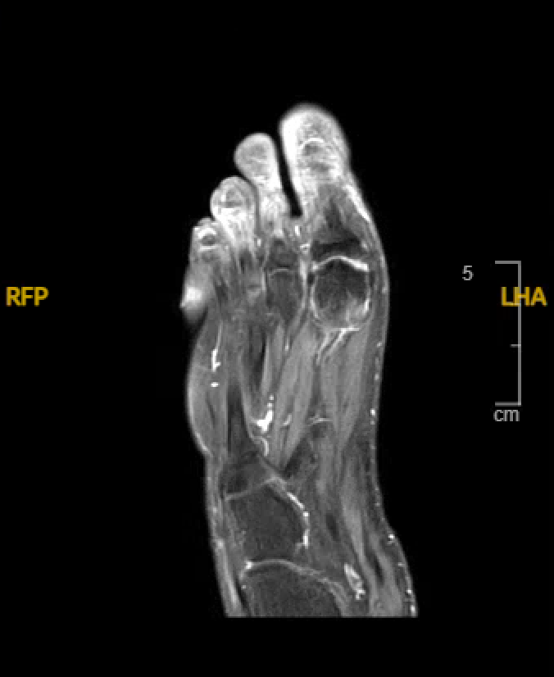
Diabetes and Destruction: A Case of Severe Foot Wounds
Alexandra Bartholomew, BA¹; Jessica Pickens, BS¹; Jason Onwenu, DO²; Ellen Mire, MD²; Alexia Tadros, MS³; Catherine Loehr, MD²; Shane Sanne, DO² ¹School of Medicine, Louisiana State University Health Sciences Center, New Orleans, LA​
²Department of Medicine, Louisiana State University Health Sciences Center, New Orleans, LA
³Department of Physician Assistant Studies, Louisiana State University Health Sciences Center, New Orleans, LA
Introduction
Labs
Discussion
People with diabetes are particularly susceptible to nonhealing foot wounds. The most common causes of nonhealing foot wounds in diabetics are peripheral neuropathy and peripheral arterial disease leading to unknown trauma and infection. Here we describe a case of a patient with diabetes who presented with acute degloving injuries of both feet of unclear etiology.
Hemoglobin A1c: 14.9
Blood glucose: 671 mg/dL
Vasculitis and rheum workup: negative (including C3, C4, RF, ANCA, cryoglobulins, and ENA panel)
Bone culture from foot at time of amputation: few colonies Enterococcus casseliflavus
Surgical pathology post-amputation: all margins negative for osteomyelitis
Foot wounds are one of the most common complications of longstanding and poorly controlled diabetes. While no obvious cause of necrosis was found, it was ultimately suspected that her wounds were related to chronic poor blood flow secondary to uncontrolled diabetes that acutely worsened with episodes of DKA and hypotension. With her new ankle fracture, she likely had an unknown trauma due to her neuropathy. It was also suspected that her necrosis could be from previous vasopressor administration. Onset for developing digit necrosis varies but usually occurs within a few hours to 21 days post-administration. Therefore, our patient presentation was likely unrelated to vasopressor-induced skin necrosis since it was last used three months prior. In conclusion, it takes a multidisciplinary approach to manage diabetic foot wounds, including annual foot examinations, appropriate footwear, glycemic control, and prompt treatment of infection and ischemia.
A
Case Presentation
42-year-old female with a history of hypertension, hypothyroidism, uncontrolled type 1 diabetes (A1c 14.9) complicated by hypoglycemia, diabetic ketoacidosis (DKA), and peripheral neuropathy presented to ED after experiencing dizziness and a fall at home. Blood glucose was 671. Hypotension responded to fluid boluses. She had degloving injuries of the first, second, and third metatarsals of her left foot and the first and second metatarsals of her right foot. She first noticed the wounds two days prior when she removed her socks. Denied any known trauma. Four days prior to this presentation, she was hospitalized for DKA at an outside hospital. She had also been hospitalized for DKA three months prior; at that time, she experienced severe hypotension requiring vasopressors.
During this admission, her toes developed necrosis bilaterally, for which she underwent extensive workup. No obvious etiology was identified. Vasculitis and rheumatology workup was negative, including C3, C4, RF, ANCA, cryoglobulins, and ENA panel. Bilateral lower extremity DVT ultrasound was negative with Doppler revealing no evidence of significant arterial disease. Superficial wound culture grew Enterococcus casseliflavus and Enterococcus faecalis. She received a 10-day course of doxycycline, flagyl, cefepime, and vancomycin. Left lower extremity x-ray demonstrated an ankle fracture. CT angiogram with runoff showed some atherosclerotic changes of the superficial femoral arteries but was patent distally. MRI of both feet was without evidence of osteomyelitis but did show findings possibly indicative of chronic ischemia.
Unfortunately, despite hyperbaric oxygen treatment, her dry gangrene progressed. She underwent a partial ray amputation of the left first, second, and third digits. On culture, few colonies of E. casseliflavus were noted. Pathology showed clean margins. After amputation she continued hyperbaric oxygen treatment.
Imaging
D
References
Preventing and Treating Foot Complications Associated With Diabetes Mellitus. Bowling FL, Rashid ST, Boulton AJ. Nature Reviews. Endocrinology. 2015;11(10):606-16. doi:10.1038/nrendo.2015.130.
Limb Necrosis in the Setting of Vasopressor Use. Derry KH, Rocks MC, Izard P, et al. American Journal of Critical Care : An Official Publication, American Association of Critical-Care Nurses. 2024;33(3):226-233. doi:10.4037/ajcc2024171. McDermott K, Fang M, Boulton AJM, Selvin E, Hicks CW. Etiology, Epidemiology, and Disparities in the Burden of Diabetic Foot Ulcers. Diabetes Care. 2023 Jan 1;46(1):209-221. doi: 10.2337/dci22-0043. PMID: 36548709; PMCID: PMC9797649.
F
G
Figure 1. MRI left foot showing edema-like signal of the first distal metatarsal and proximal phalanx (likely reactive from surrounding inflammation and possible posttraumatic changes) and chronic ischemic changes. No evidence of osteomyelitis.

