Slide 1

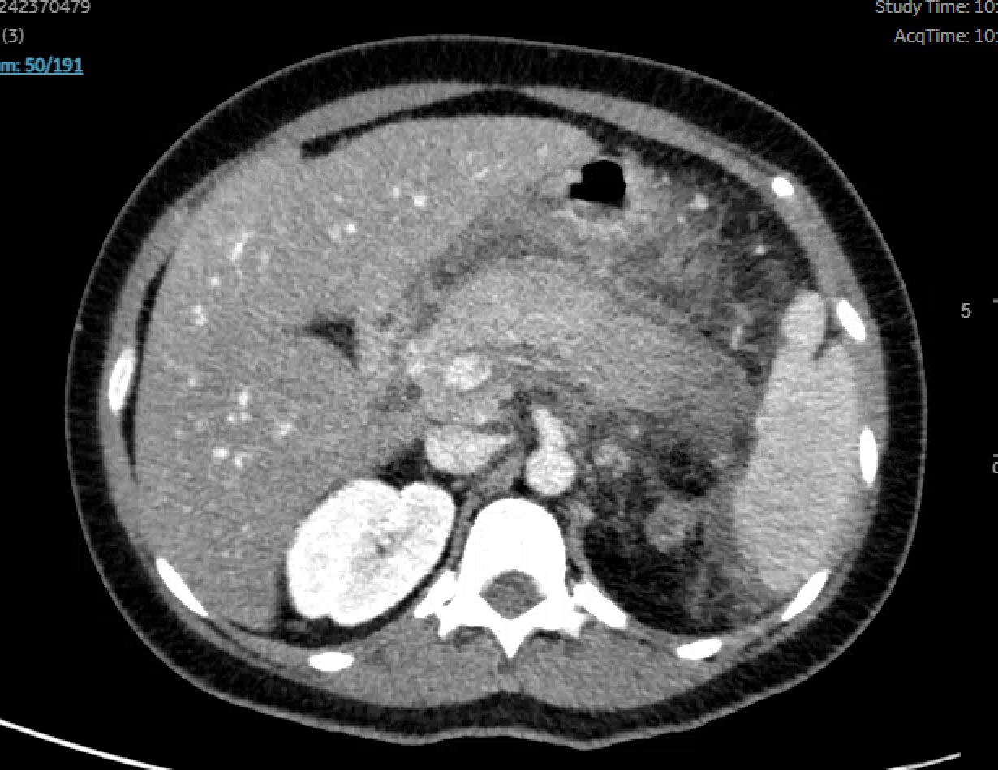
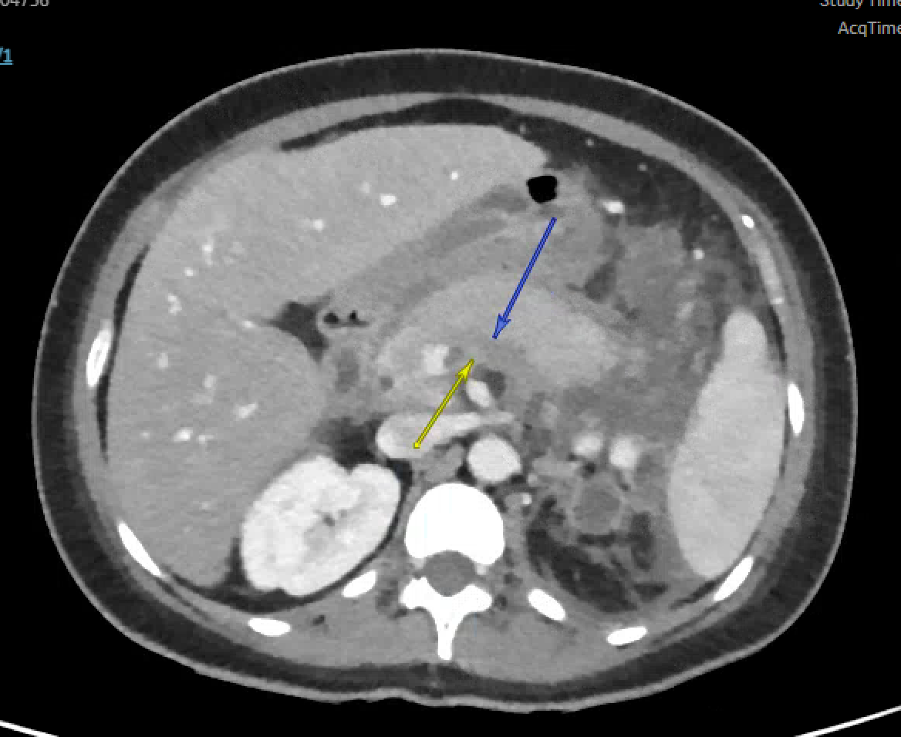
From Pill to Patch: A Case of Hypertriglyceridemia-Induced Pancreatitis with Complications
Alexandra Bartholomew, B.A.¹; Jessica Pickens, B.S.¹; Catherine Loehr, M.D.²; Farhan Mohiuddin, M.D.²; Shane Sanne, D.O.²
¹School of Medicine, Louisiana State University Health Sciences Center, New Orleans, LA​
²Department of Medicine, Louisiana State University Health Sciences Center, New Orleans, LA
Introduction
Labs
Discussion
Causes of acute pancreatitis: gallstones (40-70%), alcohol (25-35%)​, hypertriglyceridemia (1-4%), medications
Familial hypertriglyceridemia is a rare cause of hypertriglyceridemia-induced pancreatitis
  Age of presentation: often early adulthood​
  Triggers: poorly controlled diabetes, pregnancy, alcohol, medications such as hormone supplementation
Lipase: 1,456 U/L
Triglyceride level: >3000 mg/dL
WBC: 22.5 x 10³/μL
Lactic acid: 6.0 mmol/L
Estrogen-containing oral contraceptives (OCPs) are known to potentially contribute to hypertriglyceridemia, which can increase the risk of acute pancreatitis.
The mechanism behind OCP-induced hypertriglyceridemia involves estrogen-mediated upregulation of hepatic VLDL synthesis and decreased lipoprotein lipase activity, leading to impaired triglyceride clearance.
Other hormonal formulations, such as transdermal estrogen patches, vaginal rings, and intrauterine devices, may have a lesser impact on triglyceride levels due to reduced first-pass hepatic metabolism.
Thus far, there have been no reported cases of hypertriglyceridemia-induced pancreatitis directly linked to hormonal patches, vaginal rings, or topical retinoids.
The lack of reported cases may be attributed to minimal transcutaneous absorption of estrogen and the lower systemic bioavailability of topical formulations compared to oral administration.
Retinoids, particularly oral formulations such as isotretinoin, have been associated with hypertriglyceridemia, but the risk with topical retinoids remains unclear due to their limited systemic absorption.
In patients with multiple risk factors for hypertriglyceridemia (e.g., familial hyperlipidemia, metabolic syndrome, diabetes, or excessive alcohol consumption), even minor elevations in triglyceride levels from transdermal estrogen or topical retinoids could theoretically contribute to the development of acute pancreatitis.
Future studies or case reports may be needed to evaluate whether transdermal estrogen or topical retinoids have any clinically significant impact on triglyceride metabolism and pancreatitis risk.
A
Imaging
Case Presentation
30-year-old female with a history of type 2 diabetes (A1c 5.4) and hypertriglyceridemia-induced pancreatitis (last episode 15 months prior) presented to the hospital with nausea, vomiting, and severe acute abdominal pain radiating to the upper back.
She had previously been diagnosed with hypertriglyceridemia after onset of yellow papules on her thighs, buttock, axilla, and back, which pathology report suggested eruptive xanthoma. There was strong suspicion for familial hypertriglyceridemia given her family and personal history of hypertriglyceridemia and acute pancreatitis, eruptive xanthomas, and elevated triglyceride and VLDL levels. On her previous admission, she had similar presentation symptoms. At that time, her triglyceride level was 1444 mg/dL and peaked at 2127 mg/dL. She was treated with insulin and initiated on gemfibrozil. Two weeks prior to this admission, she had switched from an oral contraceptive regimen to hormonal birth control with patches in the hopes of reducing future pancreatitis episodes via the lower impact of transdermal estrogen on triglyceride levels compared to oral estrogen. Of note, she was also using topical retinoids.
At the time of presentation, CT abdomen revealed severe acute pancreatitis with developing necrosis of the pancreatic head. Her triglyceride level was over 3000 and her lipase was over 1400, confirming hypertriglyceridemia-induced acute pancreatitis. She was treated again with an insulin drip and gemfibrozil. Repeat CT of the pancreas revealed pancreatic tail necrosis and splenic vein thrombosis. No acute surgical intervention was warranted. She was treated briefly with antibiotics as well as started on anticoagulation. She was discharged in stable condition.
D
Figure 1. CT scan with contrast showing markedly enlarged pancreas with significant peripancreatic edema and fat stranding as well as irregular enhancement of the pancreatic body and tail compared to prior CT, indicative of severe acute pancreatitis with possible developing necrosis.​
F
G
References
Tenner S, Vege SS, Sheth SG, et al. American College of Gastroenterology Guidelines: Management of Acute Pancreatitis. Am J Gastroenterol. 2024;119(3):419-437. doi:10.14309/ajg.0000000000002645.​
Zilio MB, Eyff TF, Azeredo-Da-Silva ALF, Bersch VP, Osvaldt AB. A Systematic Review and Meta-Analysis of the Aetiology of Acute Pancreatitis. HPB (Oxford). 2019;21(3):259-267. doi:10.1016/j.hpb.2018.08.003.​
Whayne TF. Hypertriglyceridemia: An Infrequent, Difficult-to-Predict, Severe Metabolic and Vascular Problem Associated With Estrogen Administration. Curr Vasc Pharmacol. 2020;18(3):254-261. doi:10.2174/1570161117666190306102322.​
UpToDate. Etiology of acute pancreatitis. Accessed February 3, 2025. https://www.uptodate.com.
Figure 2. Repeat CT of the pancreas demonstrating pancreatic tail necrosis and splenic vein thrombosis.

