Slide 1


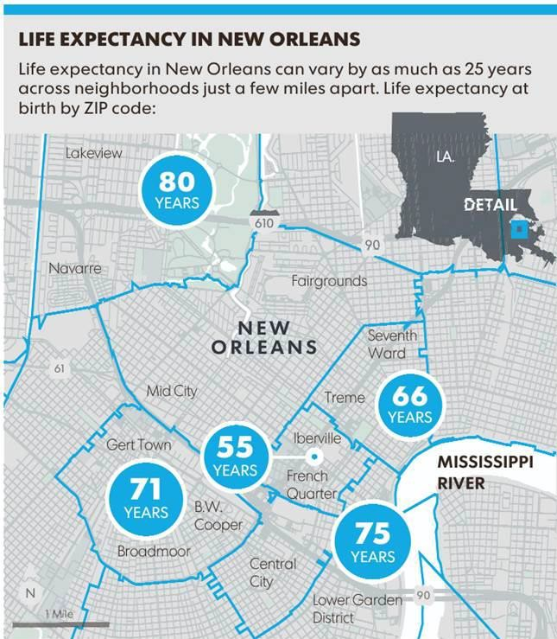


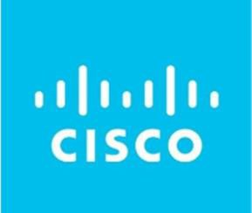
Medical Students as Patient Navigators – Bridging the Gaps to Care among New Orleans Communities with Housing Insecurity
Maggie Palopoli¹, Marisol Mosqueda Arreola¹, M. Peyton Simons², Patrick Dicken¹, Margaret Thomas¹, William Wisen¹, Joseph Aguda²
L2¹, L3², LSU Health Sciences Center, New Orleans, LA
Mentors: Dr. Joshua Lara (LSU EM-2), Dr. Elyse Stevens (LSU Community & Population Medicine)
Introduction
Program Design
Discussion
Across the US, individuals with housing insecurity are overwhelmingly burdened by healthcare disparities, particularly related to accessing comprehensive care. New Orleans is no exception to this. In 2022, New Orleans received an income inequality score of –20, compared to the national average of 3.3 (from a scale of -/+ 100)¹. One example of the disparities present within just a portion of New Orleans is shown in Figure 1, which illustrates the average life expectancy based on zip code. Shockingly, there is up to a 25-year difference in life expectancies between neighborhoods less than a 10-minute drive apart². Income inequality and the accompanying housing insecurity both impact and are impacted by other significant social drivers of health (SDOH) that unhoused individuals commonly face. These SDOH work together to shape the health of unhoused communities in New Orleans and create additional barriers to comprehensive care for this vulnerable population. To help address these disparities,
Phase 1: Determining Board of Directors, Scope of Practice & Compliance Communication
SUCCESSES:
Experiential learning in direct patient navigation on a small scale has improved patients’ access to care and has allowed for the design of an innovative program that can be shaped to meet the unique needs of patients in various settings
Student and faculty collaboration during Zoom Rounds has allowed volunteers to provide insight about patient needs, share ideas to solve these needs, and further standardize available solutions to which PNC must continue to find solutions.
Zoom Rounds has also allowed for patient needs pattern recognition and for the continual development of a “guidebook” of standardized protocols for approaching common scenarios
Working with LSU Compliance and IT to implement a HIPAA-compliant phone system and secure means of data collection and storage
CHALLENGES:
Communication both with patients and within our team as we seek to find a way to safeguard protected health information and coordinate care amidst the barriers patients face
Refining our scope of practice to accurately reflect students’ abilities and the practical and professional limitations
Equipping students with appropriate training as patient navigators that matches our scope of practice
Developing a standardized workflow that maintains flexibility while accommodating patients’ needs
LESSONS LEARNED:
Based on challenges with follow-up encounters, we have learned the importance of clear communication with patients about next steps and creating a practical and achievable care plan
Our scope of practice requires refinement such that students have clear direction and training to effectively assist patients
This program has been a mutually beneficial experience for students and patients alike as shown in a qualitative manner through the stories of our patients and has great potential for a larger-scale impact on the local unhoused population’s access to healthcare while improving both students’ health system literacy and patient education and agency
Board of Directors
Scope of Practice
Directors
Health System Navigation & Service Coordination
Secretary
– Scheduling and insurance assistance
– Program enrollment & continuity of care care
Treasurer
Clinic Support
Case Coordinator
– Hospital/Clinic navigation
– Emotional support and advocacy
Volunteering Coordinator
– Community food, housing, hygiene
– ID/mail/phone, health information
– Harm reduction supplies
– Employment support
Resource Coordinator
Community Resource Linkage
Compliance Coordinator
M3 Advisors
LSUHSC students established Student Run Community Clinics (SRCC) to provide acute primary care services for our unhoused communities at specified sites. While these SRCC clinics are a start in addressing health disparities, gaps in necessary follow-up care for these individuals abound due to the barriers to health system navigation. This program aims to assess these barriers and attempts to reduce them.
Phase 2: Determining Pod Structure, Pilot Launch & Patient Navigator Training
Pod Structure*
Pilot Launch
Program Advisor
Purpose
Resident Advisor
Resident Advisor
Resident Advisor
Pod Organization
Communication
Pod Lead
Pod Lead
Pod Lead
Documentation
Navigating Tasks
Figure 1. Life Expectancy in New Orleans²
Pod Members
Pod Members
Pod Members
Determining Limitations
Reflections and Insights
Intervention
*3 total pods with 26 total students
MISSION:
Patient Navigation Collective (PNC)​ is a community-based, student-run, patient-centered, low-barrier program which seeks to provide health system navigation through longitudinal patient care. ​
GOALS:
Aim 1: develop the infrastructure to support the functioning of a student-run patient navigation program
Aim 2: explore medical students’ effect as patient navigators to support community health in New Orleans
APPROACH:
Divided into 3 phases, we present the organizational structure and our scope of practice, followed by our pod structure system and insights from a pilot launch, and lastly, a workflow depiction and new student onboarding processes.
Phase 3: Determining Workflow, New Student Onboarding & Communication Systems
Patient Navigation Workflow
New Student Onboarding
  Completed by SRCC partners
  Case coordinator pairs patient with pod
New Members
Referral
Orientation
  Pod member meets patient to get consent, assess needs, and develop plan of care with patient
Assigned to Pod
Next Steps
Joined Zoom Rounds
Intake Meeting
Patient Navigation Training
  Patient tasks delegation
  Biweekly zoom rounds for patient updates & advising for next steps
  Longitudinal patient accompaniment
Communication Systems
Expansion of student navigation training and advisory support
Increasing the number of teams to expand assistance capacity
Standardization of protocols as the scope of practice is refined
Quantitative examination of the effect of PNC on patients’
emergency department utilization, hospitalizations, and
engagement with primary care physicians
Compare PNC's effectiveness to existing systems at local hospitals
Continuing work to establish partnerships with key LSU Health New Orleans organizations, including University Medical Center
Addressing Patient Needs
REFERENCES:
¹New Orleans Health Department. (2024). 2024 Health Disparity Report. New Orleans Health Department. Retrieved April 3, 2025, from https://nola.gov/nola/media/Health-Department/Files/2024-Health-Disparity-Report.pdf
²The Data Center. (2024). Placing prosperity: Chapter 1. The Data Center. Retrieved April 3, 2025, from https://www.datacenterresearch.org/placing-prosperity/chapter-1.html

