Slide 1

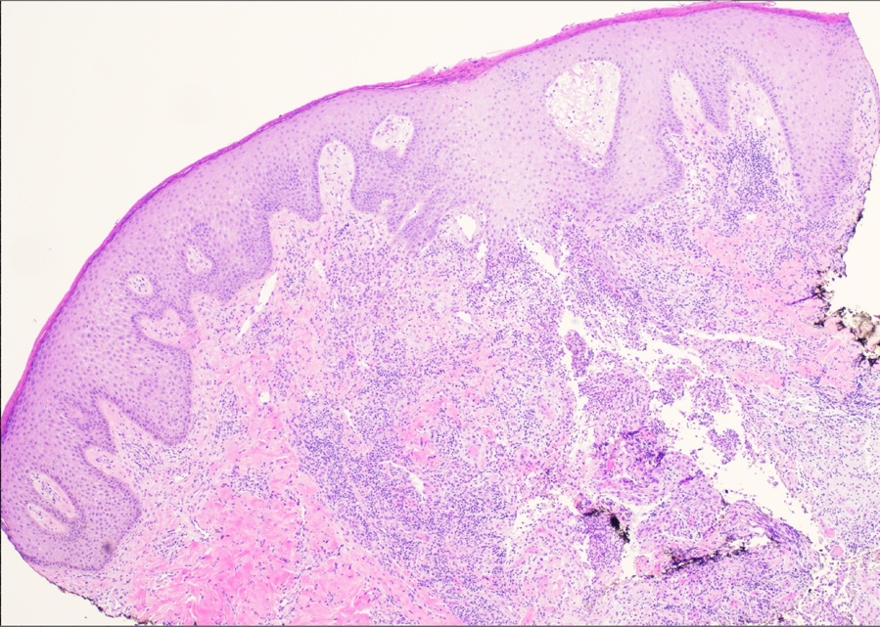

Metastatic Crohn’s disease: a cutaneous manifestation
Alex Wandler¹, Jonathan M. Joseph, MD², Christopher Haas, MD²
Department of Dermatology¹, LSU Health Science Center
Introduction
Case Presentation
Discussion
Crohn’s disease (CD) is a multisystem, granulomatous inflammatory disease that may involve any part of the gastrointestinal tract from the oral cavity to the annus and often presents with extra-intestinal involvement including the skin, eyes, joints, or hepatobiliary system. Cutaneous manifestations, being the most common extra-intestinal site, are the result of a variety of etiologies. In particular, characterization of lesions at distant sites, noncontiguous with bowel disease and with histopathological findings consistent with Crohn’s disease are referred to as metastatic Crohn’s disease (MCD).
Although MCD is most commonly characterized as erythematous plaques or nodules with a cutaneous ulcerative component, often found in the intertriginous areas, extremities, face, and gentitalia, MCD can present with polymorphic features dependent upon the site of involvement. Particularly, intertriginous areal involvement may often resemble hidradenitis suppurativa (HS) or intertrigo, as seen in this patient. This variation offers a broad differential diagnosis in the context of MCD and highlights the complexity in recognizing presentations of MCD.
In this case, we present a patient with history of fistulizing disease, diagnosed with Crohn’s disease in 2019, now status-post ileocolic resection, and receiving Upadacitinib therapy, who was found to have metastatic Crohn’s disease.
A 40-year-old African-American male with a past medical history of ileocolonic and perianal CD, diagnosed in 2019 and receiving upadacitinib therapy, who presented due to history of fistulizing disease initially diagnosed as HS and characterized as constant, draining cysts localized to buttock. Previously, his disease course had been complicated by ileal perforation, psoas muscle abscess, and pelvic necrotizing fasciitis. At this time, the patient had been receiving upadacitinib daily for 6 months for CD although uncertain of any noticeable improvement since initiating treatment. Previous therapies were significant for ustekinumab, infliximab, and methotrexate all of which were discontinued due to the development of palmoplantar psoriasis.
On presentation, physical exam was significant for involuting nodules with large ostia and granulomatous appearing erythematous papules to the superior intergluteal cleft and scarring of several nodules to right lower buttock. Given his history and previous presentations, diagnosis of Hurley Stage III HS verses cutaneous CD was further investigated. At this time, a 4mm punch biopsy of the gluteal cleft was obtained and demonstrated granulomas in the superficial papillary dermis, composed of epithelioid histocytes with admixed eosinophils, supporting the diagnosis of MCD (Fig. 1). Two weeks later, physical exam revealed four granulomatous appearing nodules with scarring and drainage to right buttock. The patient was continued on Upadacitinib daily and elected to proceed with two intralesional Kenalog injections to the right intergluteal cleft and initiate topical fluocinonide solution. Repeat intralesional Kenalog injection was performed 6 weeks later, along with the initiation of clobetasol ointment in place of fluocinonide solution per the patient's preference.
Three months following his initial presentation, patient noted significant improvement in pain and spontaneous drainage of a previously painful nodule, although reported persistence of one chronically draining lesion. Physical exam was significant for two sinus tracts with active drainage in addition to scarred plaques with several sinus tracts to the right gluteal cleft. At this time, the patient is pleased with his improvement while receiving upadacitinib and is only requiring topical steroid therapy as needed.
Although an exact pathogenesis of MCD remains undetermined, multifactorial mechanisms have been hypothesized and suggest the influence of antigen driven granulomatous response at the level of the dermis, cross-reactivity between gut and skin antigens, and T-lymphocyte mediated type IV hypersensitivity reactions to unknown antigens localized in the skin. Despite reports of spontaneous resolution, in the context of persistent cutaneous lesions, there are no definite guidelines for the treatment of MCD. Current literature reports partial improvement in regimens including TNF alpha inhibitors, azathioprine, systemic corticosteroids, metronidazole, surgical debridement, and as discussed in the case above, Janus Kinase (JAK) Inhibitors may also provide relief. Given its variability on presentation and inconclusive therapeutic management, MCD poses to be a challenging diagnosis, emphasizing the importance of increasing awareness and education across disciplines to improve recognition of disease and thus, minimize delay of treatment and risk of morbidity.
References
Aberumand, B., Howard, J., & Howard, J. (2017). Metastatic Crohn’s Disease: An Approach to an Uncommon but Important Cutaneous Disorder. BioMed Research International, 2017, 8192150. https://doi.org/10.1155/2017/8192150
Bernett, C. N., & Krishnamurthy, K. (2025). Cutaneous Crohn Disease. In StatPearls. StatPearls Publishing. http://www.ncbi.nlm.nih.gov/books/NBK470311/
Ickrath, F., Stoevesandt, J., Schulmeyer, L., Glatzel, C., Goebeler, M., & Kerstan, A. (2021). Metastatic Crohn’s disease: An underestimated entity. JDDG: Journal Der Deutschen Dermatologischen Gesellschaft, 19(7), 973–982. https://doi.org/10.1111/ddg.14447
Kurtzman, D. J. B., Jones, T., Lian, F., & Peng, L. S. (2014). Metastatic Crohn’s disease: A review and approach to therapy. Journal of the American Academy of Dermatology, 71(4), 804–813. https://doi.org/10.1016/j.jaad.2014.04.002
Mohamed, M. F., Bhatnagar, S., Parmentier, J. M., et al. (2023). Upadacitinib: Mechanism of action, clinical, and translational science. Clinical and Translational Science, 17(1), e13688. https://doi.org/10.1111/cts.13688
Figure 1. Punch biopsy of the gluteal cleft (Hematoxylin and eosin stain, original magnification ×4) demonstrating granulomas composed of epithelioid histiocytes with admixed eosinophils predominantly located in the superficial papillary dermis. The inflammatory infiltrate prominently involves adnexal structures.

