Slide 1

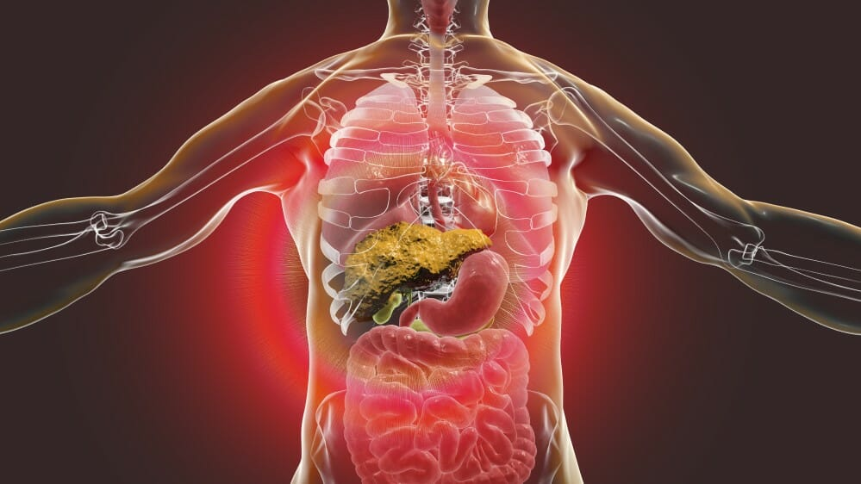
Hepatic Sequestration in Sickle Cell Disease: A Rare and Underrecognized Crisis
Hannah Porter MD, Kristen Williams MD, Seema Walvekar MD
Louisiana State University School of Medicine in New Orleans
Background
Management
Discussion
Sickle cell disease (SCD) can result in a rare but dangerous hepatic complication known as acute hepatic sequestration.
This condition results from pooling of sickle red blood cells within the liver, leading to hepatomegaly and an acute drop in hemoglobin levels.
Clinically, patients often present with right upper quadrant abdominal pain, jaundice, and symptoms of anemia.
Hepatic sequestration is treated through packed red blood cell transfusion or exchange transfusion.
In rare cases autotransfusion can occur, where pooled sickle cells within the liver are released into circulation resulting in hyper-viscosity and increased risk for stroke.
Given this potential complication, a conservative approach to red blood cell transfusion is needed in patients with acute hepatic sequestration.
Initial interventions included:
      Packed red blood cell (pRBC) transfusion, with each unit transfused slowly over 4 hours, targeting a hemoglobin level of 8 g/dL.
Serial hemoglobin monitoring to assess for autotransfusion in the setting of hepatic sequestration.
Supportive care, including intravenous fluid resuscitation, pain control, oxygen therapy, and broad-spectrum antibiotics due to concern for acute chest syndrome.
On day four of admission, the patient developed acute altered mental status, becoming oriented only to self and unable to follow commands. CT and MRI of the head were negative for acute stroke. Laboratory evaluation revealed an ammonia level of 70 µmol/L, prompting initiation of lactulose therapy.
Given the patient’s high risk for ischemic stroke, a Transcranial Doppler Ultrasound (TCD) was performed, revealing a peak velocity of 260 cm/sec, indicative of an elevated stroke risk. In close collaboration with transfusion medicine, the patient underwent slow pRBC transfusion, maintaining a target hemoglobin of 8 g/dL. Hemoglobin electrophoresis on day five (after receiving a total of 3.25 units of pRBC) revealed an HbS level of 35.1%.
Liver enzymes peaked at: AST: 2,028 U/L, ALT: 1,125 U/L, Total bilirubin: 6.3 mg/dL
TCD velocities peaked at 260 cm/sec but decreased to <170 cm/sec by the time of discharge.
By the time of discharge, the patient had been successfully weaned to room air, returned to baseline mental status, and experienced significant improvement in abdominal and chest pain.
She was discharged with close hematology follow-up, continued folic acid supplementation, and started on hydroxyurea and L-glutamine.
Hepatic sequestration is due to blockage of the sinusoids of the liver from sickle RBC’s. The trapping of RBCs in the liver leads to liver enlargement and right upper quadrant pain (Ebert, 2010). While it is typical to see hepatomegaly in hepatic sequestration, this case demonstrates that it is not necessary to make the diagnosis.
Management of acute SCD typically involves simple transfusion or exchange transfusion. Both methods help to reduce the proportion of sickle red blood cells and improve oxygen delivery, thus preventing SCD complications. The management of hepatic sequestration is further complicated by the risk of autotransfusion. Case reports have illustrated patients who have sudden autotransfusion of pooled blood within the liver, resulting in sudden volume overload, heart failure, and intracerebral hemorrhage (Lee, 1996).
In this case, the decision was made to manage the patient’s anemia with simple transfusion, serial hemoglobin monitoring, and close observation of blood pressure. The patient’s HbS level was 35.1% after receiving 3.25 units of pRBCs, indicating that the simple transfusion was effective in reducing HbS. By avoiding exchange transfusion, the patient was exposed to fewer units of blood and did not require central venous access. This case demonstrates that in certain clinical conditions simple transfusion can be used as an alternative to exchange transfusion to manage hepatic sequestration.
Case Description
48-year-old female with a past medical history of Sickle Cell Beta-Thalassemia (HbS/β+thal) presented to the emergency department with one week of chest pain, bilateral shoulder pain, and back pain; these symptoms were consistent with prior episodes of sickle cell crisis.
On initial evaluation, vital signs were stable. Laboratory results were notable for: White blood cell count (WBC): 10,000/µL, Hemoglobin (Hgb): 8.5 g/dL, Platelet count (Plt): 114 × 10³/µL, Creatinine (Cr): 1.02 mg/dL, Aspartate transaminase (AST): 28 U/L, Alanine transaminase (ALT): 7 U/L, Total bilirubin: 2.0 mg/dL
The patient was initially managed with supportive care, including pain control, intravenous fluid resuscitation, and folate supplementation.
Thirty-six hours after admission, the patient developed acute abdominal pain, jaundice, and hypoxic respiratory failure, requiring 2 L of oxygen via nasal cannula.
Repeat laboratory testing at that time revealed: WBC: 42,000/µL, Hgb: 4.1 g/dL, Plt: 77 × 10³/µL, Cr: 1.69 mg/dL, AST: 2,028 U/L, ALT: 1,125 U/L, Total bilirubin: 2.6 mg/dL, Troponin: 4,285 ng/L, Lactic acid: 14 mmol/L
Chest X-ray: Increased interstitial markings with a new right mid-lung zone opacity.
Right upper quadrant ultrasound: Liver measurement of 14.8 cm with a patent portal vein
Transthoracic echocardiogram (TTE): Left ventricular ejection fraction (LVEF) of 65–70% with moderately elevated pulmonary artery pressure (51 mmHg/21 mmHg).
Given the acute drop in hemoglobin, hepatic dysfunction, and clinical deterioration, a diagnosis of hepatic sequestration crisis was made.
Contact Information
Address all correspondence to Hannah Porter, MD at hport3@lsuhsc.edu.
References
Lee, E. S., and P. C. Chu. "Reverse sequestration in a case of sickle crisis." Postgraduate medical journal 72.850 (1996): 487-488.
Ebert, Ellen C., Michael Nagar, and Klaus D. Hagspiel. "Gastrointestinal and hepatic complications of sickle cell disease." Clinical gastroenterology and hepatology 8.6 (2010): 483-489.
Notes:
write Figure 1,2,3 etc and: Type out image description
While this patient is an outlier because of advanced age, this case serves to exemplify the potential utility of this treatment modality versus the current standard of care (biliary stenting with adjuvant chemoradiation).
(2019). Cholangiocarcinoma. Genetics Home Reference. https://ghr.nlm.nih.gov/condition/cholangiocarcinoma
Rea DJ, Munoz-Juarez M, Farnell MB, et al. (2004). Major hepatic resection for hilar cholangiocarcinoma: analysis of 46 patients. Jama Surgery 139(5), 514-23. https://www.ncbi.nlm.nih.gov/pubmed?term=15136352
Klempnauer J, Ridder GJ, von Wasielewski R, et al. (1997). Resectional surgery of hilary cholangiocarcinoma: a multivariate analysis of prognostic factors. Journal of Clinical Oncology 15(3), 947-54. https://www.ncbi.nlm.nih.gov/pubmed?term=9060532
Tamandl D, Kaczirek K, Gruenberger B, et al. (2009). Lymph node ratio after curative surgery for intrahepatic cholangiocarcinoma. British Journal of Surgery 96(8), 919-25. https://www.ncbi.nlm.nih.gov/pubmed?term=19591163
Takada T, Amano H, Yasuda H, et al. (2002). Is postoperative adjuvant chemotherapy useful for gallbladder carcinoma? A phase III multicenter prospective randomized controlled trial in patients with resected pancreaticobilary carcinoma. 95(8), 1685-95. https://www.ncbi.nlm.nih.gov/pubmed?term=12365016
Junichi Shindoh. (2017). Ablative therapies for intrahepative cholangiocarcinoma. Hepatobiliary Surgery and Nutrition, 6(1), 2-6. https://www.ncbi.nlm.nih.gov/pmc/articles/PMC5332215/
Auriemma F, et al. (2019). Radiofrequency and malignant biliary strictures: an update. World Journal of Gastrointestinal Endoscopy 11(2):95-102. https://www.ncbi.nlm.nih.gov/pmc/articles/PMC6379741/
(2006). FDA clears RF Ablation System for Use in Nonresectable Liver Tumors. Oncology Journal 20(7). https://www.cancernetwork.com/oncology-journal/fda-clears-rf-ablation-system-use-nonresectable-liver-tumors
McCarty T, et al. (2018). New Indications for Endoscopic Radiofrequency Ablation. Clinical Gastroenterology and Hepatology 16:1007-1017. https://www.cghjournal.org/article/S1542-3565(17)31248-X/pdf

